Slide 1

UHLB3132
Professional Communication Skills
Group Discussion
Awis Rumaisya

Slide 2

Group Discussion
What is the first thing that comes to your mind when the word group discussion is mentioned?
  “Oh, not again!”
  “You guys decide, I’ll follow.”
  “Well, group discussion is something that you will do a lot especially during your studies and working life.”
  “It’s a high time for me to master group discussion skills despite being an introvert.”

Slide 3
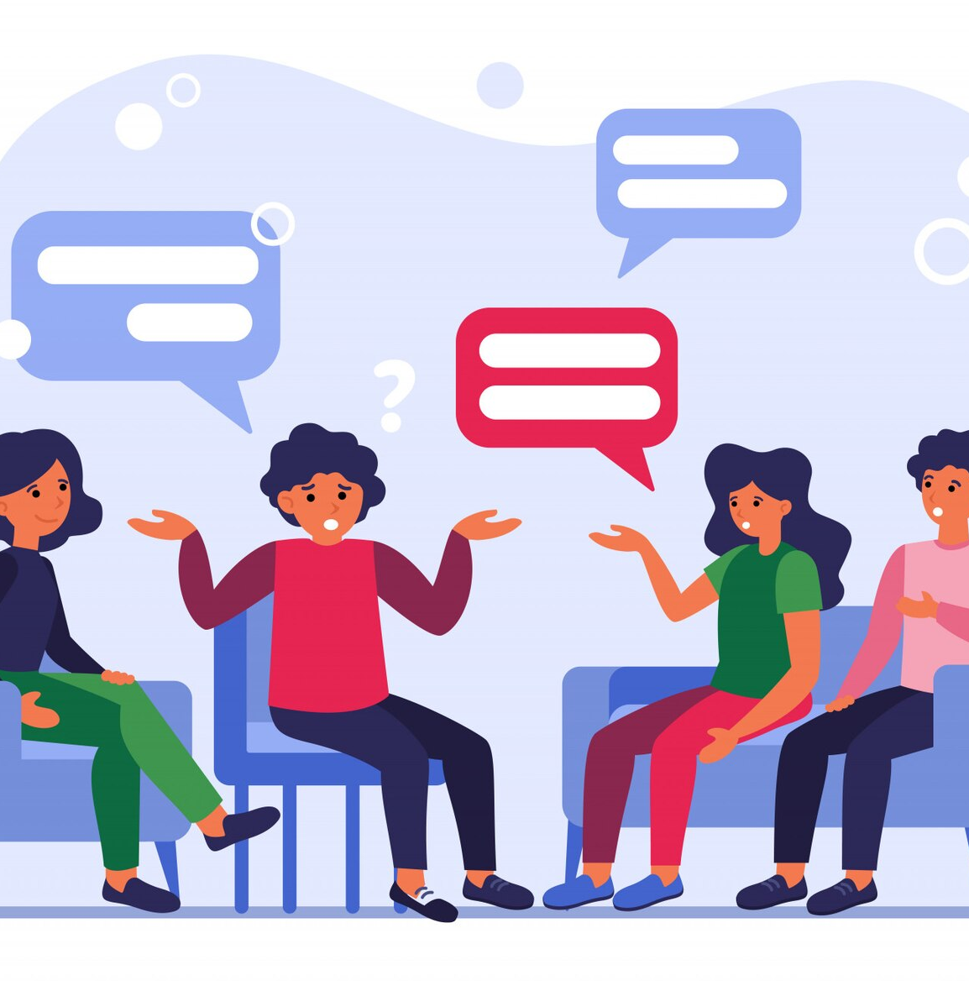
Flow of a Group Discussion
The most common stages in a group discussion are:
  Opening
  Discussing
  Concluding
But, group discussion is more than that. Can you think of the skills needed to be an effective team player and to reach a consensus for the group discussion?

Slide 4
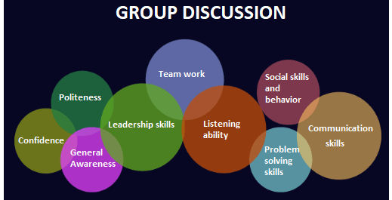
The image on the left shows but not limited to the skills, and personalities that you should have when you are discussing with others.
One aspect that you should also pay attention to is your language. You should be able to use words and phrases in the right way.
For example, you can use hedging language when you request for something (as I have explained in class).
Also, you can use phrasal verb in your conversation as explained in the next slide.

Slide 5
Use of phrasal verb
Why should you use phrasal verb in your communication?
First, they're used very commonly in conversations, so knowing phrasal verbs will help you understand other people and will help you sound natural, relaxed and friendly.
Second, as there are so many phrasal verbs, knowing them is a great way to build up your vocabulary.
Examples of phrasal verbs:
  I was called in (= asked to do something) by my boss.
  I need to catch up (=do something that should be done) with my emails.
  We are putting in (give) hours and hours.
  They won’t give up (=abandon) their demands.
  We shouldn’t give in (=surrender) to bully tactics.
  Do you think they picked up (=receive) the message?
  I will need to get back to you (=reply) on that.
  Can we work something out (=agree) here?
  I agreed to step in (=take their place)for my boss.
  You need to run this by (=tell) the client.
  Who set this up (=arranged)?
  My colleague said they would put in a good word (=say something positive) for me .
  That team always stick up for (=support) each other.
  I don’t know who to turn to (=get help from).
  You can always count on (=depend on) me.

Slide 6
POP QUIZ
Enter

Slide 7
Question 1
Which sentence means the same as the statement below: A or B?
“Unfortunately, I wont’t be able to take you up on that.”
A I’m afraid I can’t accept your offer.
B I’m afraid I can’t agree with you.

Slide 8

You’ve got it wrong.
Try again.

Slide 9

Well done!
Next question…

Slide 10
Question 2
Which sentence means the same as the statement below: A or B?
“Can I get back to you on that?”
A Can I disagree with you about that?
B Can I give you an answer to that later?

Slide 11
You’ve got it wrong.
Try again.

Slide 12
Well done!
Next question…

Slide 13
Question 3
Which sentence means the same as the statement below: A or B?
“I think we’ll go for that proposal.”
A We’ll probably agree to that proposal.
B We’ll probably dismiss that proposal.

Slide 14
You’ve got it wrong.
Try again.

Slide 15
Well done!
Next question…

Slide 16
Question 4
Which sentence means the same as the statement below: A or B?
“I’d like a week to think this over.”
A I need a week to consider this.
B I need a week to understand this.

Slide 17
You’ve got it wrong.
Try again.

Slide 18
Well done!
Next question…

Slide 19
Question 5
Which sentence means the same as the statement below: A or B?
“I need to run this past my boss .”
A I need to make sure my boss doesn’t find out about this.
B I need to get my boss’s approval for this.

Slide 20
You’ve got it wrong.
Try again.

Slide 21
Well done!
Now, go back to our class Padlet and watch a video of me talking about how to ask for clarification in a meeting/discussion.
Home

