Slide 1
Identification of Puerarin from Pueraria Mirifica Tuber Extract as Antioxidant in Formulated Cosmetic Products
NURHIRZA BINTI SHAIFUL YAMIN MKK191012

Slide 2
Outline
Abstract
Introduction
Literature review
Methodology
Results and Discussion
Conclusion

Slide 3
Abstract
Pueraria mirifica tuber extract used in cosmetic product because of its active phytochemicals and allowed in Malaysia without any claims.
To quantify the content of puerarin in the tuber extract of P. mirifica and few cosmetic products.
Tuber was macerated in 95% methanol for 120 hours while cosmetic products were vigorously mixed with methanol and followed with LLE using water and ethyl acetate.
LC-MS/MS analysis and antioxidant assay using DPPH reagent.
The other substances might also exhibit their antioxidant capacity under synergistic effect.
Tuber outlayer – more puerarin.
All the six selected commercial products were also contained puerarin with different concentrations ranged from 0.3 to 0.5 mg/L.
Notes:
Cosmetic products incorporated with Pueraria mirifica tuber extract because of its active phytochemicals, particularly puerarin for high antioxidant activity and miroestrol for estrogenic effect.
The use of P. mirifica extract in cosmetic products is allowed in most countries including Malaysia without any claims. Mostly, the antioxidant claim is only applied as supporting documents.
Therefore, this study was aimed to quantify the content of puerarin in the tuber extract of P. mirifica and few cosmetic products that used P. mirifica tuber extract as ingredient in the product formulation.
The extraction method used was The plant tuber was macerated in 95% methanol for 120 hours, while the selected cosmetic products were vigorously mixed with methanol and decanted to concentrate the supernatant for subsequent liquid-liquid extraction using water and ethyl acetate. Puerarin was transferred to the organic phase of ethyl acetate, dried and reconstituted for LC-MS/MS analysis and for antioxidant assay using DPPH reagent.
The results showed that puerarin from P. mirifica tuber and the six cosmetic products containing P. mirifica extract were detected and subsequently proven for antioxidant effect.
Somehow, puerarin was not the only compound contributed to the antioxidant property of cosmetic products. The other substances might also exhibit their antioxidant capacity under synergistic effect.
P. mirifica was found to have significant amount of puerarin, especially its tuber outlayer.
All the six selected commercial products were also contained puerarin as claimed in the product label with different concentrations ranged from 0.3 to 0.5 mg/L.

Slide 4
Introduction
Background of study
National Pharmaceutical Regulations Agency (NPRA)
Problem statement
Slight modification on the technique of extraction is highly required.
Objective
To extract and quantify the active compound, puerarin using modified extraction method.
Pueraria candollei var. mirifica
The tuber part
Puerarin is isoflavonoids - antioxidant activity & highly active phytoestrogens.
The claim for antioxidant effect not recognised in the European Union (EU) as a cosmetic function of this ingredient (CosIng).
To determine the antioxidant capacity of puerarin based on DPPH assay.
Sufficient proof and evidence for claims and statements
Isoflavonoids and chromenes
Notes:
Background of study
‘Any substance or mixture intended to be placed in contact with the external parts of human body (epidermis, hair system, nails, lips and external genital organs) or with the teeth and the mucous membranes of the oral cavity with a view exclusively or mainly to cleaning them, perfuming them, changing their appearance, protecting them, keeping them in good condition or correcting body odours’.
National Pharmaceutical Regulations Agency (NPRA) is a regulatory authority body in Malaysia which is responsible for the cosmetic product notification process (Guidelines for Control of Cosmetic Products in Malaysia, 2017) and ensure that the notified cosmetic products are safe and of a good quality.
One of the requirements for cosmetic product to comply is the claims and statements of the products. Generally, sufficient proof and evidence either from the cosmetic formulation or preparation of the products itself shall support the claimed and statements made by the CNH to their cosmetic product.
Pueraria mirifica Airy Shaw et. Suvatabhandu, the scientific name is Pueraria candollei var. mirifica also known as P. mirifica and the local name is White Kwao Krua, is one of the ingredients allowed for use in cosmetic products.
P. mirifica tuber is the most popular part of the plant which is widely used as active ingredients.
The most active ingredients in the tuberous tuber were reported to be chromenes and isoflavonoids
Puerarin is the example of isoflavonoids that exhibited the same level of α-tocopherol antioxidant activity and as highly active phytoestrogens.
Problem statement
Many extraction techniques are reported by previous researchers. Based on the nature of puerarin as the compound from the group of flavonoids, and the complexity of ingredients applied in cosmetic product formulation, slight modification on the technique of extraction is highly required.
The claim for antioxidant effect of cosmetic product containing P. mirifica tuber extract is not recognised in the European Union (EU) as a cosmetic function of this ingredient (CosIng).
Objective
To extract and quantify the active compound, puerarin from P. mirifica tuber and its outlayer, as well as six selected commercially available cosmetic products using the modified extraction method.
To determine the antioxidant capacity of puerarin rich extract compared to the 6 selected cosmetic products based on DPPH assay.

Slide 5
Introduction
Scope of study
The extraction of puerarin was conducted using maceration technique with 95% methanol, and an additional step of liquid-liquid extraction. The puerarin was analysed by LC-MS/MS.
Significant of study
The findings from this study can be benefit to;
The antioxidant capacity of puerarin was determined using DPPH assay.
Regulatory body (NPRA)
CNH
Consumers
To attract researchers to do further research on this herbal
Notes:
Scope of study
The extraction of puerarin from P. mirifica tubers and its extract from cosmetic products was conducted using maceration technique with 95% methanol, and an additional step of liquid-liquid extraction for cosmetic products to get rid of impurity. In the liquid-liquid extraction, water and ethyl acetate were used as the aqueous and organic phases, respectively. The puerarin from both plant tuber and cosmetic products were then analysed by LC-MS/MS.
The antioxidant capacity of puerarin rich extract and its extracts prepared from the 6 selected cosmetic products from the local market were also determined using DPPH assay. The antioxidant assay was carried out based on the free radical scavenging activity spectrophotometrically.
Significant of study
Regulatory body (NPRA)
At this point, there is no clear or written guideline for the use of P. mirifica tuber extract in cosmetic products. This ingredient can be used to represent the antioxidant capacity without complicated supporting documents. With this finding, the plant extract can be used as a reference to justify the use of this ingredient in cosmetic products by the CNH.
CNH
Before they submit for cosmetic notification, they will ensure all the claims are aligned with the cosmetic requirement and supported with reliable documents. They can refer this finding as their supporting document when related to the claims and tests.
Consumers
Increase consumer awareness about the mis-claim of cosmetic products in local market. The public or consumer will know the important information regarding this ingredient, and they get informed choice before they decide to purchase this type of products.

Slide 6
Literature review
Regulation of cosmetic products
P. mirifica tuber extract
P. mirifica tuber extract in cosmetic
Factor affecting phytoestrogens concentrations
Antioxidant property
Stability of phytoestrogen
Notes:
Regulation of cosmetic products
For cosmetic products in Malaysia, the requirements are the same as in EU with slightly different base on decision made by ASEAN Cosmetic Scientific Body (ACSB). The requirements are listed in the Guidelines for Control of Cosmetic Products in Malaysia in order to safeguard human health, quality and safety of the products. This guideline consists of Annex I until Annex VII. But there are ingredients which are not listed in any Annexes, these ingredients can be use without limitation. P. mirifica tuber extract is one of the ingredients which is not listed in any Annexes thus it can be used without limit. All CNH must comply with these requirements before they submit for product notification.
Cosmetic products are self-regulation means that the CNH must ensure that the products must be safe before the products enter the Malaysia’s market.
The CNH must notify to NPRA first by filled up notification form via QUEST3+ system. All information regarding the cosmetic products must be declared and based on the information, NPRA will evaluate and if everything complies then they will issue out the notification number.
For finished products, a safety assessment must carried out on all cosmetic products with considering the toxicological profile of each ingredients, their chemical structure and the systemic exposure.
P. mirifica tuber extract
Pueraria candollei var mirifica or White Kwao Krua (synonym as Pueraria mirifica) is part of the Leguminosae family.
Puerarin which is the compound of interest is a naturally occurring isoflavone C-glycoside, with the chemical name of 8-β-D-glucopyransyl-7-hydroxy-3-(4-hydroxyphenyl)-4H-1- benzopyran-4-one
The total isoflavonoid content varied between the samples, isoflavonoid levels were higher in the tuber cortex than in other areas of the tuber. These findings indicate that the tuber cortex of P.mirifica contains a significant proportion of the accumulated isoflavonoid.
Some of the biomedical effects of puerarin that have been experimentally or clinically demonstrated are improvement of blood circulation, prevention of cardiovascular diseases, control of alcoholism, and treatment for arrhythmia.
It was also reported that P. mirifica could prevent bone loss, rejuvenate properties, and provided antioxidant activity.
P. mirifica tuber extract in cosmetic
P. mirifica has been formulated into skin products such as breast creams, eye gel, body gel, day and night cream and cataplasm/patches that are used to alleviate estrogen deficiency symptoms, for example, loss of bone, skin wrinkled and slack breast.
Until now, the Thai market has been continuously supplied with various P. mirifica products and has been widespread in the global market. In Korea, Japan, Malaysia, Singapore, Europe and America, P. mirifica is well recognized. The main importers of raw material for this plant are China and Japan.
The common claims made on the use of P. mirifica in cosmetic products are rejuvenating and anti-aging effects.
Factor affecting phytoestrogens concentrations
The concentration of phytoestrogens in P. mirifica’s tuberous tubers are variable and depending on the conditions of cultivation such as the soil fertility, plant spacing, light and water. For some reported documents, various factors can affect the number of chemical constituents in plants such as the location, species identification, the age of plant harvested, atmospheric conditions during growth, drying method, harvesting period, production processes and storage condition
Among those factors, the study from Cherdshewasart et al. (2007) mentioned that genotype could give a greater effect on such variations than plant age or environmental/habitat factors.
Variability in isoflavonoid levels in mature tubers could have a significant impact on the consistency of tuber-derived materials and even research results.
Stability of phytoestrogen in P. mirifica
It is important to understand the safety, efficacy, and stability of cosmetics, herbal medicines, and food supplements.
The products stability has tendency to change throughout the period of storage which will affect the safety, quality and efficacy of the products.
Stability testing can show product quality varies according to the environmental factors, such as acid-base and temperature.
The profile of isoflavones showed to be influenced by temperature.
P. mirifica crude extract should be stored in solid form at low temperature to ensure the stability of bioactive markers.
Antioxidant property of P. mirifica
The tuber extract of P. mirifica had also been shown to have antioxidant activity (Yusakul et al. 2011). One of the most important claims for cosmetics and natural products is the antioxidant properties. Plant’s rich in phytoestrogens have been shown to possess antioxidant activity (Lee et al., 2017). Hence, products with phytoestrogens are in high demand. This is because human skin is constantly subjected to various environmental threats, such as infrared radiation, cigarette smoke, ultraviolet radiation, pollutants, and others which harm the skin and lead to skin aging
Isoflavonoids are major ingredients in tubers from P. mirifica (Cherdshewasarta and Sutjit, 2008). Flavonoids are natural compounds that are effective scavengers of active oxygen radicals such as hydroxyl and superoxide radicals. Correlation analysis showed that higher amount of puerarin was associated with higher antioxidant activity.

Slide 7
Methodology
To evaluate the presence of isoflavone (puerarin) in the tuber of P. mirifica and 6 selected cosmetic products.
The compound presence was also evaluated based on its antioxidant capacity.
The main material used in this experiment were;
P. mirifica tuber
methanol
ethyl acetate
2,2-diphenyl-1-picrylhydrazyl reagent
6 cosmetic products
The tuber of P. mirifica was bought from Phatthalung province of Thailand.
Notes:
This study was carried out to evaluate the presence of isoflavone, namely puerarin in the tuber of P. mirifica and 6 selected cosmetic products containing P. mirifica tuber extract as ingredient in the product formulation.
The compound presence was also evaluated based on its antioxidant capacity based on its capability to scavenge free radicals.
The main material used in this experiment were;
P. mirifica tuber
methanol
ethyl acetate
2,2-diphenyl-1-picrylhydrazyl reagent
6 selected cosmetic products (purchased from the local market of Selangor and Kuala Lumpur)
The tuber of P. mirifica was bought from Phatthalung province of Thailand.

Slide 8
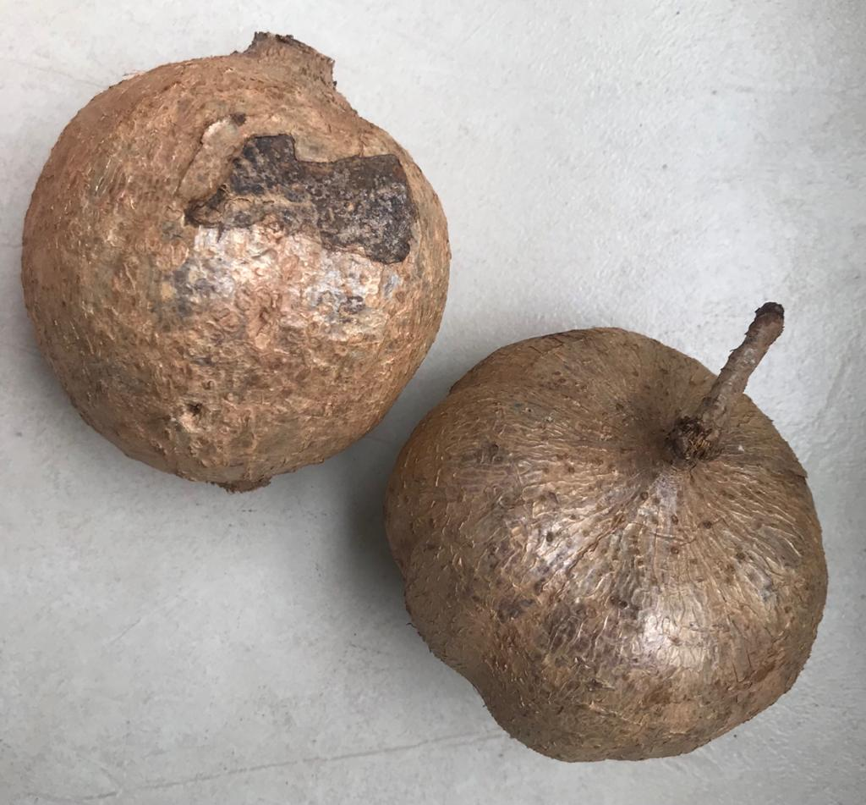
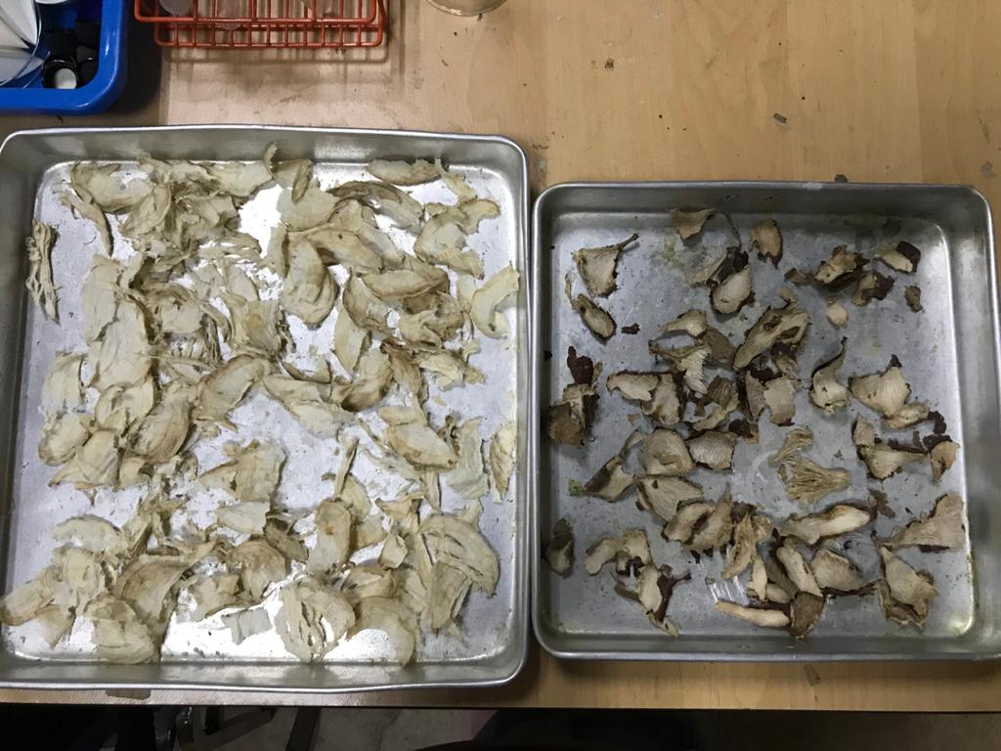
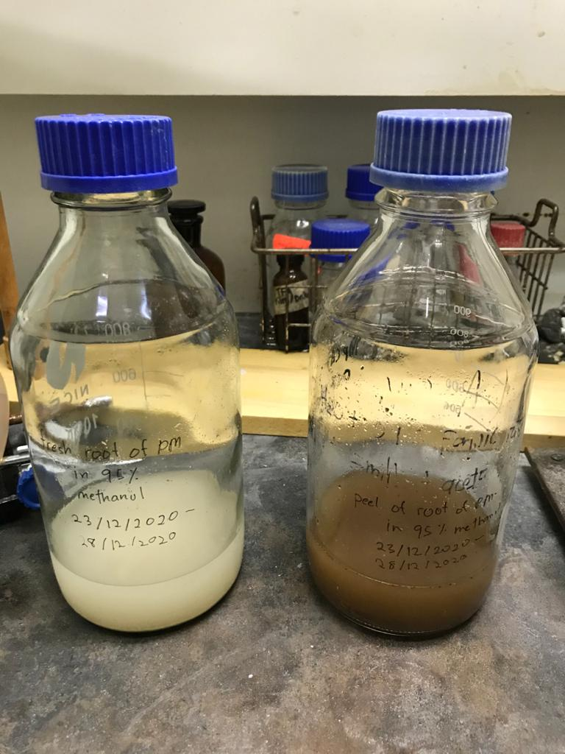
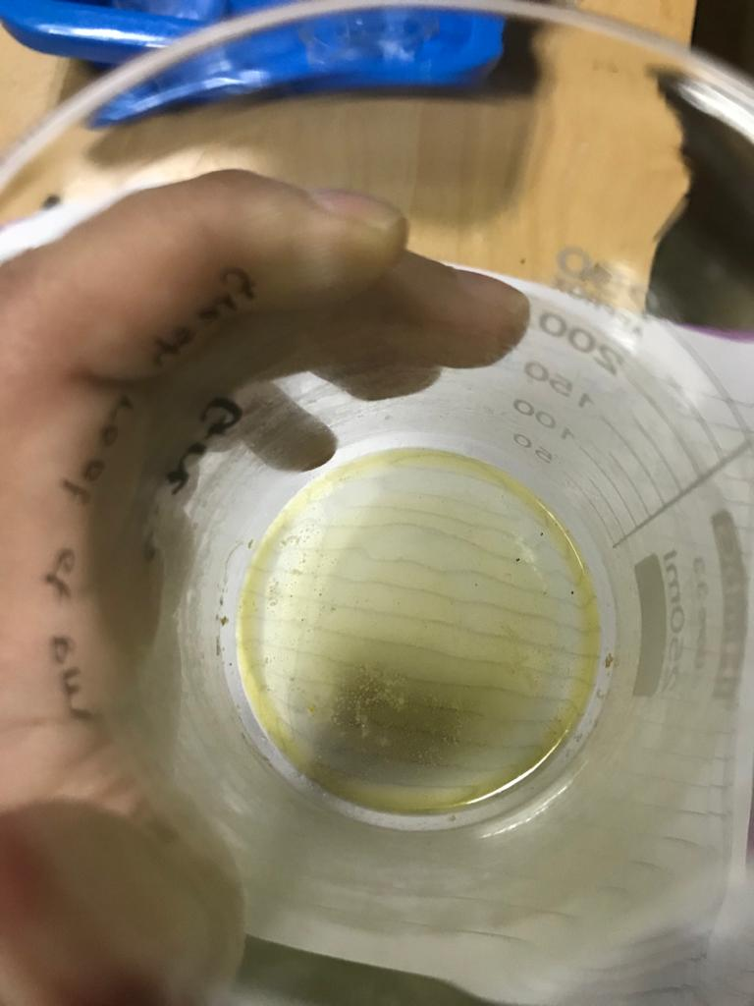
Methodology
Extraction of crude Pueraria mirifica tuber
Cleaned and sliced
Ground into powder
Drying
Separated into flesh and outlayer
Maceration
Filtered
Methanolic crude extract
Drying
Notes:
The tuber of P. mirifica was cleaned and sliced into small pieces.
The tuber was separated into flesh and outlayer which consisted of periderm and cortex.
Then the samples were dried in an oven at 65°C for 2–3 days until dryness.
The dried material was ground into powder with a stainless-steel blender.
A 10g of powdered samples was macerated in 200ml of 95% methanol for 5 days.
The flask was stirred on daily basis and loose the screw to release gas generated during maceration.
The extract was filtered through a tea cloth strainer, and followed by a filter paper to evaporate to dryness in order to produce methanolic crude extract.

Slide 9
Methodology
Sample preparation of cosmetic products
Weighing
Mixing
Sonication
Centrifuged
Filtered
Dryness
Notes:
The extraction of puerarin from the 6 selected cosmetic creams was carried out by weighing 1 g sample and mixed with 5 mL of methanol.
In spiked experiment, 1 g sample and mixed with 1ml of 10ppm puerarin standard solution.
Then, 4 mL of methanol was topped up for mixing and extraction.
The sample solutions were thoroughly mixed by a vortex mixer for 1 min.
Afterward, the samples were sonicated using an ultrasonic bath for 10 min at room temperature.
Then, the samples were centrifuged at 6000 rpm for 1 hour until the top solution become clear.
The supernatant of the solution was filtered through a filter paper and evaporated to dryness in an oven.
The net weight of methanolic crude extract was recorded.

Slide 10
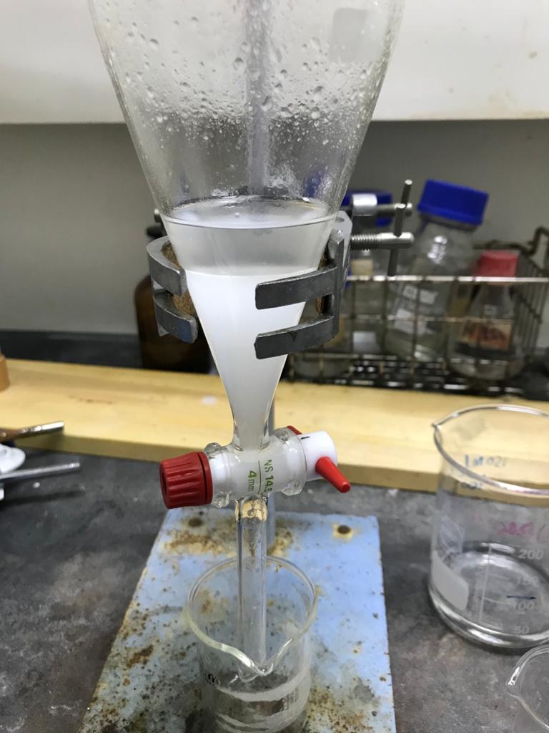
Methodology
Liquid-liquid extraction
1g methanolic crude extract
Water (20ml)
Ethyl acetate (20ml) x 3
Ethyl acetate
Water
After 15 min
Notes:
Liquid-liquid extraction was then applied to the methanolic crude extract from the cosmetic products to get rid of other impurities.
It was carried out by reconstituting 1 g methanolic crude extract in water (20ml) as aqueous phase, and topped up with ethyl acetate (20ml) as organic solvent in a 250ml separating funnel.
Vigorous extraction was performed using these two immiscible solvents.
After 10 min, the separating funnel was left for 15 min to obtain 2 separated layers.
The top layer of ethyl acetate was withdrawn and fresh ethyl acetate (20 ml) was added to extract puerarin from the remaining aqueous solution in the separating funnel.
This extraction was repeated for 3 times with a total of 60ml of ethyl acetate was collected.
The ethyl acetate layer was collected, dried and then dried before the weight of extract was recorded.

Slide 11
Methodology
Puerarin analysis using LC-MS/MS
The dried extract was reconstituted in methanol to make into 1000ppm.
The samples were filtered with 0.22 μm and transferred to vials before analyses.
Liquid chromatography tandem mass spectrometer
C18 column, 30°C and 250 µL/min
The mobile phase - 0.1% formic acid solution (A) and acetonitrile (B).
The separation in gradient elution - for solvent B: 0-5 min, 10%; 5-15 min, 10%; 15-20 min, 40%; 20-25 min, 90%; 25-26 min, 90%; and 26-30 min, 10%.
Puerarin (0.5 – 10 ppm) was used as the standard chemical to plot the calibration curve.
The recovery of puerarin extraction from the cosmetic products was determined by spiking experiments.
Notes:
The dried extract was reconstituted in methanol to make into 1000ppm. The samples were filtered with 0.22 μm and transferred to vials before analyses.
The puerarin content in P. mirifica tuber and cosmetic products were evaluated using the liquid chromatography tandem mass spectrometer according to the procedures described by Lau et al. (2014) and Chua (2020).
Acquity C18 column was used for compound separation. The column temperature and flow rate of LC were maintained at 30°C and 250 µL/min, respectively.
The mobile phase consisted of 0.1% formic acid solution (A) and acetonitrile (B).
The separation was performed in gradient elution with the following proportions (v/v); for solvent B: 0-5 min, 10%; 5-15 min, 10%; 15-20 min, 40%; 20-25 min, 90%; 25-26 min, 90%; and 26-30 min, 10%.
Puerarin (0.5 – 10 ppm) was used as the standard chemical to plot the calibration curve. The puerarin standard curve was used to determine the puerarin content in the P. mirifica tuber and cosmetic products.
The recovery of puerarin extraction from the cosmetic products was determined by spiking experiments. The recovery percent can be calculated using Equation below.
Recovery (%) = Peak area (spiked) – Peak area (unspiked) x 100
Peak area (added)

Slide 12
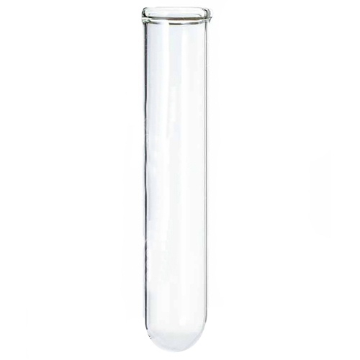
Methodology
DPPH assay
1. Cosmetic sample of 1000ppm
2. Tuber flesh and outlayer of 500ppm to 10000ppm
DPPH reagent
0.5ml
3.5ml
Vortexed
Incubated at room temperature for 30 minutes
Vortexed
Read at 517nm
Notes:
DPPH reagent (0.1mM) was prepared in methanol solvent.
Each cosmetic sample (0.5ml) of 1000ppm, tuber flesh and outlayer (0.5ml) of 500ppm to 10000ppm were add into the test tubes and 3.5ml DPPH reagent was added into the test tubes and vortexed.
The sample solutions were incubated at room temperature for 30 minutes.
After incubation, the samples solutions were vortexed and read at 517nm using a UV-Vis spectrophotometer.
Antioxidant = (absorbance at blank) – (absorbance at test) X 100
activity (%) (absorbance at blank)

Slide 13
Results and Discussion
The concentration of puerarin was analysed using LC-MS/MS from puerarin standard, tuber extract of P. mirifica and 6 selected cosmetic products extract.
Figure 4.1: Calibration curve using puerarin standard solution
Notes:
The concentration of puerarin was analysed using LC-MS/MS from puerarin standard, tuber extract of P. mirifica and 6 selected cosmetic products extract.
Figure 4.1 shows that a good linearity of calibration curve for puerarin standard using LC-MS/MS with R² equal to 0.9983.

Slide 14
Results and Discussion
Samples | Concentration of puerarin (mg/L)
Product 1 | 0.4288
Product 2 | 0.3021
Product 3 | 0.3238
Product 4 | 0.3843
Product 5 | 0.2993
Product 6 | 0.5443
The cortex from the outlayer tuber had higher levels of isoflavonoid (Yusakul et. al., 2011)
High expression of isoflavone biosynthetic genes in tuberous cortices (Suntichaikamolkul et. al., 2019)
Table 4.1: Concentration of puerarin in cosmetic products
Tuber of P.mirifica | Concentration of puerarin (mg/L)
Flesh | 1.38
Outlayer (periderm and cortex) | 45.85
Table 4.2: Concentration of tuber of P.mirifica at 2000ppm
Notes:
Based on the calibration curve of standard puerarin, the concentration of puerarin in the flesh and outlayer of P. mirifica tuber, as well as the selected commercial products were determined and tabulated in Table 4.1 and 4.2.
The results showed that all the selected products contained puerarin in the range of 0.3 to 0.5 mg/L.
Interestingly, the outlayer of tuber showed to have much higher puerarin content in the tuber flesh.
This result aligns with the finding from Yusakul et. al. (2011), which was the cortex from the outlayer tuber had higher levels of isoflavonoid as compared to the other parts of the tuber.
These findings indicate that the tuber cortex of P. mirifica contains a significant proportion of the accumulated isoflavonoid.
This is due to the high expression of isoflavone biosynthetic genes in tuberous cortices (Suntichaikamolkul et. al., 2019)

Slide 15
Results and Discussion
Puerarin in cosmetic products
Extracted by methanol followed by partitioned by ethyl acetate (liquid-liquid extraction).
Isoflavonoid is highly soluble in methanol (Wu et. al., 2010) and lower polarity.
Ethyl acetate - to recover puerarin from aqueous phase in LLE.
High sensitivity of LC-MS/MS was chosen.
Perform puerarin recovery.
Notes:
Puerarin contents from the six selected notified cosmetic products in cream were also extracted by methanol and then partitioned by ethyl acetate using liquid-liquid extraction.
Methanol was chosen in crude extract preparation as isoflavonoid is highly soluble in methanol (Wu et. al., 2010).
Subsequently, a lower polarity of organic solvent was used to transfer puerarin to ethyl acetate.
Ethyl acetate was selected as solvent to recover puerarin from aqueous phase in liquid-liquid extraction.
High sensitivity of LC-MS/MS was used to detect the existence of puerarin in the samples.
In order to confirm the reliability of the modified method, 1 ml of 10 ppm puerarin standard solution was spiked into the sample mixture for determination of puerarin recovery.

Slide 16
Results and Discussion
Samples | Peak Area (unspiked) | Peak Area (spiked) | Recovery (%)
Product 1 | 41380000 | 678800000 | 185.8
Product 2 | 10510000 | 32480000 | 6.4
Product 3 | 20670000 | 162200000 | 41.2
Product 4 | 30550000 | 349600000 | 93.0
Product 5 | 9836500 | 134900000 | 36.4
Product 6 | 69550000 | 431273333 | 105.4
The performance - satisfactory.
The viscosity - can affect active compound release (Bolla et. al., 2020).
Homogeneous condition - deliver active substances (Safila Naveed and Sidra Sajid, 2016).
Texture of products would affect the recovery of puerarin extraction.
Modified method must ensure sample homogeneity and mixing process for better results.
Table 4.3: Recovery percentage of cosmetic products using P. mirifica tuber extract
Notes:
The performance of modified extraction was satisfactory since the recovery was in the range of 93% to 105% (product 4 and Product 6) as presented in Table 4.3. Low recovery (Product 2) and extremely high recovery (Product 1) could be explained by the nature of product cream in which the cream texture of product 2 is almost like a paste, whereas product 1 is more liquified cream.
The viscosity of cream formulations is important because it can affect active compound release (Bolla et. al., 2020).
Creams must be in homogeneous condition to deliver the active substances (Safila Naveed and Sidra Sajid, 2016).
However, product number 1, 3 and 5 are in the form of pump container, whereby the cream pump from the container is not evenly homogenous.
This can also contribute to the low result of recovery percentage.
In short, the cream texture of products would affect the recovery of puerarin extraction significantly.
Therefore, it can be concluded that the modified method must ensure sample homogeneity and mixing process for better results.

Slide 17
Results and Discussion
Antioxidant activity of standard puerarin
DPPH assay - used to screen the antioxidant activity of flavonoids (Okawa et al., 2001).
Antioxidant activity of puerarin standard was in increasing trend
Cherdshewasarta and Sutjit (2008) - direct proportional relationship of puerarin and antioxidant activity.
Figure 4.3: Calibration curve of puerarin obtained from UV-Vis Spectrometer
Notes:
The antioxidant activity of puerarin was analysed using the inhibitory action of samples against free radicals generated by DPPH. This assay is often called as radical scavenging assay or DPPH assay.
The DPPH assay is a conventional method for analysing antioxidant activity with a reasonable sensitivity level.
The assay was usually used to screen the antioxidant activity of flavonoids (Okawa et al., 2001).
Hence, it was used in this study.
The results showed that the antioxidant activity of puerarin standard was increasing with the increased concentration of standard puerarin as presented in Figure 4.3. This was in line with the statement of Cherdshewasarta and Sutjit (2008) who reported a direct proportional relationship of puerarin and antioxidant activity.

Slide 18
Results and Discussion
Antioxidant activity of P. mirifica
Increasing in a concentration dependent manner.
Outlayer was found to be higher than its flesh.
The EC50 obtained were 5.7316 mg/L and 2.4084 mg/L for tuber flesh and outlayer, respectively.
The findings - puerarin play a significant role in antioxidant activity.
Puerarin - have a strong correlation with antioxidant activity (Cherdshewasarta and Sutjit, 2008).
Figure 4.4: Calibration curve of tuber of P. mirifica
Notes:
Results showed that the antioxidant activity of puerarin content in the flesh and outlayer of P. mirifica tuber is increasing in a concentration dependent manner. The antioxidant activity of outlayer was found to be higher than its flesh.
This is because the concentration of puerarin was showed to be higher than that value in outlayer (45.85 mg/L).
From Figure 4.4, the EC50 of flesh tuber was calculated using the equation y = 10.229x - 8.6288 and y = 14.394x + 15.334 for its outlayer. The results obtained were 5.7316 mg/L and 2.4084 mg/L for tuber flesh and outlayer, respectively.
The findings suggested that possibly puerarin in plant tubers of P. mirifica could play a significant role in antioxidant activity. Only puerarin was found to have a strong correlation with antioxidant activity and other isoflavonoid of the plant tubers in a correlation analysis (Cherdshewasarta and Sutjit, 2008).

Slide 19
Results and Discussion
Antioxidant activity of cosmetic products
Puerarin content.
Not proportionally related to the puerarin content
For samples cosmetic products number 1, 3 and 5, the antioxidant activities were higher.
Tocotrienol, alpha-arbutin, vitis vinifera seed extract, ascorbyl tetraisopalmitate, tocopherol, and tocopheryl acetate.
Figure 4.5: Antioxidant activity of cosmetic products
Notes:
The antioxidant activity of P. mirifica tuber extract in the six cosmetic products were depended on the puerarin content.
The average antioxidant activity was calculated and recorded showed in Figure 4.5.
The results indicated that antioxidant activity was not proportionally related to the puerarin content.
Possibly, other ingredients in the products contributed to the total antioxidant activity in this study.
For samples cosmetic products number 1, 3 and 5, the antioxidant activities were higher.
Example of ingredients that have contributed to the antioxidant activities other than puerarin are tocotrienol, alpha-arbutin, vitis vinifera seed extract, ascorbyl tetraisopalmitate, tocopherol, and tocopheryl acetate.

Slide 20
Results and Discussion
Samples | Antioxidant activity (%) | Antioxidant activity (%) | Average Antioxidant activity (%) | Standard Deviation
Sample 1 | 33.7662 | 30.3614 | 32.0638 | 2.4075
Sample 2 | 4.8866 | 7.7922 | 6.3394 | 2.0546
Sample 3 | 90.7504 | 88.4972 | 89.6238 | 1.5933
Sample 4 | 3.1414 | 3.1325 | 3.1369 | 0.0062
Sample 5 | 55.4731 | 61.5607 | 58.5169 | 4.3046
Sample 6 | 4.7120 | 4.0816 | 4.3968 | 0.4458
Table 4.5: Antioxidant activity and standard deviation of cosmetic products
The smaller standard deviations represent data are repeatable in the assay

Slide 21
Conclusion
The maceration technique can extract puerarin and detected by LC-MS/MS.
The percent recovery showed highest amounts when methanol solvent and LLE were used – extract effectively
This parameter had successfully identified the puerarin.
The DPPH assay can be used to analyse antioxidant activity of puerarin.
Puerarin contain more in outlayer compared to flesh.
The standard deviation values are small – consistent procedure.
Further research - antioxidant activities of individual compounds and screening potential undesirable compounds.
Results - Standardization of P.mirifica for quality control of crude drug as well as crude extract.
Notes:
Puerarin extracted from P.mirifica is one of the most popular Chinese herbal medicines has been suggested to exert antioxidant properties.
In this study, the extraction method and antioxidant activity of puerarin are studied. Isoflavonoid contents in P.mirifica depended on locations of cultivation and ages of its tuberous tubers. Puerarin is to be the main bioactive compounds in P.mirifica.
The maceration technique for P.mirifica tuber using 95% methanol can extract puerarin and detected by LC-MS/MS. From this study also concluded that the solvent and method extraction effected the concentration of puerarin in P.mirifica tuber extract. Moreover, the percent recovery from 2 cosmetic products showed highest amounts when methanol solvent and liquid-liquid extraction were used. This is convincingly showed that this solvent and method selection are effectively for extraction of puerarin from P.mirifica tuber extract in cosmetic products. This parameter had successfully identified the puerarin.
The DPPH assay can be used to analyse antioxidant activity of puerarin.
From this study, puerarin contain more in outlayer compared to flesh.
Furthermore, the standard deviation value of six cosmetic products in a range of 0-4 shows that this test is conducted in a consistent procedure.
Therefore, further research is required to examine antioxidant activities of individual compounds contained in the tubers of P. mirifica and screening out potentially undesirable compounds.
These results can be used for standardization of P.mirifica for quality control of crude drug as well as crude extract and it will be beneficial for suppliers and consumers before being used to develop as supplements and cosmetic products.

