Slide 1
Doctor of Philosophy/Mphil
RESEARCH TITLE:
Student name:
Supervisor name:

Slide 2
Presentation Outline
Introduction
Background of Problem
Problem statement
Research Objective
Scope and Limitations
Significance of Research
Literature Review
Research Methodology
Expected Contribution (optional)
Preliminary result (optional)
Gantt Chart
References
Publications

Slide 3
INTRODUCTION
Brief intro of your research:
Recent technology/environment
What is the importance of your topic?

Slide 4
PROBLEM BACKGROUND
Not more than 3 pages
Explain the existing problem which needs to solve
What are the effects of the problems?

Slide 5
PROBLEM STATEMENT

Slide 6
RESEARCH OBJECTIVES
Research Objective 1
xxxxxxxxxxx
Research Objective 2
xxxxxxxxxxxxx
Research Objective 3
xxxxxxxxxxx.

Slide 7
SCOPE OF RESEARCH
Location of your research
Application/environment
Simulation tools
Sampling/population size

Slide 8
SIGNIFICANCE OF RESEARCH
Brief explains your research work will be implemented/applied/deployed in your place/country.
How far your research is significant in several applications, describe it.

Slide 9
LITERATURE REVIEW
No | Research Title | Author / Year | Research Method | Results
1
2
3
Notes:
Optimize blade pitch angle- improve turbine efficiency (it depends on airfoil geometry and turbine solidity
In oscillating water column (OWC)- Four different geometry with 5 different sizes in curved-duct manifold- simulated numerically and CFD.
OWC- shape of the well turbine was modified- to enhance the efficiency and enlarge operating hour. Changed blade thickness from hub to tip. Mid section produced larger torque and larger power.-Delay flow separation and increased blade loading.

Slide 10
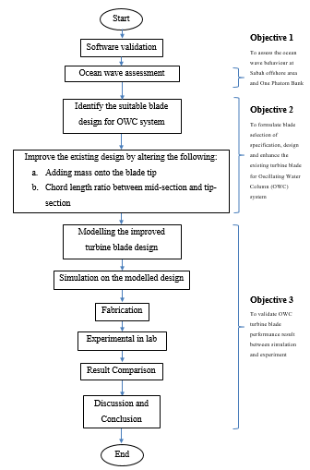
RESEARCH METHODOLOGY
Objective 1
To measure
Objective 2
To formulate
SOLIDWORKS
software
ANSYS
software
Objective 3
To validate
NAHRIM wave simulator pool

Slide 11
Research Activities
Previous turbine blade design, methods of experiments and analysis, aerodynamic
Start
Literature review
Select suitable existing wind turbine design for OWC
Software validation using the selected turbine blade
Validate previous research result with simulation result
Wave velocity, wind direction, wavelength, water depth & wave amplitude
Characterization of actual ocean wave behaviour
Success?
No
Apply additional mass on the selected blade tip design
3 mass values:
100g, 200g & 300g
Tools:
Anemometer
ADCP
Yes
3 ratio of chord length:
1:2, 1:3, 1:4
Prepare required geometry data of chord length ratio
All related Parameters
ie dimension, no of blade, length of blade
Gather all result obtained into one comparison table
Based on experiment and simulation result
Fabricate turbine blade
Transfer data to modelling
SOLIDWORKS
Perform test at actual ocean wave condition in simulator lab
Data Analysis & Conclusion
Input design into simulation software
ANSYS
Perform simulation
Proposed the effective turbine blade design
Optimize the current turbine blade design
No
Best performance?
End
To select which turbine blade design that can generate higher output power
Yes

Slide 12
Design & System Parameters
Parameters |  | Values
Design Parameters
System Parameters

Slide 13
Simulation Setup

Slide 14
Experiment Procedures

Slide 15
EXPECTED CONTRIBUTIONS

Slide 16
PRELIMINARY RESULTS

Slide 17
Research Gantt Chart

Slide 18
REFERENCES

Slide 19
PUBLICATIONS

