Slide 1
LANGUAGE EXPRESSION

Slide 3
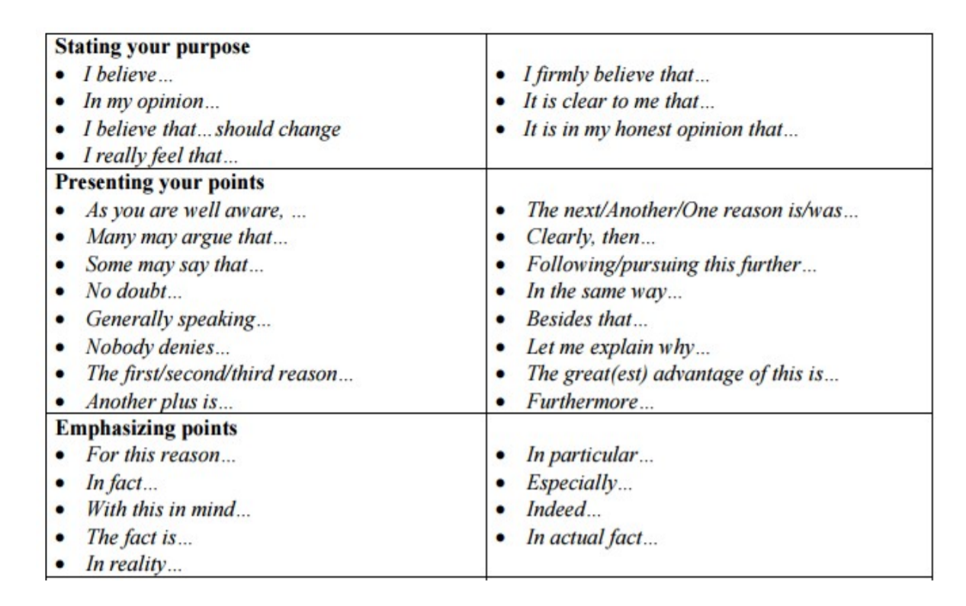

Slide 4
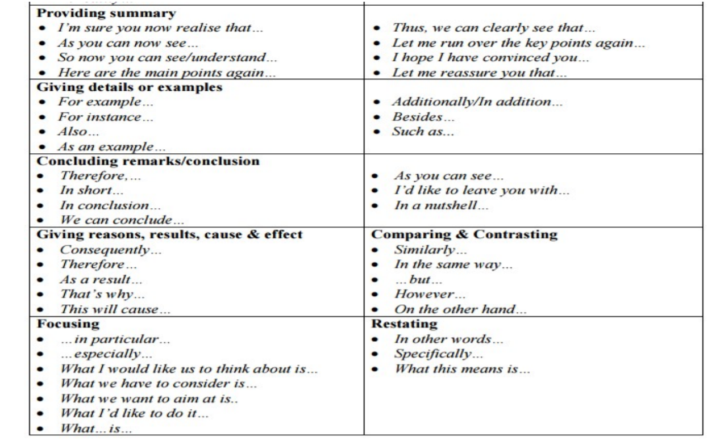

Slide 5
