Slide 1
ULAB 3162 BALLOON DEBATE

Slide 2
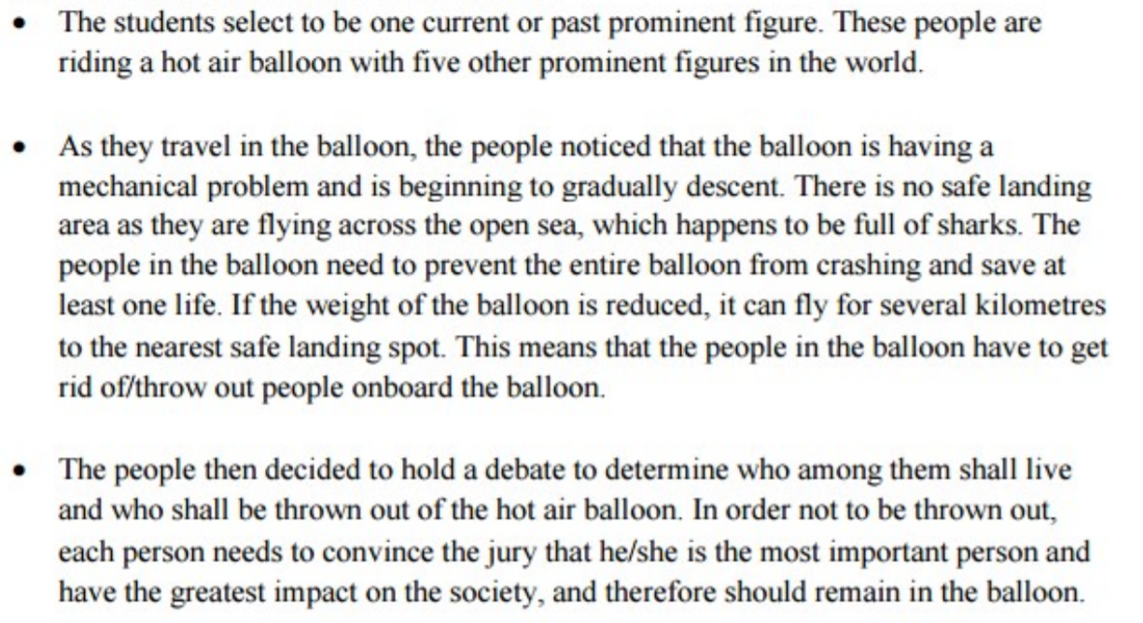
SITUATIONS

Slide 3
JUST IMAGINE THE ROLE OF YOUR CHARACTER

Slide 4
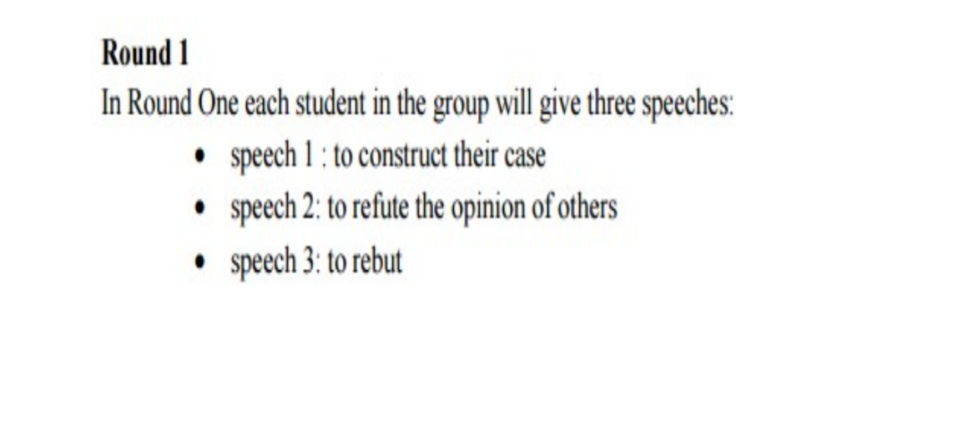
PROCEDURE

Slide 5
