Slide 1
ETHICAL FOUNDATION
MAB 2380: Business Law and Ethics

Slide 2
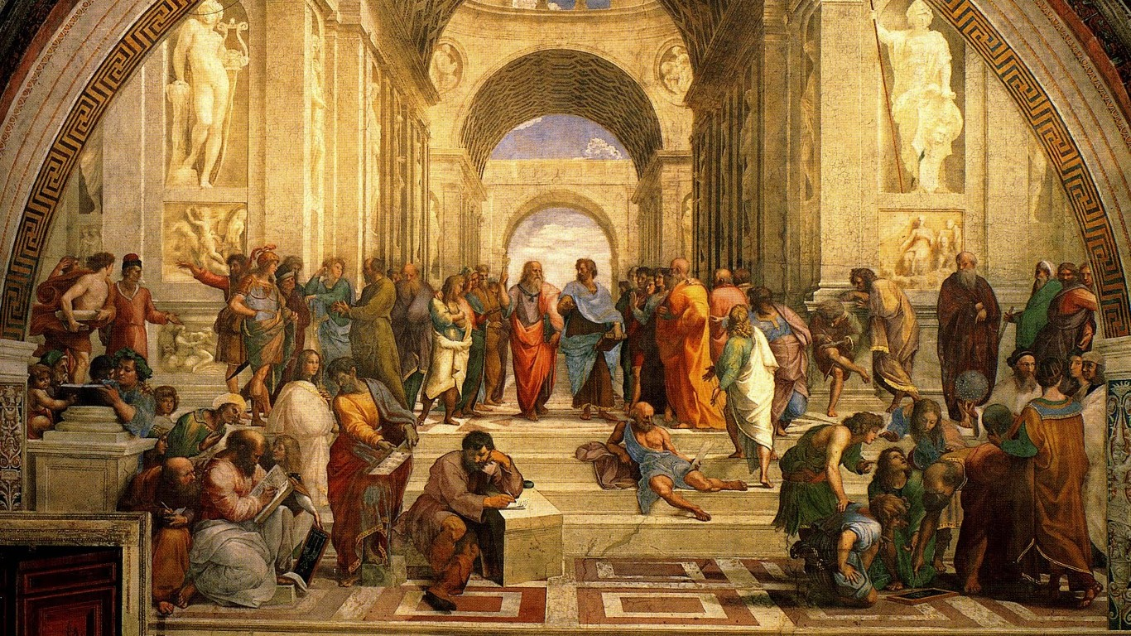
Religion as Ethical Foundation: A Special Discussion on the Global Phenomenon of Secularization

Slide 3
What is ‘ethics’?

Slide 4
What is ‘ethics’?
"Ethics has to do with what my feelings tell me is right or wrong.“
"Ethics has to do with my religious beliefs.“
"Being ethical is doing what the law requires.“
"Ethics consists of the standards of behavior our society accepts."

Slide 5
What is ‘ethics’?
Ethics refers to well-founded standards of right and wrong that prescribe what humans ought to do, usually in terms of rights, obligations, benefits to society, fairness, or specific virtues.
Ethics, for example, refers to those standards that impose the reasonable obligations to refrain from rape, stealing, murder, assault, slander, and fraud.
Ethical standards also include those that enjoin virtues of honesty, compassion, and loyalty. And, ethical standards include standards relating to rights, such as the right to life, the right to freedom from injury, and the right to privacy.
Such standards are adequate standards of ethics because they are supported by consistent and well-founded reasons.
Manuel Velasquez, Claire Andre, Thomas Shanks, S.J., and Michael J. Meyer
http://www.scu.edu/ethics/practicing/decision/whatisethics.html

Slide 6
What is ‘religion’?
Under western understanding: religion from the Latin word ‘religio’, which vaguely refers to a ‘bond between man and gods’.
Under Islamic understanding:
More precise word is ‘deen’. Islam as the deen.
It means that Islam is the subjective, personal religion of the individual as well as the objective, pervading self-same religion of the Community – that it operates as the same religion in the individual as a single entity as well as the society composed collectively of such entities.

Slide 7
Religion as perfect guidance…
Islam as a revealed religion is complete and perfect in its adequacy for mankind from the very beginning.
The values embodied in Islam are absolute– it has its own absolute vision of God, the Universe, of Reality, of Man, its own ontological, cosmological, psychological interpretation of reality; its own worldview and vision of the Hereafter having a final significance for mankind.

Slide 8
Religion, rationality and reasoning
‘Rational’ in should not merely pertain to the mind’s systematic and logical interpretation of the facts of experience; or its rendering intelligible and manageable to reason the data of experience; or its abstraction of facts and data and their relationships.
‘Reason’ is actually a projection of the intellect, therefore it functions in conformity with the intellect, which is a spiritual substance inherent in the spiritual organ of cognition known as the heart. (al-qalb)
Hence the understanding of spiritual realities is also within the province of reason and is not necessarily divorced from rational understanding of them.

Slide 9
Religion and nature
In religious understanding the nature is an open ‘Book’ to be understood and interpreted.
Nature has cosmic meaning, and must be respected because of its symbolical connection with God.
Man is God’s vicegerent and inheritor of the Kingdom of Nature—so must look after it and make legitimate use of it, and not ruin and spread chaos over it.

Slide 10
Religion and State
Theocracy is the rule of clergymen of Middle Ages. It based on the notion of unconditional submission and a blind obedience to clergymen.
In the original religious teaching, there is no theocratic way of government. No religious scholar may claim authority in the state administration.
No religion teach unconditional submission or blind obedience to state leader. People are not only allowed but, required to call state leader into account on the administration of the State.

Slide 11
‘Secular’ defined
‘Secular’ from the Latin ‘saeculum’.
Marks dual connotation of time and location:
Time: referring to now or present
Location: referring to the ‘world’ or ‘worldly’

Slide 12
‘Secularization’ defined
Secularization: the deliverance of man ’first from religious and then from metaphysical control over his reason and his language’.
It denotes the disappearance of religious determination of the symbols of culture integration.

Slide 13
Origin of secularization (1)
A fruit of the long history of philosophical and metaphysical conflict in the religious and purely rationalistic worldview of Western man.
Impact of ‘westernization’ of Christianity (began with the shift of its centre from Jerusalem to Rome).
The western elements had diluted the original and true teachings of Christianity.

Slide 14
Origin of secularization (2)
Early Christianity consistently opposed to secularization, and this opposition, endangered by the demeaning of nature and divesting of it of its spiritual and theological significance, continued throughout its history of losing battle against the secularizing forces.

Slide 15
Origin of secularization (3)
The separation of Church and State, was the result of secular Western philosophical attitude set against what is considered as the anti-secular encroachment of the ambivalent Church based on the teaching of the eclectic religion.
Moreover, the Church when it wielded power was always vigilant in acting against scientific enquiry and purely rational investigation of truth.

Slide 16
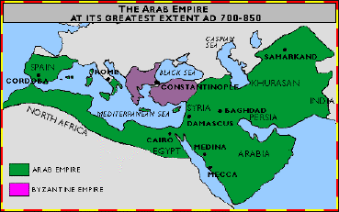
Origin of secularization (4)
Furthermore the Christianity involved itself consciously in sacral legitimation of political power and authority, which is anathema to the secularizing process.

Slide 17
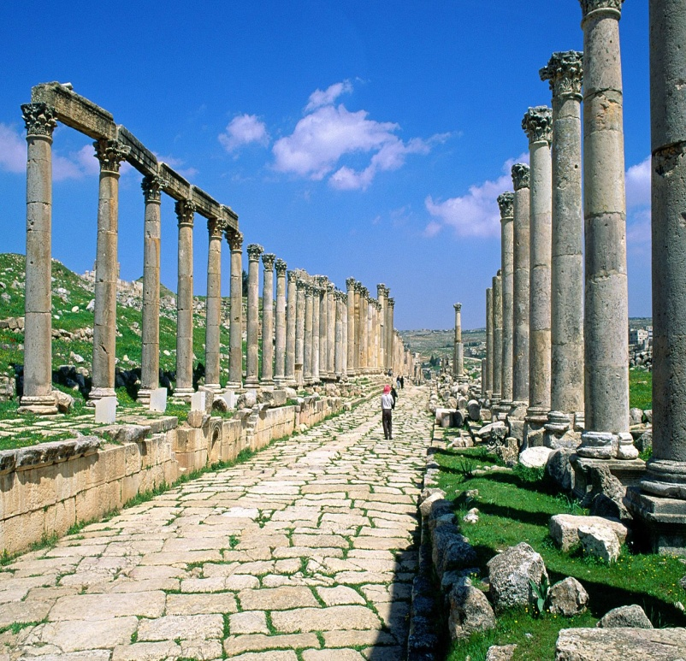
Origin of secularization (5)
Christianity has attempted to resist secularization but has failed, and danger is that having failed to contain it the influential modernist theologians are now urging Christian to join it.

Slide 18
‘Secularization’ explained
Three integral components in the dimensions of secularization:
The disenchancement of nature
The desacralization of politics
The deconsecration of values
# disenchancement : To free from illusion or false belief * desacralization : To divest of sacred or religious significance
^ deconsecration: remove the consecration (-a solemn commitment of your life or your time to some cherished purpose ) from a person or an object

Slide 19
The disenchancement of nature
Freeing the nature from its religious overtones.
Dispelling of animistic spirits and gods, and magic from the natural world.
Separating nature from God and distinguishing man from God.
Man no longer regard nature as a divine entity.
So, man may act freely upon nature, to make use of it according to his needs and plans.

Slide 20
The desacralization of politics
The abolition of sacral legitimation of political power and authority.

Slide 21
The deconsecration of values
The rendering transient and relative all cultural creations and every value system which for them includes religion.
Worldviews having ultimate and final significance, so that in this way history, the future, is open to change.
Man is free to create the change and immerse himself in the evolutionary process.

Slide 22
Thank you

