Slide 1

Ethics and Development
MAB 2383 Business Law and Ethics

Slide 2
Development…

Slide 3
Physical development
Human development
Financial development
Technological development

Slide 4

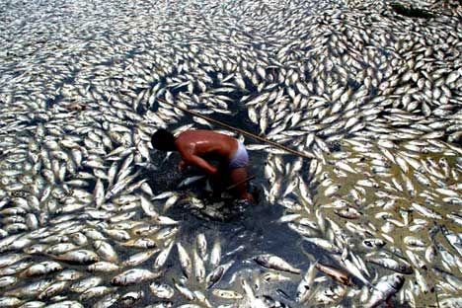
On the name of development…

Slide 5
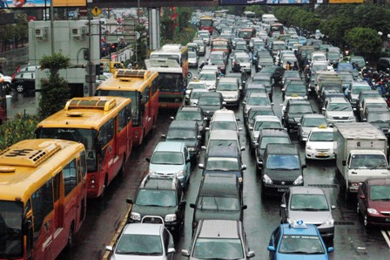
Development?

Slide 6

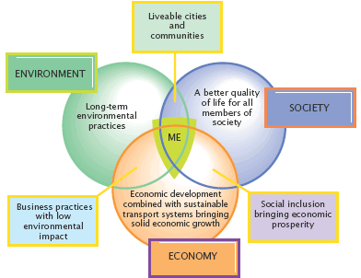
Source: Adapted from Ralph Hall, Introducing the Concept of Sustainable Transport to the U.S. DOT through the Reauthorization of TEA-21

Slide 7
Sustainable Development
The definition from Our Common Future: (also known as the Brundtland Report):
  "Sustainable development is development that meets the needs of the present without compromising the ability of future generations to meet their own needs. It contains within it two key concepts:
  the concept of needs, in particular the essential needs of the world's poor, to which overriding priority should be given; and
  the idea of limitations imposed by the state of technology and social organization on the environment's ability to meet present and future needs."

Slide 8
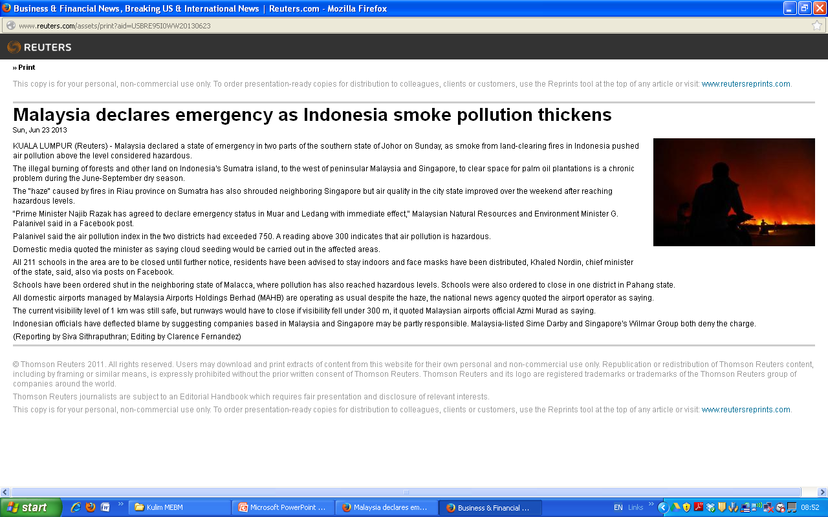

Slide 9
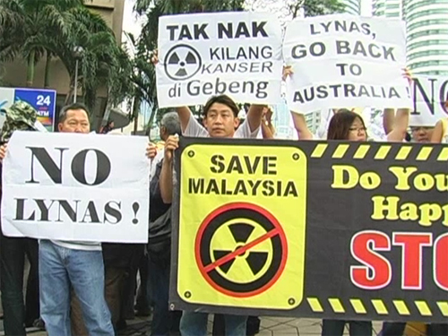

Slide 10
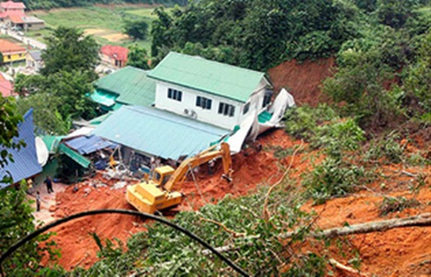

Slide 11
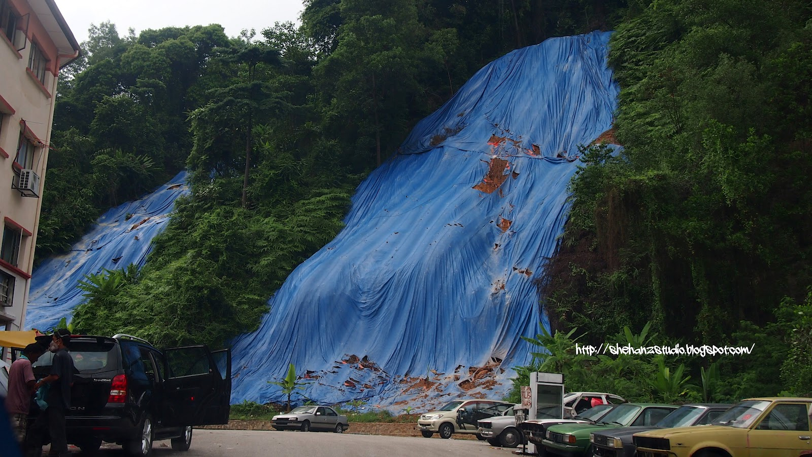

Slide 12
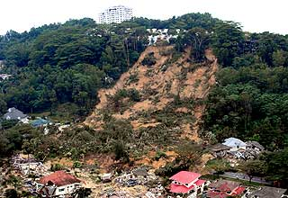

Slide 13
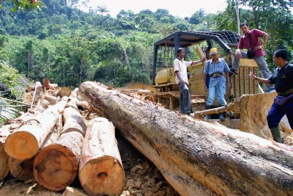

Slide 15
Discuss
Whether our existing legal system is adequate in protecting the environment from excessive development activities?
Whether the laws and policies are properly observed by the responsible parties?
What are solutions / proposals to improve our environmental protection?

