Slide 1
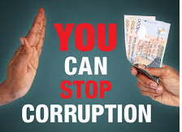
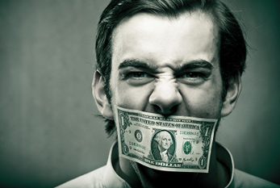
CORRUPTION Business Law and Ethics

Slide 2
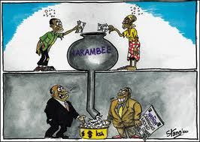
WHAT IS BRIBERY AND CORRUPTION?
Corruption is the offering or acceptance of an advantage as a reward for doing or not doing an act which amounts to abusing one's official position
a giver and a taker
committed in secret
Bribery is a specific offence which concerns the practice of offering something, usually money, to gain advantage

Slide 3
WHAT IS BRIBERY AND CORRUPTION?
From the perspective of Islam, corruption is any form of property acquired as fulfillment of a human interest either to provide benefits or to avoid harm (Zaharuddin Abd Rahman (2007).
“The abandonment of expected standards of behaviour by those in authority for the sake of unsanctioned personal advantage”. (Siergiejew, 2003)
Corruption payment constituting a bribe as ‘an illegal or unauthorized transfer of money or in-kind substitute’ (Rose-Ackerman ,1975)

Slide 4
TYPES OF CORRUPTION AND BRIBERY
It is almost the same as wages until there are people who try to say that
“this is not corruption, but wages”
“this is my selling price, what actually the price that you NEED us to put in quotation”
“this is REWARD for helping me secure this tender ”
“this is your commission for choosing our products”
“this vacation trip as an entertainment for your family”

Slide 5
TYPES OF CORRUPTION AND BRIBERY
Any office, dignity, employment, agreement to give employment or render services in any capacity
Any payment, release, discharge or liquidation of any loan, obligation or other liability, whether in whole or in part;
Any forbearance to demand any money or money's worth or valuable thing;
Form of corruptions:
Money / donation / gift / loan / fee / reward / valuable security / property or interest in property .

Slide 6
TYPES OF CORRUPTION AND BRIBERY
Any offer, undertaking or promise, whether conditional or unconditional, of any gratification within the meaning of any of paragraphs

Slide 7
Malaysian Anti-Corruption Commission Act 2009 (MACC Act 2009) (Act 694),
four (4) main offences:
Soliciting/Receiving Gratification (Bribe)
Offering/Giving Gratification (Bribe)
Intending to Deceive (False Claim)
Using Office or Position for Gratification (Bribe) (Abuse of Power/Position)

Slide 9
THE CAUSE OF CORRUPTION AND BRIBERY
Why this happens? | changes of values and norms within society, leading to some behaviour, which was traditionally tolerated, becoming unacceptable
 | new sources of assets and resources to which officials have access, and can therefore supply to the highest bidder.
 | demand among officials who aspire to better standards of living.
 | governments tend to expand, and thus there are more bureaucrats and more people in a position where they can take bribes.

Slide 10
Corruption in international businesses
Corruption has a considerable effect on our lives because it is all around us. The emphasis on making money is so great, the emphasis on getting rich, no matter how is so tremendous, that it inﬂuences virtually every aspect of our society..
Lawrence Ritter

Slide 11
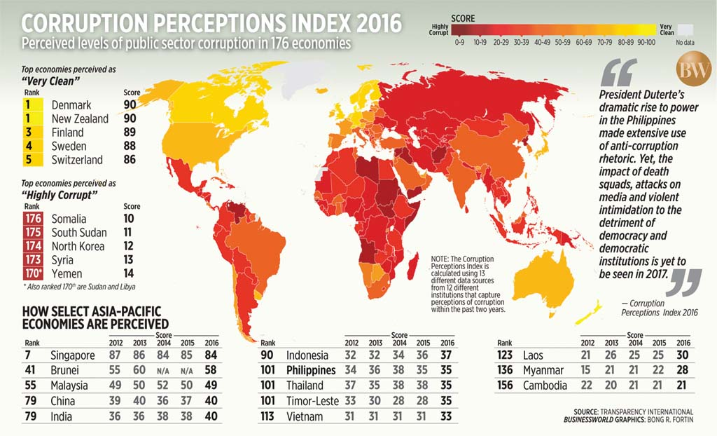

Slide 12
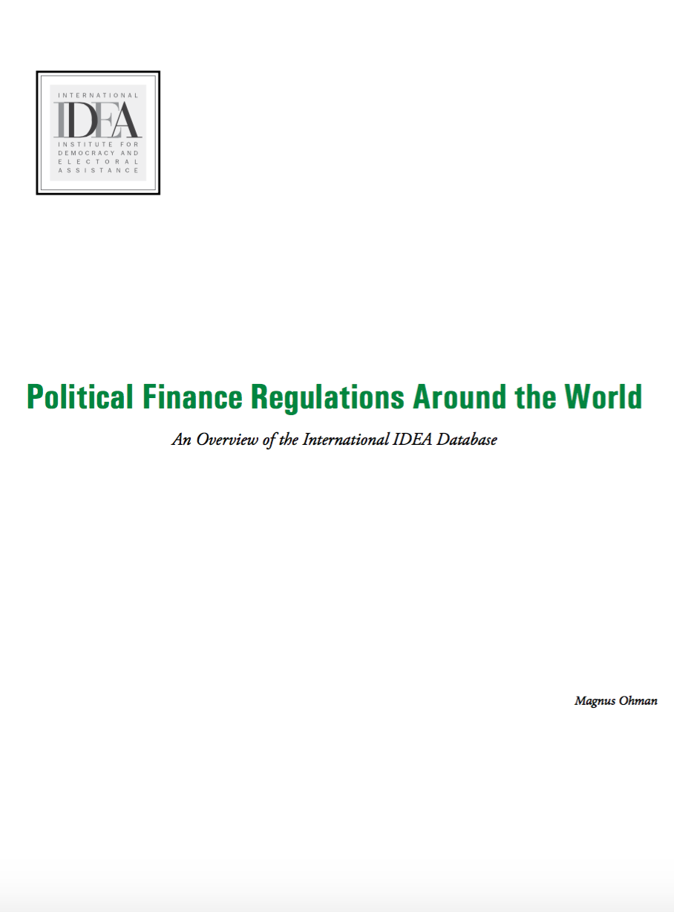
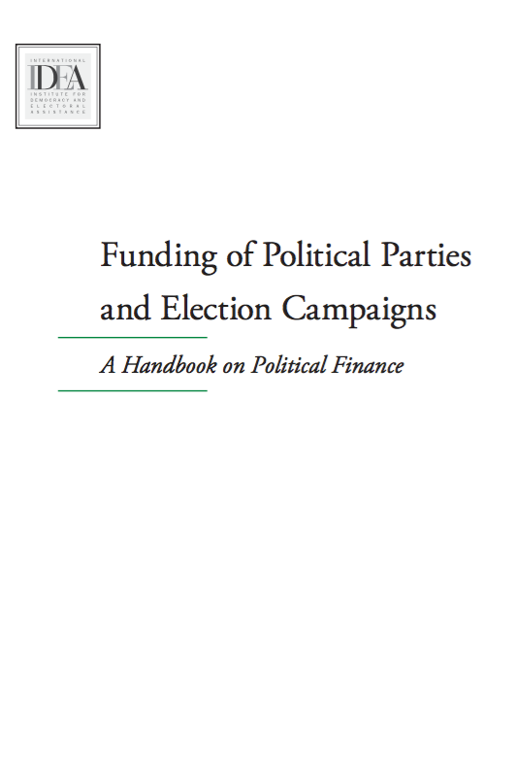

Slide 13
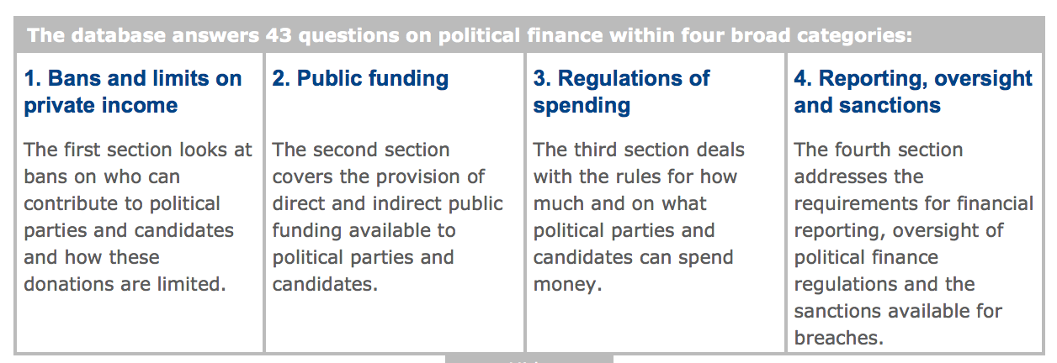

Slide 14
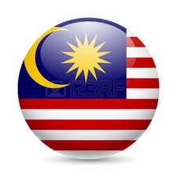
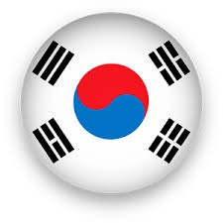
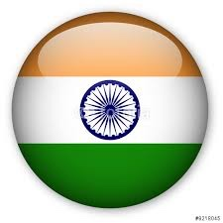
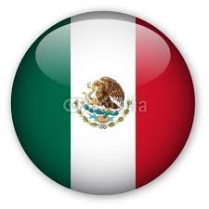

Slide 15
Bans and limits on private income
 | Malaysia | Canada | South Korea | India | Mexico | Taiwan
1. Is there a ban on donations from foreign interests to political parties? | NO | YES | YES | YES | YES | YES
2. Is there a ban on donations from foreign interests to candidates? | NO | YES | YES | YES | YES | YES
3. Is there a ban on corporate donations to political parties? | NO | YES | YES | NO | YES | NO
4. Is there a ban on corporate donations to candidates? | NO | YES | YES | NO | YES | NO
5. Is there a ban on donations from corporations with government contracts or partial government ownership to political parties? | NO | YES | YES | YES | YES | YES
6. Is there a ban on donations from corporations with government contracts or partial government ownership to candidates? | NO | YES | YES | YES | YES | NO

Slide 16
Bans and limits on private income (2)
 | Malaysia | Canada | South Korea | India | Mexico | Taiwan
7. Is there a ban on donations from Trade Unions to political parties? | NO | YES | YES | NO | NO | NO
8. Is there a ban on donations from Trade Unions to candidates? | NO | YES | YES | NO | YES | NO
9. Is there a ban on anonymous donations to political parties? | NO | YES Ban applies to donations exceeding $20 | YES | YES | YES | YES
10. Is there a ban on anonymous donations to candidates? | NO | Ban applies to donations exceeding $20 | Below $120 at a time, or $1,500 annually, are allowed. | NO | YES | YES
11. Is there a ban on state resources being given to or received by political parties or candidates (excluding regulated public funding)? | NO | YES | YES | YES | YES | YES
12. Is there a ban on any other form of donation? | NO | YES | YES | NO | YES | YES

Slide 17
Bans and limits on private income (3)
 | Malaysia | Canada | South Korea | India | Mexico | Taiwan
13. Is there a limit on the amount a donor can contribute to a political party over a time period (not election specific)? | NO | YES | NO | NO | NO | YES
14. If there is a limit on the amount a donor can contribute to a political party over a time period (not election specific), what is the limit? | NA | $1500 per year | NA | NA | NA | Individual: <20% of income and $11,000. Enterprises: <10% of income and $168,000
15. Is there a limit on the amount a donor can contribute to a political party in relation to an election? | NO | $1200 per year | NO | NO | NO | regular limit
16. If there is a limit on the amount a donor can contribute to a political party in relation to an election, what is the limit? | NA | - | NA | NA | NA | NA
17. Is there a limit on the amount a donor can contribute to a candidate? | NO | YES | YES | NO | YES | YES
18. If there is a limit on the amount a donor can contribute to a candidate, what is the limit? | NA | $1500 per year | $24,000 per year | NA | NA | Individual: $1100 Enterprises: $17000

Slide 18
Public Funding
 | Malaysia | Canada | South Korea | India | Mexico | Taiwan
19. Are there provisions for direct public funding to political parties? | NO | YES | YES | NO | YES | YES
20. If there are provisions for direct public funding to political parties, what are the eligibility criteria? | NA | Share of votes: 2% of the number of votes | Representatio, share of votes and share of seats | NA | Share of votes & registration of political party | Share of votes & registration of political party
21. If there are provisions for direct public funding to political parties, what is the allocation calculation? | NA | 50% of party expenses | Equal, proportional to votes, share of expenses reimbursed | NA | Equal, proportional to votes | Flat rate per votes received
22. If there are provisions for direct public funding to political parties, are there provisions for how it should be used (“ear marking”)? | NA | NO | Campaign, party activities and intra party institutions | NA | Campaign, party activities and intra party institutions | Campaign spending
23. Are there provisions for free or subsidized access to media for political parties? | NO | YES | YES | YES | YES | YES

Slide 19
Public Funding (2)
 | Malaysia | Canada | South Korea | India | Mexico | Taiwan
24. If there are provisions for political parties’ free or subsidized access to media, what criteria determine access allocation? | NA | a) share of seats, b) share of vote c) the number of candidates | a) share of seats, b) share of vote | Equal and other criteria | Equal & share of votes | Equal
25. Are there provisions for free or subsidized access to media for candidates? | NO | NO | YES | NO | NO | YES
26. Are there provisions for any other form of indirect public funding? | NO | Tax relief | Tax relief & premises for party meetings | Tax relief | Tax relief and subsidised postage cost | Tax relief
27. Is the provision of direct public funding to political parties related to gender equality among candidates? | NA | NO | YES | NA | NO | NO
28. Are there provisions for other financial advantages to encourage gender equality in political parties? | NO | NO | YES | NO | YES | NO

Slide 20
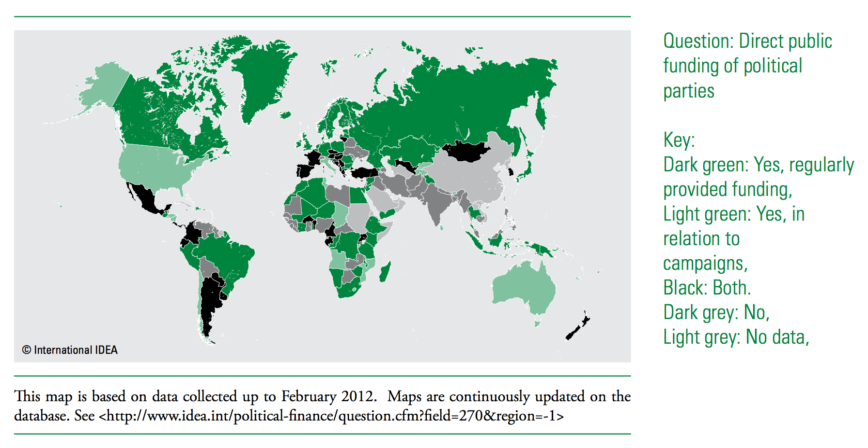

Slide 21
Regulations of spending
 | Malaysia | Canada | South Korea | India | Mexico | Taiwan
29. Is there a ban on vote buying? | YES | YES | YES | YES | YES | YES
30. Are there bans on state resources being used in favour or against a political party or candidate? | NO | no data | YES | YES | YES | YES
31. Are there limits on the amount a political party can spend? | NO | YES | YES | NO | YES | NO
32. If there are limits on the amount a political party can spend, what is the limit? | NA | $0.‌735 multiplied by the number of names on the preliminary lists of electors | Multiple of population size in electoral area | NA | YES | NA
33. Are there limits on the amount a candidate can spend? | YES | YES | YES | YES | YES | YES
34. If there are limits on the amount a candidate can spend what is the limit for spending? | RM200,000 & RM100,000 | Calculated according to a formula based on the number of names on the preliminary or revised lists of electors | Multiple of population size in electoral area | Determined by the Central Government | Limit varies for each federal public office | Calculated according to a formula based on the number of elected persons.
s

Slide 22
Reporting, oversight and sanctions
 | Malaysia | Canada | South Korea | India | Mexico | Taiwan
35. Do political parties have to report regularly on their finances? | NO | YES | YES | YES | YES | YES
36. Do political parties have to report on their finances in relation to election campaigns? | NO | YES | YES | NO | YES | YES
37. Do candidates have to report on their campaign finances? | YES | YES | YES | YES | YES | YES
38. Is information in reports from political parties and/or candidates to be made public? | NO | YES | YES | YES | YES | YES
39. Must reports from political parties and/or candidates reveal the identity of donors? | YES | sometimes, e.g. whose contributions exceeded $200 | sometimes, e.g. whose contributions exceeded $3600 | sometimes, e.g. whose contributions exceeded $1350 | YES | YES

Slide 23
Reporting, oversight and sanctions (2)
 | Malaysia | Canada | South Korea | India | Mexico | Taiwan
40. What institution(s) receives financial reports from political parties and/or candidates? | EMB | EMB | EMB | EMB | EMB | Tax Authority, Township Offices
41. Is it specified that a particular institution(s) is responsible for examining financial reports and/or investigating violations? | NO | EMB | EMB | EMB | EMB | Tax Authority
42. What other institutions have a formal role in political finance oversight? | NONE | NONE | NONE | Court | NONE | Court
43. What sanctions are provided for political finance infractions? | Fines & prison | Up to $100,000 in fines, up to five years in prison, deregistration of party, community service. | Fines, prison, forfeiture, loss of public funding, loss of political rights, others | Fines, prison, loss of nomination, loss of political rights. | Fines, loss of public funding, deregistrationof party, loss of political rights, others | Fines, prison, loss of nomination, loss of political rights.

Slide 24
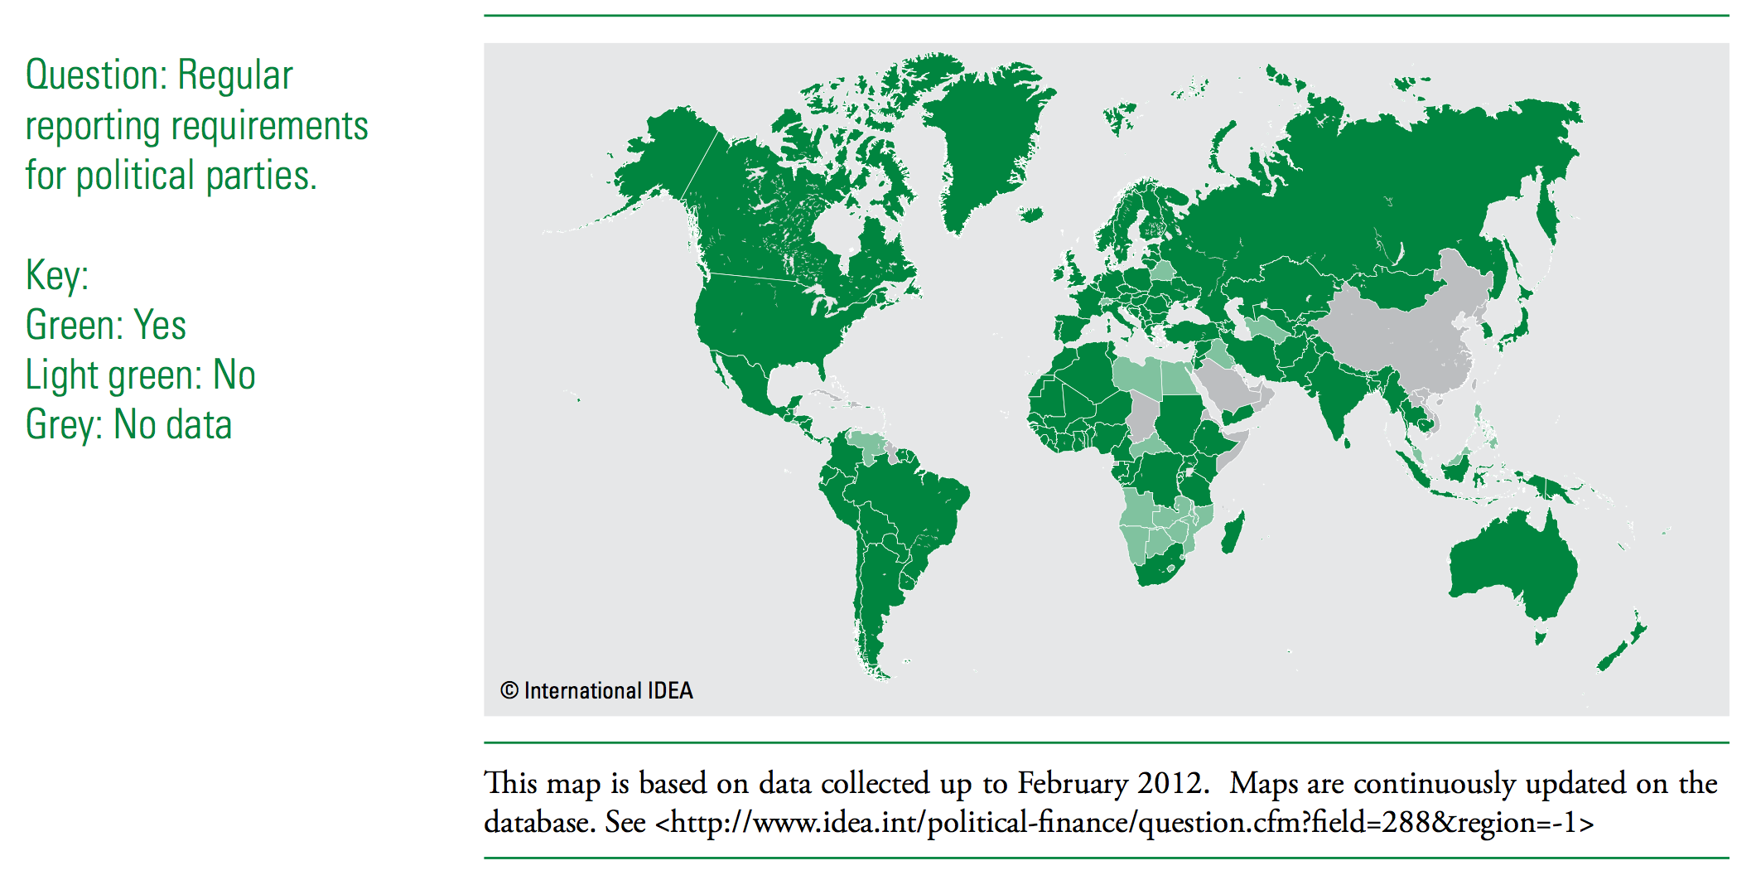

Slide 25
Legal framework for political financing
Country | Laws
Malaysia | Election Offences Act 1958
Canada | Canada Elections Act, 2000
South Korea | 1. Political Fund Act, 2010 2. Public Official Election Act, 1994 3. Republic of Korea, National Election Commission
India | 1. Representation of the People Act, 1951 2. Indian Election Commission (2011) Instructions on Elections Expenditure Monitoring 3. Companies Act, 1956 4. The Foreign Contribution (Regulation) Act, 2010
Mexico | Election Law
Taiwan | The Public Officials Election and Recall Law, 1980

Slide 26
Governing body for political finance
Country | Governing Body
Malaysia | Election Commission
Canada | Commissioner of Canada Elections
South Korea | National Election Commission
India | The Election Commission of India
Mexico | The National Electoral Institute
Taiwan | Tax Authority

Slide 27
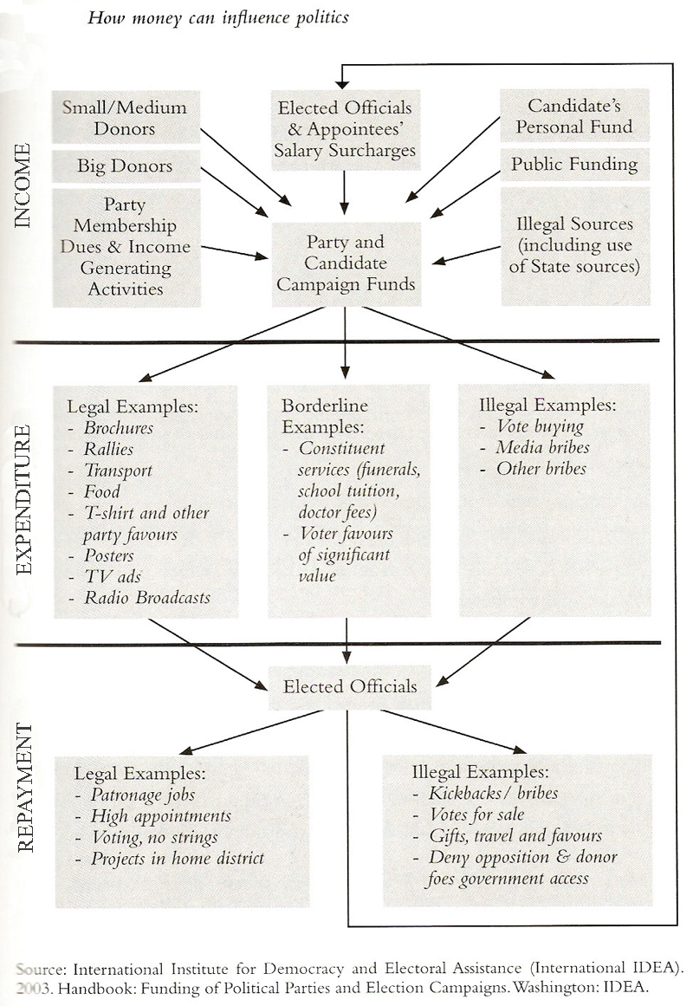

Slide 28
According to Tan Sri Abu Kassim , Chief Commissioner of the Malaysian Anti-Corruption Commission ( MACC) the arrest and indictment of several individuals involved in corruption, fraud and abuse mostly for public offices but the total felt to be too little compared to the amount of the specific findings of the report and not officially reported.

Slide 29
CORRUPTION SECTOR IN MALAYSIA
Sector | Status ( 1 = Least Corrupted , 5 = Most Corrupted)
Political Parties | 3.5
Parliament and Government Administration | 3.0
Business & Private Companies | 3.3
Police | 3.8
Judiciary | 2.8
Media | 2.4
Tax Departments | 2.5
Medical | 2.1
Education | 2.2
Military | 2.0
Services | 2.2
Registration and Permit Services | 3.1
NGO (non-governmental) | 2.2
Religious Organizations | 1.7

Slide 30
HOW TO STOP CORRUPTION???

Slide 31
MAYBE….
Salaries are doubled?
Enforcement increased?
Governments made transparent?
Improvements are really the result of any specific policy?
Perhaps…governments should become more experimental, quite literally, in how they deal with their corruption…
Fisman and Miguel

Slide 32
THANK YOU

