Slide 1
TEACHING SHORT STORIES & NOVELS IN THE 2ND LANGUAGE CLASSROOM

Slide 2
Short Stories vs Novels
A Short Story is a short work of prose fiction which usually depicts one
characters’ inner conflict or conflict with others.
It is a work of fiction in prose writing about imagined events and characters.
A short story is often contrasted with a novel on the grounds of length, magnitude and complexity.
This limitation of length imposes differences both in the effects that the short story can achieve and in the choice, elaboration and management of the elements to achieve those effects.
As the name suggests, a short story is shorter than a novel.

Slide 3
Types of Short Stories
prose narrative
myth
The form of prose narrative was developed, beginning in the early nineteenth century, in order to satisfy the need for short fiction by many magazines.
A myth is a story which is not true and involves supernatural beings or at any rate supra human beings. It is always concerned with creation.
It explains how something came to exist. Myth is transferred from one generation to another generation through oral saying.

Slide 4
Legends
Fables and parables
It is a short story, which is a part of fact and fiction about the life and deeds of a saint, a folk hero or a historical figure.
Legends are also transmitted orally from one generation to the next.
It is a short and simple story that exemplifies an abstract moral thesis or principle of human behavior.
In a fable, animal talk and act like the human being by representing them.
Parable is a kind of short stories that uses familiar events to illustrate a religious or ethnical situation.
A parable is a very short narratives about human beings presented so as to stress a general lesson that the narrator is trying to bring home to his audience.

Slide 5
A fairy tale
A ghost story
It belongs to folk literature and is a part of oral tradition.
Fairy tale tends to be a narrative in prose about the fortunes and misfortunes of a hero or heroine, who has experienced various adventures of more or less supernatural kind.
It is a story about ghosts or other supernatural beings.
In cultures all over the world, ghost stories have been told and passed down orally from generation to generation.
These stories reflect the superstitious fears and beliefs that people had in various cultures.

Slide 6
A tall tale & a trickster tale
An urban legend
It is a story with unbelievable elements that are exaggerations of the truth.
The characters are usually heroes that are ‘larger than life’.
Many tall tales are based on actual people.
Some famous examples Paul Bunyan and Pecos Bill.
A trickster tale is a story involving a character, usually an animal, who likes to play tricks on other characters.
Trickster tales are common in many cultures. Cartoons like Bugs Bunny and the Road Runner are based on trickster tales.
It is also known as an urban myth.
It is a story that is thought to be true, but is usually not.
Urban legends may contain elements of truth, but they are usually exaggerated.
Television programmes such as Ripley’s Believe It or Not!, Mythbusters (2003-present) have helped popularise urban legends in recent times.

Slide 7
Simplified Readers
Advantages | Disadvantages
The language is graded for English language learners at various levels. Students can read, understand and appreciate some of the best-loved stories written in English. Pre-reading, while-reading and post-reading activities are often provided. A CD is often provided so that students can listen to the stories as they read them. | The beauty of the language is often lost in the simplified text. The stories are often reduced to plot summaries so students may not be very interested in the story. The pre-reading, while-reading and post-reading activities are not always well-designed. Opportunities for students to practise reading strategies may be reduced with a simplified text.

Slide 8
Children’s Literature
Advantages | Disadvantages
The stories are beautifully illustrated. The language is rich and authentic. The plot structure is usually simple. The themes are often thought-provoking. | The books are expensive. The language can be difficult for second language learners to understand and appreciate. Secondary students may perceive stories from children’s literature to be too childish.

Slide 9
Elements of Stories: Plot
The short story can have a white wide range plot forms and structures.
Broadly speaking we can distinguish three major parts of plot;
  Beginning (introduction of problem),
  Middle (development of the problem),
  An end (resolution of the problem) .In short -
The beginning introduces a problem.
The middle develops the problem.
The end resolves the problem.

Slide 10
Elements of Stories: Character
A character is a person or sometime even an animal who takes part in the action of a short story or other literary works.
There are two meanings for the word character.
a) Person in a work of fiction; protagonist and antagonist
Short stories use few characters. One character is clearly central to the story with all major events having some importance to this character : he/she is the protagonist.
The opposed of the main character is the antagonist.
b) The characteristics of a person
In order for a story to seem real to the reader its character must seem real.
Characterization is the information the author gives the reader about the characters themselves. The author may reveal a character in several ways such as:
from his/her physical appearance;
what he/she says thinks feels and dreams;
what he/she does or does not do;
what others say about him/her and
how others react to him/her, etc.

Slide 11
Elements of Stories: Setting
a) Geographical location (where the action of story takes place),
b) Time (when the story is taking place, e. g. Historical period, time of
day, years etc.)
c) The weather conditions (is it rainy, sunny, or stormy)
d) Social conditions [what the daily life of the characters is like, whether
the story contains local color ( writing that focuses on the speech, dress,
mannerisms, customs, etc of a particular place) and
e) Mood or atmosphere (what feeling is created at the beginning of the
story, is it bright and cheerful or dark and frightening?)

Slide 12
Elements of Stories: Style
In layman’s terms the style refers to the way in which a story is written.
-diction or choice of words;
-its sentence structure and syntax;
-the density and types of figurative language;
-the patterns of its rhythm and other formal features;
-its rhetorical aims and devices.

Slide 13
Elements of Stories: Moral values
The theme of a fable is its moral. The theme of a parable is its teaching.
The theme of a piece of fiction is its view about life and how people
behave.
The theme in fiction is not generally intended to teach. In fact, it is not presented directly at all.
Readers have to extract it from the character, action, and setting that make up the story.
In other words, readers must figure out the theme themselves.
The theme is a controlling idea or central insight of the story.
“It is the authors underlying meaning or main idea that he is trying to convey.”

Slide 14
Advantages of using short stories or novels in language classes
a) making the students’ reading task easier because they are simple;
b) giving learners a better view of other cultures;
c) presenting a fictional and interesting world;
d) helping students to be more creative and raising the critical thinking skills;
e) raising cultural awareness; and
f) providing multicultural contexts because of its universal language
Notes:
Short story like other literary texts can raise cultural awareness, linguistic awareness, motivation, and etc. Short stories are claimed to improve all four skills. Murdoch (2002) states that “short stories can, if selected and exploited appropriately, provide quality text content which will greatly enhance ELT courses for learners at intermediate levels of proficiency”.

Slide 15
Short Story based Language Teaching (SSBLT)
Story based Language Teaching (SSBLT) is a humanistic literature-based language teaching method that aims to promote the learners` personal, cultural and linguistic awareness.
The main purpose of SSBLT is to help learners to learn language by enjoying and using language for communication through using short stories as the materials in a friendly atmosphere.
It develops the learners` communicative competence and critical thinking.
SSBLT aims at cultivating all language skills cooperatively

Slide 16
Characteristics of Short Story based Language Teaching (SSBLT)
1. The primary function of language is interaction and communication.
2. SSBLT is based on humanism and cooperative learning.
3. Personal, cultural and linguistic awareness should be developed.
4. Linguistics, sociolinguistic and communicative competence are emphasized.
5. All four language skills receive attention and are practiced integratively.
6. The student’s native language should be avoided in the classroom but can be used to talk about the procedure and cultural points.
7. Vocabulary is taught in the context of the short story.
8. All types of interaction: Teacher-student, student-teacher and student-student interaction exist.

Slide 17
Teaching Procedures of Short Story based Language Teaching (SSBLT)
1. Pre reading activities:
a. The teacher explains the procedures to the students in their native language and tells them that they are going to learn language by reading short stories and enjoying. The teacher identifies linguistic objectives, for example, what vocabulary and sentence structures he/she wants students to learn for sound, word and sentence levels.
b. The teacher provides a context for the story and presents the main characters. S/he asks them some questions about the short story content to make their schemata activated. Therefore, students will link their own experiences with those in the story.
c. The teacher shows the students the cover of the short story and they talk about what they see (title, pictures, etc.).

Slide 18
While reading activities:
a. The teacher reads the story slowly and clearly, making use of gestures; facial expressions and intonation that could help students follow the story.
b. The teacher makes the students active by asking them about the characters, and to predict what happens next in the story.
c. New vocabularies and grammatical items are explained in the text.

Slide 19
Post reading activities:
a. Students are asked to make groups and answer the questions orally: All types of questions (Factual, referential, inferential and evaluative).
b. Students are asked to write a dialogue between two characters.
c. Then, they are asked to paraphrase some sentences of a paragraph.
d. After that, they are asked to write one sentence on the theme of the story.
e. They are also asked to write a paragraph on what caused a character did something for example lying.
f. Next, they are invited to summarize the story in three sentences, including the main character, setting, conflict, climax, and resolution.
g. Then, the students go through a Discussion on the themes of the story and what they would do if they were the protagonist of the story.
h. Finally, the teacher asks them to express their opinions about the story and the activities.

Slide 20
THE KNOCK AT THE DOOR
Sample Activities

Slide 21
Pre-reading Activities
Pre-reading activities can serve the following purposes:
• Activate prior knowledge and/or provide background information necessary for comprehending the text.
• Clarify cultural information that may cause comprehension difficulties.
• Familiarise students with features of the genre/text type.
• Encourage students to make predictions based on the title, the illustrations and/or the opening of the story.
Notes:
Students should be encouraged to engage in pre-reading activities and to establish a purpose for reading. Well-structured pre-reading activities are most important with students who have a low level of reading proficiency. As students become more competent readers, teachers will be able to reduce the amount of support and allow students to do pre-reading activities independently.

Slide 22
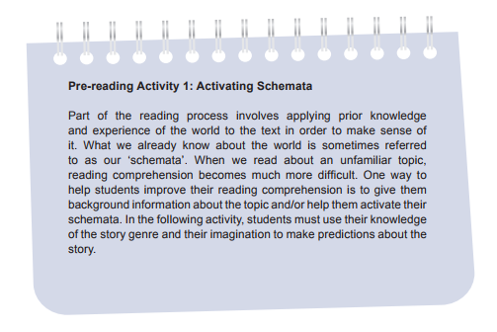

Slide 23
Pre Reading Suggested Procedures
1. Tell students to close their eyes. Play a recording of spooky music to create a feeling of suspense. Knock hard on the desk or door three times quickly.
2. Tell students that what they have heard is a scene in the story that they are about to read. Ask students to guess which story genre it is and why they think so.
3. Accept reasonable answers, such as ‘horror story’ or ‘ghost story’. Students should be able to relate the spooky music and loud knocks to their prior experience with horror stories or ghost stories.
4. Ask students to guess: • Who is knocking in the story? • What is the person knocking on? • Why is the person knocking so loudly? • What time is it in the story? • Where does the story take place?
5. Record students’ guesses on the board.
6. Tell students the title of the story. Ask if they would like to change their responses to the questions.
7. Ask students: If you were in the house alone, would you open the door? Why/Why not?
8. Conduct a picture walk to preview and make predictions of the story

Slide 24
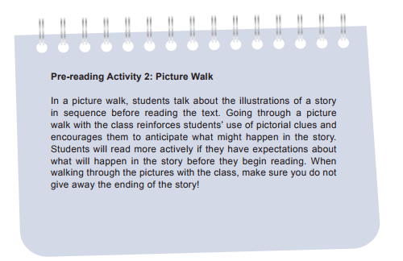

Slide 25
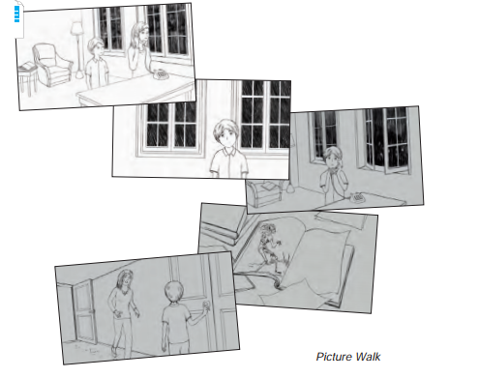
Illustrations from the short story ‘The Knock at the Door’ (Stuart Mead)
It can be used to do a picture walk before students read the story

Slide 26
Using Picture Walk Suggested Procedures
1. Tell students the title of the story. Encourage students to guess what the story is about.
2. Project the first picture on the screen. Ask students to talk about what they see and what may be happening in the picture. Encourage students to draw on their personal experiences as they interpret the picture.
Focus questions may be used:
• Look at the picture. What do you see? What do you think is happening?
• Look at Joey. How do you think he feels? What do you think has happened?
• Who is the woman? Who is she talking to? How does she feel? What do you think has happened?
• What can you see outside the window?
• What do you think will happen next?
• Have you ever been at home alone on a stormy night?
3. Direct students to details in the pictures that they may not have noticed. Discuss whether these clues affect their predictions.
4. After completing the picture walk, ask students to predict the end of the story. (If there is a picture illustrating what happens at the end, do not show it to the class.)

Slide 27
While Reading Activities Suggested Procedures
1. Explain that all stories have three basic story elements: character, setting and plot. Use a story familiar to students to illustrate this point, e.g. ‘The Three Little Pigs’ or ‘Cinderella’.
2. Distribute Worksheet and explain that it will be used to take notes on ‘The Knock at the Door’ by Stuart Mead. Ask students to fill in the title and the author first.
3. Students work in small groups to take notes on the setting and characters of the story.
4. Discuss answers with the class.
5. Have students work in small groups to take notes on the sequence of events, i.e. what happens at the beginning, in the middle and at the end of the story.*
6. Discuss answers with the class.

Slide 28
While reading a story with the class, it is important to model particular reading strategies for students so that they learn how to interact with the text and negotiate meaning.
For example, if students have difficulty reading an unfamiliar word aloud, do not simply feed them the correct pronunciation; instead, model for them how to use letter-sound relationships or other ‘word attack’ skills (e.g. breaking words into syllables; recognising familiar prefixes, suffixes or other word parts; making analogies with familiar words that have similar spellings) to decode, or sound out, the word.
If students do not understand the meaning of a word, do not simply translate the word into Chinese for them or ask them to look it up in the dictionary; rather, model for students how to infer the meaning of the word from the pictures or from the context.
It is often possible for students to work out the part of speech of an unfamiliar word, and then to use the information that comes before and after the word to infer its meaning.
To become more skilful readers, students should also learn how to ask questions and make predictions as they read.
  ‘How are these characters related?’,
  ‘What is this main character’s motivation?’,
  ‘What will happen if...?’

Slide 29
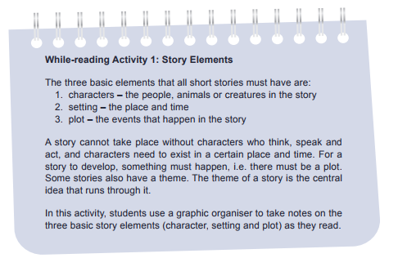

Slide 30
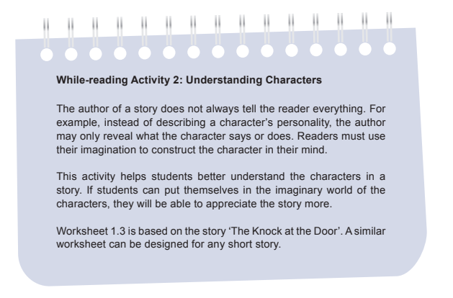

Slide 31
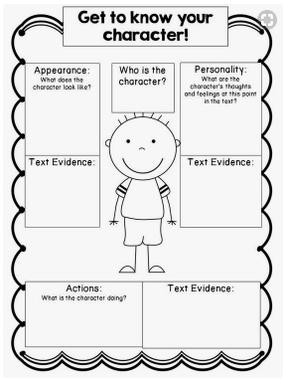

Slide 32
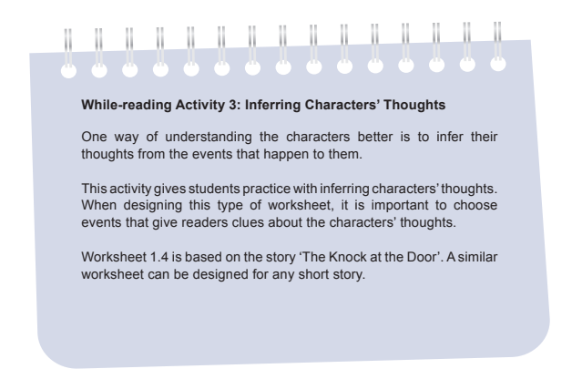

Slide 33
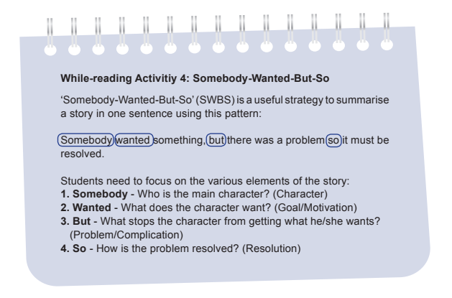

Slide 34
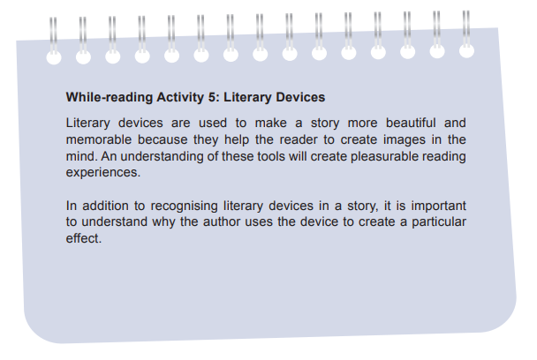

Slide 35
Post-reading Activities
After students have finished reading a short story, there is a wide range of activities that teachers can design to extend student learning.
One way to design post-reading activities is to refer to the different levels of thinking skills in Bloom’s Taxonomy, as revised by Anderson and Krathwohl (2001).
They are as follows:
Remembering: Can students recognise, list, describe, identify, name or locate the main characters and events in the story?
Understanding: Can students interpret, summarise, infer, paraphrase, compare or explain the character’s motivations or the plot development?
Applying: Can students apply a lesson from the story to their own lives?
Analysing: Can students compare, organise, deconstruct, outline, structure or integrate ideas about the characters or the events in the story?
Evaluating: Can students critique or judge the story based on how successful it is in achieving its purpose, e.g. to entertain an audience?
Creating: Can students design, construct, plan or produce something new based on the characters and the events in the story?

Slide 36
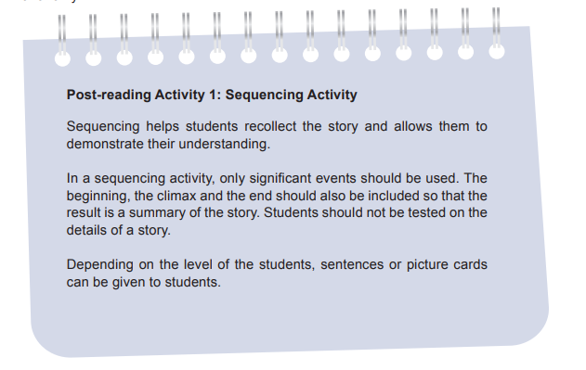

Slide 37
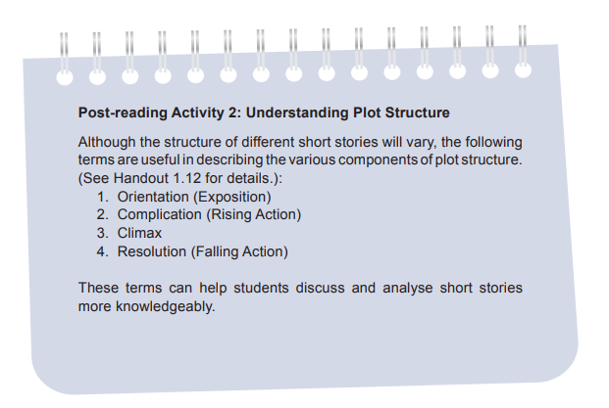

Slide 38
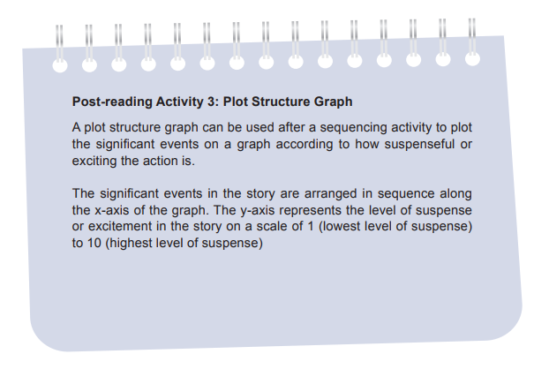

Slide 39
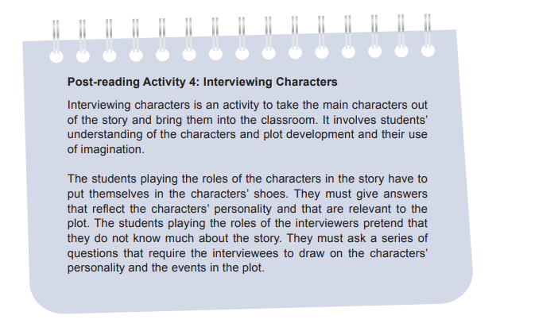

Slide 40
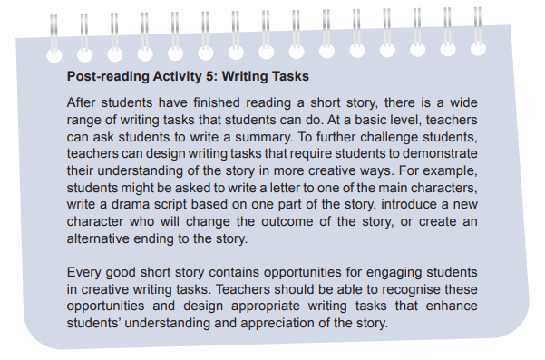

Slide 41
How can you bring active learning to your literature classroom?

