Slide 1
FINAL YEAR PROJECT
4SSCZ
Progress Presentation
NURDYANA BINTI RAMLEE
NUR FATIN NASUHA BINTI JAAFAR

Slide 2
PROBLEM STATEMENT
In cargo scanning system, the image form was not clear when detect transmission x-ray only.
To get clear image, backscatter x-ray must be detect.
In this project, backscatter x-ray represent as photon will be detect by using MPPC.

Slide 3
OBJECTIVES
The main objectives of this research are as follows:
To construct the prototype of x-ray backscatter detector using MPPC.
Test the prototype using alpha, beta, gamma and x-ray source.
To measure the backscatter x-ray that represent as photon.
To estimate and determine the detector resolution.

Slide 4
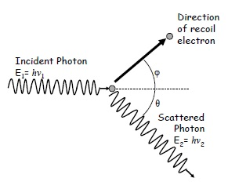
WHAT IS BACKSCATTER X-RAY?
Backscatter x-ray is produced from Compton Scattering process.
In cargo scanning system, the energy of incident photon (x-ray) is higher than binding energy of atomic electron, then can treat the electron as free electron.
This technique involves positioning both source and detection apparatus on only one side of a target object.
The collision of a photon by a charged particle, usually an electron. It results in a decrease in energy (increase in wavelength) of the photon (which may be an X ray or gamma ray photon), called the Compton effect.

Slide 5
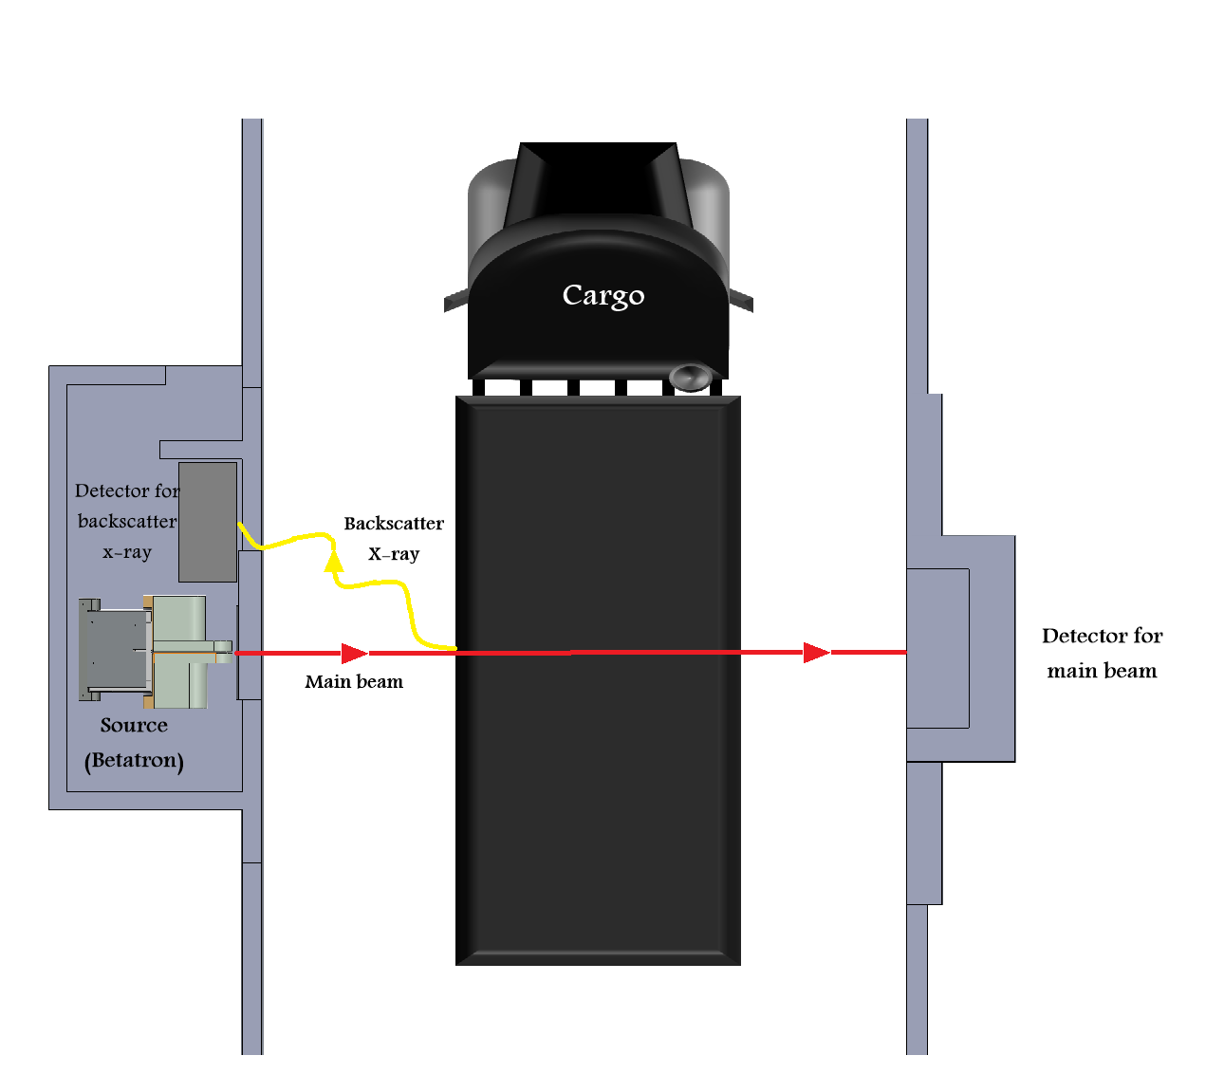
EXPECTED PROTOTYPE POSITION

Slide 6
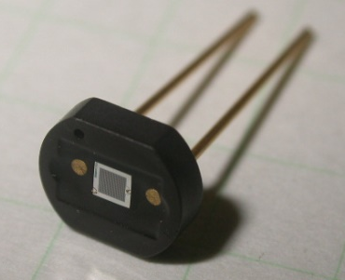
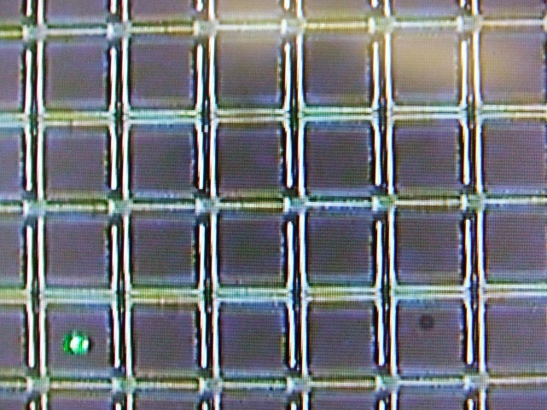
MPPC DETECTOR
Multi-Pixel Photon Counter ( MPPC ) is a new type of photodetector device developed by Hamamatsu Photonics.
Is a Si-PM (silicon photomultiplier) device
Sensitive area of MPPC detector

Slide 7
significant Characteristics
of MPPC
Low Dark Count
Low Crosstalk
Low Afterpulses
High Gain and low noise
Fast response
High Photon detection efficiency
Excellent Time resolution

Slide 8
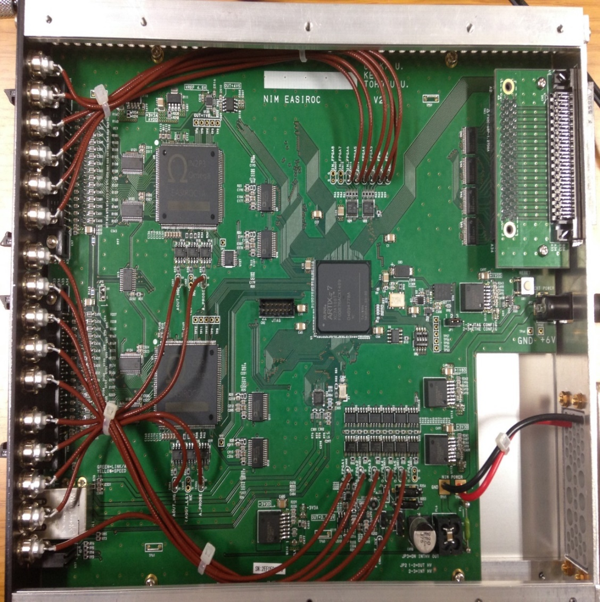
EASIROC-NIM MODULE
EASIROC-NIM MODULE is an optical measurement modules
Capable of measuring light over a wide range of light levels (10 orders of magnitude)
This module is equipped with a chip called EASIROC. EASIROC stands for Extended Analogue SI-pm ReadOut Chip is a 32 channels fully analogue front end ASIC dedicated to readout SiPM detectors.

Slide 9
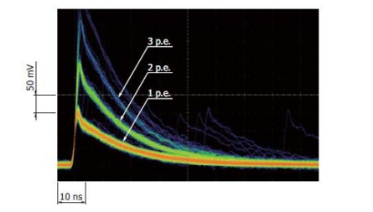
When light enters the MPPC at particular time
Output pulse height varies depending on the number of photons detected
The pulses separated from each other according to the number of detected photon.
Observing pulse
Figure shows the pulse waveforms when using a linear amplifier

Slide 10
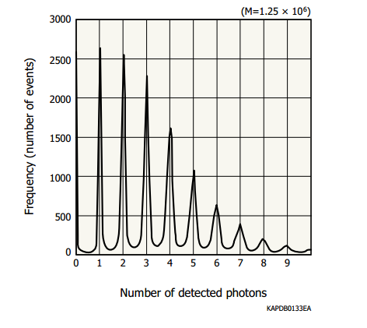
Intergrating the output charge
Figure shows a distribution plotted for the amount of charge accumulated in the intergration time
When light enters the MPPC at variable time
The number of photons detected within a certain time period can be estimated by integrating the MPPC output
Using intergrating amplifier

Slide 11
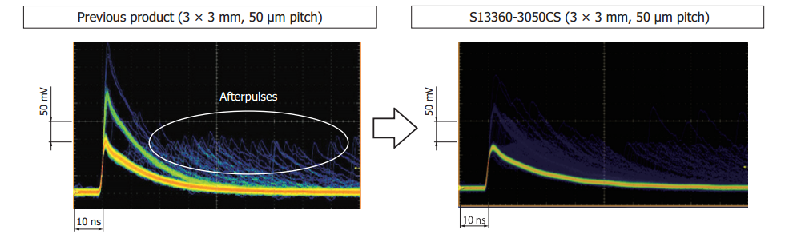
Features
Low afterpulses
  new MPPC reduced afterpulses due to use of improved materials and wafer process technologies.
  Reduces the generation of delayed output signal

Slide 12
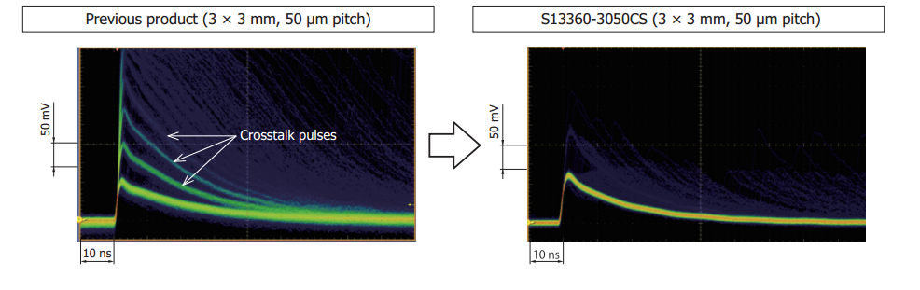
Low crosstalk
  Lower the generation of other pulses by affected pixels

Slide 13
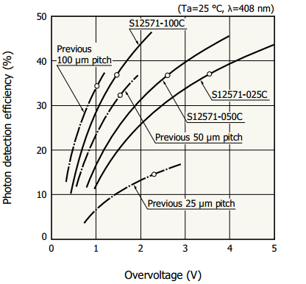
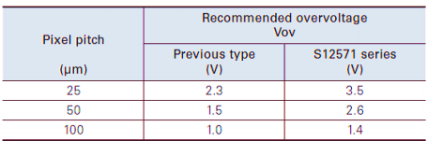
HIGH PHOTON DETECTION EFFICIENCY
Graph of Photon detection efficiency(%) vs Overvoltage(V)
The table shows some recommended overvoltage.

Slide 14
END

