Slide 1
Isotope Production Technique by Muon Beam from Pion Capture Solenoid System
using Root v5
Dedicated to
Dr. Izyan Hazwani + JPARC (Prof. Ejiri)

Slide 2
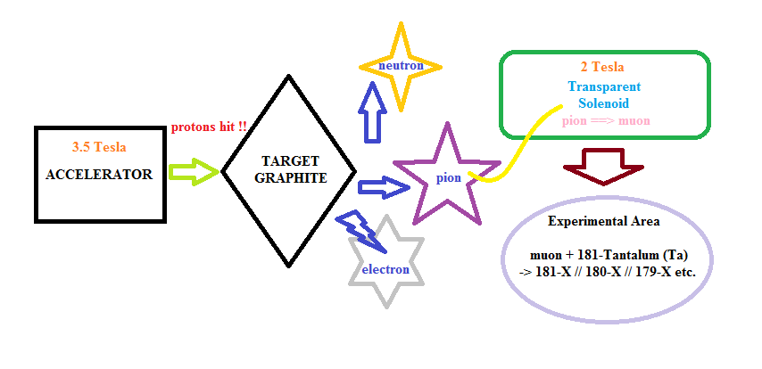

Slide 3
Data Files available from JPARC (Japan Proton Accelerator Research Centre)
According to Dr. Izyan’s slides, MUSE beamline, MLF was used with intensity = 10⁵ μ⁻ /s and 30 MeV/c of muon momentum. The targets are ⁹³Nb, ¹⁰⁰Mo, and ¹⁸¹Ta.
Experiments done on three consecutive days (from 2014-06-18 to 6-20)
A total of 17 data files were generated on the first day, 12 on the second while 15 on the third, summing up to total of 34 data files for three days.
However, only four were chosen for further analysis. For the early data files, because the activity of the sample is still quite high, so we require only short measurement time to obtain the intensity. However, as time passes the activity of the sample recedes due to decay. Thus we will need longer measurement time (i.e.: 24 hours or equivalent to 86400 sec) to gain enough statistical data for each peaks.
Naming of the data files, i.e.: GMX4_20140620_123852.

Slide 4
Data Analysis requires nuclear physics knowledge…
Due to decaying of Tantalum-181 (target of experiment), any related isotopes with the half life between 30 minutes to 3 days are considered relevant.
Measurement of very short-lived nuclei is practically impossible while for too long-lived is impractical.
Thus, aside from technical analysis of those data files using Root v5, we ventured out to find out more about those energy peaks could represent about~! (possibly another isotope that Ta-181 decayed to)
At initial stage, TWO nuclear datasheets were referred to…

Slide 5
Nuclear Data Sheets for A = 180
Nuclear Data Sheets 126 (2015) 151-372 @ ScienceDirect by E.A. Mccutchan
Nuclear Data Sheets for A = 182
Nuclear Data Sheets 130 (2015) 21-126 @ ScienceDirect by Balraj Singh

Slide 12
Continue…
Unfortunately, the nuclear data from the nuclear data sheets was not ample enough for our data analysis due to missing of low intensity peaks.
So, Dr. Izyan introduced another source, a link provided by JAEA (Japan Atomic Energy Agency):
http://wwwndc.jaea.go.jp/NuC/sbygame.html

Slide 14
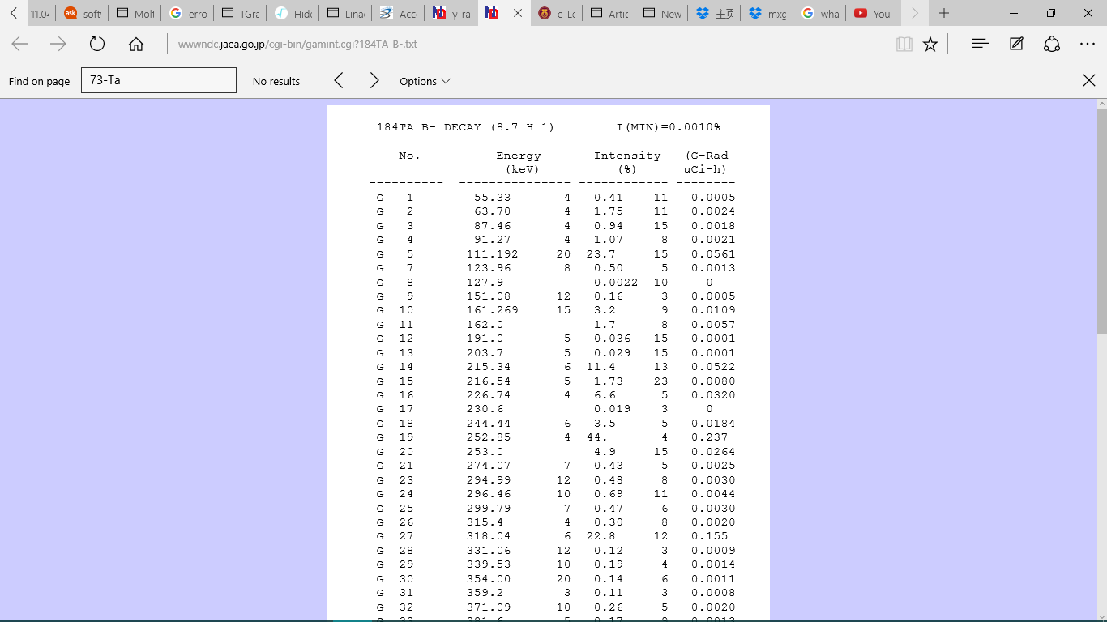

Slide 15
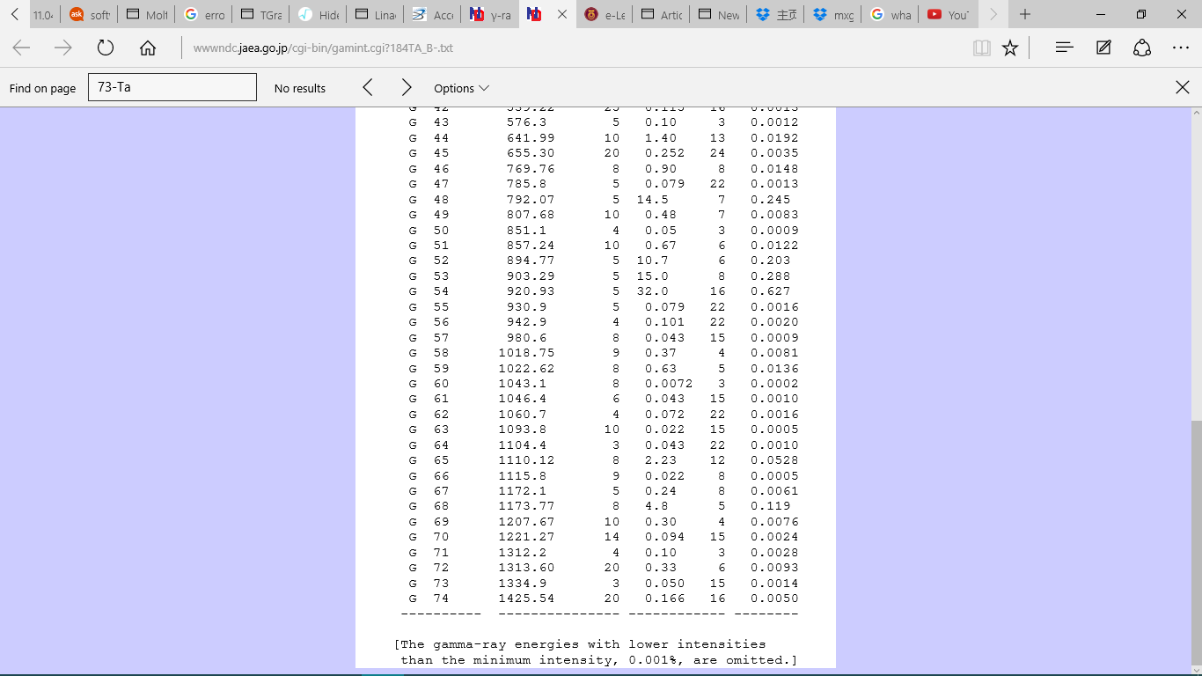

Slide 16
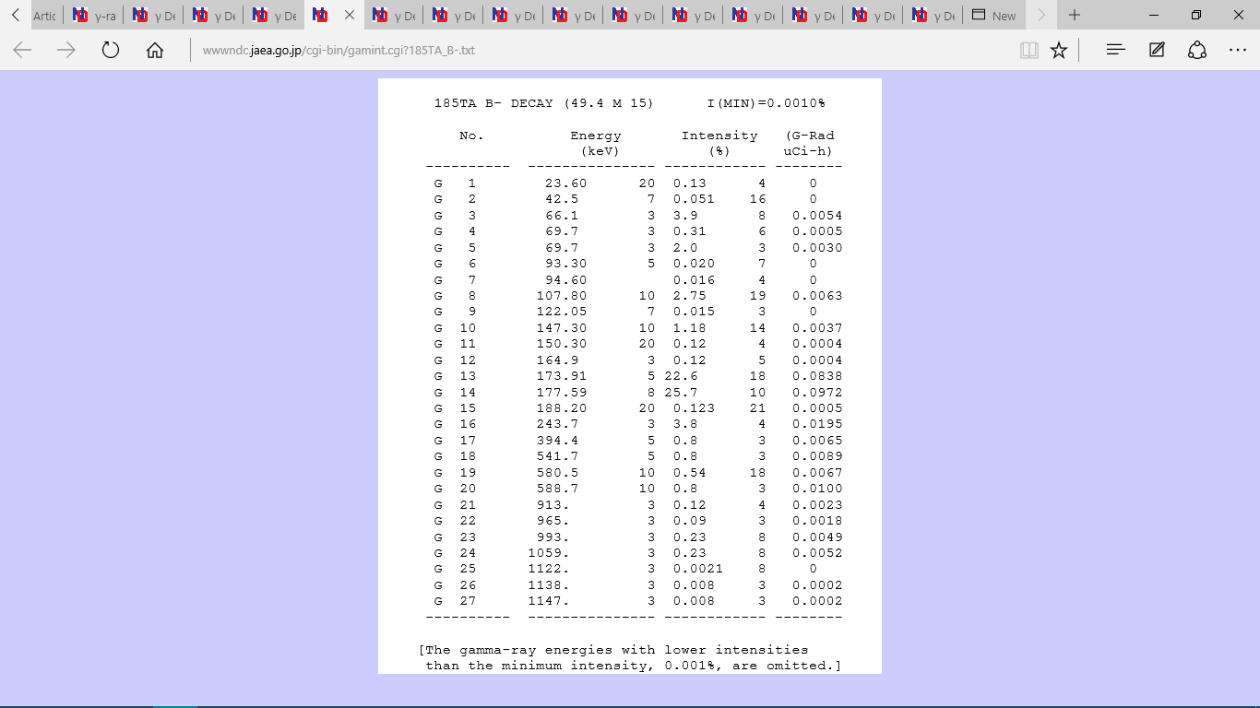

Slide 17
Nuclide Energy(keV) Intensity(%) Decay mode Half life Effective Intensity(dps)
72-Hf-180 215.43 81.32 IT 5.5H 2.85E-05
72-Hf-180 332.27 94.12 IT 5.5H 3.29E-05
72-Hf-180 443.16 81.88 IT 5.5H 2.87E-05
¹⁸¹Ta (μ, n) ¹⁸⁰Hf

Slide 18
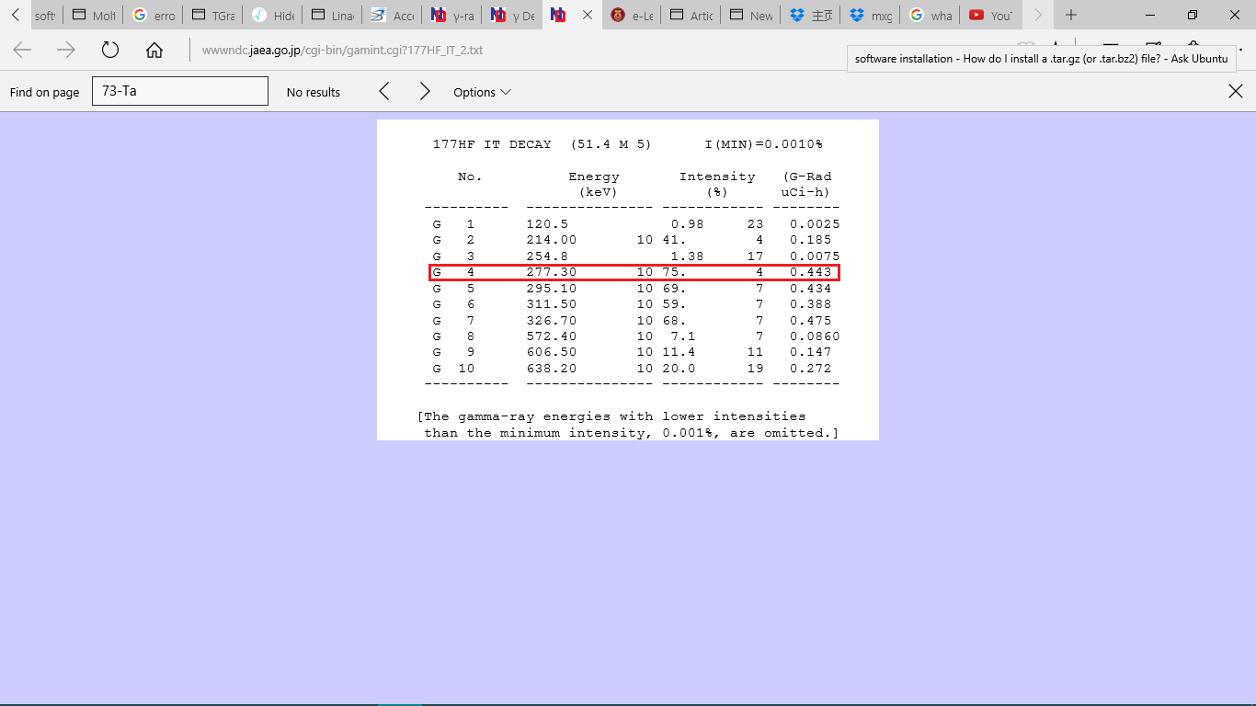
¹⁸¹Ta (μ, 4n) ¹⁷⁷Hf

Slide 19
Technical Work (Result is the main priority!!)
From technical problems faced during installation of Ubuntu, root, and even trying to use UNIX system on Windows (Cygwin), etc. In the end, I realized, stop wasting time on those unnecessary stuff ☹
Basically, there are FOUR main steps I need to follow.
1st: Read, check carefully each data files, and change the first row count from (usually 0) to real time measurement. Also, convert them into text files using Excel

Slide 20
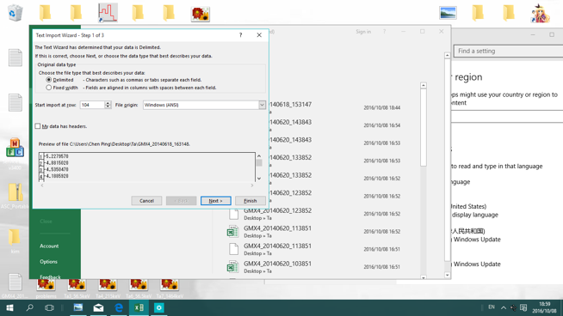

Slide 21
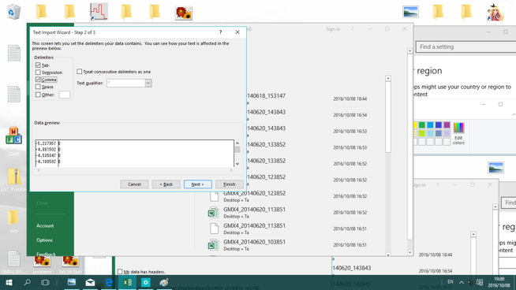

Slide 22
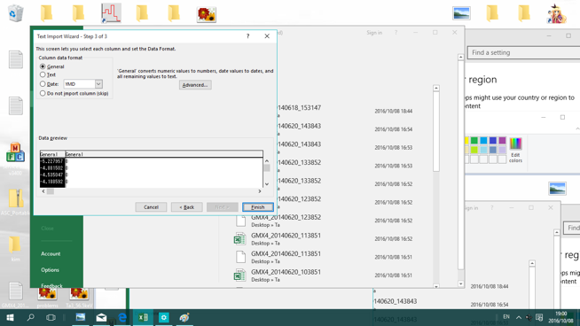

Slide 23
Continue…
2nd: By studying Mo1_140keV.C, make similar coding for Ta1, Ta2, Ta3, and Ta4 (four selected data files). Change only the range and value of energy and counts area (SetParLimit and FixParLimit). Make two or more Gaussian peaks depending on graphs analysed.
Some simple commands needed:
$ root –l [open root]
$ .L Ta1_215keV.C
$ Ta1(“GMX4_20140618_100940.txt”)

Slide 24
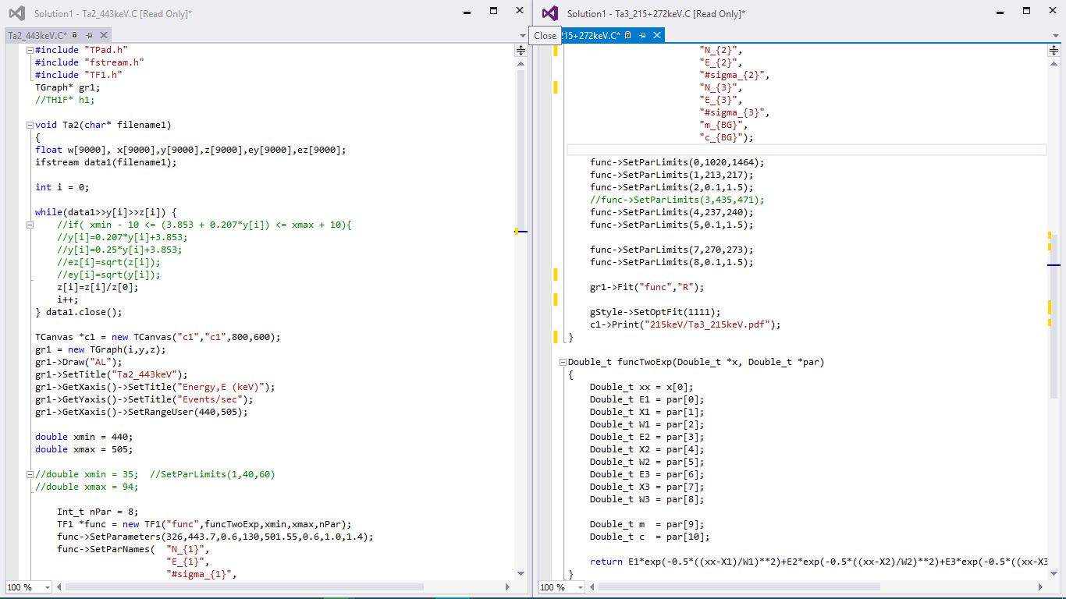

Slide 25
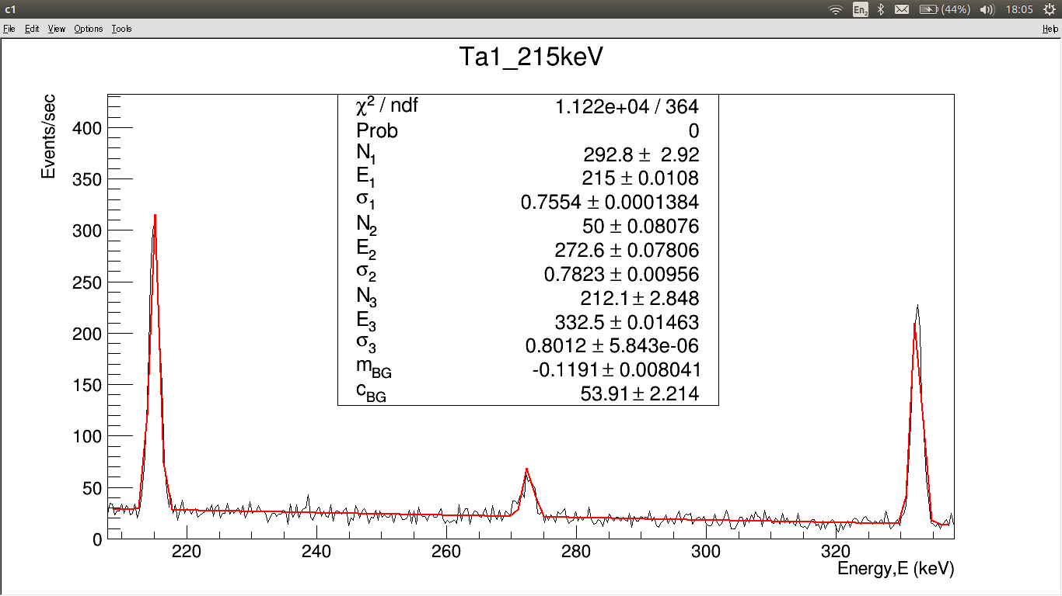

Slide 26
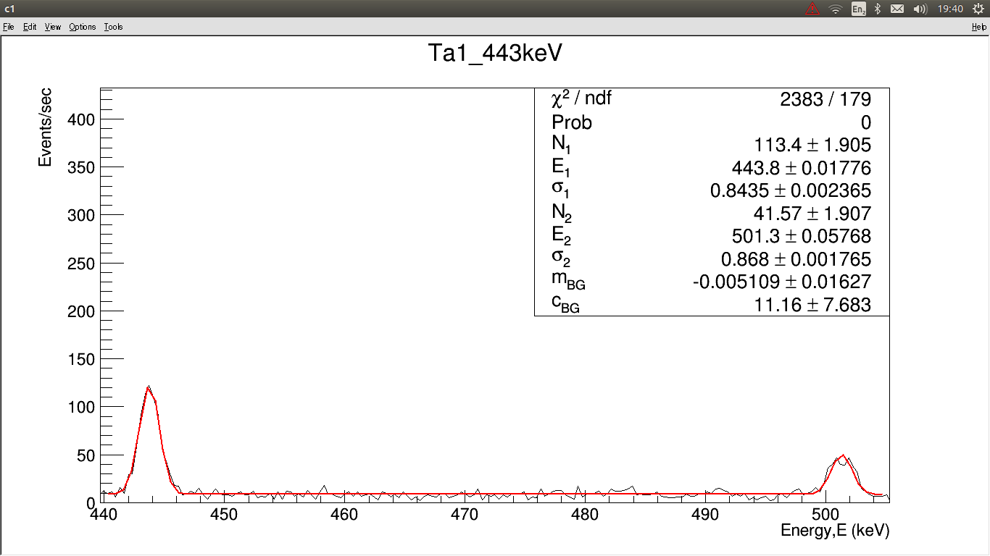

Slide 27
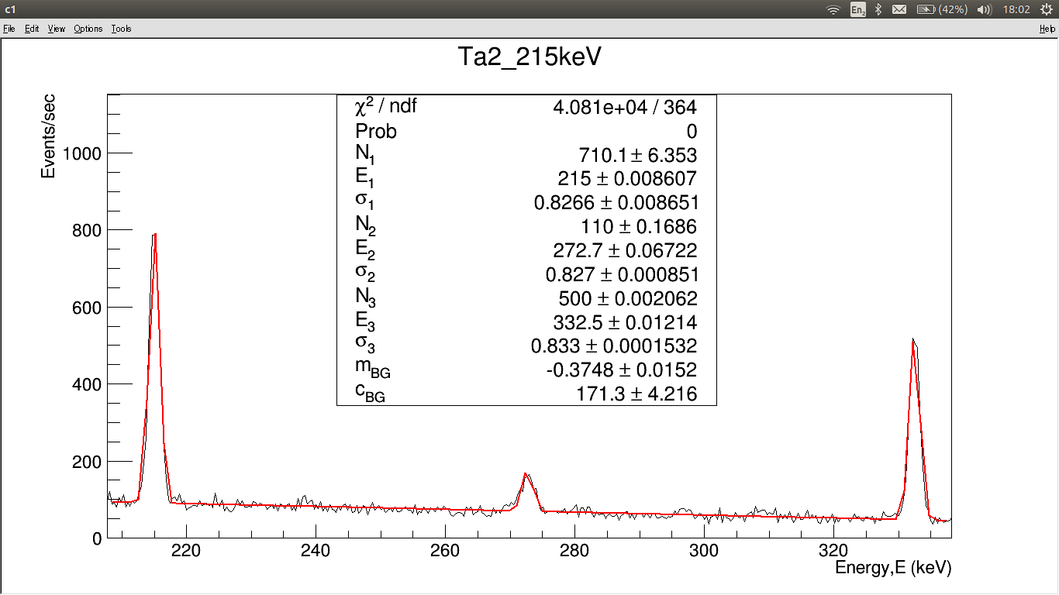

Slide 28
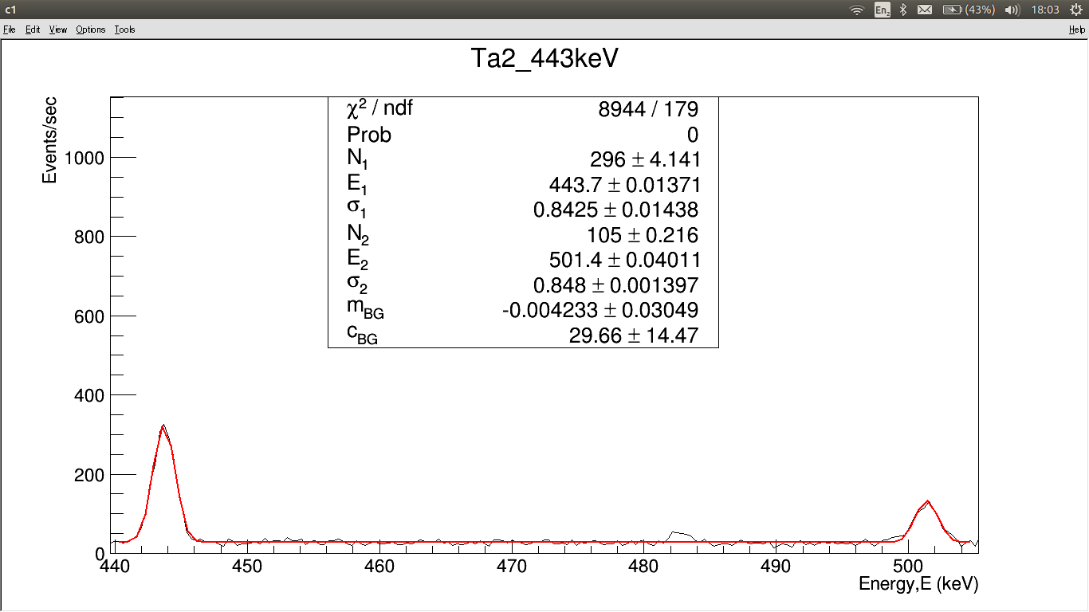

Slide 29
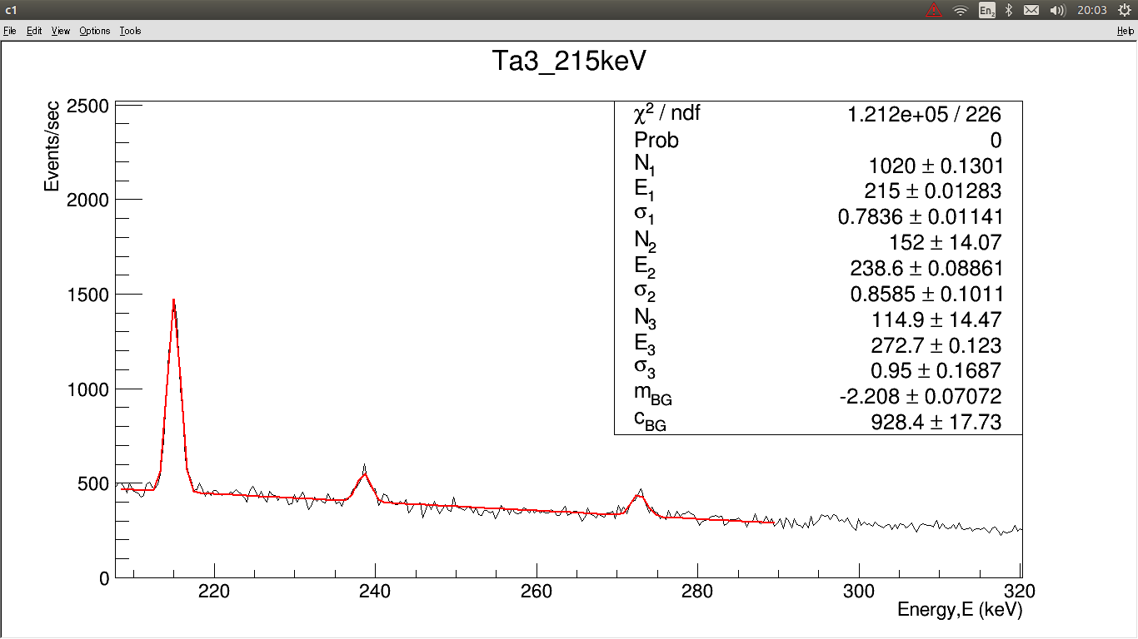

Slide 30
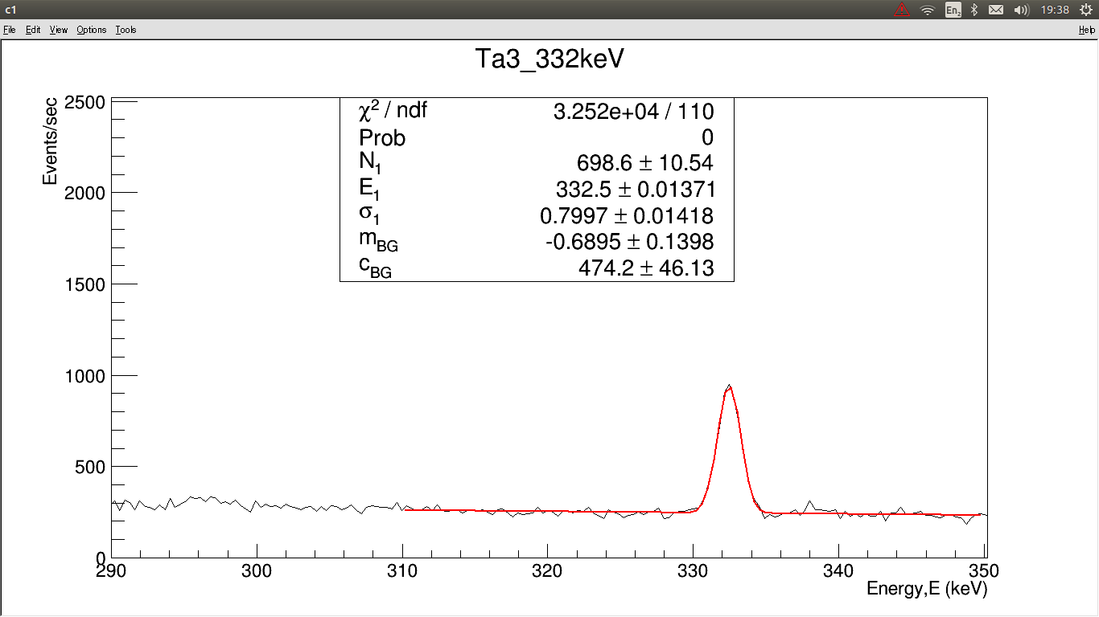

Slide 31
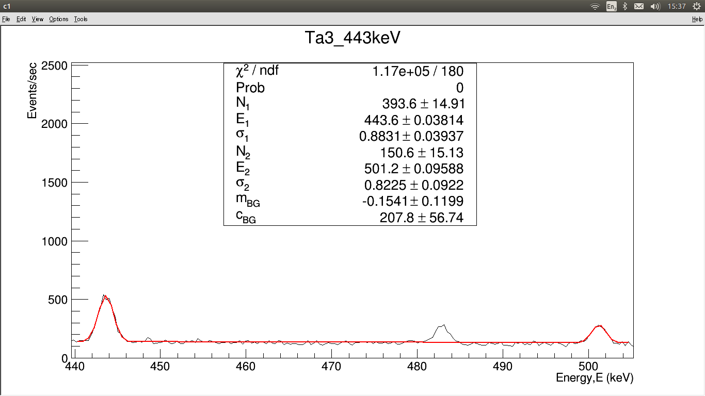

Slide 32
Continue…
3rd: Several further analysis that need to be revised: checking the Full Width Half Maximum (FWHM) of all peaks. Make sure all sigma(s) (statistical errors) fit in the line so that Chi square is less than or close to 1.

Slide 33
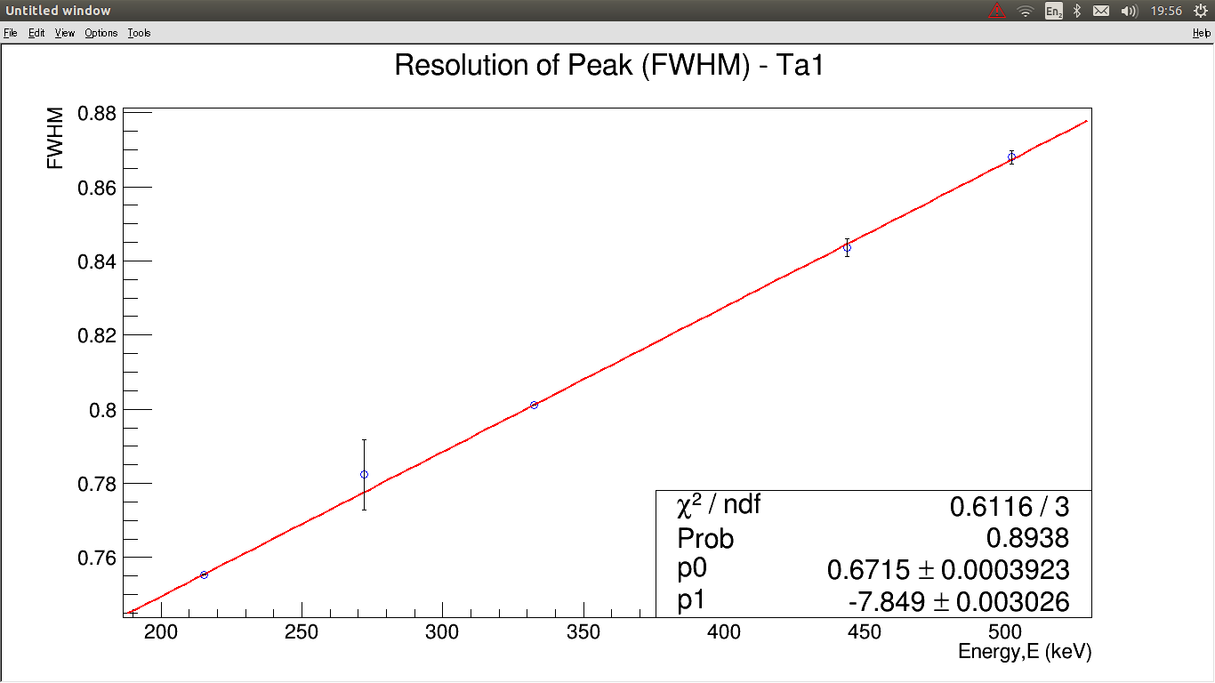

Slide 34
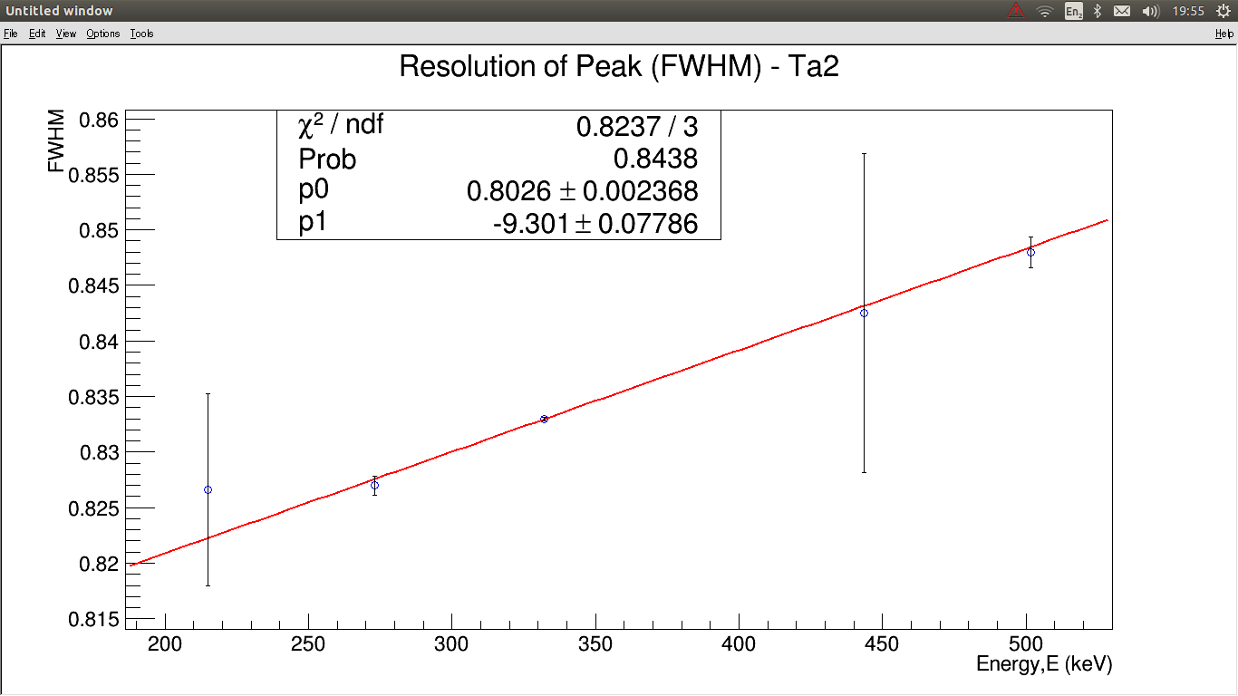

Slide 35
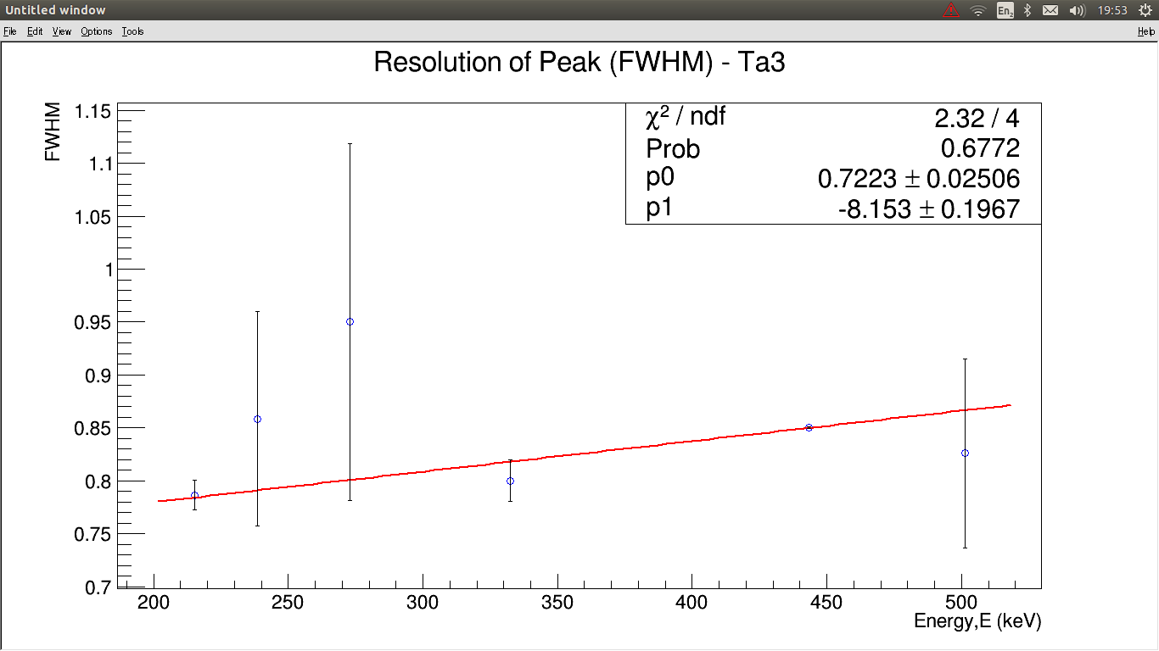

Slide 36
To Be Continued …
4th: Muon activation analysis is on green light then! Estimate the initial activity of the isotope and the reaction rates of the decay. By referring to the equations in MCID paper, Y(X’), N(X’) and R(X’) can be calculated.
To obtain N₀(X’), the decay curve need to be plotted using
F1_98Nb_722keV.C (for single decay mode)
F1_98Nb_140keV.C (for multiple decay mode, transient radioactive equilibrium)
Plot R(X’) for all capture products in one figure.

Slide 37
THANK YOU FOR LENDING ALL EARS~
HOPE TO SEE YOU AGAIN NEXT TIME ☺
~ENJOY YOUR DAY~

