Slide 1
SYSTEMATIC STUDY OF NEUTRON EMISSION MODEL FOR NUCLEAR MUON CAPTURE EXPERIMENT
NAME OF STUDENT:FAIZNUR BINTI OTHMAN
NAME OF SUPERVISOR:DR IZYAN HAZWANI BINTI HASHIM
22/2/2017

Slide 2
Introduction
The fundamental of neutrino
Majorana or Dirac neutrino
Absolute mass and mass hierarchy
Lepton charge parity phases
Neutrino nuclear synthesis
etc
Nuclear matrix element (NME) uncertainty is one of the main contribution towards understanding on neutrino fundamental properties.
Whereas, muon capture reaction is pointed to be the alternative in the investigation of nuclear structure properties of double beta decay.
IH Hashim 2016, RCNP16
Notes:
Parameters related to the nuclear structures: spin states, strength interactions, axial parameters

Slide 3
Problem Statement
The source of neutrino factory are limited and the analysis are complicated (Barea et al, 2013).
The NME uncertainty is huge and there is no accurate or sensitive approximation for absolute neutrino mass (Ejiri, 2013).
There are no accurate remark of neutron emission after muon capture reaction due to unknown nuclear excitation range after muon neutrino was released from the reaction(Hashim, 2014).
Notes:
-parameters;spin states, strength interactions, axial parameters
using high sensitivity spectrometer and isotopes
the nuclear probes are used for direct measurement of neutrino nuclear response
-due to assumption made in each theoretical models
the experimental data to support and reduce the uncertainty are not properly studies
-the probability of neutron emission after the muon capture reaction are remain unknown
this study are necessary in order to have a theoretical reference to prove the experimental data

Slide 4
Previous latest study
(IH Hashim,2014)
-Development experiment method to study neutrino response by muon capture.
-Development of the neutron statistical model for evaluation of neutrino response
(IH Hashim,2016)
Comparing the observed residual isotope(Mo-100, Nb-93 and Ta-181 ) distributions with the neutron statistical model shows a giant resonance-like strength around 9-13 MeV.
(SS Saroni,2015)
Fixed 15-30% fraction of PEQ to compare isotope population

Slide 5
Layout of neutron statistical model(IH Hashim,2014)
ν
3n
Excitation energy
1n
μ
β,ɣ
Nb-99
Nb-100
Mo-100
Notes:
The neutron emission depends on its initial excitation energy.
Then beta decay or delayed beta decay together with the transition of gamma rays will be followed to ground state (Herbert,2004).

Slide 6
Assumption made for this calculator
1. Level density parameter are constant for constant excitation level.
Reference Input Parameter Library (RIPL-3).
The reports provide systematic study on the factors affecting the nuclear level density parameter.
Constant Temperature Model (CTM), Back Shifted Fermi Gas Model (BFM), Generalized Superfluid Model (GSM) and Enhanced GSM (EGSM)
Level Density Parameter from EGSM model (Capote et al,2009)
Element | Level Density Parameter, a
¹²C | 3.0
¹⁶O | 3.0
²⁸Si | 4.5
³²S | 4.5
⁴⁰Ca | 7
²⁰⁴Tl | 22.5
207Pb | 22.5
209Bi | 22.5

Slide 7
2. Zero proton emission events due to Coulomb barrier.
During the feasibility test using Mo-Nat and current measurement using Mo-100, we
can not observed gamma rays related to one proton emission.
Due to very low statistics of the proton emission channel, we assume that no proton emission occurs during the reaction.
This assumption corresponds to the higher proton separation energy compared to the neutron binding energy contribute to the high Coulomb barrier.

Slide 8
Aim
The aim of this report is to provide systematic study on the neutron emission model, which have been developed for neutrino nuclear response study.
Objectives
1)To investigate the influence of pre-equilibrium neutron emission contributions after muon capture reaction.
2)To investigate the effect of nuclear excitation level on kinetic energy of the emitted neutron.
3)To study the contribution of pre-equilibrium neutron on the nuclear temperature factor
4)To optimize the constant x, excitation energy, nuclear temperature factor coefficient by comparison on neutron emission with the previously observed neutron spectrum in muon capture experiment.
Notes:
the constant x for 0.01 to 0.10 in the pre-equilibrium neutron emission events
the excitation energy between 15 MeV to 21 MeV are investigated for maximum neutron kinetic energy observation
pre-equilibrium nuclear temperature factor from 3 to 5
χ² analysis and the optimize value for light, and heavy nuclei will be determined.

Slide 9
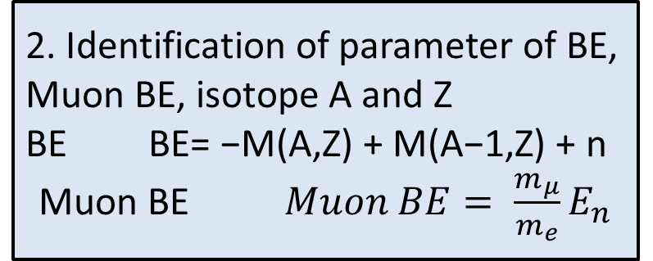
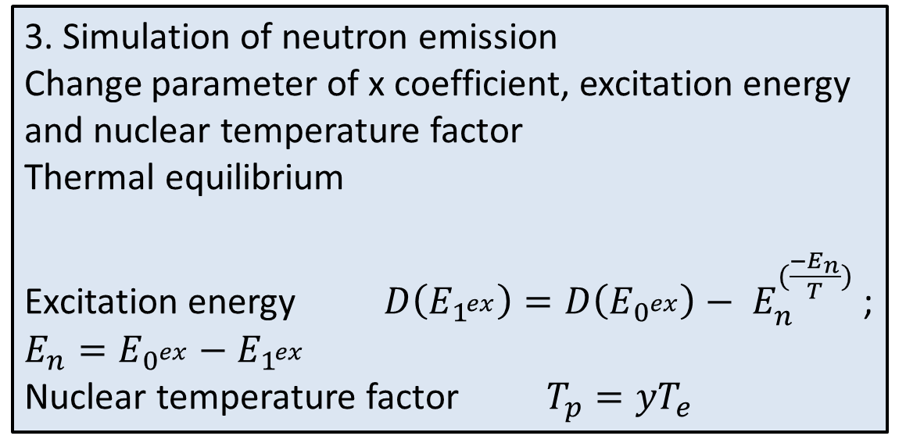
Research Methodology
1. Setting up environment for neutron emission model
-Binding energy(BE) calculator, Neutron emission simulator, Isotope Simulator
4.Comparison model to experimental for ¹²O, ³²S, ⁴⁰Ca, ²⁰⁷Pb and ²⁰⁹Bi by χ² analysis
3. Simulation of neutron emission
Change parameter of x coefficient, excitation energy and nuclear temperature factor
Thermal equilibrium
Excitation energy $D\left(E_{1^{ex}}\right)=D\left(E_{0^{ex}}\right)− E_{n }^{(\frac{{−E}_{n}}{T})}$ ; $E_{n}=E_{0^{ex}}−E_{1^{ex}}$
Nuclear temperature factor $T_{p}=yT_{e}$
2. Identification of parameter of BE, Muon BE, isotope A and Z
BE BE= −M(A,Z) + M(A−1,Z) + n
Muon BE $Muon BE= \frac{m_{μ}}{m_{e}}E_{n}$
IH Hashim 2016, RCNP16

Slide 10
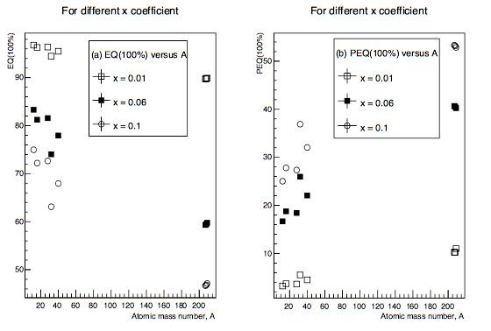
Study of x coefficient
Figure 4.1 (a) EQ versus A for different x coefficient.
Figure 4.1 (b) PEQ versus A for different x coefficient.

Slide 11
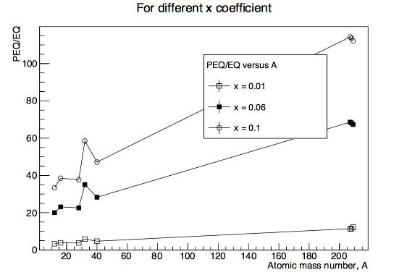
Figure 4.2 PEQ/EQ versus A for different value of x coefficient

Slide 12
The value of x coefficient use in this study are from 0.01 to 0.10. But only plot 0.01, 0.06 and 0.1 as they shows obvious different.
For EQ versus A -the highest value of 0.01 is 98% and the lowest value is 90%
-the highest value of 0.06 is 82% and the lowest value is 60%
-the highest value of 0.1 is 76% and the lowest value is 46%
For PEQ versus A -the highest value of 0.01 is 10% and the lowest value is 2%
-the highest value of 0.06 is 40% and the lowest value is 18%
-the highest value of 0.1 is 54% and the lowest value is 24%

Slide 13
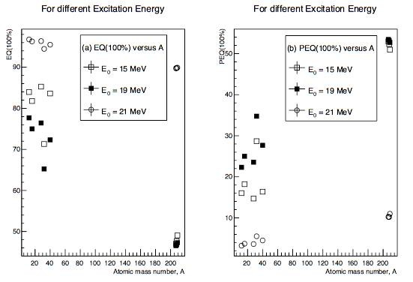
Study of excitation energy
Figure 4.3 (a) EQ versus A for different excitation energy.
Figure 4.3 (b) PEQ versus A for different excitation energy.

Slide 14
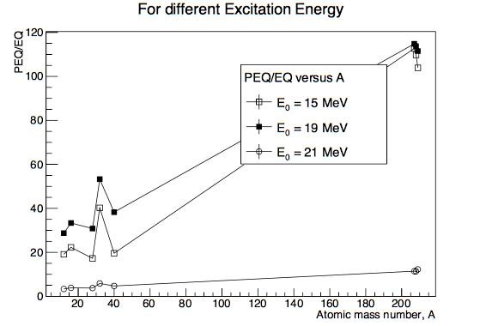
Figure 4.4 PEQ/EQ versus A for different excitation energy

Slide 15
The value of excitation energy use in this study are from 15 MeV to 21 MeV. But only plot 15 MeV, 19 MeV and 21 MeV as they shows obvious different.
For EQ versus A -the highest value of 15 MeV is 86% and the lowest value is 50%
-the highest value of 19 MeV is 78% and the lowest value is 46%
-the highest value of 21 MeV is 98% and the lowest value is 90%
For PEQ versus A -the highest value of 15 MeV is 50% and the lowest value is 14%
-the highest value of 19 MeV is 54% and the lowest value is 22%
-the highest value of 21 MeV is 10% and the lowest value is 2%

Slide 16
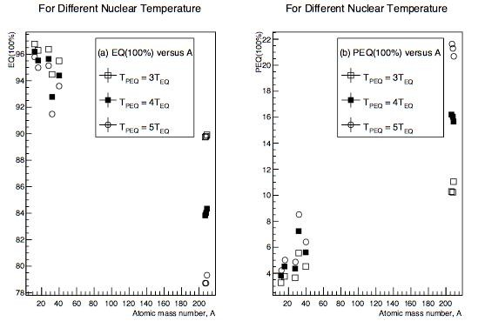
Study of nuclear temperature factor
Figure 4.5 (a) EQ versus A for different nuclear temperature.
Figure 4.5 (b) PEQ versus A for different nuclear temperature.

Slide 17
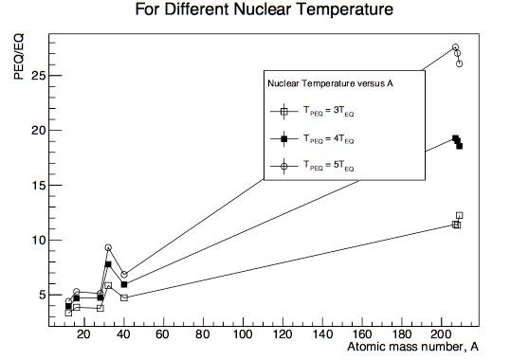
Figure 4.6 PEQ/EQ versus A for different nuclear temperature

Slide 18
The value of nuclear temperature factor use in this study are from 3 to 5 as they shows obvious different.
For EQ versus A -the highest value of 3 factor is 97% and the lowest value is 89%
-the highest value of 4 factor is 96.5% and the lowest value is 83.5%
-the highest value of 5 factor is 96% and the lowest value is 78.5%
For PEQ versus A -the highest value of 3 factor is 11% and the lowest value is 3%
-the highest value of 4 factor is 16.5% and the lowest value is 3.5%
-the highest value of 5 factor is 21.5% and the lowest value is 4%

Slide 19
(MacDonald, S. N. Kaplan et al, 1965 and SS Saroni 2015) suggested that the EQ neutron emission ratio is between15% and 30%.
For PEQ/EQ the value in range 15% to 30% are 0.06, 15 MeV and 5 factor.

Slide 20
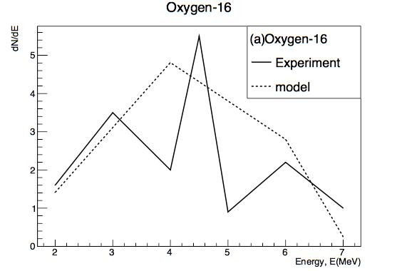
Oxygen-16
(A van der Schaaf et al,1983)
Figure 4.7(a) shows dN/dE versus Energy for Oxygen.

Slide 21
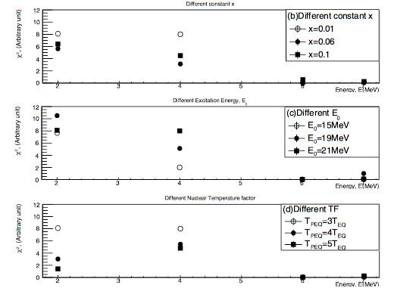
Figure 4.7(b) shows χ2 versus Energy for different constant x in Oxygen.
Figure 4.7(c) shows χ2 versus Energy for different excitation energy in Oxygen.
Figure 4.7(d) shows χ2 versus Energy for different nuclear temperature in Oxygen.

Slide 22
For Figure 4.7(a) the graph x-axis range is from 0 MeV to 7 MeV. At 2 MeV to 3 MeV the model and the experiment plotting have the same direction with difference value.
The optimize value for different constant x is 0.06 with = 8.91
Σχ²
The optimize value for different excitation energy is 15 MeV = 9.76
Σχ²
Σχ²
The optimize value for different nuclear temperature factor is 5 = 6.62

Slide 23
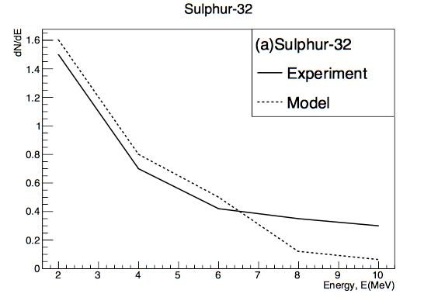
Sulphur-32
(Evseev et al,1972)
Figure 4.8(a) shows dN/dE versus Energy for Sulphur.

Slide 24
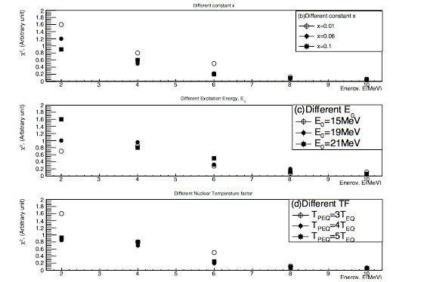
Figure 4.8(b) shows χ2 versus Energy for different constant x in Sulphur.
Figure 4.8(c) shows χ2 versus Energy for different excitation energy in Sulphur.
Figure 4.8(d) shows χ2 versus Energy for different nuclear temperature in Sulphur.

Slide 25
For Figure 4.8(a) the graph x-axis range is from 0 MeV to 10 MeV. At 2 MeV to 6 MeV the model and the experiment plotting have the same direction with difference value.
The optimize value for different constant x is 0.01 with = 0.38
Σχ²
The optimize value for different excitation energy is 21 MeV with = 0.38
Σχ²
The optimize value for different nuclear temperature factor is 3 with = 0.38
Σχ²

Slide 26
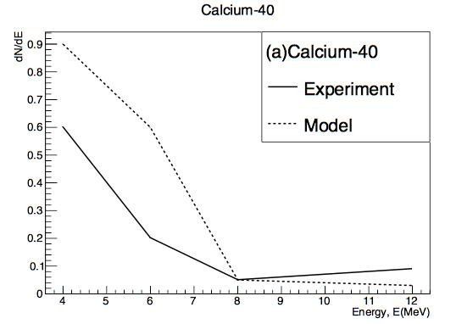
Calcium-40
(Evseev et al,1972)
Figure 4.9(a) shows dN/dE versus Energy for Calcium

Slide 27
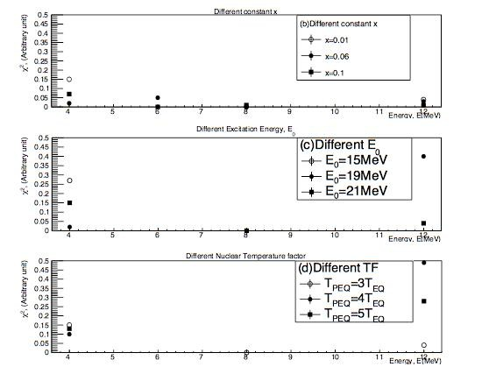
Figure 4.9(b) shows χ2 versus Energy for different constant x in Calcium.
Figure 4.9(c) shows χ2 versus Energy for different excitation energy in Calcium.
Figure 4.9(d) shows χ2 versus Energy for different nuclear temperature in Calcium.

Slide 28
For Figure 4.9(a) the graph x-axis range is from 0 MeV to 12 MeV. At 8 MeV the model and the experiment plotting have the same point.
The optimize value for different constant x is 0.01 with = 0.99
Σχ²
The optimize value for different excitation energy is 21 MeV with = 0.99
Σχ²
The optimize value for different nuclear temperature factor is 3 with = 0.99
Σχ²

Slide 29
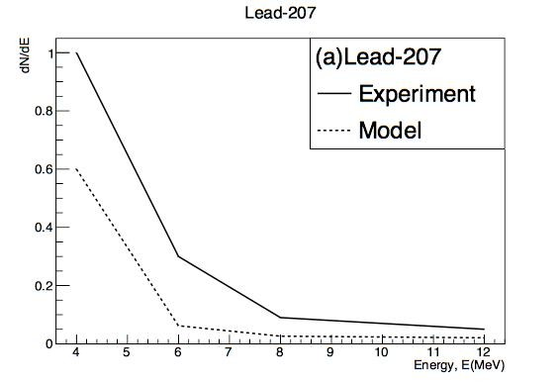
Lead-207
(Evseev et al,1972)
Figure 4.10(a) shows dN/dE versus Energy for Lead.

Slide 30
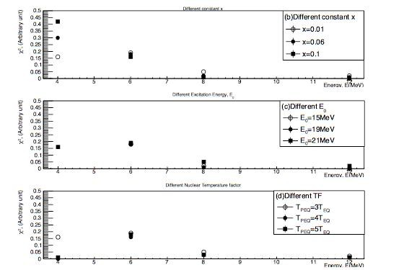
Figure 4.10(b) shows χ2 versus Energy for different constant x in Lead.
Figure 4.10(c) shows χ2 versus Energy for different excitation energy in Lead.
Figure 4.10(d) shows χ2 versus Energy for different nuclear temperature in Lead.

Slide 31
For Figure 4.10(a) the graph x-axis range is from 0 MeV to 12 MeV. From 4 MeV to 6 MeV and from 8 MeV to 12 the model and the experiment plotting have the same direction with difference value.
The optimize value for different constant x is 0.01 with = 0.49
Σχ²
The optimize value for different excitation energy is 21 MeV with = 0.42
Σχ²
The optimize value for different nuclear temperature factor is 4 with = 0.21
Σχ²

Slide 32
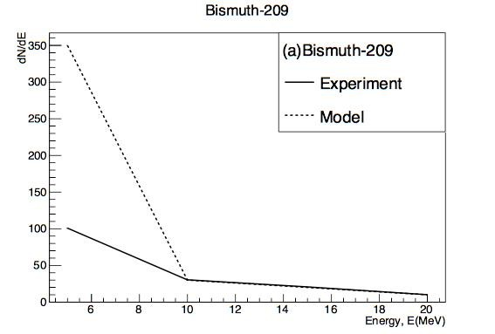
Bismuth-209
(Schröder,1974)
Figure 4.ll(a) shows dN/dE versus Energy for Bismuth

Slide 33
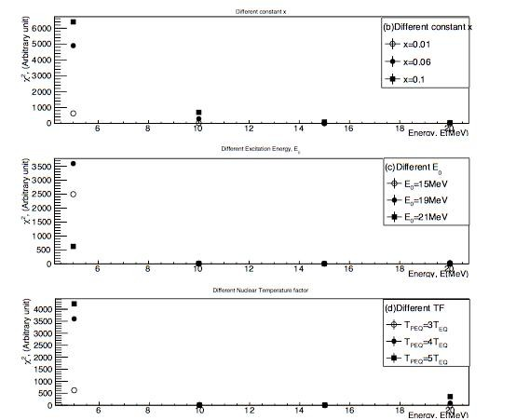
Figure 4.11(b) shows χ2 versus Energy for different constant x in Bismuth.
Figure 4.11(c) shows χ2 versus Energy for different excitation energy in Bismuth.
Figure 4.11(d) shows χ2 versus Energy for different nuclear temperature in Bismuth.

Slide 34
For Figure 4.11(a) the graph x-axis range is from 0 MeV to 20 MeV. At 10 MeV to 20 MeV the model and the experiment plotting have the same point.
Σχ²
The optimize value for different constant x is 0.01 with = 637.36
The optimize value for different excitation energy is 21 MeV with = 637.36
Σχ²
The optimize value for different nuclear temperature factor is 3 with = 637.36
Σχ²
For Bismuth the chi-square is very high compare to the other four element. This is because, for heavy nuclei K shell energy is higher. Therefore, for muon to release it needs higher energy as well.

Slide 35
x coefficient with 0.01 have the similar value compare to the experimental. This is only valid for a heavy nuclei. While for light nuclei x coefficient with 0.06 have the similar value compare to the experimental.
Excitation energy with 21 MeV have the similar value compare to the experimental. This is because most nuclei will excite at around 90 MeV to 100 MeV after muon capture on nuclei. The neutrino will carries most of the energy of the reaction. But the emission of the muon neutrino, it was expected that the excitation region is around 20 MeV to 30 MeV.
Nuclear temperature factor of 5 for light nuclei and factor of 3 for heavy nuclei have the similar value compare to the experimental. If the PEQ nuclear temperature is very large, thus the PEQ event will be very small. There are several parameters effecting the value of nuclear temperature.

Slide 36
Conclusion
1)This study shows that influence of pre-equilibrium neutron emission contribution after muon capture process is 0.06 for light nuclei and 0.01 for heavy nuclei.
2)The effect of nuclear excitation region on neutron emission is 21MeV for light and heavy nuclei.
3)The contribution of pre-equilibrium neutron on the nuclear temperature factor is 5 for light nuclei and 3 for heavy nuclei.
4)The best result for x constant, excitation energy and nuclear temperature factor are 0.06, 21MeV and 5 for light nuclei and 0.01, 21MeV and 3 for heavy nuclei based on the all plotting graph with 5 different element of ¹⁶O, ³²S, ⁴⁰Ca, ²⁰⁷Pb and ²⁰⁹Bi.

Slide 37
Further Outlook
In future, we can try to look on different element to create more useful information for experimental theory by using same parameter of x constant, excitation energy and nuclear temperature factor .

