Slide 1
Muon capture rates and their relation with the double beta decay
NURAINEE BINTI IBRAHIM
DR IZYAN HAZWANI BINTI HASHIM

Slide 2
ABSTRACT
Light nuclei
Nuclear shell model
Ordinary Muon capture
Medium nuclei
Quasiparticle random phase approximation
Heavy nuclei
Notes: Double beta decay matrix element

Slide 3
New probe of the double beta decay
Ordinary muon capture
1)To states of the intermediate nucleus of the double beta decay
2) To the relevant intermediate states

Slide 4
INTRODUCTION
The two neutrino and neutrinoless double beta decay via virtual transition through $1^{+}$ and other multipole states of the intermediate double –odd nucleus
$ββ$ decay?
weak interaction in nuclei
occurs when an unstable nucleus releases two beta particles in the singles process
could be either of +/- decay wherein two neutrons or protons decayed to form a stable nucleus with larger binding energy

Slide 5
(0$vββ)$
all the multipole state $J^{π}$ of the intermedius nucleus are active at transition
all the intermediate states are active
involve lepton number violation
This process violates the total lepton number and forbidden to Standard model
(2v$ββ$)
rare nuclear transition
the $1^{+}$ states are involved/active
contributions from the forbidden / fermi level are negligibly small

Slide 6
PROBLEM STATEMENT
A reliable theoretical description of these transition to test the calculated amplitudes against experimental data
Only the lowest virtual transition can be probed by the traditional electron capture $β^{−1}$ decay experiments
SUGGESTION METHOD
That calculated amplitudes for many virtual transitions can be use the ordinary muon capture

Slide 7
What is OMC process?
like an electron -capture process
occurs when a ${ μ}^{−}$stopped in matter where it undergoes several EM transitions leaving it on the K atomic orbit
that the mass of the captured $μ^{−}$is about 200 times the electron rest mass
Advantages
the ones which from double –even ${ 0}^{+}$ ground state and end on ${ J}^{π}$ states of the intermediate double-odd nucleus
In the case of the ${ β}^{−}β^{−}$ decays one probes the final leg of a double-beta transition and in the case of the double positron decays one probes the initial leg of the double-beta transition
able to probe intermediate states at high excitation energies because the large mass energy absorbed by the final nucleus in an OMC transition

Slide 8
Disadvantages
the muon recoil also activates the induced parts (weak magnetism)
the theoretical expression for the partial OMC rates such as capture rates to a particular final state is more complicated than the expressions for the virtual legs of the $ββ$decay
the OMC rates as such cannot be directly interpreted as amplitude of the virtual transitions in the $ββ$ decay

Slide 9
Calculations
pnQRPA
${ β}^{−}β^{−}$ decay
${ β}^{+}β^{+}$ decay
$${}_{}^{76}{Ge}$$
$${}_{}^{106}{Cd}$$

Slide 10
First case
Can test by the OMC on${}_{}^{ 76}{Se}$ the states of ${}_{}^{ 76}{As}$ (this is the final virtual leg in the $β^{−}β^{−}$ decay of ${}_{}^{ 76}{Ge}),$the most relevant of which are the $1^{+}$ states and the $2^{−}$ states( the ground states of ${}_{}^{ 76}{As}$ is a $2^{−}$ state).
Second case
Can test $1^{+}$ states on of ${}_{}^{ 106}{Ag }$the OMC on ${}_{}^{ 106}{Cd}$ (this is the initial virtual leg in the double- positron decay of of ${}_{}^{ 106}{Cd. }$

Slide 11
Muon capture in light nuclei

Slide 12
Expression for the half-life of the $2vββ$decay:
-where double Gamow –Teller matrix element
Scaled by the electron mass, bwtween the initial (0 g.s.) and final (0 g.s.) ground state
$Q_{ββ→}$ the 2v$ββQ$ value
$E_{n →}$energy of the nth intermediate state
$M_{i →}$mass energy of the initial nucleus
$M_{e →}$rest mass energy of the electron
$\sum_{i}{→}$ the running over all the neutrons (protons) of yhe dacaying nucleus

Slide 13
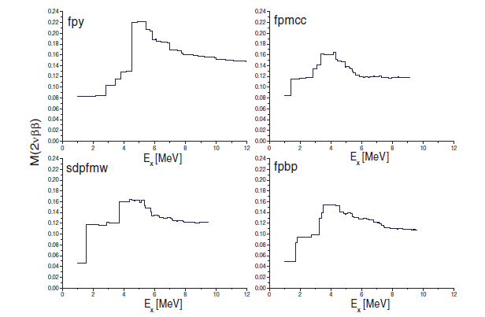
Q value has been specified for the final ground state ( for excited final states its value will has be different, naturally)
Figure 1: Two- neutrino double beta decay of ${}_{}^{48}{Ca}$ using different interactions in the pf shell

Slide 14
To study the predictive power of the shell model for the light nuclei in Fig 1 four different shell model calculation s concerning the 2v$ββ$ decay of ${}_{}^{46}{Ca}$ to ground state of ${}_{}^{46}{Ti}$

Slide 15
Muon capture in heavy nuclei

Slide 16
The structure of heavy nuclei was calculated by using the formalism of the pn-QRPA
It is well known that 2v$ββ$ decay rates depend on the strength, denoted usually by the parameter $g_{pp}$, of the proton-neutron particle-particle interaction in $1^{+}$channel
Fig 3 shows the partial capture rates in the reactions ${}_{}^{76}{Se}$($0_{}^{+})→{}_{}^{76}{As \left(1^{+}\right) }$as a function of $g_{pp}$

Slide 17
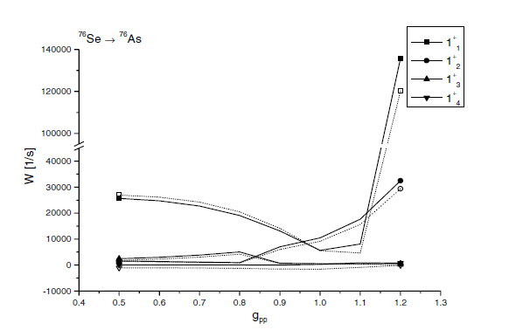
Figure 2: Partial capture rates on${}_{}^{76}{Se}$ as functions of parameter $g_{pp}$

Slide 18
CONCLUSION
1)Both the 2v$ββ$ decay amplitudes and the OMC observable (partial and total) depend on the strength($g_{pp}$) of the particle-particle part of the proton-neutron interaction
2)Good possibility to constrain the wave functions of the double beta intermediate nucleus

