Slide 1





MASTER OF PROFESSIONAL SCIENCE
New Semester
Student-Coordinator Meeting
SEMESTER 2, 2021/2022
19 MARCH 2022
10.00am – 11.30am
Notes:
Last engagement 15/10/2021

Slide 2

AGENDA
EXAM RESULTS
1
4
2
STUDENT FEEDBACK/CQI
3
3
NEW SEMESTER
STUDY PLAN
2
1
OTHERS
-Bengkel Pengukuhan Pengajian
-Common issues
-Academic regulations
4

Slide 3
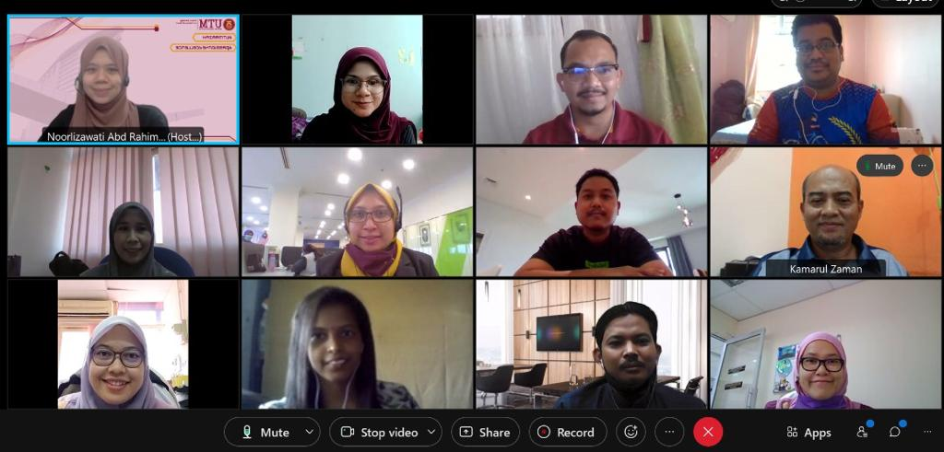
Kehadiran 15/10/22
(MOSTI/UTM-OR):
(MOSTI/UTM-CHEM):
TENGKU MOHD HAZIMI BIN TUAN HASSAN - PSN
KAMARUL ZAMAN BIN SHAFIE - LPTA
SITI FARHANA BAJUNID BINTI SHAKEEB ARSALAAN BAJUNID - ASM
NURHAYATI BINTI SULAIMAN – MDV
UWARANI – MOSTI / MASTIC
ABDUL JALIL BIN ABDUL RAHMAN - KIMIA (PNG)
NUWAIRA BINTI MUHAMADUN AMIN - KIMIA (PAHANG)
NUR LIYANA BINTI ZAINOL ABIDIN - KIMIA (PAHANG)
ABDUL HADI BIN ABD RAHIM – KIMIA (PNG)
SITI ZAIHASRA BINTI SA'AMIN – KIMIA (PAHANG)

Slide 4
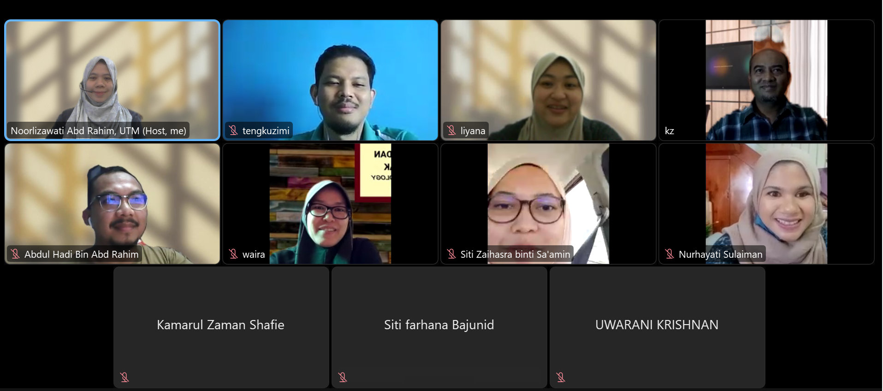
Attendance - 19/3/22
TENGKU MOHD HAZIMI BIN TUAN HASSAN - PSN
KAMARUL ZAMAN BIN SHAFIE - LPTA
SITI FARHANA BAJUNID BINTI SHAKEEB ARSALAAN BAJUNID - ASM
NURHAYATI BINTI SULAIMAN – MDV
UWARANI – MOSTI / MASTIC
ABDUL JALIL BIN ABDUL RAHMAN - KIMIA (PNG)
NUWAIRA BINTI MUHAMADUN AMIN - KIMIA (PAHANG)
NUR LIYANA BINTI ZAINOL ABIDIN - KIMIA (PAHANG)
ABDUL HADI BIN ABD RAHIM – KIMIA (PNG)
SITI ZAIHASRA BINTI SA'AMIN – KIMIA (PAHANG)

Slide 5

1.0 EXAMINATION RESULTS
(SEM 1, SESSION 2021/22)
Courses taken
(MOSTI/UTM-CHEM):
i. MRSQ1193 Advanced Materials Chemistry (Compulsory)
ii. MRSQ1213 Consumer Chemistry (Compulsory)
Ii. Pick 2 elective courses
(MOSTI/UTM-OR)
i. MRSQ1133 Operations Research for Professional (Compulsory)
ii. MRSQ1153 Decision Analysis for Professional (Compulsory)
iii. Pick 2 elective courses
GPA | No. of students
4.00 | 2 (Applied Chemistry), 3 (OR)
3.86-3.9 | 2
3.75-3.85 | 3
Total (Cohort 9) | 10
Notes:
4.00:
Abd Hadi
Nuwaira
Hayati
Hazimi
Uwarani

Slide 6
UTM Grading System
Marks | Grade | Point | Level Of Achievement
90 – 100 | A+ | 4.00 | Excellent Pass
80 – 89 | A | 4.00
75 – 79 | A- | 3.67
70 – 74 | B+ | 3.33 | Good Pass
65 – 69 | B | 3.00
60 – 64 | B- | 2.67 | Pass
55 – 59 | C+ | 2.33 | Fail
45 – 49 | C- | 1.67
40 – 44 | D+ | 1.33
35 – 39 | D | 1.00
30 – 34 | D- | 0.67
00 – 29 | E | 0.00
    (Source: Peraturan Akademik Pengajian Siswazah 2020 | Item 16; Page 43)

Slide 7
UTM Academic Standing
Academic Standing | Taught Course | Condition to proceed with the study | Award of the Degree
Good Pass (KB) | CGPA >= 3.00 Satisfactory (MM) | Qualified | Qualified
Conditional Pass (KS) | 2.67 <= CGPA > 3.00 Unsatisfactory (TM) | Qualified | Not qualified*
Fail (KG) | CGPA < 2.67 Fail (GG) | Terminated | Not qualified
    (Source: Peraturan Akademik Pengajian Siswazah 2020 | Item 17; Page 46)

Slide 8
Academic Standing
    Students in Research or Coursework and Research mode who are currently conducting research and obtaining a Term (KS) for two (2) consecutive terms will be terminated.
    Students in Coursework mode who are obtaining KS must attain a KB before the end of the maximum period of study in order to qualify for a degree.
    Students in Coursework mode are allowed to repeat courses that pass with B- grade to improve the grade with approval by faculty. Repeated courses must be registered with the Grade Repeat (UG) status. The best grades will be taken into consideration in the calculation of GPA and CGPA.
    (Source: Peraturan Akademik Pengajian Siswazah 2020 | Item 17; Page 47)

Slide 9


2.0 STUDENT FEEDBACK
Areas for improvement | Feedback | Suggestion for CQI
1. Course content | Overall, the content of the OR and Decision Analysis course were good. However, it is hoped that more examples of OR/DA calculations are given to students, as this is where students struggle the most. | OR: Create group discussions (during and after course)
2. Course delivery | -Online (preferred) - Request at least 1 F2F session before graduation -Difficult to access paid OR-related software (AN tABLE.. Treeplan) (Decision analysis- paid software) -calculation not shown on whiteboard/ slide limitation (OR+ Decision analysis) | OR: -Calculation is shown (digital whiteboard etc.) -OR software made accessible to students
This Photo by Unknown Author is licensed under CC BY-NC-ND
Notes:
4.00:
Abd Hadi
Nuwaira
Hayati
Hazimi
Uwarani

Slide 10
Areas for improvement | Feedback | Suggestion for CQI
3. Assessment | Student performance before final (PMA) are not informed Difficulty to find references on PMA topic for class presentation Preparation for final exam | Inform formative assessment (60%) marks before PMA submission Guidelines to find references (keyword, database) for PMA (OR, decision analysis,management courses-strategic mgmnt,) 1-day leave for exam preparation (Forensic courses)
2.0 STUDENT FEEDBACK
This Photo by Unknown Author is licensed under CC BY-NC-ND
Notes:
4.00:
Abd Hadi
Nuwaira
Hayati
Hazimi
Uwarani

Slide 11
2.0 STUDENT FEEDBACK
Areas for improvement | Feedback | Suggestion for CQI
4. Student service/support | Dr., I noticed that there are several systems such as MyUTM Portal, UTM - CAS - Central Authentication Service and UTM VPN (Virtual Private Network) .. sometimes confused which one to access | Faculty briefing on IT systems
5. Others | - | -
Notes:
4.00:
Abd Hadi
Nuwaira
Hayati
Hazimi
Uwarani

Slide 12
3.0 NEW SEMESTER STUDY PLAN
7 Core Courses
3 Elective
Courses
Master’s
Project
=
MPS
2 University
General
Courses
Management - 9 credits
+
+
+
Science - 12 credits
Management & Science
9 credits
10 credits
6 credits
Master of Professional Science
(46 credits)
PACKAGE 2 WEEKEND CLASSES
SEMESTER 1
SEMESTER 2
SEMESTER 3
SEMESTER 4
Core course 1
Core course 2
Elective 1
Elective 2
Core course 3
Core course 4
Elective 3
University Course-Research Methodology (Compulsory)
Core course 5
Core course 6
Master Project 1
University course-Elective
Core course 7
Master Project 2
Notes:
4.00:
Abd Hadi
Nuwaira
Hayati
Hazimi
Uwarani

Slide 13
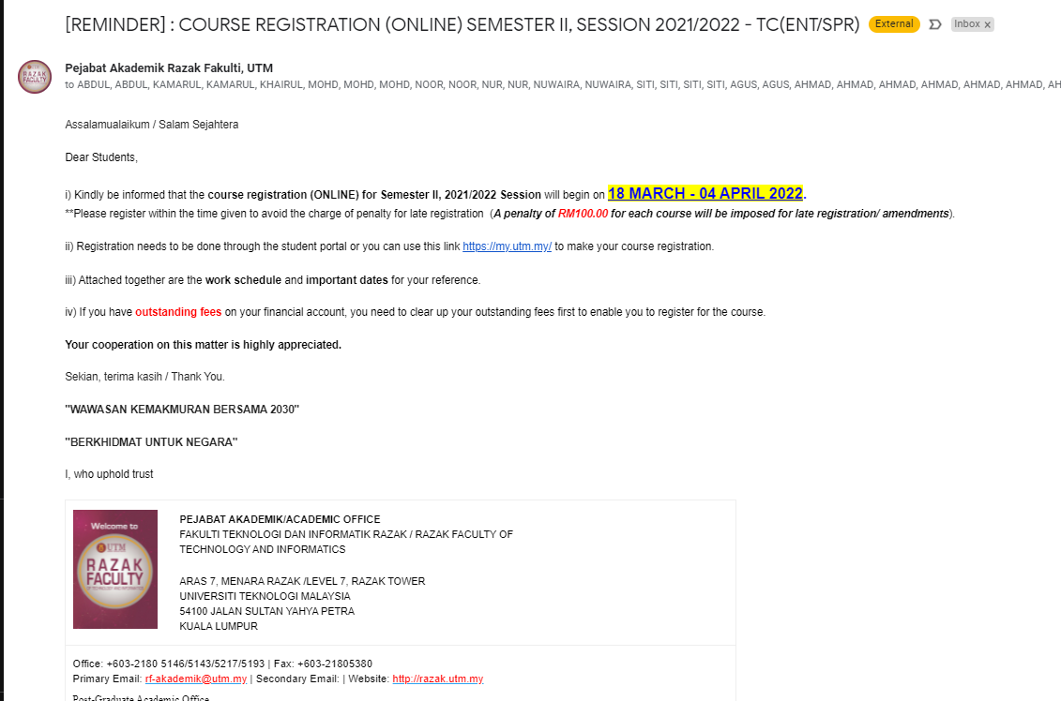

Slide 14
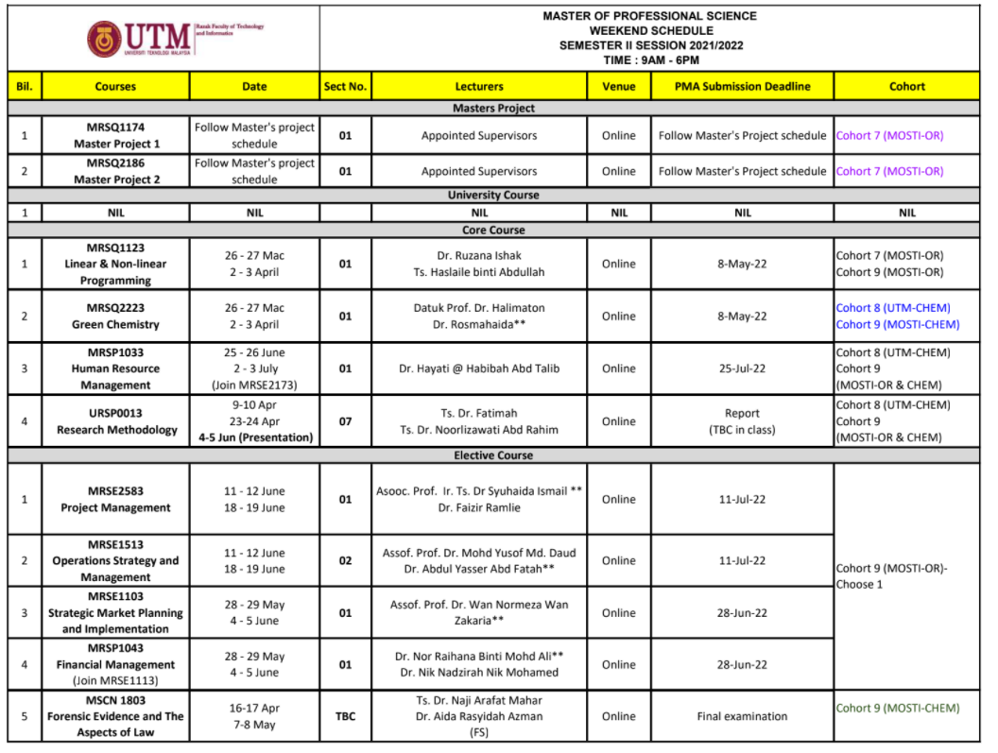
Please select and register 4 courses based on your cohort number:
Cohort 9 (MOSTI/UTM-CHEM):
i. MRSQ22233 Green Chemistry (Compulsory)
ii. MRSP1103 Human Resource Management (Compulsory)
iii. URSP 0013 Research Methodology (Compulsory)
iv. Pick 1 elective ( Forensic Evidence and The Aspects of Law)
Cohort 9 (MOSTI/UTM-OR)
i. MRSQ1123 Linear & Non-linear programming (Compulsory)
ii. MRSP1103 Human Resource Management (Compulsory)
iii. URSP 0013 Research Methodology (Compulsory)
iv. Pick 1 elective
Important information for course registration
Course code
Course name
Section number

Slide 15
Registration of Courses
A student must register his/her courses every semester within the specified dates determined by the University. Those who fail to register without acceptable reasons will be terminated.
Students who do not register for any courses must apply for the deferment of the study and the deferment is considered as a period of study (refer to Item 21: Deferment, Suspension and Termination).
Students in debt are not allowed to enrol in courses subject to the Student Financial Payment Regulations by the Office of the Bursary.
A late registration fee will be imposed upon registration of courses after the closing date of the course registration.
    (Source: Peraturan Akademik Pengajian Siswazah 2020 | Item 8; Page 27)

Slide 16
Registration of Course
  Repeat Course (UK) or (Ulang Kursus) is a REPEAT STATUS of the failed course.
  Redeem Grade (UG) is a repeated status of a course that has been graduated grade (B-) with the faculty's permission for the purpose of improving academic achievement.
  Students need to fill in the Course Registration Amendment Form (UTM.E/3-5) and get the signature from their supervisor/academic advisor before submitting the form.
    (Source: Peraturan Akademik Pengajian Siswazah 2020 | Item 8; Page 27)

Slide 17

Withdrawal (TD) of a Course
    A student may withdraw (TD) any course registered in the current semester within the prescribed duration subject to the minimum credits starting from week SIX (6th week) and no later on Friday of week NINE (9th week). After this date, any application of course withdrawal will not be entertained
    A student who withdraws (TD) all of the courses will be given a deferment of the study (TP).
    (Source: Peraturan Akademik Pengajian Siswazah 2020 | Item 8; Page 29)

Slide 18
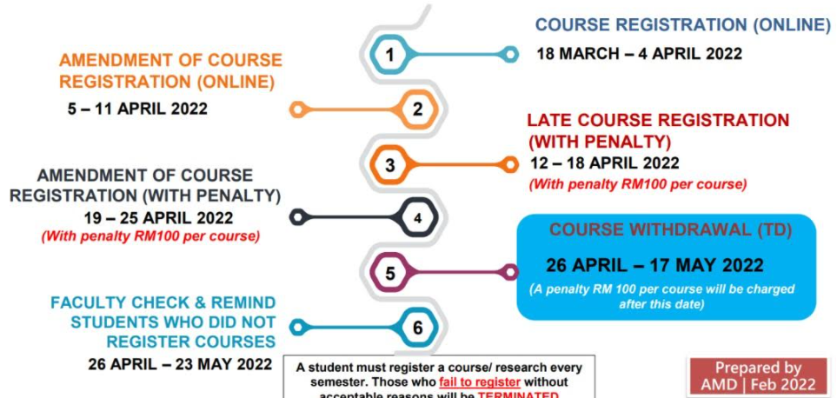
IMPORTANT DATES OF COURSE REGISTRATION

Slide 19
4.0 OTHERS
-Bengkel Pengukuhan Pengajian
-Common issues
-Academic regulations
Notes:
4.00:
Abd Hadi
Nuwaira
Hayati
Hazimi
Uwarani

Slide 20
BENGKEL PENGUKUHAN PENGAJIAN
Cadangan Perancangan drpd pelajar:
Kemudahan Cuti Hadir Kursus (cuti tanpa rekod)
30 hari setahun
Dlm tempoh Mac – Julai 2022
2 bengkel/semester cuti utk exam lain , cuti bengkel lain
3 pelajar KIMIA Pahang (2 slot PG + PNG)
Bagi kursus kritikal
(RM, LNL/Forensic)

Slide 21
COMMON ISSUES
1. Register Wrong Course Code/Section?
2. Outstation/Overseas Assignment by Employer
3. Barred from course registration (every semester)
  Sponsored
  Self-financed
  Debts
4. Deferment of study (see notes in next pg)

Slide 22
Deferment
A student may apply for deferment of study due to these reasons (the deferment will not be taken into account in the duration of study):
  health reasons by submitting a medical report certified by a Medical Officer recognised by the University.
  due to reasons of interest to the University or the Nation.
A student may apply for deferment of study due to reasons other than those stated above and the deferment will be taken into account in the duration of study.
Deferment of more than two (2) consecutive semesters is not allowed. A student who fails to register after deferment of two (2) consecutive semesters may be terminated.
    (Source: Peraturan Akademik Pengajian Siswazah 2020 | Item 21; Page 52)

Slide 23

COMMON ISSUES (contd.)
5. Failed courses
Cannot Attend Class (80%)
Assessment:
  Formative: 60% of the total marks
  (in the classroom: Tests, project, presentation case study, class activities)
  Summative: 40% of the total marks
  (Post Module Assessment (PMA) / Final examination)
Late/No submission of PMA (keep in touch with lecturer)

Slide 24
COMMON ISSUES
8. Attendance
Must be at least 80%

Slide 25


POSTGRADUATE
ACADEMIC RULES
AND REGULATIONS
Download from SPS Website :
https://sps.utm.my/policy-guidelines-v2/

Slide 26
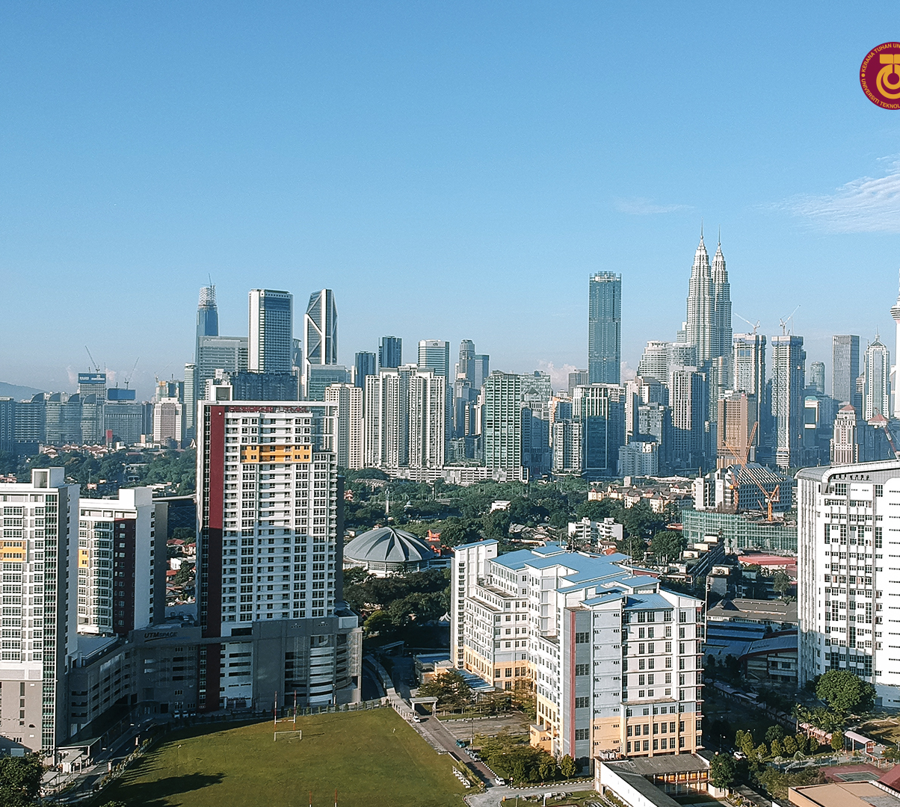

ALL THE BEST
&
ENJOY YOUR NEW SEMESTER!
THANK YOU
~Dr. Liza
In the Name of God for Mankind
www.utm.my

