Slide 1
Creating Online Alternative Assessment
ADIBAH BINTI ABDUL LATIF

Slide 2
LEARNING OUTCOMES
At the end of the course, participants will be able to
1- Differentiate between online alternative and traditional assessment
2- Select an online alternative assessment method suitable for one of your CLOs.
3- Create an online alternative assessment that suitable for summative assessment

Slide 3
“Assessment is at the heart of student experience”
Brown and Knight (1994)
“If you want to change student learning then change the method of assessment”
Brown, Bull & Pendlebury (1997)

Slide 4
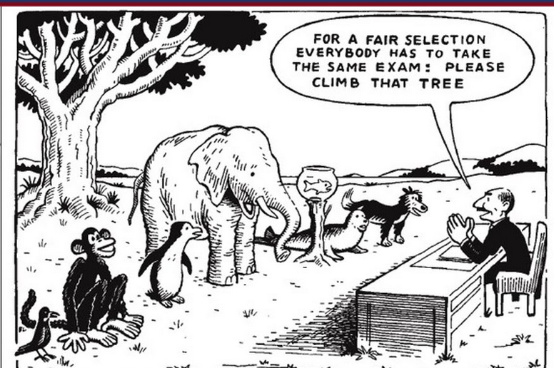

Slide 5
ASSESSMENT
FORMATIVE
SUMMATIVE
Continuously
At the end of lesson
TRADITIONAL
ALTERNATIVE
Synchronous
OFFLINE
ONLINE
Asynchronous

Slide 6
ASSESSMENT
ALTERNATIVE
CONVENTIONAL
PERFORMANCE BASED
AUTHENTIC

Slide 7
ASSESSMENT

Slide 8
ALTERNATIVE ASSESSMENT
Beyond the traditional psychometrically driven testing. Design to assess learning tasks that stimulate critical thinking skills and require students to produce or demonstrate knowledge rather simply recall information provided to them by others

Slide 9
Alternative assessments are used to determine what students can and cannot do, in contrast to what they know or do not know

Slide 10
WHEN TO USE??
Substitute Pencil and Paper test
Measuring higher level skills or other skills that cannot be measured by pencil and paper
E.g (acting skills, balancing, counting, drawing, experimenting, interviewing, musical skills, physical education skills, speaking skills, writing skills)

Slide 11
TYPES OF ALTERNATIVE ASSESSMENT (Ooshterof,2001)
Process ‘vs’ product
Simulated ‘vs’ Real Setting
Natural ‘vs’ structured setting

Slide 12
Assessment ‘vs’ Evaluation
Dimension of Difference | Assessment | Evaluation
Timing | Formative | Summative
Focus of Measurement | Process-Oriented | Product-Oriented
Relationship Between Administrator and Recipient | Reflective | Prescriptive
Findings, Uses Thereof | Diagnostic | Judgmental
Ongoing Modifiability of Criteria, Measures Thereof | Flexible | Fixed
Standards of Measurement | Absolute | Comparative
Relation Between Objects of A/E | Coöperative | Competitive
various sources, but especially Dan Apple 1998)

Slide 13
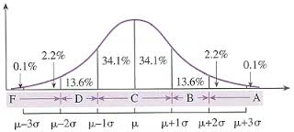
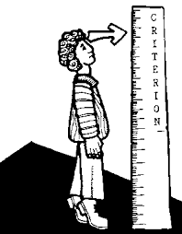
Norm Referenced?
Criterion Referenced?

Slide 14
Characteristics of Alternative Assessment
HUMAN JUDGMENT IN SCORING
REAL WORLD APPLICATIONS
MEANINGFUL INSTRUCTIONAL TASK
HIGHER LEVEL OF THINKING
STUDENTS PERFORMANCE
Notes:
© Copyright PresentationGO.com – The free PowerPoint template library

Slide 15
ALTERNATIVE ASSESSMENT LADDER

Slide 16
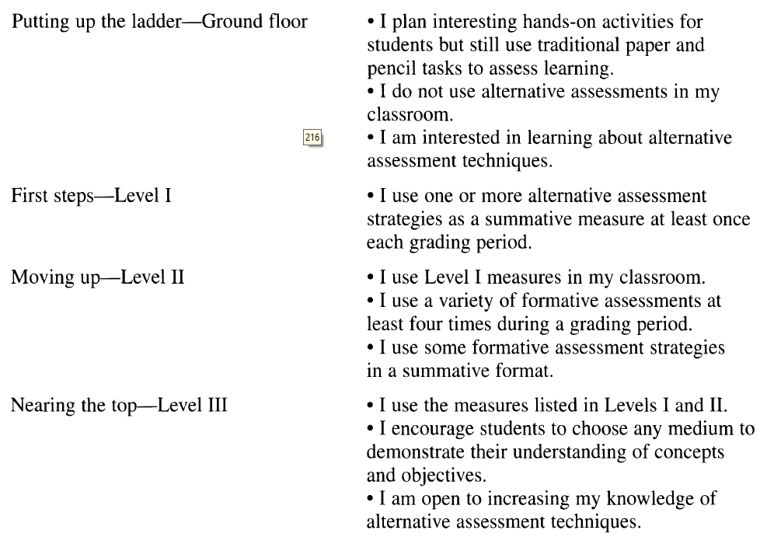
The Ladder of Alternative Assessment

Slide 17
KAHOOT!!
1- Differentiate between online alternative and traditional assessment

Slide 18
MENTI METER!!
Write one word that represents an alternative assessment

Slide 19
Examples of alternative assessment
Research Project
Debate
Writing Speech / summary
Industrial Training
Portfolio
Article Review
Writing Journal / proposal
Case Study
Reflection
presentation
Service Learning
Service learning

Slide 20
Example of online Alternative Assessment (Mind Map)

Slide 21
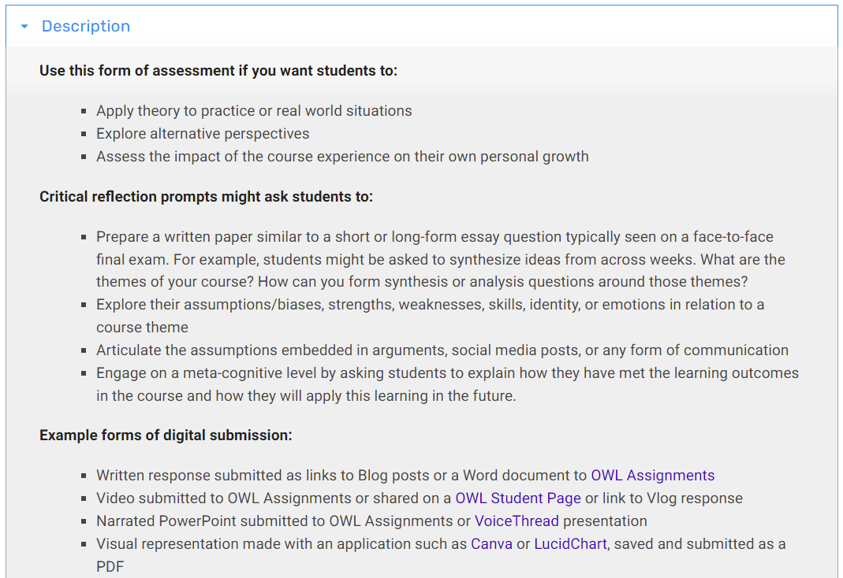
Example of online Alternative Assessment (Critical Reflection)

Slide 22
Example of online Alternative Assessment (Discussion Boards)

Slide 23
Example of online Alternative Assessment (Discussion Boards)

Slide 24
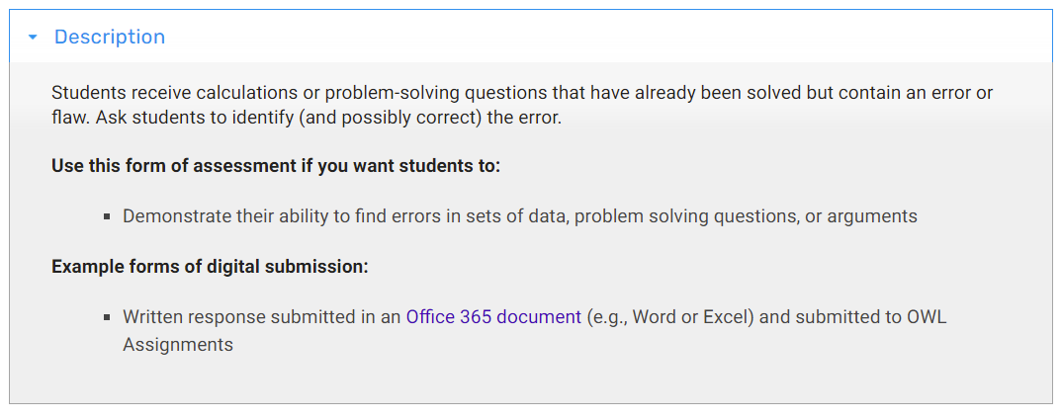
Example of online Alternative Assessment (Find the Error)

Slide 25
Example of online Alternative Assessment (PBL)

Slide 26
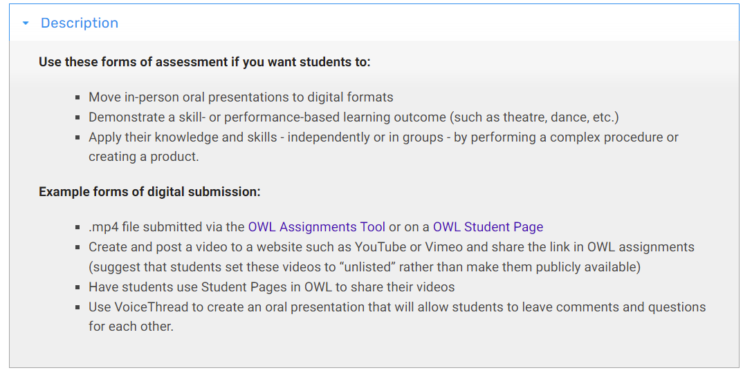
Example of online Alternative Assessment (PBL)

Slide 27
PRESENTATION
2- Select an online alternative assessment method that is suitable for one of your CLO.
CLO | Online Assessment Methods | Description | Online Assessment Platform | Online Assessment Tools

Slide 28
PRESENTATION
2- Select an online alternative assessment method that is suitable for one of your CLO.
CLO | Online Assessment Methods | Description | Online Assessment Platform | Online Assessment Tools
Students should be able to conduct virtual FGD to construct the themes (PLO5) | Virtual Focus Group Discussion | Students will moderate the FGD among 3 experts | Webex/ Zoom/ Google Meet | Rubric for Communication

Slide 29
CYCLE OF FORMATIVE ALTERNATIVE ASSESSMENT

Slide 30
CYCLE OF ALTERNATIVE ASSESSMENT
1.IDENTIFY OUTCOMES
Measure the behavior expected from the outcomes
Can be in cognitive, affective and psychomotor
Based on the philosophy of outcome based education and constructive alignment

Slide 31
Bloom’s Taxonomy
Create
Evaluate
Analyze
Synthesize the knowledge
Give judgment and think about the impact
Compare and contrast the information
Apply
Understand
Remember
Use the knowledge to another setting/ situation
explain with your own word
Recall only

Slide 32
Key Point for Simpson Taxonomy
Origination
Create new skills/ performance
Adaptation
Modify skills to adapt with problem
Complex Overt Response
Skilful
Mechanism
Perform without guidance
Guided Response
Perform with guidance
Set
Readiness (physical, mental & emotional)
Perception
Observe how to perform

Slide 33
Krathwol’s taxonomy
5
Characterizing
Consistent and predictable behavior
4
Organizing
Comparing the new and
existing value
3
Valuing
Attach the values
2
Responding
Active participation
1
Receiving
Student willingness

Slide 35
CYCLE OF ALTERNATIVE ASSESSMENT
1.IDENTIFY OUTCOMES
Students should be able to apply and conduct in a group, the research using a valid instrument
Students should be able to analyze the information ethically, respect group members and able to take actions that involve others through e-service-learning activities

Slide 36
CYCLE OF ALTERNATIVE ASSESSMENT
2. Choose an alternative assessment
Choose the assessment that can measure the behavior
Relate with the learning activities that can use the alternative assessment
Constructive learning outcomes – alternative assessment –transformative learning

Slide 37
CYCLE OF ALTERNATIVE ASSESSMENT
Learning Outcomes | Alternative Assessment Strategies | Transformative Learning activities
Students should be able to apply and conduct in a group, the research using a valid instrument | Research proposal, review of literature, interview script, | Mini scale research, Case study, interview, group discussion
Students should be able to analyze the information ethically, respect group members and able to take actions that involve others through e-service-learning activities | Portfolio. Observation, peer assessment | e-Service Learning, information searching, presentation,

Slide 38
CYCLE OF ALTERNATIVE ASSESSMENT
3. Choose assessment tool and online tool
Assessment tool/s that measure the assessment strategies
No one tools that can measure everything
Adapt / Adopt or self develop
Meta content analysis / rubistar
Choose online platform that can capture an evidence

Slide 39
Online Learning Guidelines duringCOVID-19 Pandemic
pg . 12
Assessment Method | Formative (F)/Summative (S) | Traditional (T)/ Alternative (A) | Peer Assessment | Instructor- Student Assessment | Self Assessment | Instructor Assessment
Performance Assessment | F or S | A | Yes | Yes | Yes | Yes
E-portfolio | F or S | A | Yes | Yes | Yes | Yes
Final Exam | S | T | - | - | - | Yes
Reflection Journal and Paper | F or S | A | - | Yes | Yes | Yes
Research Projects and Reports | F or S | A | - | - | - | Yes
Case Study Analysis and Report | F or S | A | Yes | Yes | Yes | Yes
Discussion | F | A | Yes | Yes | Yes | Yes
Example of online assessment method

Slide 40
Online Learning Guidelines duringCOVID-19 Pandemic
pg . 12
Summative Assessment Method | Synchronous (S)/ Asynchronous (A) | Traditional (T)/ Alternative (A) | Online Tools
Final Exam | S | T | UTM E-learning
Simulation/Demonstration | S or A | A | Recorded video, BigBlueButton, ZOOM, Webex, Google Meet, LifeSize/Whatsapp
Portfolio | A | A | UTM E-portfolio, Wordpress, Blogger, EduBlog
Task based project | A | A | UTM e-Learning Assignment, NearPod, EdPuzzle, Flipgrid, Padlet or Trello
Take home test | A | T / A
Case Study | S or A | A
Presentation | S or A | A | Recorded video, BigBlueButton, ZOOM, Webex, Google Meet, LifeSize/WhatsApp
Example of online summative assessment method

Slide 41
EXAMPLE
Learning Outcomes | Alternative Assessment Methods | Assessment tools | Transformative Learning activities | Online Platform
Students should be able to apply and conduct in a group, the research using a valid instrument | Research proposal, review of literature, interview script, | Rubric, answer scheme, checklist, | Mini scale research, Case study, interview, group discussion | UTM E-learning Moodle Assignment NearPod EdPuzzle, Padlet Trello
Students should be able to analyze the information ethically, respect group members and able to take actions that involve others through e service-learning activities | Portfolio. Observation, peer assessment | Rubric, anecdotal notes, rating scale. | Service Learning, information searching, presentation, | E-portfolio, Moodle Blog Entries, Wordpress, Blogger EduBlog

Slide 42
What lecturers should do?
Plan the Lesson
Time | Activities | Online Tools | Assessment Tools
Week 1 | Briefing and distribute course information, forming group | UTM E-learning BBB/ Webex / Zoom/Whatsapp | -
Week 2 to Week 5 | Online Class Online formative Assessment (Reflection) Online task progress report (Draft 1) | UTM E-learning/Whatsapp BBB/ Webex / Zoom Kahoot/ Padlet | Rubric for reflection Rubric for project report
Week 6 to week 9 | Online Class Online formative Assessment (online presentation) Online task progress report (Draft 2) | UTM E-learning/Whatsapp BBB/ Webex / Zoom Kahoot/ Padlet | Rubric for online presentation Rubric for project report
Week 10 to Week 13 | Project implementation (can be formative or summative) Online task progress report (Draft 3) | Online platform chosen by students Upload the evidence (video screen cast) | Rubric for e-service learning project
Week 14 –Week 15 | Assignment Submission (can be formative or summative) Online Presentation (Summative Assessment | UTM E-learning BBB/ Webex / Zoom/Whatsapp | Rubric for online presentation Rubric for project report

Slide 43
CYCLE OF ALTERNATIVE ASSESSMENT
4. Monitor students progress
Advisable to do more than three times (for formative)
Assessment for learning (formative)
Scaffold the summative assessment
As an evidence
Write the name, date and some narrative notes

Slide 44
EXAMPLE

Slide 45
EXAMPLE

Slide 46
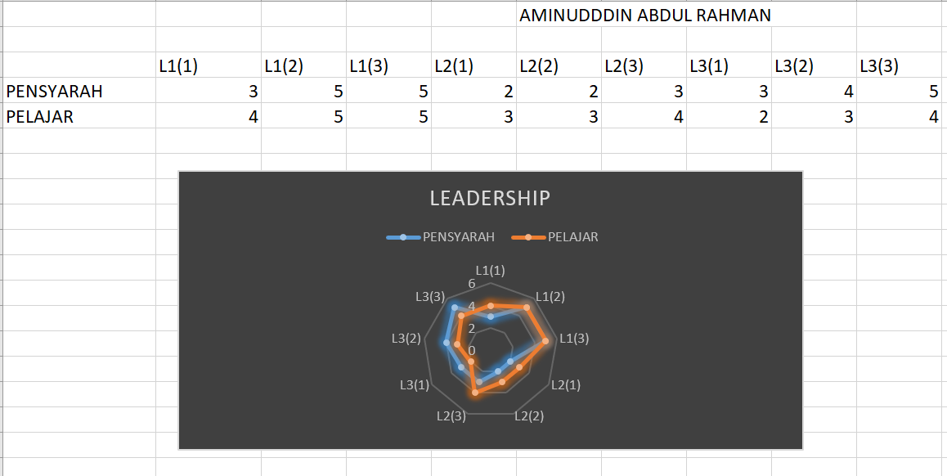
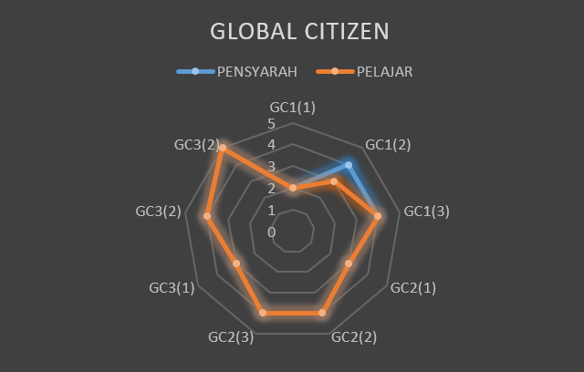
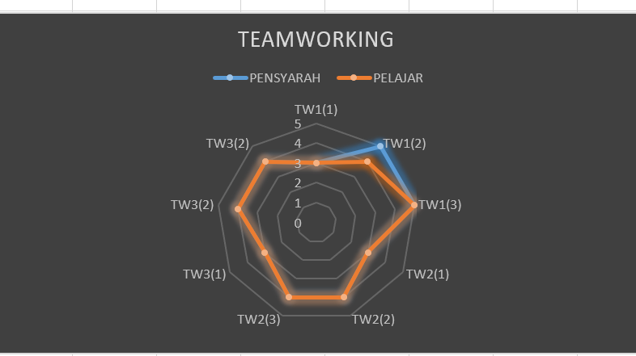
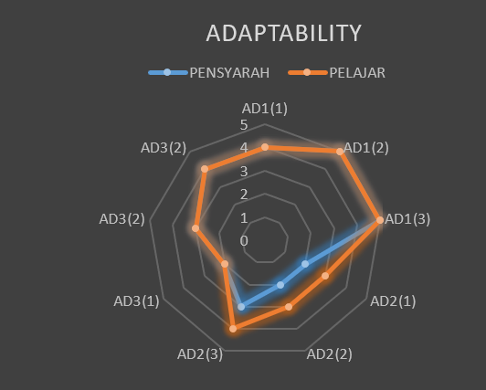

Slide 47
GUIDELINES
Make sure the alternative assessment can measure the course learning outcomes and program learning outcomes
The task must be performance based and involve high order thinking skills
Choose the online platform that user friendly, easy to access and can capture evidence
Choose the online assessment tools that has validity, reliability and fairness
Share the rubric with the students
Do monitoring more than one time for Formative assessment
Do analysis and CQI

Slide 48
CRITERIA OF ASSESSMENT TASK
Measuring high order thinking skills in cognitive level (Applying), at least Mechanisms skills in psychomotor and Valuing level in affective
Measuring more than declarative knowledge (functional/ procedural knowledge). So its measuring more on applied proficiency more than it measures knowledge
Need evidence and support resources / materials in performing task (not only can answer using logic).
Human judgment in marking (subject matter expert)
Can prove the process of doing (E.g. : Reflection)

Slide 49
EXAMPLE 1 (SUMMATIVE ASSESSMENT)
TRADITIONAL HOTS | ALTERNATIVE ASSESSMENT
1. Create one conceptual framework from the given articles and justify either the variables are appropriate to be the independent variables, dependent variables and mediator / moderator variables (15 marks) | 1. You want to investigate the preference of UTM lecturers’ working from home. Do a meta-analysis to find the valid conceptual definition, construct formation and operational definition in measuring the preference. Choose one appropriate motivation theory by comparing with other two theories from different scholars. Finally using your own reflection, value how important the process of systematic literature review in producing valid research findings. Please upload the materials as an evidence (30 marks)

Slide 50
PADLET!
3- Create an online alternative assessment question that is suitable for summative assessment.
https://padlet.com/p_adibah/1ml25n8cbuq1

Slide 51
(SUMMATIVE ASSESSMENT)
TRADITIONAL HOTS | ALTERNATIVE ASSESSMENT
1. | 1.

Slide 52
“Students can escape bad teaching but they cannot escape bad assessment.” (Boud,1995)
Thus, use the valid alternative assessment to design the transformative teaching and achieve the constructive outcomes

