Slide 1
Do’s and Don’t in Writing a Research Proposal
FRGS

Slide 2
Deputy Director (Strategic & Research University) RMC, UTM
Shukor Abd Razak
BSc. Computer Science, UTM
PhD Network Security, University of Plymouth, UK
shukorar@utm.my

Slide 3
The Approach
Focus and address each section of the proposal
Strictly follow the guidelines – the most recent
Look at the examples of past successful and rejected comments

Slide 4
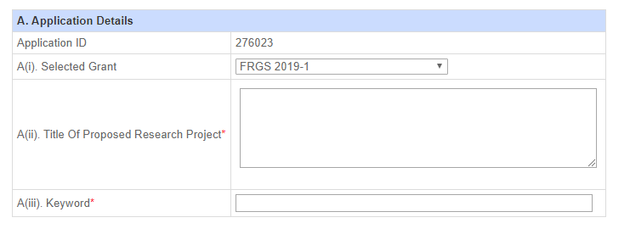
Title and Keywords

Slide 5
Title and Keywords
Title must be fundamental
Complete elements
New idea/algorithm/mechanism
Based on what technique/principal/theory
Purpose
Avoid keywords that show the work is not fundamental
Development of a system
Integration
Exploration through experiments in different domains

Slide 6
Rejected Applications – Examples of Panel Comments
Project title does not reflect fundamental research to improve government policy etc.
No new theories can be recognized from the title.
The research proposal does not reveal the fundamental research aspect.
Title: Looks like applied research.
Title: Penyelidikan ini tidak termasuk dalam agenda NRP negara dan tidak bersifat fundamental
Not novel in which the proposed approach is try to investigate the impact of 3 imputation methods, in which these are standard methods. The hybrid between PCA and K-means for clustering is also not a new and interesting approach

Slide 7
Another example
A Study on Correlation of Two Modes Backscatterred Waves and Bone Porosity Based on Pulse Echo Ultrasound
Comments: The title is very simplistic and reflects nothing of the work being proposed. It is unclear of the purpose or the fundamental issues/novelty of the study.

Slide 8
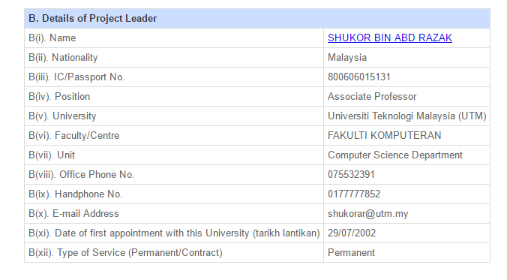
Principal Investigator

Slide 9
Principal Investigator
Please follow guidelines
Who can lead who can be the members
PI research area must match proposal research domain
PI eligibility to supervise Master or PhD students
PI contract with institution

Slide 10
Examples
Project leader is Iranian and contract will be finished by 2019. Most probably there will be no enough time for the applicant to deliver the project on-time. Also time constraints for the applicant to produce expected outcome of the research, PhD student less than 2 years as mentioned in the proposal.
The leader has MSc degree and no successful research project been done previously. How can the leader without PhD degree supervise PhD student.
While the project appears worthy, the performance of the PI in the last 2 years remains questionable as despite leading several grants, there has been no publication.
Track Record and Composition of Team: No indication of completed project.

Slide 11
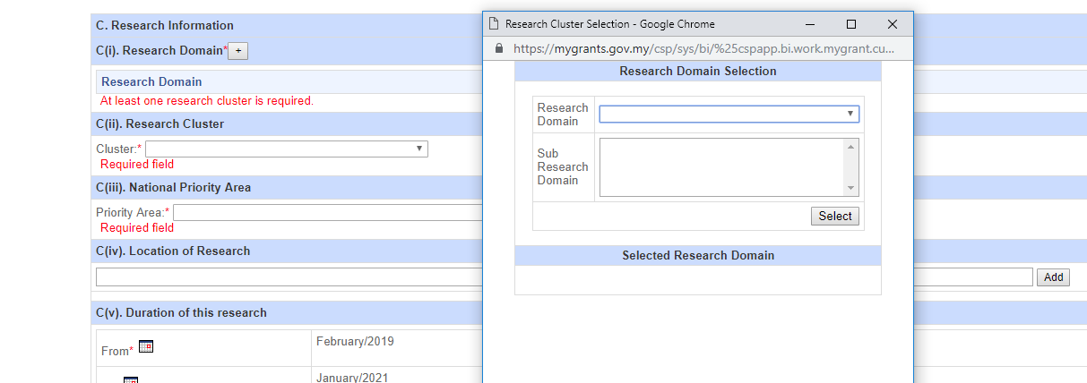
Research Domain

Slide 12
Research Domain
Wrong domain – most probably will be rejected
Must reflect PI main research domain/sub domain
Must reflect title of the research proposal

Slide 13
Research Cluster and Priority Area

Slide 14
Research Cluster and Priority Area
Need to be carefully chosen
Must reaffirm in the executive summary and project background
Good if also relevant to the university agenda or CoE or RG

Slide 15
Examples
Expected Result: No development of new knowledge. Need to relate research to National Priority Areas.
Executive Summary: Only global concerns are raised. The current status in Malaysia is what needs to be highlighted in problem statement

Slide 16
Duration of Research

Slide 17
Duration of Research
Always confirm your contract with the university
Related to human capital – Master or PhD
Must according to guidelines
Realistic to the problems and objectives of the research
If the project can be completed in 2 years do not extend it to 3 years

Slide 18
Location of Research

Slide 19
Location of Research
Depends on methodology and case study
If multi location must mention here
This also justify budget for travelling
Make sure the research is conducted within Malaysia
Must synchronize with research activities

Slide 20
Co-Researchers

Slide 21
Co-Researchers
At least 1 from same institution
Good combination of Prof/ Assoc. Prof/ SL/ L
Better if cross institution but not necessary
Must justify the role of co-researchers in methodology
Involve co-researchers relevant to the research cluster/agency
e.g. research related to cardiovascular – member from IJN
6. Any industry partners – to show the project has the potential to be commercialized
7. If possible to include: Academician, Industry, Community and Government Agency

Slide 22
Examples
Project Member: Does not contain well balanced team.
All Professor
No members from domain experts
Output: provision of guidelines and intervention will require health/medical experts' direct input; these experts ought to be part of research team so that there is a clear understanding of the existing problems right from the start
There is no health expert in this team
Track Record and Composition of Team: This team is not well balanced. No health or medical experts who should be the core members

Slide 23
Past and Current Research Grants

Slide 24
Past and Current Research Grants
Any ongoing FRGS?
Complete PR and ER in Mygrants?
To show the strength of PI based on completed or ongoing other research grants
Must update researcher profile in Mygrants – evaluators will not look at your homepage or anywhere else

Slide 25
Publications

Slide 26
Publications
One of FRGS output is publication
Good track record of PI publication is a bonus especially in
high impact and indexed journals
- must be updated and verified by RMC
- publications relevant to the field – better
- any other forms of publications i.e. non-indexed, reports, monograph, etc.
- also matters to show that the PI is able to produce scientific publications

Slide 27
Executive Summary

Slide 28
Executive Summary
Please look at what is required in the exec. summary
The problem statement
Objectives
Research methodology
Expected output/outcomes/implication
Significance of output from the research project

Slide 29
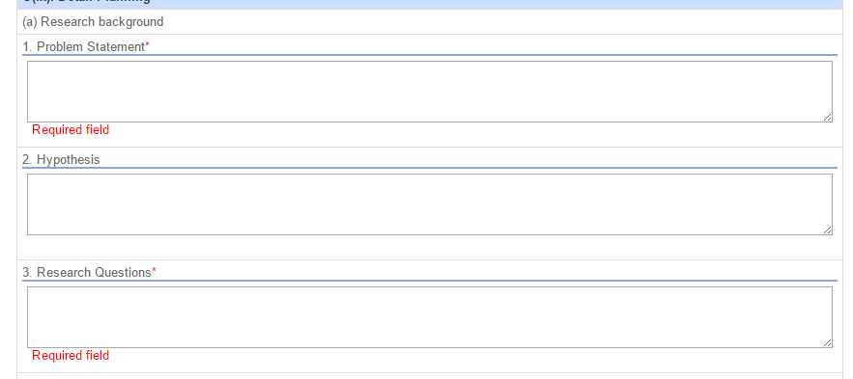
Research Background

Slide 30
Research Background
Must match and extend exec. summary
Problem statement must be clear – what is lacking in existing works that requires this research to be conducted
Emphasize on how the project relates to cluster and National Priority Area

Slide 31
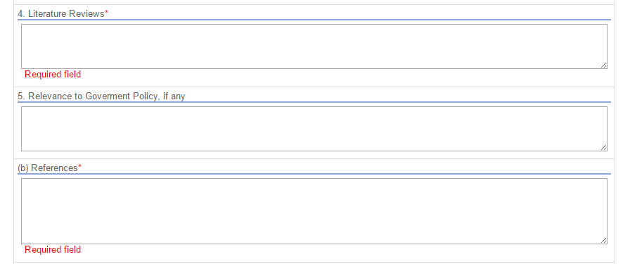
Literature Review and References

Slide 32
Literature Review and References
It is important to show that PI has done a thorough review of existing work
Cite as many as possible relevant references
It is important to show that the literature review is recent – based on numbers of recent references

Slide 33
Objectives and Methodology

Slide 34
Objectives and Methodology
Objectives
Measurable
Not too many and not too few
Avoid literature review to study research gap as objectives – prior work must be done
Methodology
Methodology for each objective
Show scientific approach not just general approach
Explicitly mention data involve, duration, steps, technique will be used
Show how each phase is related to each other – no disjoint

Slide 35
Examples
The methodology is not given in the executive summary.
Suppose not to have a reference in the executive summary
Old references to support the problem statement.
The methodology consists of 6 phases. The applicant states steps 15 and 16 in one of the phases in which there are not available.
The phase that involve in the development of proposed approach i.e., the hybrid between PCA and k-means is not presented
Problem statement too general and not specific to the research field.
Many of the citations and references are more than 5 years old (close to 50%).
Methodology - not clear. How will these 12 parents from each setting be selected? Will they be representative of the population?

Slide 36
Flow Chart, Activities and Milestones

Slide 37
Flow Chart, Activities and Milestones
Flow chart attached as appendix
Make sure it is not corrupted and can be opened – pdf
Make sure it is addressing all the research methodology and activities
Do not upload a generic flow chart. Must specific to the project
Activities
Better to highlight which team members responsible for each activity
Make sense – literature review 6 months?
What, Who, When, How, Why (to correspond to which methodology/objective)

Slide 38
Flow Chart, Activities and Milestones
Milestones
Proper wording – “Completion of …
Realistic – not too many and not too few
Preferably every 6 months

Slide 39
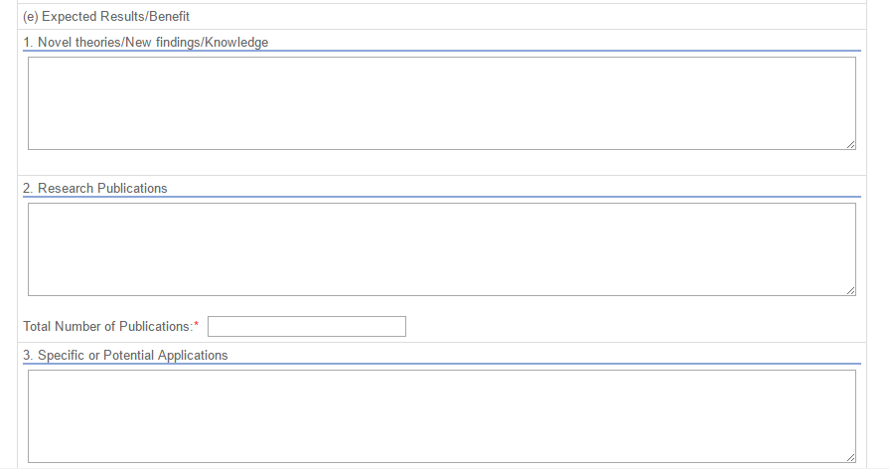
Expected Results and Outcomes

Slide 40
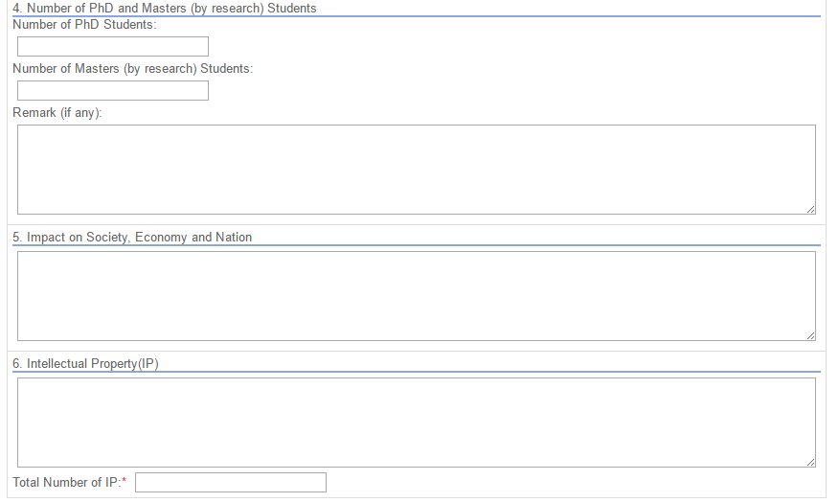
Expected Results and Outcomes

Slide 41
Expected Results and Outcomes
Most important outcomes
New Idea/Mechanism/Theory/Findings
Publications – 2 indexed journals – better if already identify names of the journals
Human Capital/Talents – see guidelines depends on project duration
Potential Applications – 2 to 3 potential applications
Impact on society
Emphasize on NPA
Increase in ….
Decrease in ….
List the society who will benefit from the research
IP – Copyright is the simplest one

Slide 42
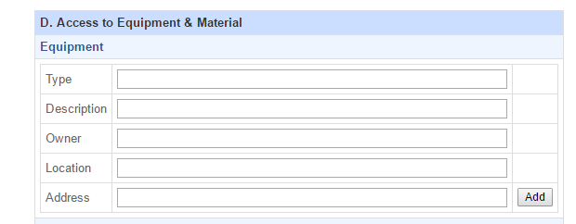
Access to Equipment

Slide 43
Access to Equipment
FRGS allocation is limited thus show how other resources contribute to the project
Existing PC, Printer, Server, etc.
Not just own institution, perhaps collaborators e.g. industry partners, members institution, etc.
This shows the strength of the PI as well as the collaboration between members

Slide 44
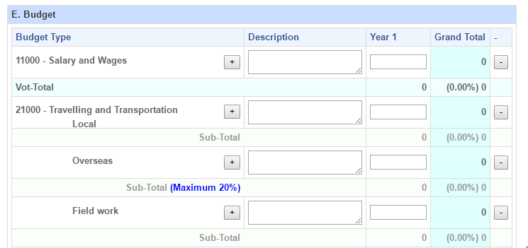
Budget

Slide 45
Budget
Be realistic – not too costly
Should we create a budget to match the maximum quantum?
- Not advisable unless justified
Avoid purchase of equipment that expected to be made available by the institution e.g. PC
Avoid purchase of personal mobile devices

Slide 46
Budget
Pay attention to travelling expenses – overseas conference is OK but not recommended to put high cost. - Local conference but International level is recommended.
Professional service – Do not pay for the service that is expected to be delivered by the PI
Try to avoid paid journals – but proof reading is OK

Slide 47
Budget
8. Allowance for GRA
Make sure the rate follows guidelines
Must match the promised human capital output – do not contradict e.g. output is masters student but appointed GRA is PhD
Specify in the description the duration and number of GRA expected to be appointed

Slide 48
Budget
9. Purchase of equipment needs strong justification and always mention how the equipment is specific to the project
- If need to purchase a high end PC for computational purposes justify how the equipment is special and not available in institution
- If available in institution justify why the project needs a dedicated equipment

Slide 49
Appendix

Slide 50
Appendix
Make sure to check all attachments can be opened in other PCs
Attach quotations to justify cost of equipment, proof reading service, professional service, etc.
For PI who still have an ongoing FRGS project, attach financial and progress report certified by RMC to support the claim of 75% completion of current FRGS

Slide 51
Some of the comments for rejection
Quality of Proposal: This in an interesting topic. However, numerous grammatical errors compromises the quality of the proposal.
Track Record and Composition of Team: Penyelidik tidak mempunyai pengalaman mengkaji isu-isu berkaitan dengan pekerja asing. Bidang penyelidikan penyelidk lebih tertumpu kepada pendidikan terutama pendidikan teknik dan vokasional Oleh kerana banyak kajian telah dijalankan ke atas isu ini, maka impak kajian yang dicadangkan ini dijangka rendah.

Slide 52
Some of the comments for rejection
Executive Summary: should consist of introduction, aim, objectives, methodology and significant contribution to the body of knowledge
Similarity check showed 45.3% with another FRGS project on brain connectivity as part of multimodality treatment of seizure, started Nov 2015.

Slide 53
Some of the comments for rejection
The budget is too high, since the research can be done in a laboratory using simulation software
travelling expenses could be reduced professional services could be reduced
Most of the references are not recent.
Output is not that significant because is can only be applied to medical images.

Slide 54
Some of the comments for rejection
On the methodology, it is not clear where the subjects are going to be recruited from.
The writing of the whole proposal, especially the research questions, has not been meticulous.
Ethical issues have not been stated, and references are plenty but very few are those published in the last 5 years.

Slide 55
Some of the comments for rejection
Title: Penyelidikan ini tidak termasuk dalam agenda NRP negara
The proposal's research questions and objectives are not synchronize.
Most references are out of date. (more than 5 years)
Flow chart: The flow chart loaded is not relevant to the project.
References: References are not recent and formatting in the text in term of citation of the works are not done properly.

Slide 56
Some of the comments for rejection
Methodology: To place an electrode on autistic kid, to capture the EMG signal will pose a huge challenge. The applicant needs to get clearance from ethical committee to conduct such experiment
Too costly.
There is no novelty and high impact on society in research
Only 4 citations for most recent (last 5 years) references

Slide 57
Thank You

