Slide 1
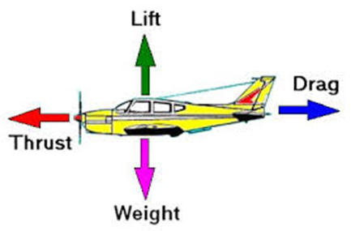
Measurement of dynamic thrust produced by CAMAR Unnamed Aerial Vehicle Model
UNDERGRADUATE PROJECT 2 (UGP2)
NAME : MOHD NAJIB BIN AB RAZAK
SUPERVISOR : Dr.-Ing. Mohd Nazri bin Mohd Nasir

Slide 2



UGP 2 FLOW CHART
Calculate propeller
Do few testing to
Fabricate support
Start UGP 2
and motor size
find suitable motor
for motor to attach
(THEORY)
and propeller
at UAV
(EXPERIMENT)
Discussion and
Discussion with
Collect data from
Setup testing inside
conclusion
supervisor on wind
wind tunnel testing
wind tunnel
tunnel testing data
(EXPERIMENT)
Draft report
Presentation

Slide 3
UGP 2 GANTT CHART
ID
Task Name
w1
w2
w3
w4
w5
w6
w7
w8
w9
w10
w11
w12
w13
w14
w15
1
REVIEW UGP 1
EXPERIMENTAL SETUP
2
A. CALCULATION PROPELLER SIZE
3
B. DO EXPERIMENT TO FIND SUITABLE MOTOR
AND PROPELLER
4
C. FABRICATE MOTOR SUPPORT AND FIX
AT CAMAR UAV MODEL
5
DATA COLLECTION FROM WIND TUNNEL
TESTING
6
DISCUSSION AND CONCLUSION
7
COMPLETE DRAFT REPORT
8
PRESENTATION SLIDE
9
SUBMISSION LOG BOOK AND THESIS
3

Slide 4
PROBLEM STATEMENT
Problem
Motor
Propeller
Produce torque
Unbalance Propeller will cause excessive vibration
Contribute important effect on the dynamics of UAV
Will Affecting the handling of UAV resulting inaccurate reading by sensor
Will cause bearing Problem
Based on this problem I choose the selection of motor and propeller to get the required thrust

Slide 5
Objectives
To design measurement techniques in order to remotely quantify dynamic thrust.
To measure the performance of propulsion system of powered by CAMAR UAV model
To measure the impact of dynamic scaling of model using appropriate procedure which is need to compare the effect of the model with propeller and without propeller.

Slide 6
SCOPES
Literature studies on the propulsion system used in UTM UAV known as CAMAR V1.
The experiment will be executed at wind speed 40m/s (model) and motor speed 15600rpm (max)
Other setting and nature of the experiment shall be relevant to CAMAR V1.

Slide 7
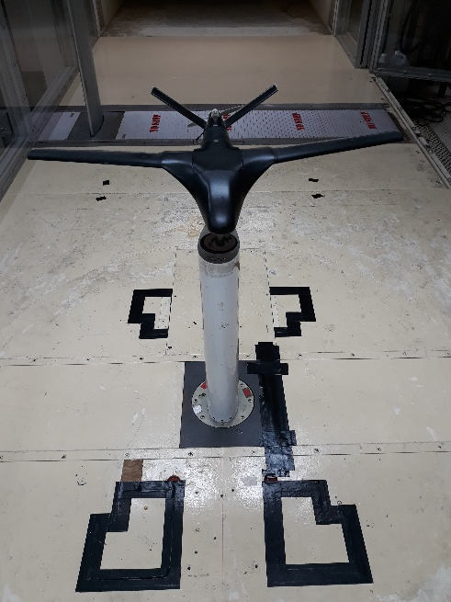
INTRODUCTION
What is Thrust
Thrust is a mechanical force generated by the engines to move the aircraft/uav through the air.
Thrust is generated by the propulsion system of the aircraft/uav.
What is Dynamic Thrust
The work done by the propeller or a fan to give forward motion, it is equal to the product of mass flow/second and the difference between slipstream velocity and aircraft speed.

Slide 8
SELECTION OF LITERATURE REVIEW
TITLE | AUTHOR | YEAR PUBLISHED | FINDINGS
Design Parametric Study of a Compound Wing-in-Ground Effect. II: Aerodynamics Coefficients | Saeed Jamei, Ph.D., M.ASCE; Adi Maimun, M.ASCE; Shuhaimi Mansor; Nor Azwadi; and Agoes Priyanto. | August 2013 | The span of the side wing affects the performance of the compound wings significantly. The anhedral angle of the compound wing has a vital role in the efficiency of the compound wing.
Effect of Tail Dihedral Angle on Lateral Directional Stability due to Sideslip Angles | Nur Amalina Musa, Shuhaimi Mansor, Airi Ali, and Mohd Hasrizam Che Man, Wan Zaidi Wan Omar. | January 2015 | This paper investigates the effect of different tail dihedral angles and tail type to the aerodynamic characteristics of the same wing body fuselage.
The Effect of Propeller Scaling Methodology on the Performance Prediction | Stephan Helma ,*, Heinrich Streckwall and Jan Richter | May 2018 | This paper shows the influence of different scaling procedures on the predicted power
Measurement Of Static And Dynamic Performance Characteristics Of Small Electric Propulsion Systems | Aron J. Brezina | April 2012 | This paper to compare information about small propulsion systems so that proper motor and propeller combinations can be selected for a given mission profile.

Slide 9
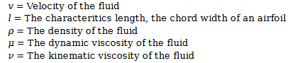
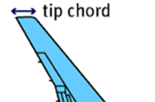
TO CALCULATE AIR SPEED FOR WIND TUNNEL TESTING
Camar Uav Model V1 will be testing using 40m/s air speed
ACTUAL
MODEL
J.B.BarlowW.H.RaeJrA.Pope-LowSpeedWindTunnelTesting.1-JohnWileySons1999
Camar
Model

Slide 10
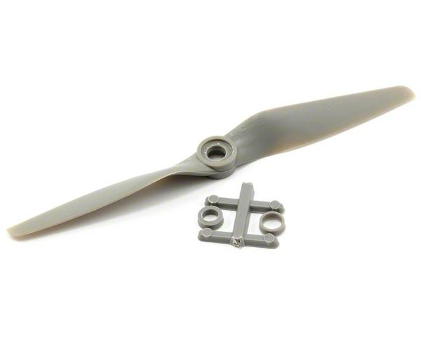
TO ESTIMATE PROPELLER SIZE FOR CAMAR UAV MODEL
Equation
Nm | Rotational speed in RPS
Vm | Wind tunnel speed ( 40M/S)
Ns | 4700 rpm (78.33rps)
Ds | Diameter full Scale Propeller (13inch)
Vs | Full scale air speed (22m/s)-Cruising
Dm | Propeller Diameter (Inch)
Propeller size (6.9 INCH)

Slide 11
TO FIND SUITABLE PROPELLER AND MOTOR
Motor GT2215/09
Propeller 10 x 4.5 | 8500RPM
 | 18A(11.1V)
Propeller 13 x 7 | 4500RPM
 | 20A(11.1V)
Propeller 9 x 6 | 7680RPM
 | 15.7A(11.1V)
Motor GT2826/04
Propeller 8 x 5 | 9500RPM
 | 13.4A(11.1V)
Propeller 6 x 4 | 11000RPM
 | 5.5A (11.1V)
Propeller 6 x 4 | 15600RPM
 | 10.8A(14.8V)

Slide 12
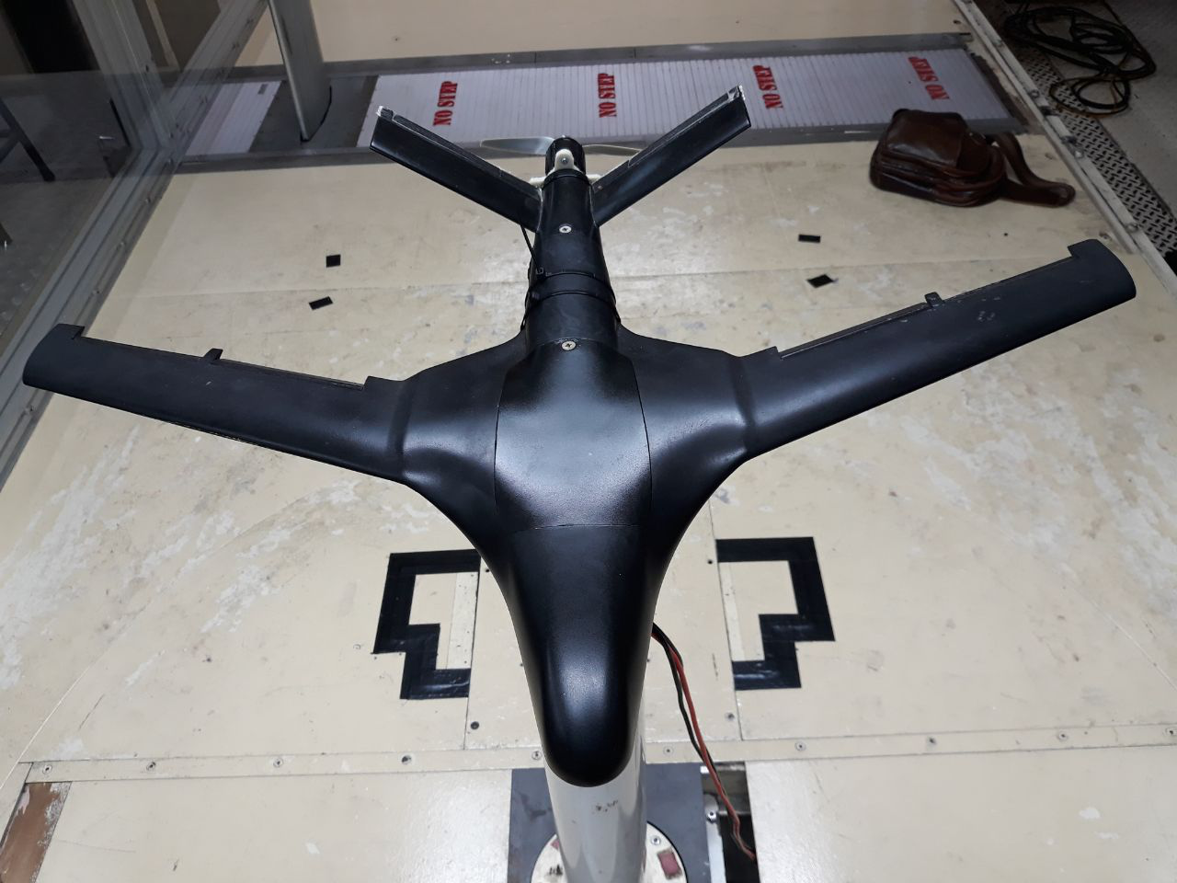
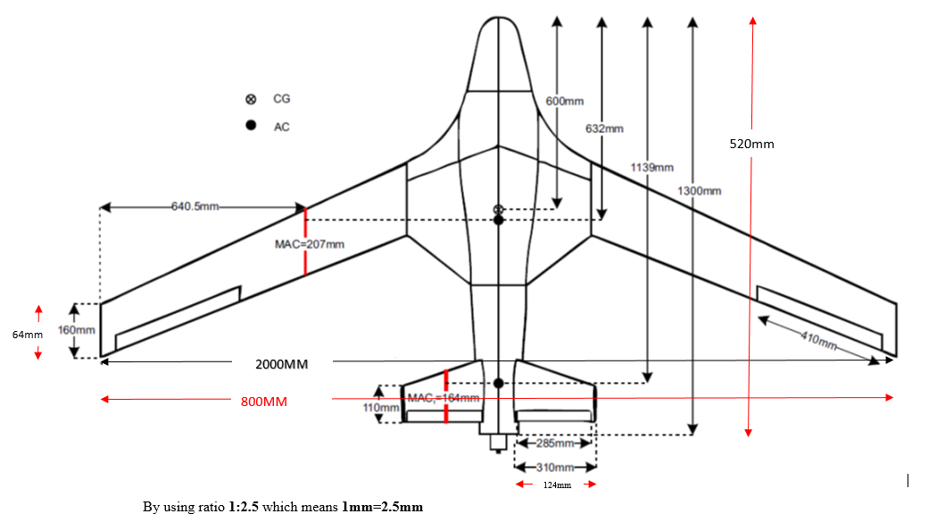
UAV MODEL
Black = Actual
Red = Model
MAC Model = 82.2mm
UAV MODEL V1 WITH STRUT
(MATERIAL = FIBER GLASS)

Slide 13
CLOSED LOOP UTM LOW SPEED WIND TUNNEL
wind tunnel specification
Size H/W/L : 1.5m x 2m x 5.8m
Max wind speed : 3 to 80m/s
Circuit type : Close loop, single return
Power : 430kW AC motor/573HP

Slide 14
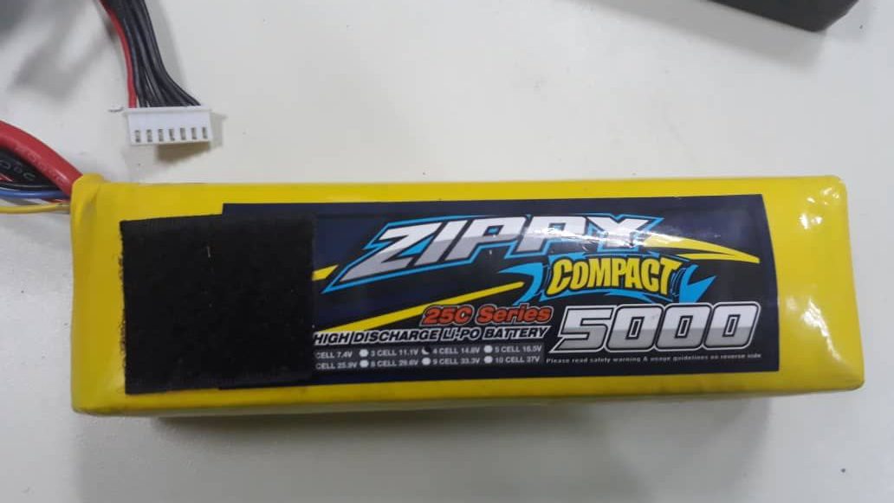
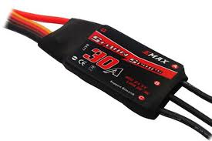
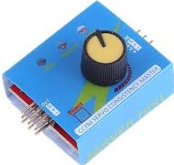
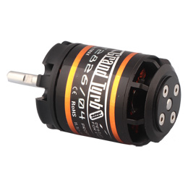
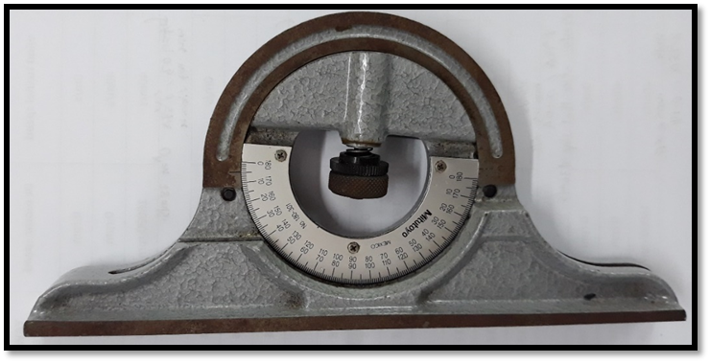
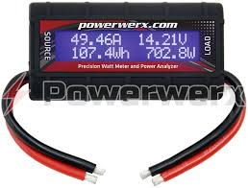
EQUIPMENT USE FOR WIND TUNNEL TESTING
LITHIUM POLYMER BATTERY 4S
ELECTRONIC SPEED CONTROLLER
SERVO TESTER
BRUSHLESS DC MOTOR
INCLINOMETER
WATT METER

Slide 15
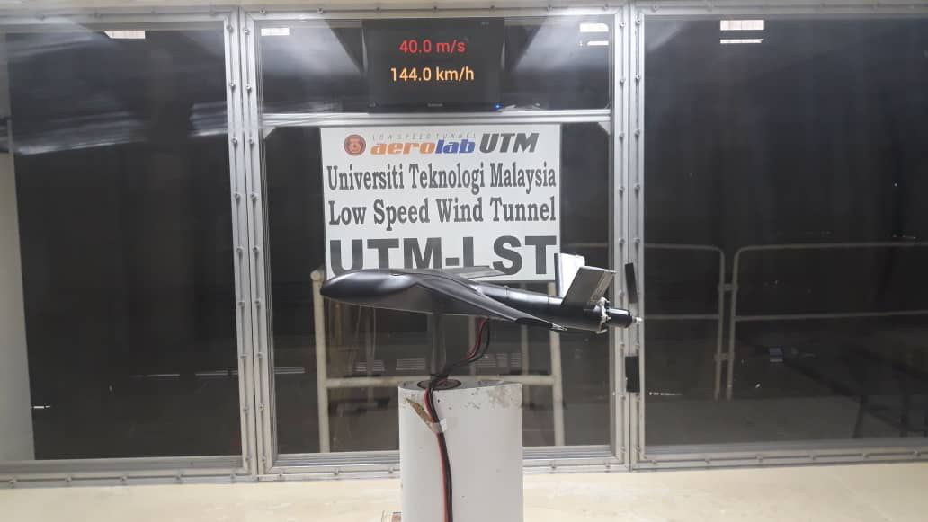
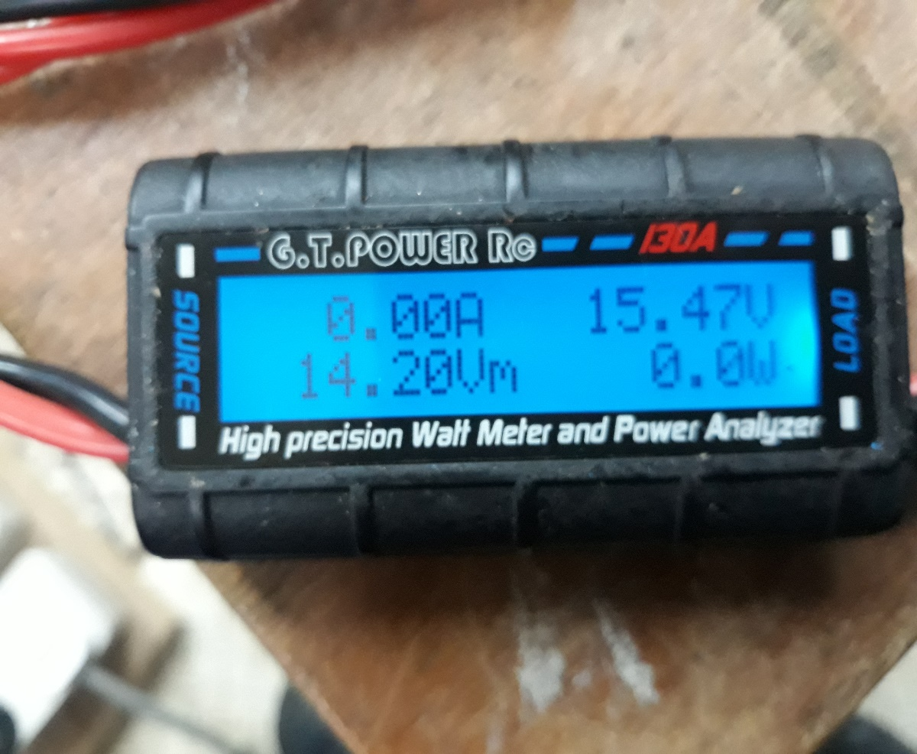
WIND TUNNEL TESTING
Wind tunnel testing at 4 degree pitch,
wind tunnel speed 40m/s and motor speed 15600rpm

Slide 16
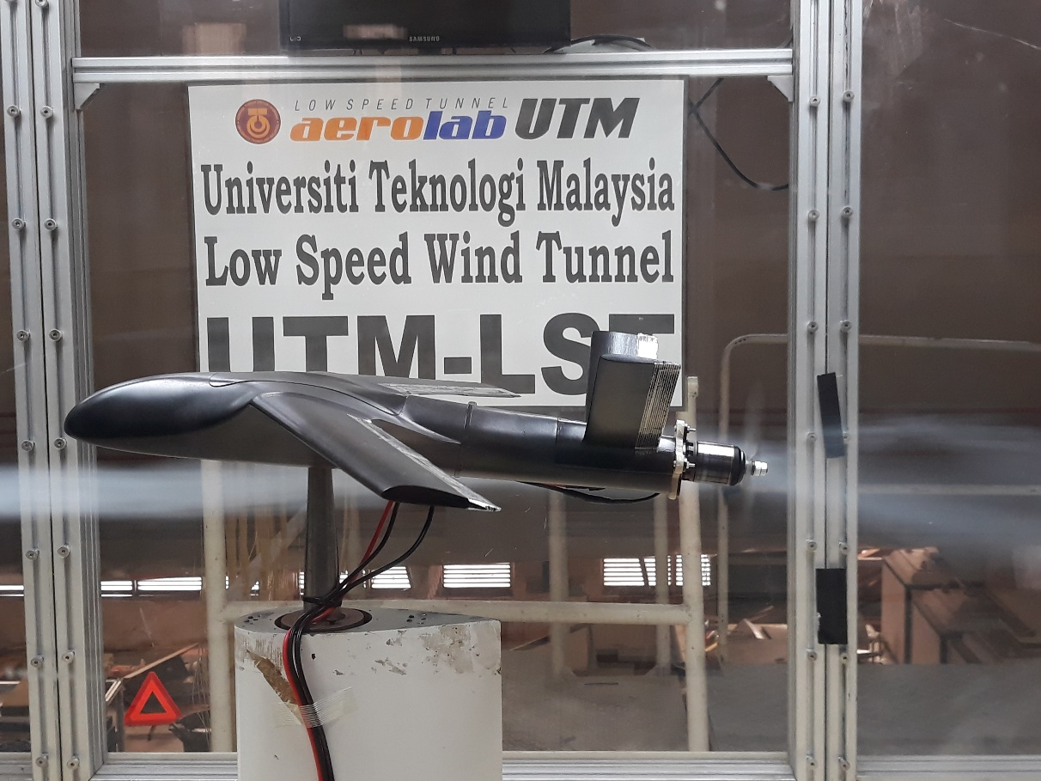
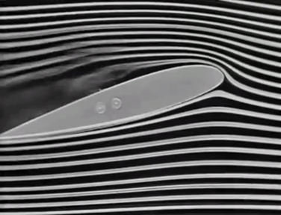
WIND TUNNEL SMOKE TEST
During this test, wind tunnel speed is 8m/s and brushless DC motor speed 15600Rpm
VIDEO

Slide 17
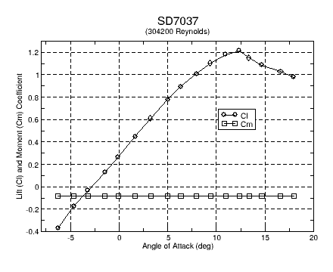
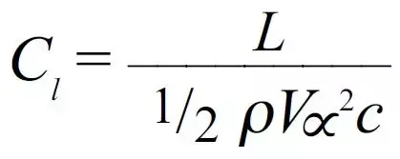
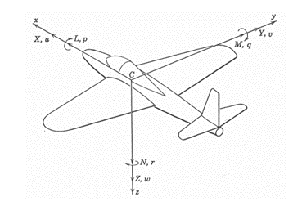
COEFFICIENT OF LIFT VS ANGLE OF ATTACK
The lift coefficient (Cl) varies significantly, steadily increasing until the stall occurs
Maximum lift coefficient at 8⁰
Aerodynamic Analysis of Multi Element Airfoil Udaya Kumar D*, Kannan S, Vimal Chand D, Sriram R and Ganapathi C Aeronautical Jeppiaar Engineering College, Chennai, India

Slide 18
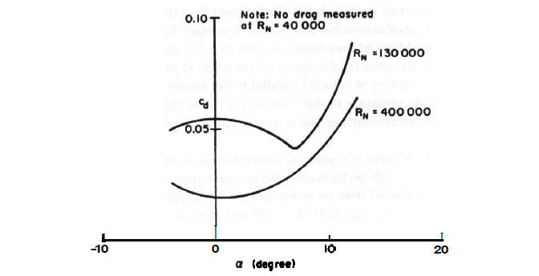
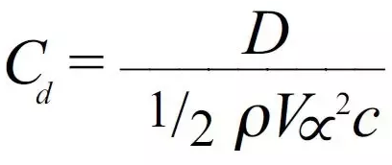
COEFFICIENT OF DRAG VS ANGLE OF ATTACK
At low angles, the drag is nearly constant.
As angle increase, drag also increase
The drag coefficient contains not only the complex dependencies of object shape and inclination but also the effects of air viscosity.
J.B.BarlowW.H.RaeJrA.Pope-LowSpeedWindTunnelTesting.1-JohnWileySons1999

Slide 19
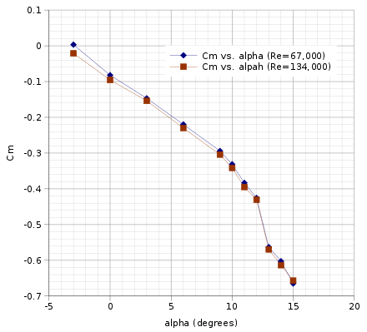
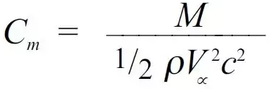
COEFFICIENT OF PITCHING MOMENT VS ANGLE OF ATTACK
The negative slope for positive α indicates stability in pitching.
Ira H. Abbott, and Albert E. Von Doenhoff (1959), Theory of Wing Sections, Dover Publications Inc., New York SBN 486-60586-8

Slide 20
YAWING MOMENT VS YAW ANGLE
V-tail contributes to strong directional stability as compared to Conventional tail
At the same time V-tail also generate a higher rolling moment, and this will lead to the cross-coupling problem when aircraft start to yaw.
The yaw moment is the moment about the z body axis and is positive if it moves the nose of the plane to the right. The significant contributor to the yaw moment is the vertical tail.
Effect of Tail Dihedral Angle on Lateral Directional Stability due to Sideslip Angles
Nur Amalina Musa, Shuhaimi Mansor, Airi Ali, and Mohd Hasrizam Che Man,Wan Zaidi Wan Omar

Slide 21
CONCLUSION
The coefficient of lift show not much different when I did testing with and without the motor.
When the motor is running at 40m/s, the current show 0 amperes, it's because of the motor no need much power to turn the propeller.
Using the Reynolds number formula, I able to find the suitable wind speed for wind tunnel testing.
Using the advance ratio formula, I able to estimate the size of the propeller for testing

Slide 22
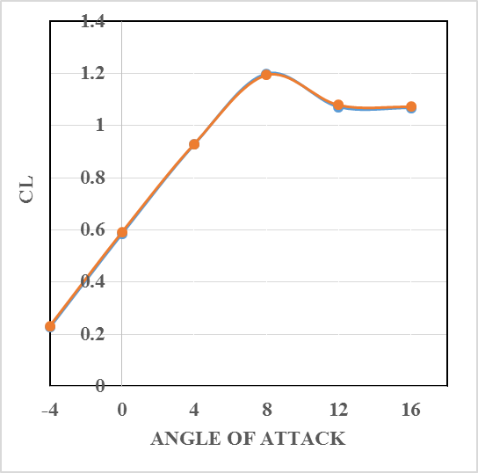
Q & A

Slide 23
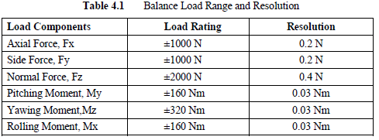
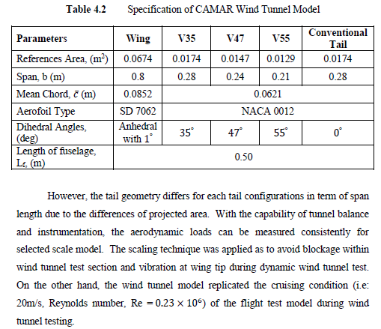
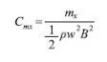

Slide 24
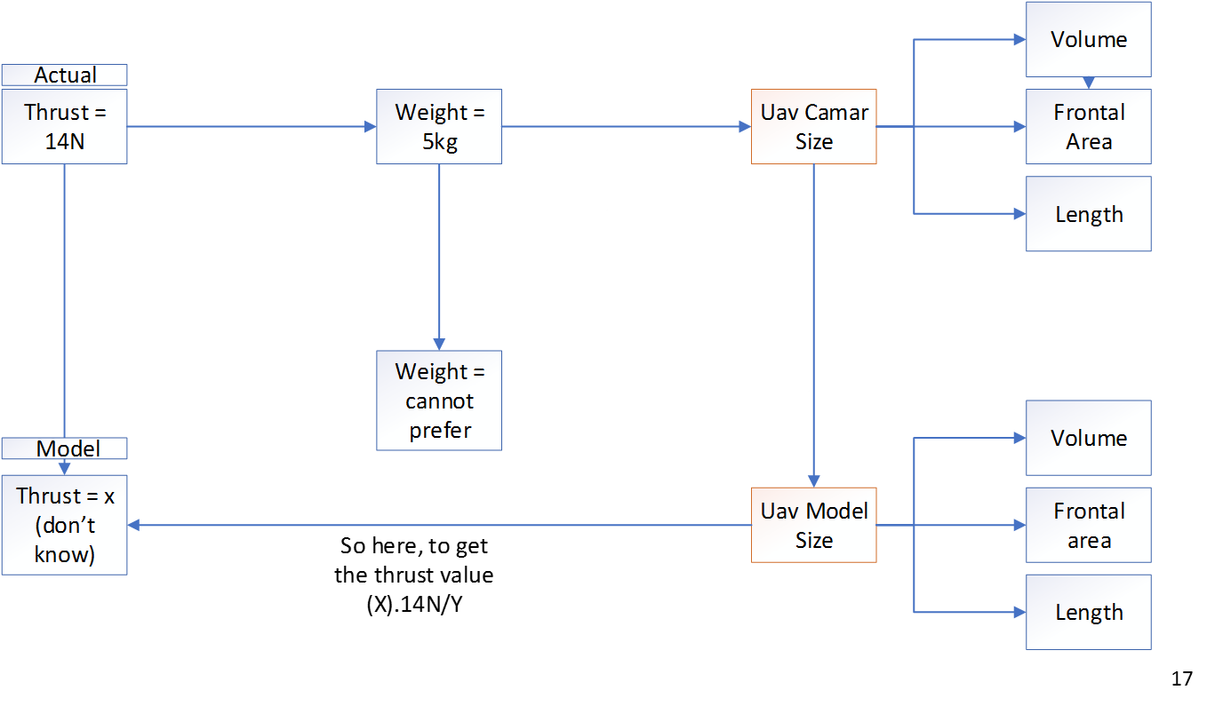
Parameters | Value
Length | 1.4m
Wingspan | 2.5 m
Datalink range | 20km
MTOW | 5kg
Length from nose to center of gravity | 640mm
Mean aerodynamics chord, MAC | 207mm
Location MAC from wing root | 568.5mm

