Slide 1
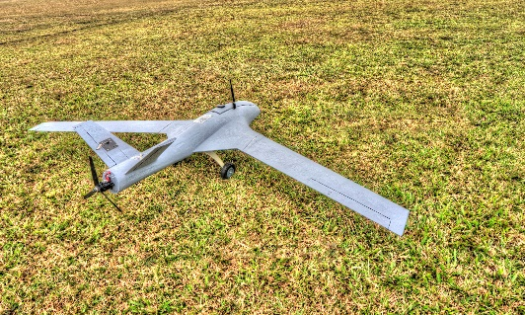
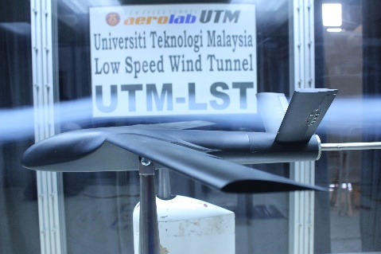
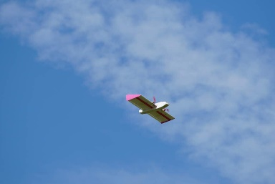
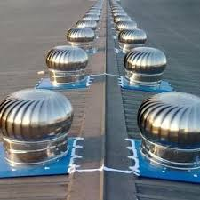
Unmanned Aerial System, UAS & Nature Inspired Flight Technologies
UAS flight test & performance analysis, wing tunnel testing, wind-driven ventilator
unsteady flight & perturbation, aerodynamics of insect flight & kinematics
Ir. Dr.-Ing. M. Nazri M. Nasir PEng, CEng MIMechE
Uni. of Manchester (BSc), TU Delft (Master), TU Darmstadt (PhD)
https://people.utm.my/mnazri/
mnazri@mail.fkm.utm.my
011-10845041

Slide 2
UAS defination
•DRONE
•UAV – Unmanned Aerial Vehicle
•UAV – Uninhabited Aerial Vehicle
•UAS – Unmanned Aerial System
•RPV – Remotely Piloted Vehicle
•RPA – Remotely Piloted Aircraft
•RPAS – Remotely Piloted Aircraft System
•ROAV – Remotely Operated Air Vehicles
•MAV – Micro Aerial Vehicle
Unmanned Aerial (Aircraft) System
operate autonomously or to be piloted remotely
The UAV and the equipment to control it remotely
Source: Regulation (EU) 2019/945

Slide 3
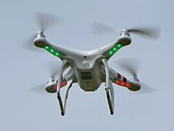
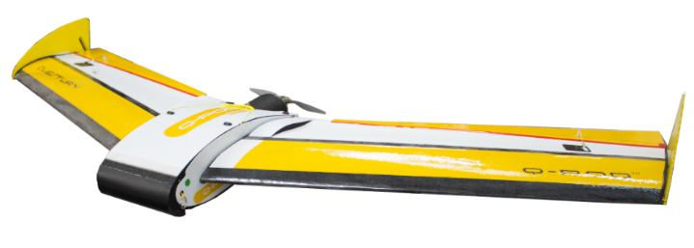
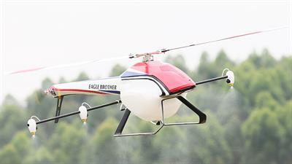
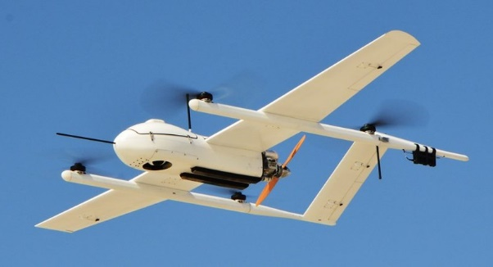
Configurations of UAV
Multi Rotor UAV (DJI phantom 1)
Fixed Wing UAV (QuestUAV Q-200)
Single Rotor UAV (Shenzhen Eagle Brother Model 25L)
Hybrid UAV (Fixed Wing /VTOL) (JOUAV’s CW-30 hybrid VTOL/Fixed-wing)
Singhal, Bansod, & Mathew (2018)

Slide 4
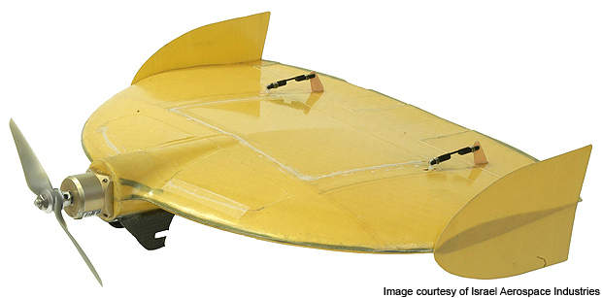
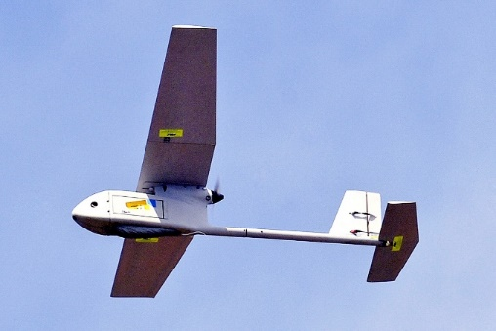
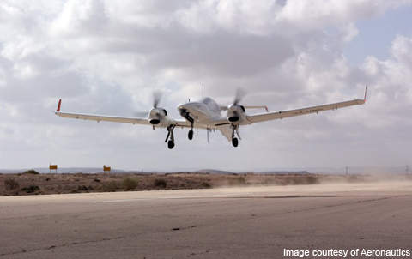
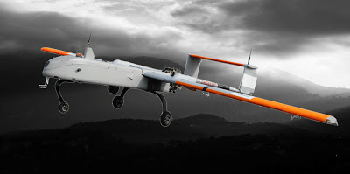
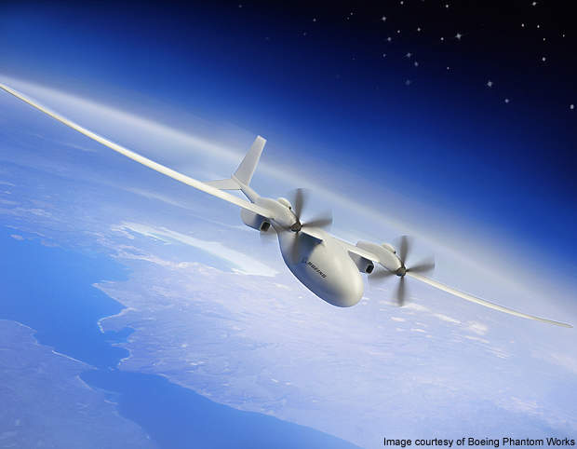
Micro UAV
Israeli IAI Malat Mosquito
Mass Range Flight Altitude and Endurance
SUAV
RQ-11 Raven, by US Aero Vironment
Medium range UAV
Israel Aeronautics Defense Dominator
Close range UAV
Aludra
HALE UAV
Phantom Eye
Source: Room M. H. M. & Ahmad A. (2014).

Slide 5
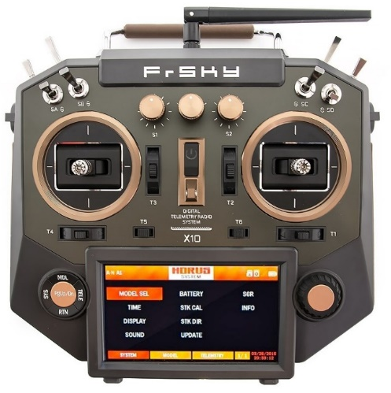
Radio-Controlled Aircraft (RC)
Small flying machine that is controlled remotely by an operator on the ground using a hand-held radio transmitter.

Slide 6
Components
Basic Component
Motor
Propeller
Electronic Speed Controller
(ESC)
Receiver
Servo
Battery
Components
(Advance)
Stabilization
Navigation
Global Positioning System (GPS)
FPV

Slide 7
Battery ( LiPo Battery )
NiCad (Nickel Cadmium), NiMH (Nickel Metal Hydride), Li-ion, LiPo (Lithium Polymer), LiFe
Advantages / Characteristic
Why LiPo ?
Light weight
Can be made by almost any shape and size
Has larger capacities
Has high discharge rates to power the most demanding electric motor

Slide 8
Battery Ratings
Voltage - 3. 7 volt per cell
7.4 volt battery = 2 cell x 3.7 volts ( 2S )
11.1 volt battery = 3 cell x 3.7 volts ( 3S )
14.8 volt battery = 4 cell x 3.7 volts ( 4S )
Capacity - how much power pack the battery can hold in milliamps hour ( mAh ) [ You can think of fuel tank ]
Discharge rate - How fast a battery can be discharged safely.
A battery with a discharge rating of 10C would mean you could safely discharge it at the rate 10 times more the capacity of the pack.
Ex : 15C pack = 15 times more
20C pack = 20 times more
1000 mAh battery as an example; if it was rated at 10C that would mean you could pull a maximum sustained load up to 10,000 milliamps (10 amps off)

Slide 9
Battery Charging Mode
Charge
Fast Charge
Storage
Balance

Slide 10
Component - Motor
Brushless motor
A motor with a lower kV will not be as fast, but will accelerate faster/high torque.
Watts - are the power rating or the horsepower equivalent of your brushless RC Motor. The math here is Amps x Volts = Watts. Example 180 watt
synchronous motors powered by DC electricity via an inverter or switching power supply which produces an AC electric current to drive each phase of the motor via a closed loop controller.
Consists of two main part :
Stator-consist of coils
Rotor-permanent magnet with two poles

Slide 11
So if we apply the appropriate current, the coil will generate a magnetic field that will attract the rotors permanent magnet.
Now if we activate each coil one after another the rotor will keep rotating because of the force interaction between permanent and the electromagnet.

Slide 12
In order to increase the efficiency of the motor we can wind 2 opposite coils as a single coil in way that will generate opposite poles to the rotors poles, thus we will get double attraction force.
With this configuration we can generate the 6 poles using 3 coils or phase.
We can further increase the efficiency by energizing 2 coils at the same time.
In that way one coil will attract and the other coil will repel the rotor.
In order the rotor to make a full 360 degrees cycles, it need 6 steps or intervals.
Each interval there is one phase with positive current, one phase with negative current and third phase is turned off.
This gives an idea that we can connect the free end point, so each of the 3 phases together and so we can share the current between them or use a single current to energize the 2 phases at the same time.

Slide 13
Component - Propeller
Scale RC aircraft propeller are usually specified as diameter x pitch (in inches).
Ex : 5 x 3 propeller
Pitch is distance that the propeller would advance if turned through one revolution in solid medium
R for reverse propeller

Slide 14
Propeller - Type
Wooden
Made up of beech wood
Great dynamic balance and sound
If the aircraft crash, the wooden propeller is easily deformed
Plastic
Cheap, light, colourful
simple structure that doesn’t yield good air-flow, and they aren’t so durable

Slide 15
Fiberglass
Rarely used
Carbon Fiber
Give more power than any other propellers on the market
light, strong, and durable
Two kinds of carbon fibre , composite carbon fiber technology and composite of nylon and carbon fiber

Slide 16
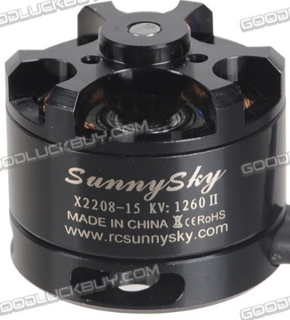
Product details

Slide 17
Number & Size of Blades
The number of blades required per propeller will vary depending on the platform, usage and payload requirements.
Smaller blades ( < 8 inch ) are most frequently used for racing drones and those used for acrobatics.
Generally paired with smaller motors with high kV ratings.
Larger blades ( > 8 inch ) are paired with motors that have low kV ratings and can be used to carry heavier payloads,
Ex :video equipment or spraying containers for agriculture.

Slide 18
Propeller - Pitch
The correct pitch will often depend on the specific application for a UAV platform.
Lower pitch often results in more torque and less turbulence for lifting,
As a result the motors do not have to work as hard to carry heavy payloads which can result in increased flight time (as the motors will draw less current from the battery).
Propellers with higher pitches move more air, but generally create more turbulence and less torque.

Slide 19
Propeller - Diameter
A larger diameter propeller blade allows greater contact with the air.
As a small increase or decrease in diameter can change how efficiently a drone performs.
Larger propellers tend to be more stable when hovering than smaller propellers.
However, smaller propeller blades require less effort to speed up or slow down than larger ones, making them more responsive than larger propellers.
Smaller propellers with a high pitch are better suited for fast and quick maneuvers
Larger propellers with low pitches are more appropriate for carrying heavier payloads and aerial video cameras.

Slide 20
Component - ESC
ESC - Electronic Speed Controller
Purpose to vary an electric motor 's speed, its direction and possibly also to act as a dynamic.
Provide +5V power for electronic flight electronics
ESC rating - maximum current rating
Will be given in 2 figures. Ex 18/22A
First term is the current which the ESC will take continuously
Second term is the short term current allowed normally for no more than 10 - 30 seconds.

Slide 21
ESC with Battery Eliminator Circuit (BEC)
Red ( Positive )
Black ( Negative )
White/Yellow ( Signal )
ESC without Battery Eliminator Circuit (BEC)
( Only Black and White/Yellow )

Slide 22
Battery Eliminating Circuit ( BEC )
Works by reducing the motor battery voltage to down to 5V needed by the receiver
No need to separate battery to power the servo
Opto-isolation (Opto)
Electrically isolates the signal from the radio throttle channel from the ESC
Doing this can dramatically reduce the level of radio interference which can be created especially with very high currents

Slide 23
Criteria to choose an ESC
Have about 10 - 20% higher amp rating than your motor
Make sure your ESC can handle the same amount of cells (battery) that your motor can handle
Make sure your ESC has a BEC built in
If running a LiPo battery
must have a low cut-off voltage or not it will kill the battery
not lower than 3 V per sets

Slide 24
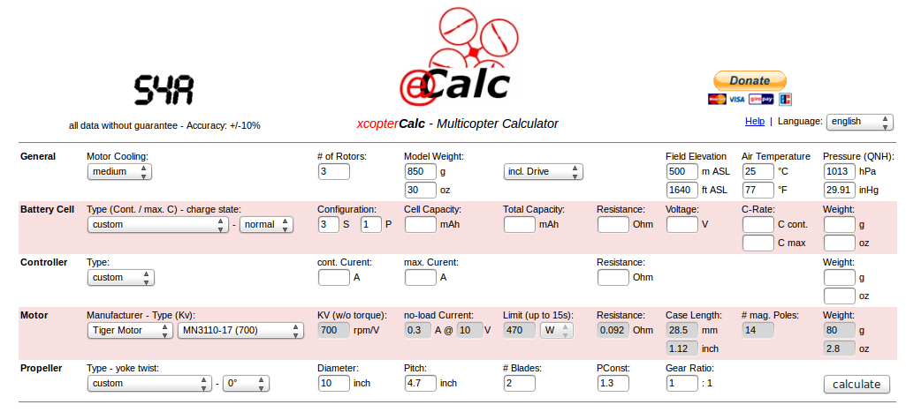
Propulsion System Selection
40 -70 % thurst is Ok
Start from aircraft weight
E-calc
Static thrust
Dynamic thrust

Slide 25
Propulsion type

Slide 26
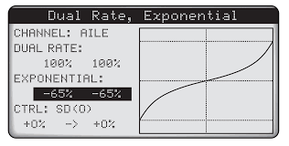
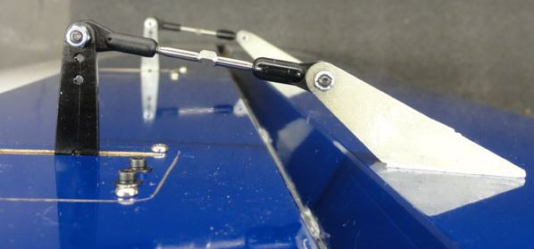
Component - Servo
Metal/ plastic
RC servos convert electrical commands from the receiver back into movement
Simply plugs into a specific receiver channel and is used to move that specific part of the RC model.
This movement is proportional meaning that the servo will only move as much as the transmitter stick on your radio is moved

Slide 27
Operation - have a 3 wire connector.
One wire supplies positive DC voltage – usually 5 to 6 volts.
The second wire is for voltage ground
The third wire is the signal wire (white).
The receiver “talks” to the servo through this wire by means of a simple on/off pulsed signal.
Rating – Speed , time taken to 60 degree.
Example 0.12/60°, servo rating.
The smaller the fastest.
Torque determines the maximum amount of rotational force the servo can apply
measured in ounces per inch (oz-in) or in kilograms per centimeter (kg-cm)

Slide 28
Receiver
Electronic unit that rides in the aircraft.
Receives signals from the transmitter and relays these signals to the servos and sends them out to the individual channels through Pulse Position Modulation (PPM) or SBUS commands
The receiver usually receives power from ESC, simply by plugging it into one of the signal ports.
Servos receive power from the receiver.

Slide 29
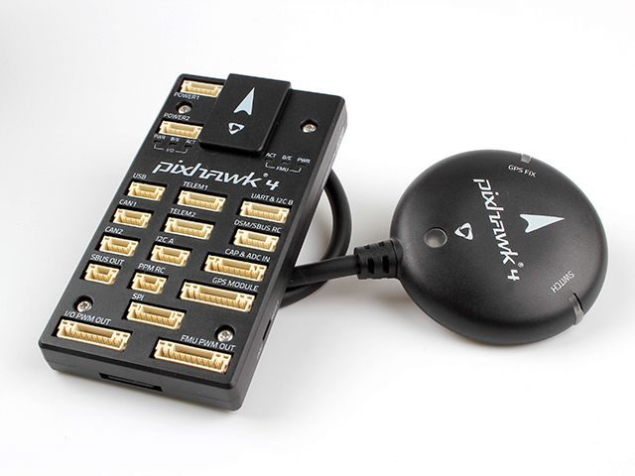
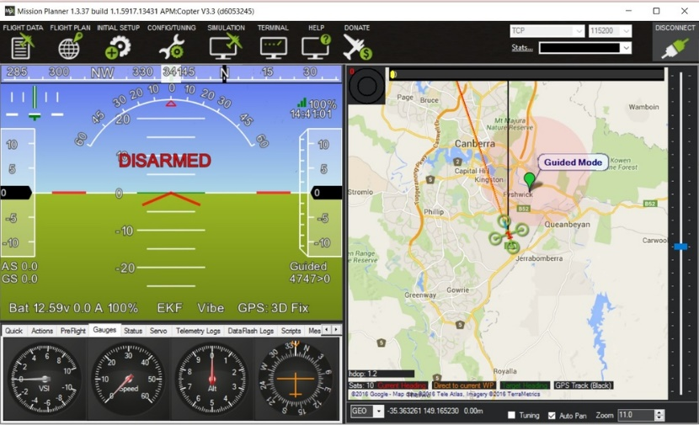
Flight Controller
Flight controller is the brains of UAV (central unit that runs the autopilot firmware).
The flight controller reads all of the sensor data and calculates the best commands to send to your drone.
Inertial sensors on UAV
Accelerometer measures acceleration forces, and the gyro measures rotational forces.
Barometer measure the aircrafts altitude
These pressure sensors are so sensitive that they can detect the change in air pressure when your drone moves a few centimeters
The autopilot handles both stabilization and navigation, eliminating the need for a separate stabilization system.

Slide 30
Airspeed Sensor
An airspeed sensor is another form of a pressure sensor, but instead of measuring altitude, this measures for fast the air is passing the aircraft.
It does this by comparing the dynamic and static pressure via a pitot tube.

Slide 31
Power Module
A power module is used to convert the battery voltage from your drone battery down to a low voltage that your autopilot uses (often 5 V)
Benefit of using a power module is that it gives you the ability to measure your battery voltage and capacity.
This is useful because if your flight controller can measure the battery it knows when your battery is running low so it can warn you to land.

