Slide 1
July Progress 2020
OTEC group

Slide 2
Key aspect selecting refrigerant
Global warming properties (GWP) - a relative measure of the amount of heat trapped in the atmosphere by a greenhouse gas
Ozone depleting potential (ODP) - a chemical compound, it is the relative amount of degradation to the ozone layer.
Efficiency

Slide 3
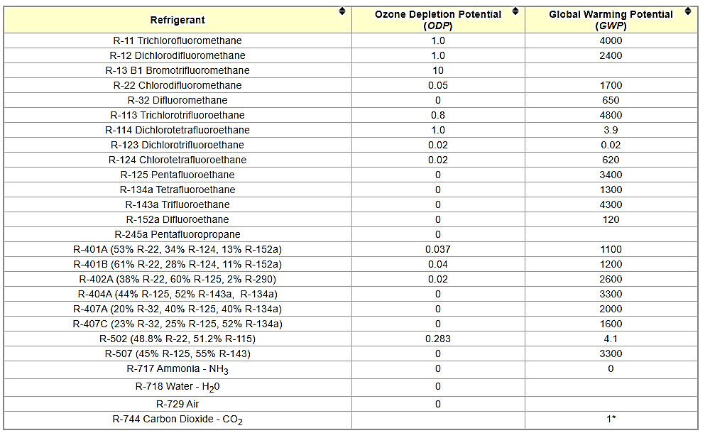
Comparison of refrigerant

Slide 4
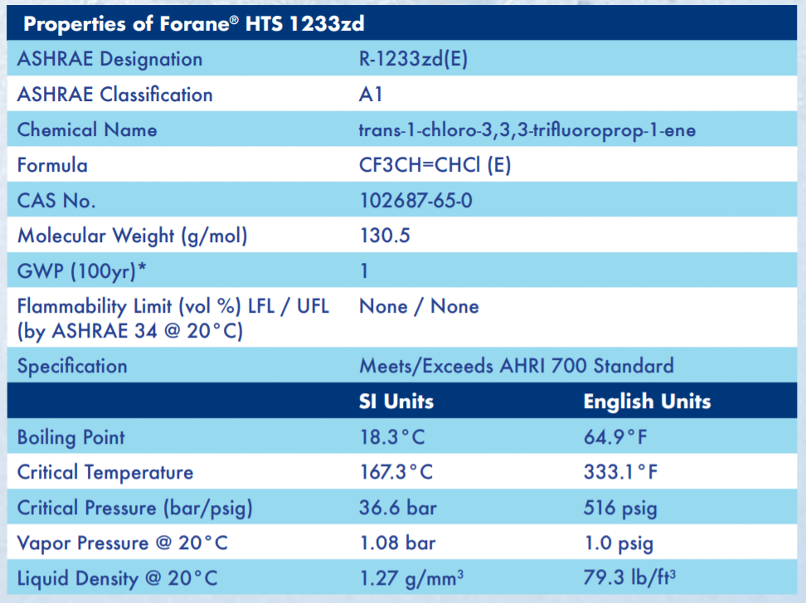
Properties of R1233zd

Slide 5
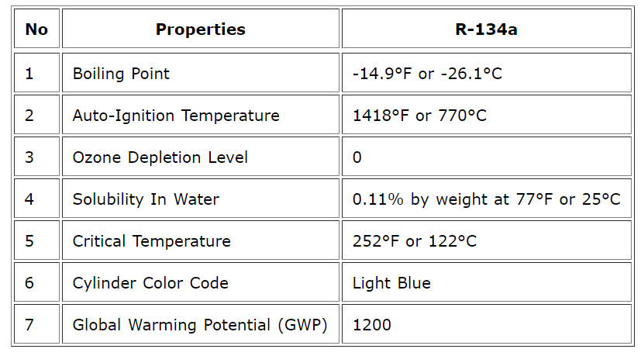
Properties of R134a

Slide 6
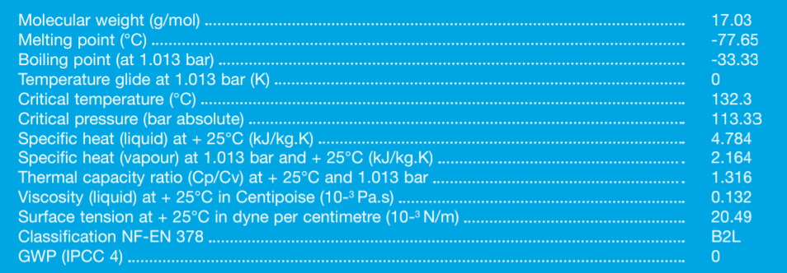
Properties of R717 Ammonia

Slide 7
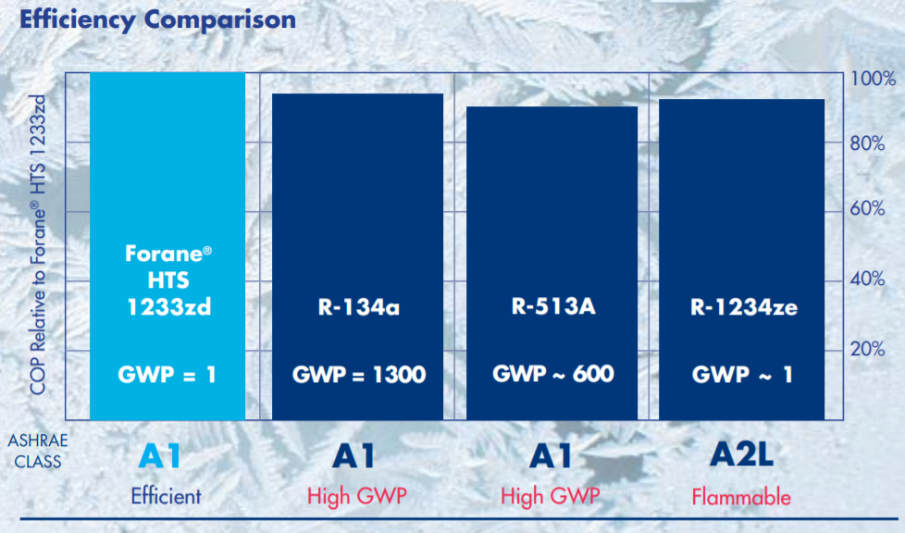
Comparison of R134 and R1233zd

Slide 8
Key aspect why Ammonia???
Targeting GWP value is zero, since R1233zd give value 1, it considers as acceptable or options in this project
Ammonia gives GWP and ODP values are 0, the main reason ammonia is selected.

Slide 9
Benefit of Ammonia as Refrigerant
Small piston displacement, small pipes size can be used in developing the test rig
Better heat transfer
Low density in liquid phase
Compressor, condenser and chillers used with ammonia refrigerant is compatible
Environmental friendly
High discharge temperature of ammonia gas
Miscibility with oil, oil separator should be installed in the evaporator.

Slide 10
Disadvantages of Ammonia as Refrigerant
Not compatible with copper. Do not use in any system with copper pipes.
Mitigate the risk

Slide 11
Comparison power output turbine between Refrigerant
Ammonia low mass flow rate give high power turbine
R1233zd gives average performance
R134 gives lower power output with same mass flow rate.

Slide 12
Comparison of efficiency between refrigerant
Close efficiencies between R134 and R717
R1233zd less efficiency

Slide 13
Leak testing of ammonia
Using sulfur sticks
Using soap solution

Slide 14
Conclusion
Using Interpolation method at 0.36kg/s mass flow rate R1233zd power output is 2.86047KW, R717 is 14.5KW and R134 is 2.3542KW
Reduce the risk while handling the ammonia refrigerant
In stead of copper, the test rig should be used glass types to transform liquid refrigerant
Piping system can be small size since the mass flow rate is low can be produced the high power output turbine.
The significant result gives the turbine size is small compared to the others refrigerant are used in this project.

