Slide 1
Course Requirements
All assignments MUST be submitted to TURNITIN (excluding cover and reference pages)
Required similarity index ≤ 20%
MORE marks will be given for similarity index ≤10%
plagiarism will result in an outright failure
Please submit the Turnitin report along with your Term Paper.

Slide 2
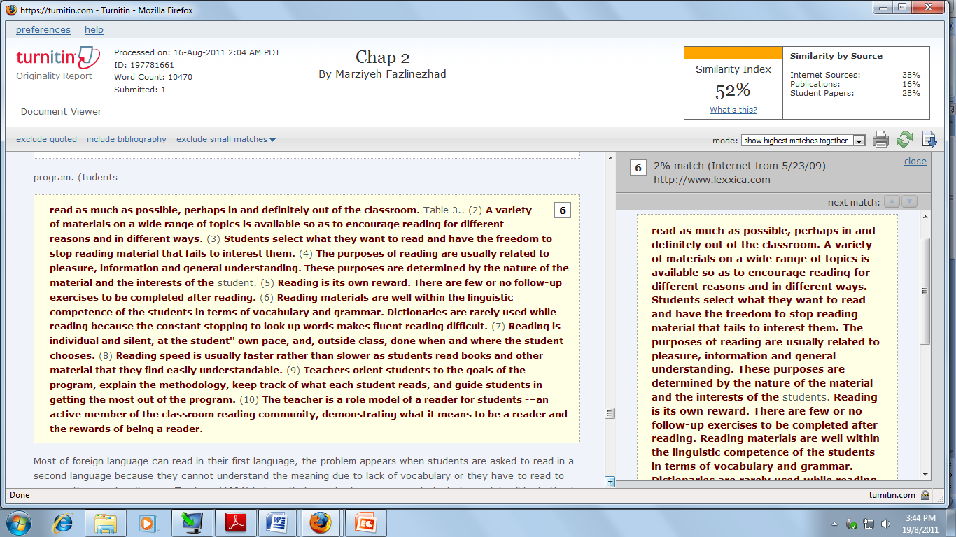

Slide 3
Click CREATE ACCOUNT

Slide 4
Use UTM LIVE email add

Slide 5
Select STUDENT

Slide 6
7683165
MPB1313sec01

Slide 7
Click MORE ACTION

Slide 8
Click SUBMIT PAPER

