Slide 1
SOIL COMPACTION
Noel Reginald Akeu anak Reginald
Muhammad Fitrie bin Abdullah
Muhammad Nuriman Ismail Bin Mat Tajuddin
Muhammad Aiman Shafiq Bin Nik Ahmad Ridzaudin
Muhammad Ashraff Bin Mohd Zamri
Muhammad Daniel bin Zakaria
Muhammad Irwan bin Mohd Nor
Muhammad Muhafiz Bin Mohd Maliki
Muhammad Syamsul Anwar Bin Samsularip
Nazatul Nazira Binti Azahar

Slide 2
SOIL MODIFICATION- A process of improving soil engineering such as shear strength, bearing capacity, etc.
4 Main Group:
Mechanical - Increasing soil density by application of short- term external mechanical forces
Physical & chemical- Mixing additives with surface layers or columns of soil
Hydraulic- Free-pore water is forced out of the soil via drains/wells
Modification- Reinforcement by fibers, strips, bars, meshes and fabrics imparts tensile strength to be constructed soil mass.
Proctor Test
SPECIFICATION | STANDARD | MODIFIED
MOULD VOLUME | 944 cm^3 | 944cm^3
HAMMER : MASS FALL DISTANCE | 2.5 kg 300mm | 4.5 kg 450 mm
NO. BLOWS/ LAYER | 25 | 25
NO. LAYER | 3 | 5
COMPACTIVE EFFORT | 595 kJ/m^3 | 2072 kJ/ m^3

Slide 3
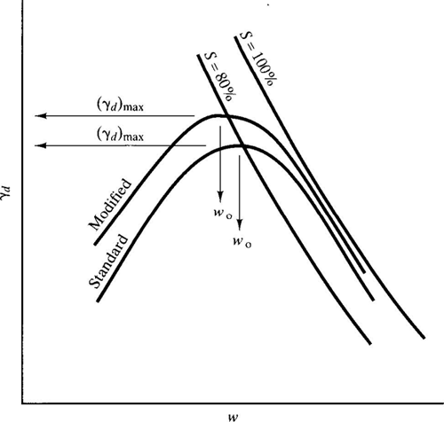
PURPOSE OF SOIL COMPACTION
Increase shear strength of soil
Reduce void ratio
Prevent liquefaction
Decrease undesireable settlement
Dry unit weight vs moisture content
FACTOR AFFECTING COMPACTION
Moisture content
Soil type and compaction effort
Degree of compaction
FIELD COMPACTION
COMPACTION EQUIPMENT
Smooth - wheel rollers
Pneumatic rubber – tired rollers
SPECFICATION FOR FIELD COMPATION
R(%)=
$$\frac{γd(field)}{γd(max−lab)}$$
R(%)=
(𝛾𝑑(𝑓𝑖𝑒𝑙𝑑))/(𝛾𝑑(𝑚𝑎𝑥−𝑙𝑎𝑏))
List of formula
$γd$=
($\frac{Gs }{1+e}$)$γw$
𝛾𝑑=
((𝐺𝑠 )/(1+𝑒))𝛾𝑤
$γ$b=
($\frac{γd}{1+w}$)
𝛾b=
(𝛾𝑑/(1+𝑤))
R(%)=
$$\frac{γd(field)}{γd(max−lab)}$$
R(%)=
(𝛾𝑑(𝑓𝑖𝑒𝑙𝑑))/(𝛾𝑑(𝑚𝑎𝑥−𝑙𝑎𝑏))
e= $\frac{Ga γw}{γd} −1$
e= (𝐺𝑎 𝛾𝑤)/𝛾𝑑 −1
SOIL STABILATION
CHEMICAL
Cement stabilization
Lime stabilization
PHYSICAL
Embankments

