Slide 1
Soil COMPOSITION
AIDIEL ASHRAF BIN ABDUL RAZAK
ANDY SIA CHEE MAU
ANIS NAJMIAH SILMI BINTI MAT HASSAN
ARVINDRAJ A/L THANGARAJOO
AZRUL SHAH BIN AMINUDDIN
CHEN JUN YAN
CHERYL HONG SHING YEE
ELAINE TAY YEE LING
EMER AIMAN BIN MOHD SALEH
EZZYAN INTAN SYAFHIRAH BINTI ABDUL RAHIM
HUANG WEI HONG

Slide 2
$V=V_{S}$+$V_{V}$
$$=V_{S}+V_{W}+V_{A}$$
W$=W_{S}$+$W_{W}$
e$=\frac{V_{v}}{V_{s}}=\frac{n}{1−n}$
n$=\frac{V_{v}}{V_{}}=\frac{e}{1+e}$
S$=V_{w}/V_{v}$
w$=W_{w}/W_{s}$
p$=\frac{M}{V}$
$$W_{s}=G_{s}{\text{γ}}_{w}$$
$$W_{w}={wG}_{s}{\text{γ}}_{w}$$
$\text{γ}$=$\frac{(1+w)G_{s}{\text{γ}}_{w}}{1+e}$
${\text{γ}}_{d}$=$\frac{G_{s}{\text{γ}}_{w}}{1+e}$
$$e=\frac{G_{s}{\text{γ}}_{w}}{{\text{γ}}_{d}}−1$$
${ V}_{w}=\frac{W_{w}}{{\text{γ}}_{w}}$
$=\frac{wG_{s}{\text{γ}}_{w}}{{\text{γ}}_{w}}=wG_{s}$
$$S=\frac{V_{w}}{V_{v}}=\frac{wG_{s}}{e}$$
$${\text{γ}}_{sat}=\frac{(G_{s}+e){\text{γ}}_{w}}{1+e}$$
p=$\frac{(1+w)G_{s}p_{w}}{1+e}$
$p_{d}$=$\frac{G_{s}p_{w}}{1+e}$
$p_{sat}$=$\frac{(G_{s}+e)p_{w}}{1+e}$
$$A_{v}=\frac{e(1−S)}{1+e}=n(1−S)$$
$$A_{v}=\frac{e−wG_{s}}{1+e}$$
γ=$\frac{W}{V}= \frac{W_{s}(1+w)}{V}$
${\text{γ}}_{d}$=$\frac{W_{s}}{V}=\frac{\text{γ}}{1+w}$
$$p_{d}=\frac{M_{s}}{V}$$
$$G_{s}=\frac{p_{s}}{p_{w}}=\frac{{\text{γ}}_{s}}{{\text{γ}}_{w}}$$

Slide 3
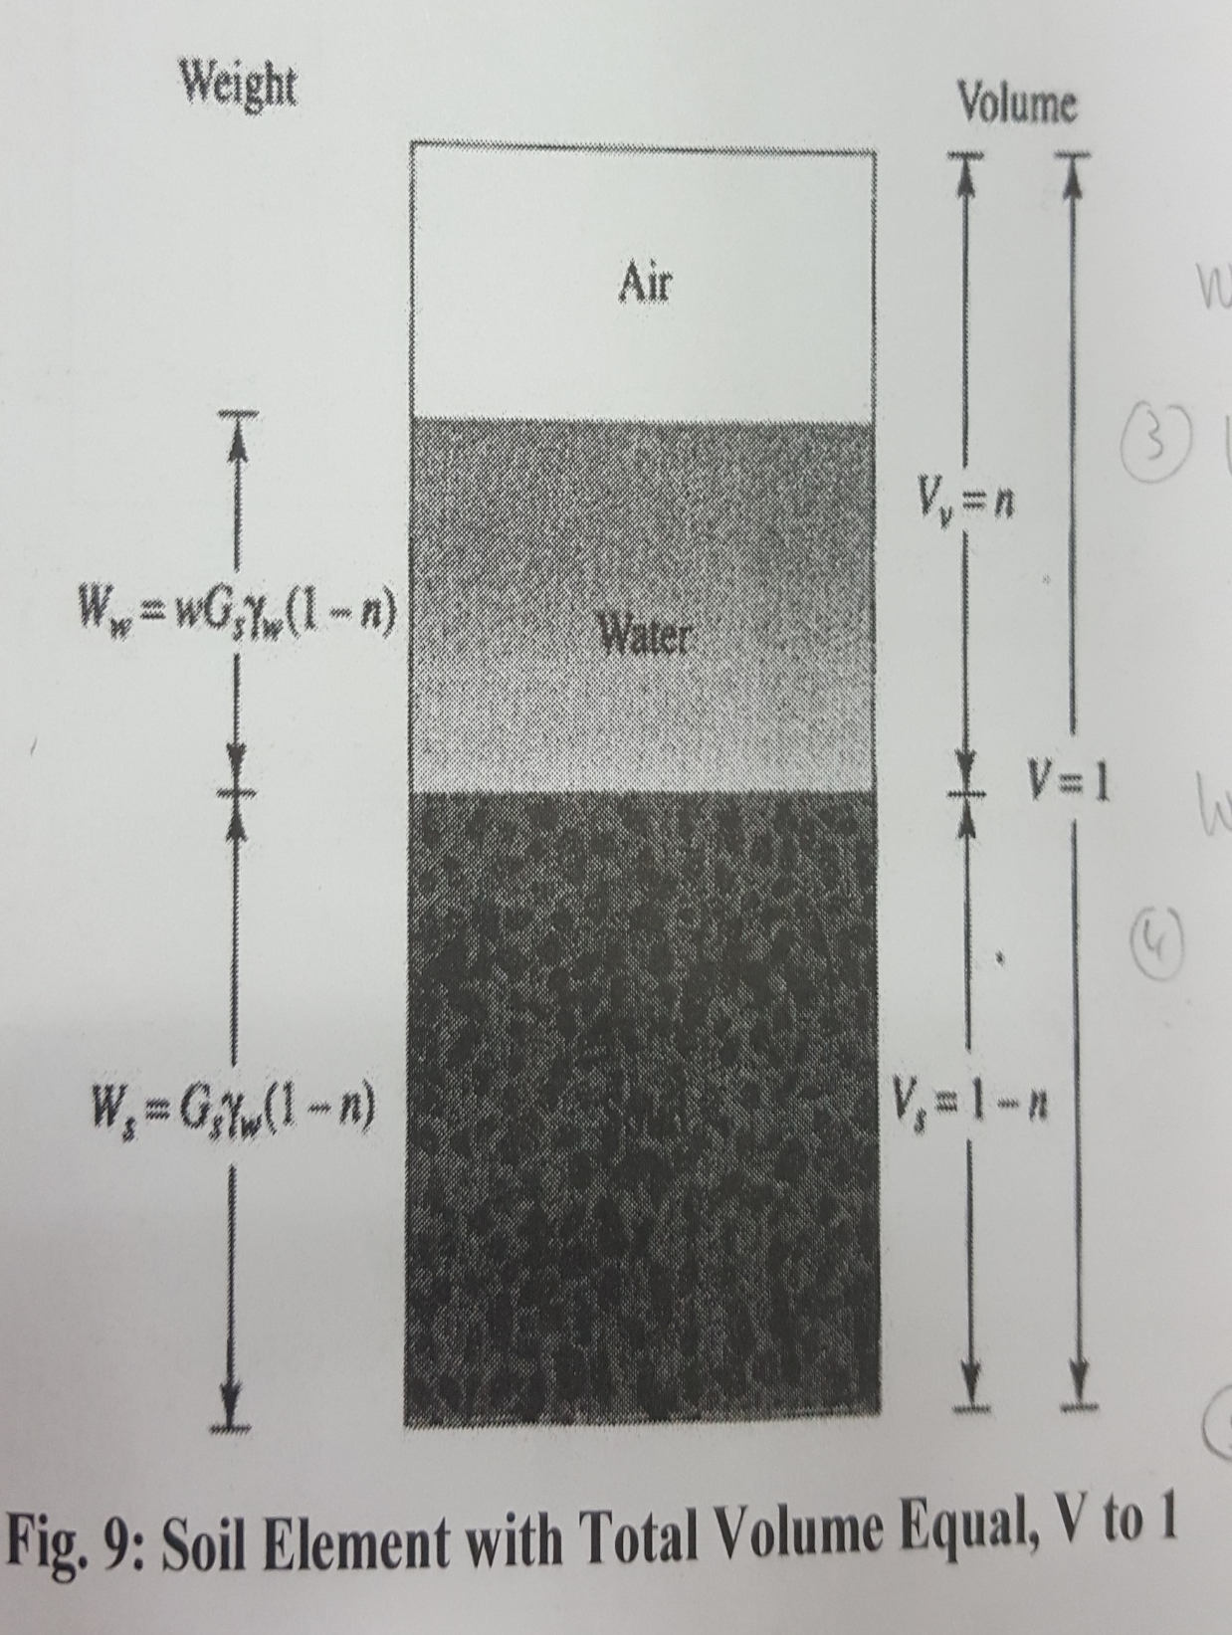
$$W_{s}=G_{s}{\text{γ}}_{w}\left(1−n\right)$$
$$W_{w}={wG}_{s}{\text{γ}}_{w}\left(1−n\right)$$
$${\text{γ}}_{d}=G_{s}{\text{γ}}_{w}\left(1−n\right)$$
$${\text{γ}}_{}=G_{s}{\text{γ}}_{w}\left(1−n\right)\left(1+w\right)$$
${\text{γ}}_{sat}=\frac{G_{s}{\text{γ}}_{w}\left(1−n\right)+n{\text{γ}}_{w}}{1}=[\left(1−n\right)G_{s}+n]$ ${\text{γ}}_{w}$
$$w=\frac{W_{w}}{W_{s}}=\frac{n{\text{γ}}_{w}}{(1−n)G_{s}{\text{γ}}_{w}}=\frac{n}{(1−n)G_{s}}$$

