Slide 1
Shear strength
Professor: Dr Nor Zurairahetty Mohd Yunus
Students:
Filzah Atikah Binti Yusop
Nurul Ashikin binti Mohamed
Tee Zi Hou
Ong Kai Cheang
Wan Nur Afiqah Zamri
Nurul Nur Syuhada Binti Hisammudin
Siti Sarah A'qilah Binti Sohaimi
Patricija Kadagyte
Nurul Fasihah Bt Zaidin
Razin b Abdul Malik
Sauddah Bt Baharom

Slide 2
Mohr Circles And Failure Envelope
Cohesion, (C) – the act or state of similar particles sticking together
Internal Friction Angle, (φ) - the stress-dependant component which is similar to sliding friction of two or more soil particles
Shear Strength at failure: τ_{f}= = c + σ_{n}tanΦ
COHESIVE SOIL
COHESIONLESS SOIL
C = ✔
φ = 0
For example:
Clay
Silt
C = 0
φ = ✔
For example:
Sand
Gravel

Slide 3
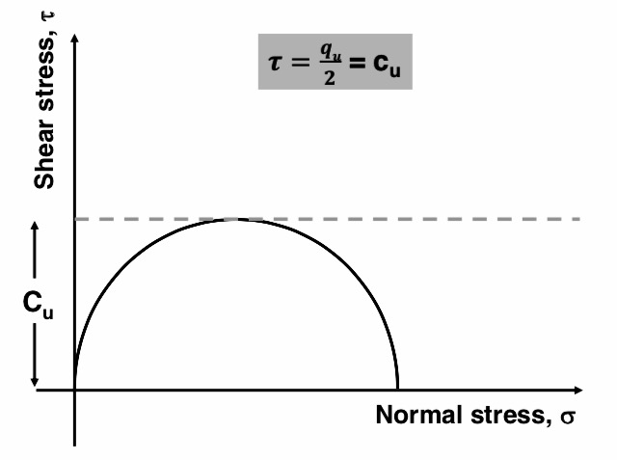
Determination Of Shear Strength In Lab
UCS
DIRECT SHEAR
TRIAXIAL COMPRESSION
normal force (P)
area of cross section
sample
=
shear resistance develope at sliding surface (S)
=
area of cross section sample
Important equations:

