Slide 1
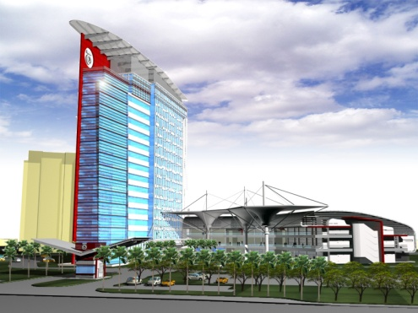
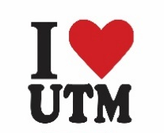
Welcome to the class….
Maintenance Technology
(FRSI 2043)
TPM

Slide 2
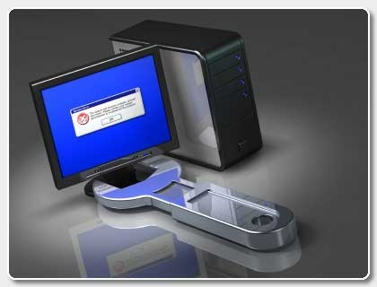
Lecture 4
Total Productive Maintenance

Slide 3
Total Productive Maintenance
T: TOTAL
  Participation of all Employees.
  Includes all departments, operation, equipment and process.
P: PRODUCTIVE
  Pursue the maximization of efficiency of the production system by making all loses zero.
  Zero accidents; Zero defects; Zero breakdowns.
M: MAINTENANCE
  To improve the efficiency of the equipment.
  Maintenance means the entire life cycle of the production system.
  Maintenance is not only to repair and maintain the machines.

Slide 4
History of TPM
TPM evolved from TQM, which evolved as a direct result of Dr. W. Edwards Deming's influence on Japanese industry.
Dr. Deming began his work as a statistician in Japan shortly after World War II.
He initially began to show the Japanese how to use statistical analysis in manufacturing and how to use the resulting data to control quality during manufacturing.
The initial statistical procedures and the resulting quality control concepts fueled by the Japanese work ethic soon became a way of life for Japanese industry.

Slide 5
Background of TPM
Main manufacturing excellence approach of Toyota and other excellent Japanese companies since the 70’s
TPM is the foundation for JIT, FA, Poke Yoke, Lean Manufacturing and Zero Defects
Comes from the best of Japanese Industrial Excellence and evolved from the heat of the continuing Energy Crisis and Globalization Challenges to achieve More with Less

Slide 6
Background of TPM - continue
TPM brings maintenance into focus as a necessary and vitally important part of the business which was regarded as a non-profit activity.
Down time for maintenance is scheduled as a part of the manufacturing day and, in some cases, as an integral part of the manufacturing process.
It is no longer simply squeezed in whenever there is a break in material flow.
The goal is to hold emergency and unscheduled maintenance to a minimum.

Slide 7
When to use TPM
MARKET CIRCUMSTANCES
IN-HOUSE CIRCUMSTANCES
Easy funds for /capacity build up
Market demand / consumption sluggish, High quality competition in the market
Result - Stiff competition, low returns
Opportunity to earn profit
Increasing quality consciousness in market
New plants very efficient and cost effective.
Increasing input material cost
Increasing wages and salaries.
Rising cost of raw material
Higher power cost & specific power
Higher specific fuel consumption
Higher man power cost
Heavy losses, low profit due to equipment failures / low reliability / indifferent attitude
Lower skill levels and involvement
Compartmentalization,
lack of horizontal communication
Low moral/ organizational politics
Unsafe working
Pressure from top to progress fast
CRISIS FOR THE COMPANY

Slide 8
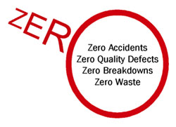
TPM Objectives
Increase production while, at the same time, increasing employee morale and job satisfaction.
Hold emergency & unscheduled maintenance to a minimum.
To provide the safe and good working environment to the worker.
Achieve Zero Defects, Zero Breakdown and Zero accidents in all functional areas of the organization.
Involve people in all levels of organization.
Form different teams to reduce defects and Self Maintenance.
To maintain the HSE conditions of plant and equipments.
To fulfill regulatory compliances.

Slide 9
Benefit of TPM
Direct benefits of TPM:
Increase in productivity and OEE (Overall Equipment Efficiency)
Reduction in customer complaints.
Reduction in the manufacturing cost.
Satisfying the customers needs by delivering the right quantity at the right time, in the required quality.
Reduced or eliminate accident at workplace.

Slide 10
Benefit of TPM
Indirect benefits of TPM:
Higher confidence level among the employees.
A clean, neat and attractive work place.
Favourable change in the attitude of the operators.
Achieve goals by working as team.
Horizontal deployment of a new concept in all areas of the organization.
Sharing knowledge and experience.
The workers get a feeling of owning the machine.

Slide 11
TPM Targets
PRODUCTION
    Obtain Minimum 80% Overall Production Efficiency
    Obtain Minimum 90% Overall Equipment Effectiveness
    Machines run 24/7
QUALITY
Operate in a manner, so that there are no customer complaint.
COST
Reduce the manufacturing cost as much as possible.
DELIVERY
Achieve 100% success in delivering the goods as required by the customer.
SAFETY
Maintain an accident free environment.
MULTYTASK
Develop multi-skills & flexible workers.

Slide 12
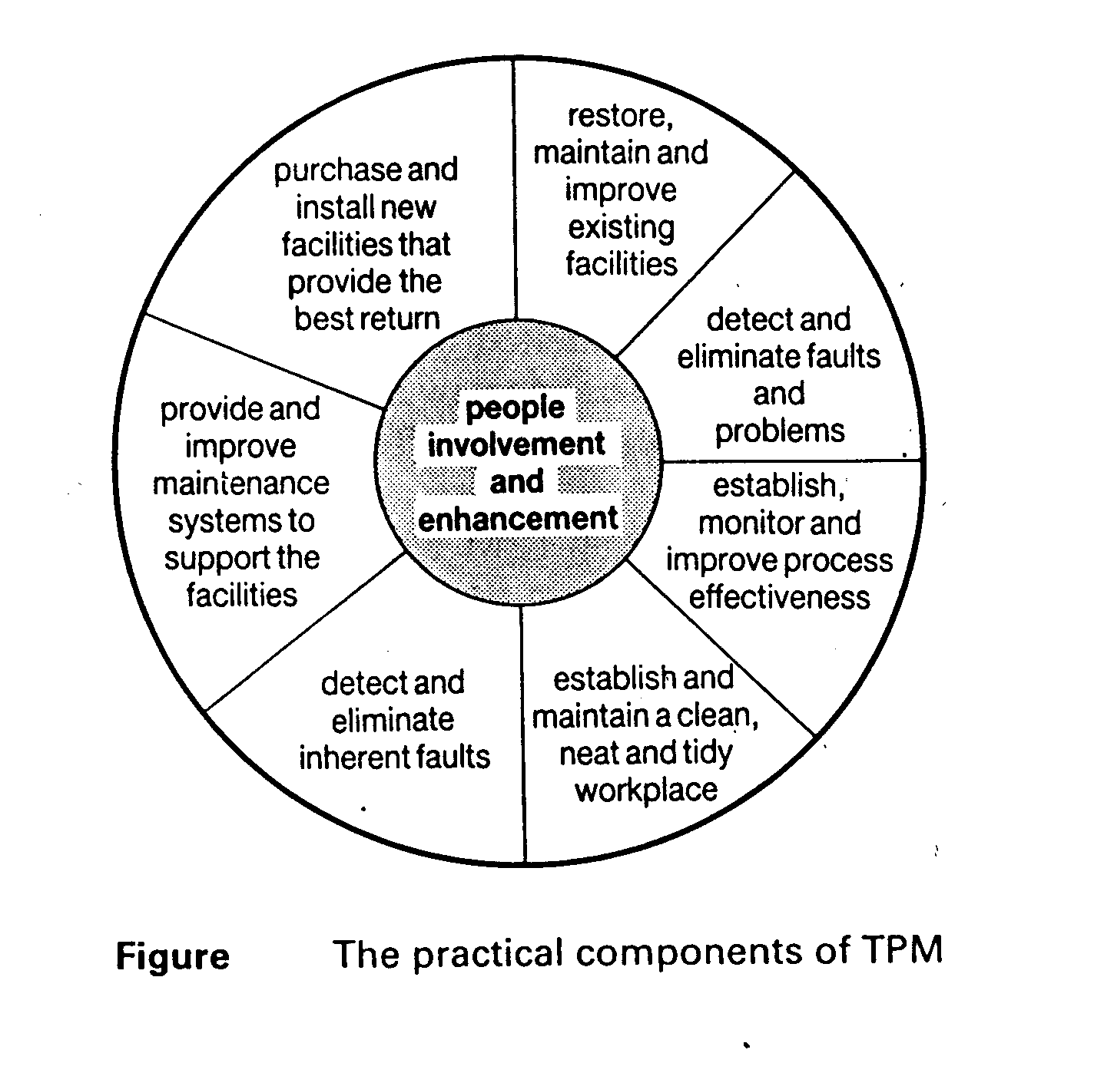
Components of TPM
The Practical Components of TPM

Slide 13
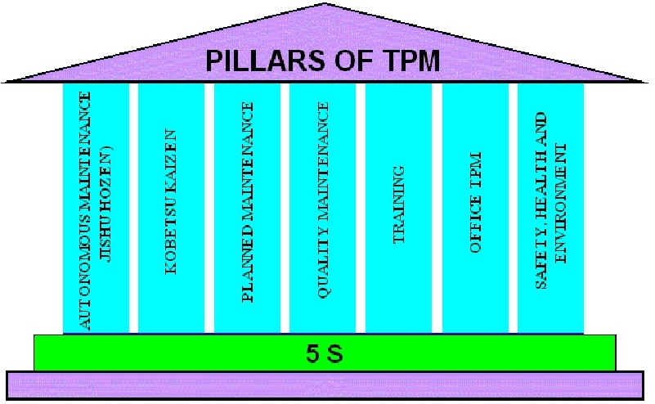
Total Productive Maintenance

Slide 14
TPM Base
TPM starts with 5S.
One can’t see problems clearly when the workplace is in disarray.
Cleaning and organizing the workplace helps the team to uncover problems.
Making problems visible is the first step of improvement.
Clean machines and workplace create pride & safety

Slide 15
TPM Base
  SEIRI – SORTOUT
  Keep only essential items and eliminate what is not required, prioritizing things as per requirements and keeping them in approachable places. Everything else is stored or discarded.
  SEITON – ORGANIZE
  There should be a place for everything and everything should be in its place. Each tool, part, supply, or piece of equipment should be kept close to where it will be used – in other words, straightening the flow path.
  SEISO – SHINE THE WORKPLACE
  Keep the workplace tidy and organized. At the end of each shift, clean the work area and be sure everything is restored to its place.

Slide 16
TPM Base
  SEIKETSU – STANDARDIZATION
  Work practices should be consistent and standardized. Everyone should know exactly what his or her responsibilities are for adhering to the first 3 S's.
  SHITSUKE – SELF DISCIPLINE
  When an issue arises such as a suggested improvement, a new way of working, a new tool or a new output requirement, review the first 4 S's and make changes as appropriate.

Slide 17
PILLAR 1: JISHU HOZEN
Jishu Hozen = Autonomous Maintenance
Policy
Uninterrupted operation of equipments
Flexible operators to operate & maintain other equipments
Eliminating the defects at source through active employee participation
Stepwise implementation of JISHU HOZEN activities.
Jishu Hozen Targets
Reduce process time by predicted values.
Reduce oil/ lubricants consumption by predicted values.
Increase use of Jishu Hozen

Slide 18
Pillar 1: JISHU HOZEN
Jishu Hozen Steps:
Preparation of employees
Initial cleanup of machines
Take counter measures
Fix tentative Jishu Hozen standards
General inspection
Autonomous inspection
Standardization
Autonomous management

Slide 19
Pillar 1: JISHU HOZEN
Train the Employees:
  Educate the employees about TPM, Its advantages, JH advantages and Steps in JH.
  Educate the employees about the equipment they use, the frequency of oiling, day-to-day maintenance activities required and the abnormalities that could occur in the machine and way to find out the abnormalities.

Slide 20
Pillar 1: JISHU HOZEN
2. Initial cleanup of machines:
  Arrange all items needed for cleaning.
  On the arranged date, employees clean the equipment with the help of maintenance department.
  Dust, stains, oils and grease has to be removed.
  When cleaning oil leakage, loose wires, unfastened nuts and bolts and worn out parts must be taken care.
  After clean up, problems are categorized and suitably tagged. White tags are place where operators can solve problems. Pink tag is placed where the aid of maintenance department is needed.
  Contents of tag are transferred to a register.
  Make note of area, which were inaccessible.
  Open parts of the machine are closed, and the machine is run.

Slide 21
Pillar 1: JISHU HOZEN
3. Counter Measures:
  Inaccessible regions had to be reached easily. E.g. If there are many screw to open a flywheel door, hinge door can be used. Instead of opening a door for inspecting the machine, acrylic sheets can be used.
  To prevent work out of machine parts necessary action must be taken.
  Machine parts should be modified to prevent accumulation of dirt and dust.
4. Tentative Standard:
  JH schedule has to be made and followed strictly.
  Schedule should be made regarding cleaning, inspection and lubrication and it also should include details like when, what and how.

Slide 22
Pillar 1: JISHU HOZEN
5. General Inspection:
  The employees are trained in disciplines like pneumatics, electrical, hydraulics, lubricant and coolant, fasteners and Safety.
  This is necessary to improve the technical skills of employees and to use inspection manuals correctly.
  The employees should share this with others.
  By acquiring this new technical knowledge, the operators are now well aware of machine parts.
6. Autonomous Inspection:
  Each employee prepares his own autonomous chart / schedule in consultation with supervisor.
  Parts, which have never given any problem, or part, which don’t need any inspection, are removed from list permanently based on experience.
  Inspection that is made in preventive maintenance is included in JH.
  The frequency of cleanup and inspection is reduced based on experience.

Slide 23
Pillar 1: JISHU HOZEN
7. Standardization:
  The surroundings of machinery are organized. Necessary items should be organized, such that there is no searching and searching time is reduced.
  Work environment is modified such that there is no difficulty in getting any item.
  Everybody should follow the work instructions strictly.
  Necessary spares for equipments is planned and procured.

Slide 24
Pillar 2: KOBETSU KAIZEN (CQI)
KAI + ZEN = KAI means change or improvement and ZEN means good (for the better). Kobetsu means focus.
Basically Kobetsu Kaizen is for small adjustments and corrections but effects the whole process and carried out on a continual basis and involves all people in the organization.
The principal behind is that “a very large number of small improvements are more effective in an organizational environment than a few improvements of large value”.
This pillar is aimed at;
  Reducing losses in the work place that affect our efficiencies.
  losses in a systematic method using various Kaizen Tools.

Slide 25
Pillar 3: Planned Maintenance
With planned maintenance, we evolve an effort from a reactive to a proactive method and use trained maintenance staff to help train the operators to better maintain their equipment.
Policy:
      Achieve and sustains availability of machines
      Optimum maintenance cost.
      Reduce spares inventory.
      Improve reliability and maintainability of machines.

Slide 26
Pillar 3: Planned Maintenance
Steps and Target:
  Equipment evaluation and recording present status.
  Restore deterioration and improve weakness.
  Building up information management system.
  Prepare time based information system, select equipment, parts and members and map on the plan.
  Prepare predictive maintenance system by introducing equipment diagnostic techniques and
  Evaluation of planned maintenance.

Slide 27
Pillar 3: Planned Maintenance
Production Operators
  Clean & Check
  Observe
  Categorize
Active
Planned
Maintenance
Process
Production Planning & Control
  Schedule P.M.
Quality Engineers
  Standards & Calibrations
Manufacturing Engineers
  Equipment Planning
  Equipment Studies
Notes:
All of these activities must work together to fully achieve a successful planned maintenance program.
Everyone must understand their roles and responsibilities and execute as a team.
Planned maintenance can no longer be the sole responsibility of the maintenance department.

Slide 28
Pillar 4: Quality Maintenance
It is aimed towards customer delight through highest quality and defect free manufacturing. Focus is on eliminating non-conformances in a systematic manner.
Quality defects are classified as “CUSTOMER END DATA” and “IN HOUSE defects”.
For customer-end data, we have to get data on Customer-end line rejection and field complaints. In-house data include data related to products and data related to process.

Slide 29
Pillar 4: Quality Maintenance
Policy:
  Defect free conditions and control of equipments
  QM activities to support quality assurances.
  Focus of prevention of defects at source
  Focus on precaution (Pokayoke) system.
  In-line detection and segregation of defects.
  Effective implementation of operator quality assurance.
Target:
Achieve and sustain customer complaints at zero.
Reduce in-process defects.
Reduce cost of quality.

Slide 30
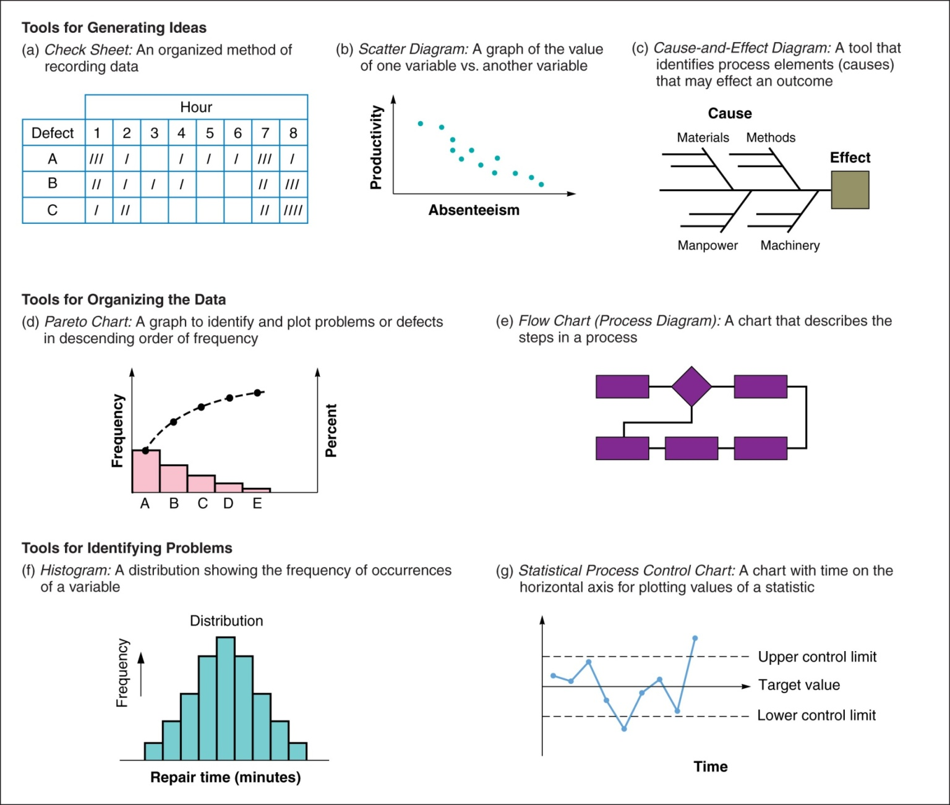
7 Tools to Measure Quality

Slide 31
Pillar 5: Training
It is aimed to have multi-skilled revitalized employees whose moral is high and who has eager to come to work and perform all required functions effectively and independently. Education is given to operators to upgrade their skill.
The employees should be trained to achieve the form phase of skill which are as under:
    PHASE 1: Do not know.
    PHASE 2: Know the theory but cannot do.
    PHASE 3: Can do but cannot teach.
    PHASE 4: Can do and also teach.

Slide 32
Pillar 5: Training
Policy:
1. Focus on improvement of knowledge, skills and techniques.
2. Creating a training environment for self-learning based on felt needs.
3. Training curriculum / tools /assessment etc conductive to employee revitalization
4. Training to remove employee fatigue and make, work enjoyable.
Target:
  1. Achieve and sustain downtime due to want men at zero on critical machines.
  2. Achieve and sustain zero losses due to lack of knowledge / skills / techniques
  3. Aim for 100 % participation in suggestion scheme.

Slide 33
Pillar 5: Training
Steps in training activities:
Setting policies and priorities and checking present status of education and training.
Establish of training system for operations and maintenance skill up gradation.
Training the employees for up gradation the operation and maintenance skills.
Preparation of training calendar.
Evaluation of activities and study of future approach

Slide 34
Pillar 6: Office TPM
Office TPM should be started after activating four other pillars of TPM (JH, Kaizen, QM, PM).
Office TPM must be followed to improve productivity, efficiency in the administrative functions and identify and eliminate losses.
This includes analyzing processes and procedures towards increased office automation.

Slide 35
Pillar 6: Office TPM
Office TPM addresses twelve major losses. They are:
  1. Processing loss
  2. Cost loss including in areas such as procurement, accounts, marketing, sales leading to high inventories
  3. Communication loss
  4. Idle loss
  5. Set-up loss
  6. Accuracy loss
  7. Office equipment breakdown
  8. Communication channel breakdown, telephone and fax lines
  9. Time spent on retrieval of information
  10. Non availability of correct on line stock status
  11. Customer complaints due to logistics
  12. Expenses on emergency dispatches/purchases.

Slide 36
Pillar 6: Office TPM
Office TPM and its Benefits:
  1. Involvement of all people in support functions for focusing on better plant performance
  2. Better utilized work area
  3. Reduce repetitive work
  4. Reduced administrative costs
  5. Reduced inventory carrying cost
  6. Reduction in number of files
  7. Productivity of people in support functions
  8. Reduction in breakdown of office equipment
  9. Reduction of customer complaints due to logistics
  10. Reduction in expenses due to emergency dispatches/purchases
  11. Reduced manpower
  12. Clean and pleasant work environment.

Slide 37
Pillar 6: Office TPM
How to start office TPM?
A senior person from one of the support functions e.g. Head of Finance, MIS, Purchase etc should be heading the sub-committee.
Members representing all support functions and people from Production & Quality should be included in sub committee. TPM co-ordinate plans and guides the sub committee.
  Providing awareness about office TPM to all support departments
  Identify the scope for improvement in each function
  Collect relevant data
  Help them to solve problems in their circles
  Make up an activity board where progress is monitored on both sides - results and actions along with Kaizens.
  Fan out to cover all employees and circles in all functions.

Slide 38
Pillar 7: Safety, Health and Environment
Target:
  1. Zero accident,
  2. Zero health damage
  3. Zero fires.
It focus on how to create a safe workplace and a surrounding area that is not damaged by the process or procedures. This pillar will play an active role in each of the other pillars on a regular basis.
A committee is constituted for this pillar, which comprises representative of officers as well as workers. Manager (Safety) is looking after functions related to safety.
To create awareness among employees various competitions like safety slogans, quiz, brochures, posters, etc. related to safety can be organized at regular intervals.

Slide 39
Difficulties faced in TPM implementation
Typically people show strong resistance to change.
Many people treat it just another “Program of the month ” without paying any focus and also doubt about the effectiveness.
Not sufficient resources (people, money, time, etc.) and assistance provided
Insufficient understanding of the methodology and philosophy by middle management
TPM is not a “quick fix ” approach, it involve cultural change to the ways we do things
Departmental barrier existing within Business Unit
Many people considered TPM activities as additional work/threat.

