Slide 1
Author responsibilities and rights
© Reed Elsevier Group PLC
Notes:
The goal of this presentation is to focus on the responsibilities that as an author you need to be mindful of when submitting manuscripts for publication.

Slide 2
What are my responsibilities as an author? Publishing ethics
© Reed Elsevier Group PLC

Slide 3
March 2015
Author responsibilities
Report only real, non-fabricated data
Originality
Declare any Conflicts of Interest
Authorship
Submit to one journal at a time
© Reed Elsevier Group PLC
Notes:
This is an overview slide that shows the different areas of author responsibilities that the following slides will cover in depth.
Real, unfabricated data
Originality
Conflicts of interest
Authorship
Submission
Who else is responsible?
Punishments

Slide 4
January 2015
The most serious issues to avoid
These are the 3 most common forms of ethical misconduct that the research community is challenged with
1. Fabrication Making up research data
2. Falsification Manipulation of existing research data
3. Plagiarism Previous work taken and passed off as one’s own Plagiarism takes many forms, from “passing off” another’s paper as the author’s own paper, to copying or paraphrasing substantial parts of another’s paper (without attribution), to claiming results from research conducted by others
© Reed Elsevier Group PLC
Notes:
There are different ways that research cannot be considered original:
Fabrication is when the researcher makes up data.
Falsification is when the data collected is manipulated to fit certain trends.
Plagiarism is when work previously done or reports previously written are taken and passed off as one’s own work.

Slide 5
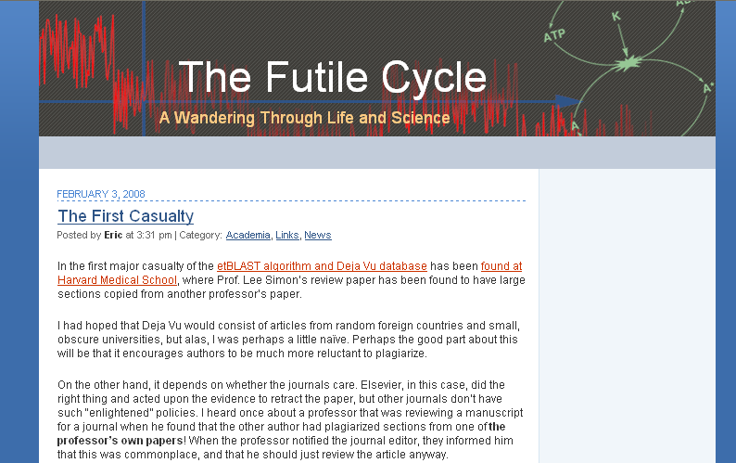
January 2015
Why do we need originality and ethical conduct?
Unethical behavior by Researchers degrades the scientific record and the reputation of science and medicine in the broader community.
It can unfairly affect the reputation and academic record of individual researchers/authors.
A Massive Case Of Fraud Chemical & Engineering News February 18, 2008 Journal editors are left reeling as publishers move to rid their archives of scientist's falsified research
William G. Schulz
A CHEMIST IN INDIA has been found guilty of plagiarizing and/or falsifying more than 70 research papers published in a wide variety of Western scientific journals between 2004 and 2007, according to documents from his university, copies of which were obtained by C&EN. Some journal editors left reeling by the incident say it is one of the most spectacular and outrageous cases of scientific fraud they have ever seen. …
© Reed Elsevier Group PLC
Notes:
This slide reaffirms why it is important to uphold ethical conduct and original works.
Unethical behavior, if allowed to pass, would degrade the scientific record and would affect the reputation of the scientific community.
If left unchecked, the integrity, quality, and credibility of scientists would deteriorate.
The boxes below give two recent examples of unethical conduct:
1. An article in Chemical & Engineering News reports on a chemist in India who plagiarized more than 70 papers over a period of 4 years.
2. The blog on the right reports how recently developed plagiarism software, etBlast, detected that a Harvard Med School professor copied large sections of a review paper from another professor’s work.

Slide 6
January 2015
Conflicts of interest question
Indicate if any of the following are examples of conflicts of interest:
A University Researcher, who owns stock in a large oil company, conducts an experiment on the environmental effects of oil drilling.
A University Researcher, who is developing and testing a new technology, is also a consultant for a financial services firm that weighs investments in new technologies.
A Researcher submits an article to a journal for which the Editor-in-Chief is a Professor in the Researcher’s department.
A Doctor who abides by traditional healing procedures writes a paper on emerging current medical technologies.
© Reed Elsevier Group PLC
Notes:
Discussion slide:
Indicate if any of the following potential scenarios where there might be conflicts of interest.
A University Researcher, who owns stock in a large oil company, conducts an experiment on the environmental effects of oil drilling.
A University Researcher, who is developing and testing a new technology, is also a consultant for a financial services firm that weighs investments in new technologies.
A Researcher submits an article to a journal for which the Editor-in-Chief is a Professor in the Researcher’s department.
A Doctor who abides by traditional healing procedures writes a paper on emerging current medical technologies.

Slide 7
January 2015
Conflicts of interest answer
These are all present potential conflicts
They can take many forms:
Direct Financial - employment, stock ownership, grants, patents
Indirect Financial - honoraria, consultancies, mutual fund ownership, expert testimony
Career & Intellectual - promotion, direct rival
Personal Belief
The proper way to handle potential conflicts of interest is through transparency and disclosure.
At the journal level, this means disclosure of the potential conflict in your cover letter to the Journal Editor
© Reed Elsevier Group PLC
Notes:
All four examples in the thought questions are all potential conflicts of interest because conflicts can take many forms:
Direct financial conflicts (e.g. researcher is employed by or owns stock in those commissioning the research work)
Indirect financial conflicts (e.g. researcher is a consultant to the company commissioning the research work)
Career conflict (e.g. researcher submits his paper to a journal w/ the Editor in Chief residing in his own university/department or where the Editor in Chief may be a staunch advocate of a rival theory on the exact same topic the author is researching)
Personal belief conflict (e.g. example on previous slide of doctor who abides by traditional healing practices writes an article on emerging medical technologies)
Note that just because a potential conflict of interest exists does not automatically imply any wrong-doing. Transparency and disclosure is the proper way to avoid potential conflicts becoming an issue. Authors should therefore disclose any potential conflicts to the journal editor when they submit their cover letter with their manuscript.

Slide 8
January 2015
What does it mean to be an Author?
A researcher completes her paper. Along the way she consulted her advisor for guidance on the experiment, the data analysis and writing and revising the final article.
A professor in India assisted her in analyzing the data only. A lab assistant helped her in preparing the experimental design and maintaining and operating the equipment. Two fellow grad students read her paper and edited it, though they had no hand in the experiment.
Who is listed as an Author?
Who is listed first?
© Reed Elsevier Group PLC

Slide 9
January 2015
Authorship
The correct answer depends on journal policy. Authorship policies vary across disciplines, cultures and journals.
Example, the International Committee of Medical Journal Editors (aka Vancouver Group) declared that an author must:
substantially contribute to conception and design, or acquisition of data, or analysis and interpretation of data AND
draft the article or revise it critically for important intellectual content AND
give their approval of the final version to be published all three conditions must be fulfilled to be an author
Applying this set of policies to our example, only the researcher and her advisor would qualify as authors
All others would qualify as “Acknowledged Individuals”
© Reed Elsevier Group PLC

Slide 10
January 2015
Authorship: order and abuses
General principles for who is listed first:
Abuses to be avoided:
First Author:
conducts and/or supervises the data analysis and the proper presentation and interpretation of the results
puts paper together and submits the paper to journal
Co-Author(s):
makes intellectual contributions to the data analysis and contributes to data interpretation
reviews each paper draft
must be able to present the results, defend the implications and discuss study limitations
Ghost Authors:
leaving out authors who should be included
Scientific Writers and Gift Authors:
including authors when they did not contribute significantly
© Reed Elsevier Group PLC
Notes:
The listing of authors can be an unexpectedly tricky situation. Here are some general principles that can be considered to determine first authors and co-authors.
First authors are the ones who conduct or supervise the data analysis as well as the interpretation and presentation of the results. They also put the paper together and submit it to the journal.
Co-Authors make intellectual contributions to data analysis and interpretation. They also review drafts of the paper. They must be able to present, defend, and discuss their study and the results.
Abuses of authorship include:
Ghost authors: leaving out those who should be included
Gift authors: including those who should not be included.

Slide 11
January 2015
Submission question
These are all present potential conflicts
A researcher is ready to submit her paper and decides to submit to Science, Nature and Cell at the same time.
A researcher has had his paper rejected by Science and decides to submit it to Nature. Failing that, he plans to submit it to Cell. Failing that, he plans to submit to each journal in his discipline until it is accepted.
The first scenario is not acceptable to most research communities and journals
The second scenario is acceptable but authors should heed the advice of referees and editors concerning improvements.
© Reed Elsevier Group PLC
Notes:
Thought question on submission ethics for audience discussion before revealing of answers at the bottom.
The first scenario is strongly discouraged by most research communities and present potential ethical issues. Authors should only submit to one journal at a time and wait to hear a decision from the editor before considering submitting to another journal. By submitting to multiple journals concurrently, authors may find themselves in complicated situations where the article has been accepted in multiple journals, which most journals do not allow. It is also wasteful of referees time. At the very least, this approach is certainly ensuring a greater burden for journal editors.
Scenario #2 is generally acceptable as long as authors address any issues raised by referees and editors before submitting it again to another journal. Continuing to submit it in a brute force method without considering the review comments will likely waste the time of journal editors and that behaviour is discouraged.

Slide 12
January 2015
Submissions answer
Multiple, redundant, or concurrent publication issues
Should be avoided where manuscripts that describe essentially the same research are published in more than one journal or primary publication.
An author should avoid submitting a previously published paper for consideration in another journal.
Duplication of the same paper in multiple journals of different languages should be avoided.
“Salami Slicing”, or creating several publications from the same research, is manipulative and discouraged.
© Reed Elsevier Group PLC
Notes:
Further explanation of unethical submission behavior related to multiple, redundant, or concurrent submissions:
Manuscripts ideally should not be published in more than one journal or primary publication. The author has a responsibility to ensure that he/she is submitting top quality, well-written, original research work. By submitting and re-submitting unoriginal work, an author is wasting the editor’s time while not advancing the front of science.
Authors should avoid re-submitting previously published works in other journals for the same reasons of originality.
Duplication of papers across journals in different languages should be avoided as well for the same reasons. However, it is acceptable to have an article translated into other languages to broaden reach, provided permission is sought from the original publication and duly acknowledged in the translated version.
Slicing one’s research work into smaller “sub-papers” is a manipulation of the research and publishing process.

Slide 13
January 2015
Re-cap
Real, non-fabricated data
Originality
Declare any conflicts of interest
Authorship
© Reed Elsevier Group PLC
Notes:
Above all else:
Use real, unfabricated data
Ensure your work is original
Correctly list all authors
Declare any conflicts of interest

Slide 14
Plagiarism
© Reed Elsevier Group PLC
Notes:
This module provides a overview of plagiarism and how to avoid it.

Slide 15
January 2015
What is plagiarism?
Plagiarism is the appropriation of another person’s ideas, processes, results, or words without giving appropriate credit, including those obtained through confidential review of others’ research proposals and manuscripts. Federal Office of Science and Technology Policy, 1999
Presenting the data or interpretations of others without crediting them, and thereby gaining for yourself the rewards earned by others, is theft, and it eliminates the motivation of working scientists to generate new data and interpretations. Professor Bruce Railsback, Department of Geology, University of Georgia
Notes:
According to the Federal Office of Science and Technology Policy “Plagiarism is the appropriation of another person’s ideas, processes, results, or words without giving appropriate credit, including those obtained through confidential review of others’ research proposals and manuscripts.” Professor Bruce Railsback, Department of Geology, University of Georgia suggest it is “Presenting the data or interpretations
of others without crediting them, and thereby gaining for yourself the rewards earned by others, is theft, and it eliminates the motivation of working scientists to generate new data and interpretations.”

Slide 16
January 2015
What may be plagiarised?
Work that can be plagiarised includes…
Words (language)
Ideas
Findings
Writings
Graphic representations
Computer programs
Diagrams
Graphs
Illustrations
Information
Lectures
Printed material
Electronic material
Any other original work
Higher Education Academy, UK
© Reed Elsevier Group PLC
Notes:
Work that can be plagiarised includes…
Words (Language)
Ideas
Findings
Writings
Graphic Representations
Computer Programs
Diagrams
Graphs
Illustrations
Information
Lectures
Printed Material
Electronic Material
Any Other Original Work

Slide 17
January 2015
Question
Has the researcher violated any ethical boundaries?
A researcher notices a paragraph in a previously published article that would be suitable as the Materials and Methods in his article.
The researcher decides to copy that paragraph into his paper without quotes or attribution.
© Reed Elsevier Group PLC
Notes:
Question: A researcher notices a paragraph in a previously published article that would be suitable as the Materials and Methods in his article. The researcher decides to copy that paragraph into his paper without quotes or attribution.
Has the researcher violated any ethical boundaries?

Slide 18
January 2015
Answer
Yes
Re-using texts in the materials and methods when you followed the same technique and used the same equipment as another author may be a less serious form of plagiarism. However, it is still unacceptable: instead, just say that you followed the same technique as another author and cite them fully.
.
© Reed Elsevier Group PLC
Notes:
Answer
It is vitally important that the scientific results and ideas in a paper are the authors’ own. Plagiarism of results or original ideas is a serious offence. Re-using texts in the materials and methods when you followed the same technique and used the same equipment as another author may be a less serious form of plagiarism. However, it is still unacceptable: instead, just say that you followed the same technique as another author and cite them fully. Or re-write the technique in your own words. Copying and pasting the words of others is disrespectful to the original author: always give credit where it is due.

Slide 19
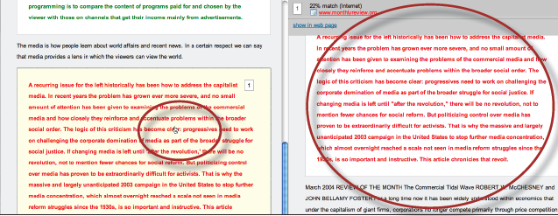
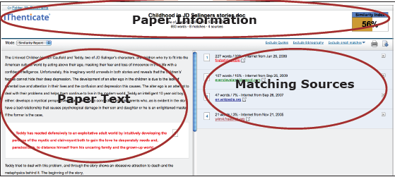
March 2015
Plagiarism Detection
© Reed Elsevier Group PLC

Slide 20
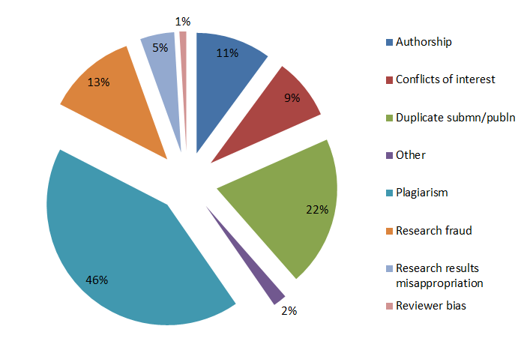
January 2015
Plagiarism highest amongst ethical issues
Sample of cases reported to Elsevier Journals publishing staff in 2014
© Reed Elsevier Group PLC
Notes:
Plagiarism is the single most commonly reported ethics issue, based on cases reported to Elsevier Journals publishign staff in 2012. However, we do not know whether this is because plagiarism actually occurs the most often. More likely, it is just the easiest ethical issue to detect: especially these days with plagiarism detection software such as CrossCheck.

Slide 21
January 2015
How big is the problem of plagiarism?
Huge database of 30+ million articles, from 50,000+ journals, from 400+ publishers
Software alerts Editors to any similarities between the article and this huge database of published articles
Many Elsevier journals now check every submitted article using CrossCheck
© Reed Elsevier Group PLC
Notes:
CrossCheck is a huge database of 30+ million articles, from 50,000+ journals, from 400+ publishers. Software alerts Editors to any similarities between the article and this huge database of published articles. Many Elsevier journals now check every submitted article using CrossCheck

Slide 22
January 2015
Plagiarism is serious but easily avoidable
Plagiarism is easily avoided
You can use ideas, phrases and arguments from sources already published, just acknowledge the source and the original author
© Reed Elsevier Group PLC
Notes:
Plagiarism is serious but easily avoidable
Plagiarism is easily avoided
You can use ideas, phrases and arguments from sources already published, just acknowledge the source and the original author

Slide 23
January 2015
Correct citation is key
Crediting the work of others (including your advisor’s or your own previous work) by citation is important for at least three reasons:
To place your own work in context
To acknowledge the findings of others on which you have built your research
To maintain the credibility and accuracy of the scientific literature
© Reed Elsevier Group PLC
Notes:
Crediting the work of others (including your advisor’s or your own previous work) by citation is important for at least three reasons:
To place your own work in context
To acknowledge the findings of others on which you have built your research
To maintain the credibility and accuracy of the scientific literature

Slide 24
January 2015
Paraphrasing
Paraphrasing is restating someone else's ideas while not copying their actual words verbatim
It is unacceptable:
Using exact phrases from the original source without enclosing them in quotation marks
Emulating sentence structure even when using different words
Emulating paragraph organization even when using different wording or sentence structure
– Statement on Plagiarism
Department of Biology, Davidson College.
www.bio.davidson.edu/dept/plagiarism.html
© Reed Elsevier Group PLC
Notes:
Paraphrasing is restating someone else's ideas while not copying their actual words verbatim.
It is unacceptable to:
Using exact phrases from the original source without enclosing them in quotation marks
Emulating sentence structure even when using different words
Emulating paragraph organization even when using different wording or sentence structure

Slide 25
January 2015
Can you plagiarise your own work? Text re-cycling/Self-plagiarism
A grey area, but best to err on the side of caution: always cite/quote even your own previous work
For example You publish a paper and in a later paper, copy your Introduction word-for word and perhaps a figure or two without citing the first paper
Editors may conclude that you intentionally exaggerated your output
© Reed Elsevier Group PLC
Notes:
Can you plagiarise your own work?
Text re-cycling/Self-plagiarism is a grey area, but best to err on the side of caution: always cite/quote even your own previous work.
If you publish a paper and in a later paper, copy your Introduction word-for word and perhaps a figure or two without citing the first paper, Editors may conclude that you intentionally exaggerated your output.

Slide 26
March 2015
Consequences
Potential consequences can vary according to the severity of the misconduct and the standards set by the journal editors, institutions and funding bodies.
Possible actions include:
Written letters of concern and reprimand
Article retractions
Some form of disciplinary action on the part of the researcher’s institute or funding body
RETRACTED
© Reed Elsevier Group PLC

Slide 27
January 2015
Recap
Never cut & paste (even to save time in drafts)
When in doubt, cite!
If you suspect: REPORT
Responsibility
© Reed Elsevier Group PLC
Notes:
Never be tempted! If in doubt, cite your source - even if the original authors have died.
Never when drafting your papers to save time cut and paste, because you may forget what you have taken from where.
If you suspect you have detected plagiarism you must report it.
Then we can rely on the literature and on the scientific community to relay the truth, which is after all our mission.

Slide 28
Useful links
January 2015
Elsevier.com/authors
Elsevier.com/reviewers
Elsevier.com/ethics
Mendeley.com - free reference manager and academic social network
Elsevier.com/webshop - Language Editing Services
COPE - www.publicationethics.org.uk/about
PERK - http://www.elsevier.com/editors

Slide 29
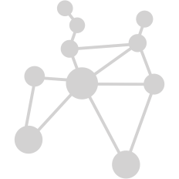
January 2015
Who is really responsible for Ethics?
All Stakeholders
Authors
Institutions/Companies/Agencies/Funding Bodies Publishers/Journal Editors
All Elsevier journals are members of:
Elsevier supports editors
with a Publishing Ethics Resource Kit (PERK)
to guide them in investigations of unethical behavior
© Reed Elsevier Group PLC
Notes:
Authors are not the only ones who are responsible for ethics. A general division of responsibilities is as follows:
1. Authors – uphold ethics by learning of standards (such as through this presentation).
2. Institutions/companies/agencies/funding bodies – should set standards and communicate them; investigate and take action if unethical behavior is discovered
3. Publishers/journal editors – set standards for their journals and take editorial action if misconduct is discovered
In Elsevier’s case, we have listed all of our journals with the Committee on Publishing Ethics, a forum for editors to seek guidance on ethical issues.
And we have also established a Publishing Ethics Resource Kit (PERK) on our website for editors to use as a guide in making decisions on ethical issues with their journal.
COPE - http://www.publicationethics.org.uk/about
PERK - http://www.elsevier.com/wps/find/editorshome.editors/Introduction

Slide 30
Author rights Content ownership
Notes:
I’ve written my paper but who technically owns it?

Slide 31
I’ve written my paper but who technically owns it?
Notes:
I’ve written my paper but who technically owns it? This course serves to provide a baseline understanding of copyright and content ownership.

Slide 32
Copyright fundamentals
Myth or Fact?
Authors (and in some cases their employers) have the right under national copyright laws (and international treaties) to control how their works are to be used and distributed to others
Fact
Notes:
Authors (and in some cases their employers) have the right under national copyright laws (and international treaties) to control how their works are to be used and distributed to others
This is statement is a fact.
Authors (and sometimes their employers [if the author and employer have an agreement in place as part of the authors employment]) retain the rights to the use and distribution of their works under national copyright laws unless they sign away those rights.

Slide 33
Copyright fundamentals
Myth or Fact?
Copyright protects the underlying facts, the ideas of your work, and the way you express your thoughts and describe your research and conclusions in your writing
Myth
Notes:
Copyright protects the underlying facts, the ideas of your work, and the way you express your thoughts and describe your research and conclusions in your writing
This statement is a myth. Copyright only protects the way in which the ideas or concepts are expressed, not the underlying facts themselves.
Someone else could describe or express some facts or results in a different way from you and that would not be considered a copyright infringement.

Slide 34
Copyright fundamentals
Myth or Fact?
The extent of copyright rights allows authors to permit: the copying, distribution, online access, translation and creation of other derivative works of research such as a thesis, book etc
Fact
Notes:
The extent of copyright rights allows authors to permit: the copying, distribution, online access, translation and creation of other derivative works of research.
This statement is a fact.
The extent of copyright rights does allow authors to permit all of the following: copying, distribution, online access, translation, and creation of derivative works.

Slide 35
Copyright fundamentals
Myth or Fact?
Publishers or other distributors do not need written agreements from authors to transfer copying and distribution rights
Myth
Notes:
This is a myth. Publishers DO need written agreement from authors to be able to distribute the author’s work.

Slide 36
Copyright fundamentals
Myth or Fact?
Journal publishing agreements can take the form of a transfer of copyright or a publishing license
Fact
Notes:
The extent of copyright rights does allow authors to permit all of the following: copying, distribution, online access, translation, and creation of derivative works.

Slide 37
Copyright fundamentals
Myth or Fact?
Journal publishing agreements generally only spell out rights granted to the publisher
Myth
Notes:
This statement is a myth. Journal publishing agreements usually spell out the rights that are transferred to the publisher as well as the rights retained by the author.

Slide 38
Publishing agreements
Author warranties
The publishing agreement has warranties as to originality
Obtaining of necessary permissions
Obtaining of any necessary privacy waivers (subjects)
Compliance with research standards
Compliance with publisher and journal ethics and conflicts of interest policies
Agreement of all co-authors
Government works
The laws of some countries note that the works of government employees may have a special copyright status
US Government Works: if done in the scope of employment, exclusively by government authors, then will be public domain (no copyright attaches)
Crown Copyright Works: for UK government authors, work is owned by and licensed out by UK government (similar rules in other countries)
Notes:
Publishing agreements also usually include Author Warranties. Generally, these are statements that certify the work was created and conducted in an ethical, compliant manner.
There may also be certain special provisions for government works, for example:
US government works are to be in the public domain
UK government works are to be owned and licensed by the UK government

Slide 39
Rights retained by authors
Rights retained by authors in publishing agreements usually address academic usage rights
Use of the work by the author in teaching
Re-use in other scholarly works
Publishing agreements differ by publisher
Notes:
Rights retained by authors are spelt out in the publishing agreements and typically address academic usage rights.
Use of the work in an author’s teaching
Re-use of the work in other scholarly works.
It is important to note that publishing agreements vary by publisher, so they should be carefully read.

Slide 40
Elsevier author rights
Teaching: allowed to make copies of the article for use in classroom teaching
Educational materials: article can be included in the author’s institution or company e-course packs or company training
Scholarly sharing: copies of the article can be shared with research colleagues
Meetings/conferences: article can be presented and copies can be made for attendees
Further works: article can be used in compilations, expanded to book-form, or used in thesis or dissertation
Patent and trademark rights: for any invention disclosed or product identified
Notes:
Publisher agreements do vary and less restrictive terms do apply to those Elsevier titles that are published “Open Access”.
In Elsevier’s case though, our author agreements allow the following:
Copies of the article for classroom teaching
Articles to be included in coursepacks for Educational purposes
Copies of the article for sharing with fellow research colleagues
Copies of the article for those attending a meeting where you are presenting the article
Article can be expanded to book form or used in a thesis/dissertation
Article can be used for any patent and trademark rights.

Slide 41
Other allowances and restrictions (I)
Elsevier’s posting allowances:
Pre-print version of article to internet websites
Revised personal version of text of final article to author’s personal or institutional website or server
According to funding body agreements (e.g. Wellcome Trust, Howard Hughes Medical Institute, National Institutes of Health)
Notes:
Publishers also typically spell out “Posting” allowances for authors.
In Elsevier’s case we allow:
Posting of pre-prints to internet websites including pre-print servers
Posting of a revised personal version of the text of the final journal article (to reflect changes made in the peer review process) to the author’s personal or institutional website or server.
Posting in accordance with agreements made between Elsevier and funding bodies such as the Wellcome Trust and HHMI. The link provided is to directly view all of the agreements Elsevier has in place with different funding bodies. (www.elsevier.com/fundingbodies)

Slide 42
Other allowances and restrictions (II)
Elsevier’s commercial purpose prohibitions
Posting by companies for customers to use
Placing advertisements against the postings
Charging fees for access to postings or delivering postings to third parties
Any form of systematic distribution of the article.
Notes:
Express prohibitions that would be considered commercial use of the article include:
Posting by companies for customers to use
Placing advertisements against the postings
Charging fees for access to postings or delivering postings to third parties
Any form of systematic distribution of the article.

Slide 43
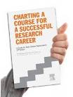
publishingcampus.com
elsevier.com/authors
elsevier.com/reviewers
elsevier.com/editors
Further reading at
Understanding the Publishing Process with Elsevier – complete guide
Publishing Ethics brochure – top reasons to publish ethically
Get Published – top tips on writing, reviewing and grant writing etc.
Get Noticed – new ways to promote your article and research
Open access – definitions and options
Career Planning Guide – download in 12 languages
Notes:
Useful collateral. We have shipped some to this event and they are at the back of this room for you to take home.

Slide 44
Thank you
For further information please visit: www.elsevier.com/authors
Visit Elsevier Publishing Campus
www.publishingcampus.com

Slide 45
Open access publishing
Notes:
The goal of this presentation is to provide researchers with background information on open access publishing and guidelines for users to re-use the content.

Slide 46
Who are the stakeholders in open access?
Funders
Open access policies and mandates
Institutions
Open access polices and repositories
Publishers
Implementing open access options for researchers
Researchers
Being encouraged to publish research output open access
Readers
Everyone should be able to read the research being published
Governments
Open access policies and mandates
Notes:
Open access brings together many different stakeholders who all need to work together. These include
Researchers: Starting with perhaps one of the most important stakeholders – researchers. Increasingly you will be encouraged to publish your research output open access. In fact, if we go back to how journals work, it is you who actually drives the uptake and popularity of open access by your choice of where and how you publish.
Funding bodies: Perhaps considered to be new stakeholders, as in most cases funders want to make sure the research they fund is available to the wider public . As such many have introduced open access or public access policies to achieve this aim. Examples of funders with these policies include the Wellcome Trust in the UK, The NIH in the US but also the European Research Council, and the Chinese Academy of Sciences (CAS). They are important stakeholders as researchers will increasingly need to comply with these policy to ensure they continue to receive grant funds in the future.
Institutions: In addition to funders, many institutions also have a firm commitment to making research produced by their faculty open access and their policies will also support their government or funding body policies. Institutions are important as they help provide valuable information about open access options on their intranet and often hold open access discussions and learning sessions on campus. For researchers it will be important to understand any additional requirements from your institution, such as depositing your datasets or publications in the institutional repository.
Publishers: We also play an important role by investing in the infrastructure and systems to support and implement open access options in our journals. This requires a lot of change for example to support individual researchers paying for gold open access or adjusting and refining labelling of articles on platforms to ensure author’s choice of user licenses are shown.
General Public: We should not forget that a major stakeholder in scientific research is the general public. It is important that they too are able to access and to read the research that is being published.
Governments: Finally, your government also plays a role in open access. In some cases, the Government have a preference in how your country or region should approach and implement open access. For example in the UK and the Netherlands, the government would like to introduce 100% gold open access. In other countries such as the US, the government has tasked funding agencies to come up with an appropriate plan.

Slide 47
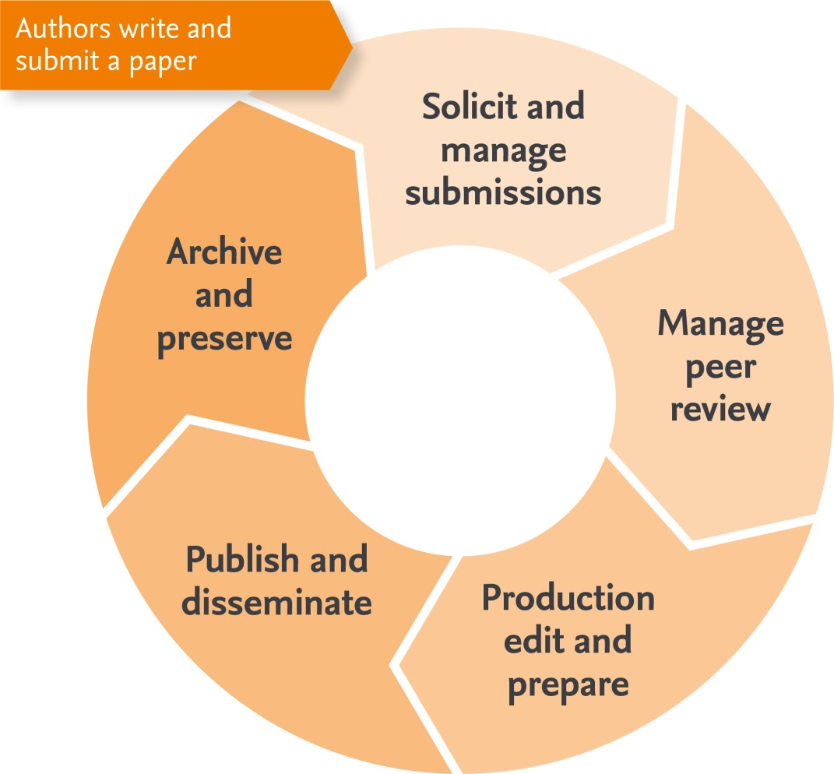
How do STM journals work?
1.8 Million
Peer reviewed articles*
28,000
Scholarly peer reviewed journals*
5,000+
Publishers
But how will your paper be access and reused?
*STM report 2012
Notes:
To help understand open access publishing it is important to start at the beginning.
Throughout your career you will need to use scholarly articles in order to stay up to date with the latest research, use and cite articles when writing your own papers and to also publish your own papers. It is important to understand how journals work and how others will access and use your own research when you come to get published.
How do journal’s work?
The basic process is that an author will write and submit their paper to a journal of their choice.
The journal will register the paper in their submission system and check that it is an original piece of research.
The journal will then organize the paper to be sent to at least two experts in the field who can comment on the merit of the work and suitability for the journal. This is what is called peer review.
After collecting these comments, the journal sends the reviewer comments to the author who can then incorporate them into their paper. If the comments are addressed satisfactorily, the paper will be accepted for publication.
At this stage the journal will edit and typeset the paper as well as add critical information like metadata and DOI registration which ensures the article can be found and cited.
This system helps ensure an estimated 1.8 million articles undergo peer review in 28,000 peer reviewed journals which form the basis of the scholarly record which we can all use and trust.
However, when we come to the publishing and disseminating, it is increasingly important to understand how your article will be accessed and used by both your community and beyond.

Slide 48
Who needs to access research?
How to access published research:
Institutions & Researchers
1. Subscription options
Individual journal title
Collection of relevant journals
2. Open access
Authors or sponsors pay for readers to access free
Delayed access
Manuscripts posted in institutional/discipline/funder repository
3. Access programs
Lending/rental services
Research4Life
Patient access programs
Public library access
Etc.
Corporations
& SMEs
Hospitals & Medical Schools
Readers, General public & Patients
Notes:
There are three high level ways you can access research
The first is though a subscription. This could be to an individual journal or a collection of relevant journals. Subscribers usually receive significant discounts in much the same way as a magazine or newspaper subscriber.
The second way to access content is through open access. We will learn more about this option in this presentation.
Through various access programs. These programs are set up to identify and address important access gaps. For example for developing countries, the Research4Life program provides free or very low cost access to up to 45,000 peer-reviewed international scientific journals, books and databases as well as literacy training and support. Other examples listed here include access through local public libraries, such as the Access to Research initiative in the UK, but also specialized patient access programs, usually set up in conjunction with healthcare providers in order to supply trusted and reliable information to patients and their caregivers.

Slide 49
What is open access?
Free and permanent access to scholarly research
combined with clear guidelines (user licenses) for users to re-use the content.
Gold open access
After submission and peer review, an article publishing charge (APC) is payable
Upon publication everyone can immediately and permanently access the article online
Green open access
After submission and peer review in a subscription journal, the article is published online
Subscribers have immediate access and the article is made open access either through author self-archiving, publisher deposit or linking, after a time-delay, usually 24 months.
Notes:
Open access is about the free and permanent access to scholarly research combined with clear guidelines for users to re-use the content. – these guidelines take the shape of a user license which is attached to the article ( more of which we will go into later).
From this definition we have two routes to publishing open access- gold and green open access.
The 1st route- gold open access is where an author will submit to will submit to a journal which is either open access or has an open access option (also known as a hybrid journal). After peer review and acceptance, the author pays an article publishing charge – also called an APC and the final published article is immediately and permanently free to access online.
The 2nd route – green open access is a little different. This is where a version, not necessary the final published article but usefully the preprint or accepted manuscript version of a subscription articles is also made available open access. It complements longstanding approaches to scholarly sharing (e.g. mailing reprints). There are a number of ways to achieve green open access which includes authors self-archiving (for example in an institutional repository), publishers depositing a copy of your article, or via links where publishers make a free copy of your article available on the publisher’s platform (such as an open archive).

Slide 50
What is the difference?
 | Gold Open Access |  | Green Open Access
Access | Free public access to the final published article Access is immediate and permanent |  | Free public access to a version of your article Time delay may apply (embargo period)
Fee | Open access fee or article publishing charge (APC) is paid by the author, or on their behalf (for example by a funding body) |  | No fee is payable by the author, as costs are covered by library subscriptions
Use | Determined by your user licence |  | Authors retain the right to use their articles for a wide range of purposes Open versions of your article should have a user license attached
Options | Publish in an open access journal | Publish in a journal that supports open access (also known as a hybrid journal) | Link to your article. Selected journals feature open archives Self-archive a version of your article
Notes:
So what exactly is the difference? Here you can see the two routes to open access side by side.
The key difference for gold open access is
Access is to the final published article, which is the trusted version of record and preferred by other researchers when wanting to cite your paper.
To enable free access to everyone and to cover the cost of publication, a fee is paid by the by the author (which is usually covered by their funder or institution).
Authors determine how their article can be reused by others. This means you can choose to make your article available either for all types of purposes, including commercial, or only for non-commercial purposes - the choice is up to the author.
For green open access, this is the process of making a version of a subscription article open access. In this case the key difference is:
Free public access is to a version of your article - normally the version after peer review called the accepted manuscript. Usually it is not the final published article which contains all the formatting and journal branding.
Open access is after a time delay called an embargo period. Embargo periods typically range from 12- 24 months for most publishers.
Green open access can be enabled in multiple different ways either through posting a link to your article, or when a journal opens their archive to the public (also called delayed access) and when researchers post an open version of their article externally perhaps on their blog or personal website or institutional repository.

Slide 51
Why publish in an open access journal?
14%
have been asked by their departmental head or funding organization to publish open access
Notes:
So – the next logical question is why would a research want to publish open access?
Elsevier regularly survey’s researchers to ask them about their needs and preferences. In 2014, we surveyed just over 6,000 researchers to ask why they would publish open access journal. The results were somewhat surprising.
The majority of researchers wanted to publish open access as they wanted their own community and everyone else to be able to access their research.
On the other side we can see that mandates from funding bodies (10%) and institutions (5%) are not the primary reason for researchers to publish open access. In addition to this only 14% of surveyed authors have been asked by their departmental head or funding organization to publish open access.

Slide 52
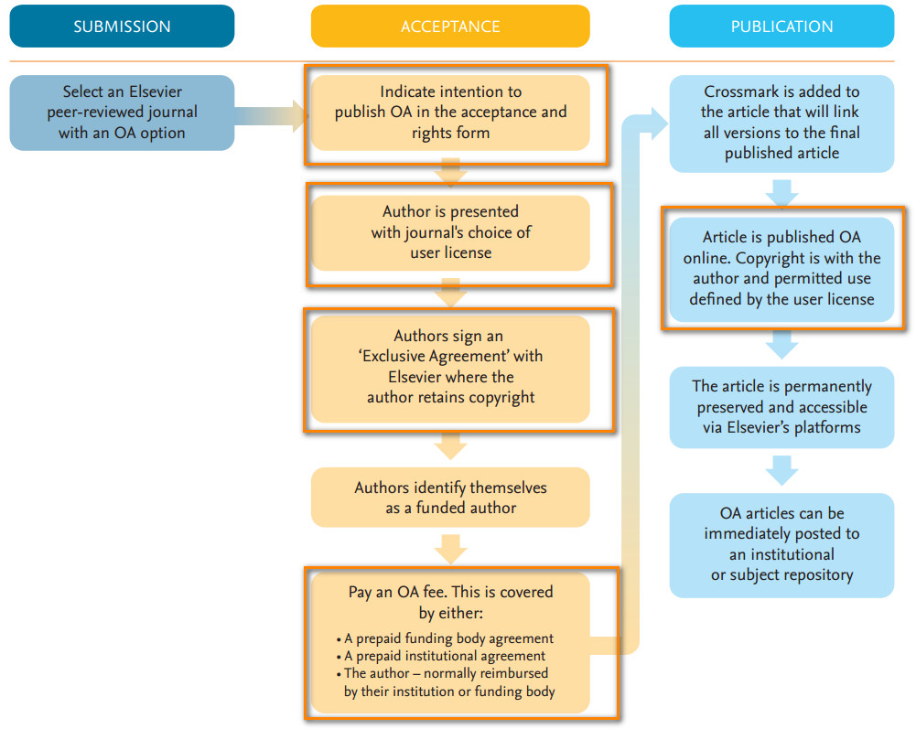
Publishing gold open access
Notes:
What changes when you publish gold open access?
There are key changes for the publishing process. These are mainly after acceptance where
Authors publishing in hybrid journal will need to actively indicate if they want to publish gold open access. For Elsevier this is after acceptance when authors indicate their funding body etc.
After this, authors can choose a user license, which is normally a selection from creative commons user licenses.
In most OA publishing, they will also need to sign an Exclusive Agreement, where they will retain copyright
Finally, an APC needs to be paid- this is either covered by the author, which may be reimbursed, or via prepaid plan through their institution or funding body.
After publication as the final step their article is published online as an open access article, with the correct user license, funding body and copyright information.

Slide 53
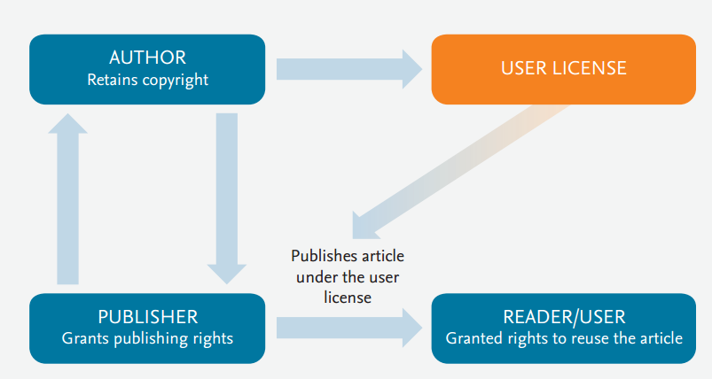
Understanding the fine print
Notes:
It is important that you as an author understand the various legal licenses required for publishing. As we described at the start- open access is made up of two parts the free access and permitted reuse.
Reuse is the “new” part for authors as it has introduced a lot of new terminology around licenses.
It is important that you, as authors, understand how licenses impact on the publication and use of your research- so for open access publishing you need to understand the fine print.
In general you can see the process of licensing in the diagram. Publishing requires two different types of licenses:
1. A license between the author and publisher- determined by a publishing agreement - copyright.
2. The second is between the author and the reader – determined by the Creative Commons user license.

Slide 54
Copyright
Describes the rights related to the publication and distribution of research
Publisher's need publishing rights
This is determined by a publishing agreement between the author and publisher
In subscription journals, it is normal to transfer copyright to the publisher
In open access, authors retain copyright and grant publishers a license to publish their article.
Authors retain:
Copyright of the article
Patent trademark and other intellectual property rights in the article
Publisher gets:
An exclusive right to publish and distribute an article.
Are able to adapt the article for latest technology even after publication.
Notes:
Copyright is the term used to describe the rights related to the publication and distribution of research. It governs how authors (as well as their employers or funders), publishers and the wider general public can use, publish and distribute articles or books.
Publisher's need publishing rights- and this is determined by a publishing agreement between the author and publisher- usually after acceptance.
In subscription journals it common to transfer the copyright to the publisher. However in open access publishing it is common that the author would retain their copyright.

Slide 55
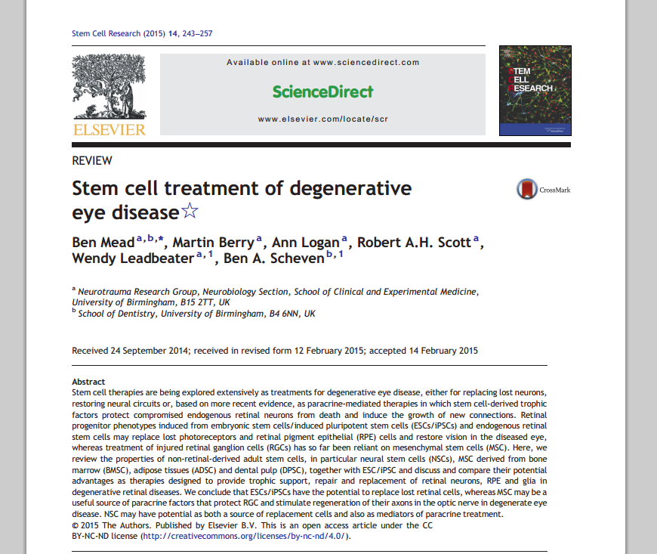
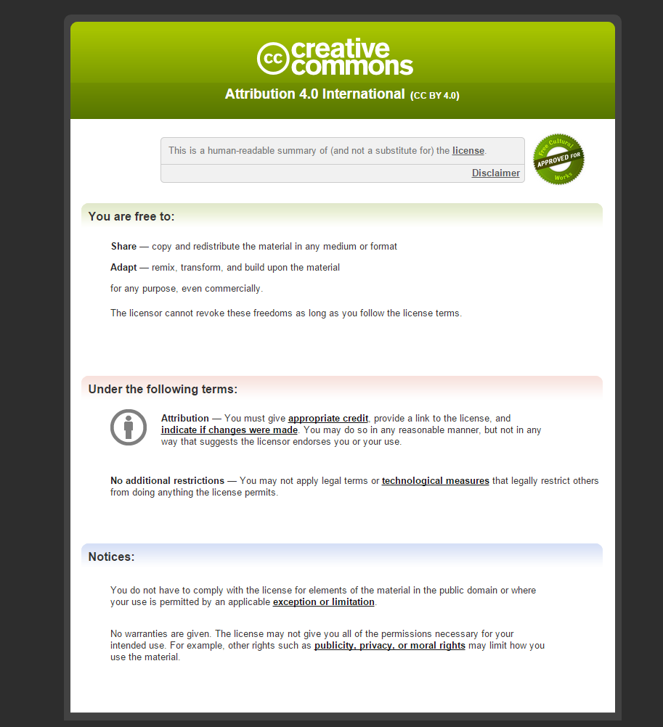
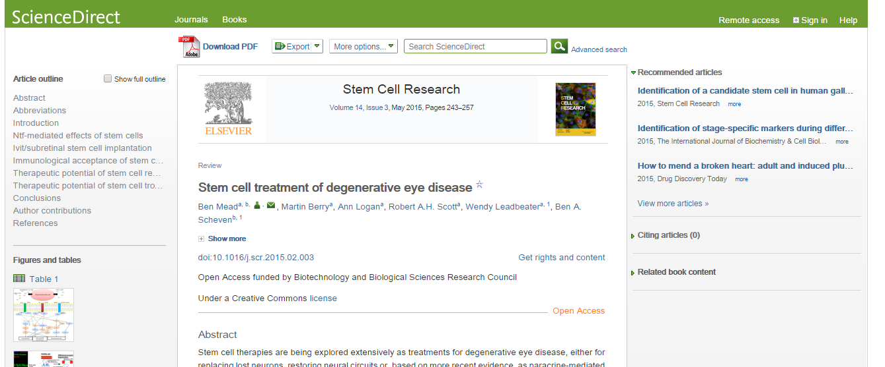
Creative Commons licenses
How readers can reuse your article
Tells readers what they can and can’t do with your article
Ensures you get credit for your work
Notes:
After you have an agreement in place between an author and the publisher ( i.e. the copyright part) you will also need to attach some guidelines to your article in the form of a creative commons license. This is important as your article is available for everyone to access and if you can access an article you may also want to reuse it.
So for example perhaps the reader would like to translate your article, or display this in a repository or use this in other ways that you may not have originally indented. You as an author do not want to be contacted each time someone would like to do this – so by attaching a Creative Commons license you give readers permission to do certain things with your article. The license is also needed as it ensures if your article is reused, that the you will need to be credited (something that is called Attribution).
How does it work?
Let’s take an example of a gold open access article. On the PDF version, the license information, in addition to the copyright information is listed under the abstract. In this case the author has chosen a CC BY license and you can see the URL. When we look at the HTML version, a link is provided as part of the title and author information. When clicked readers are taken to the Creative Commons website where they can read more information about what they can and can’t do.

Slide 56
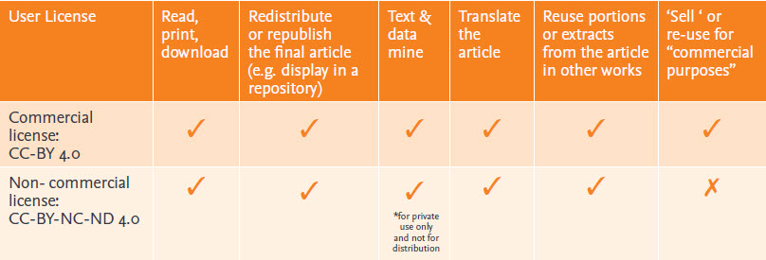
User Licenses
Describes how readers can use your article which may include commercial reuse
Know your OA policies - some funders require specific licenses
Be informed - you can’t necessarily change your mind
Notes:
The Creative Commons licence determines what readers can do with your article. We encourage authors to understand what you are and are not permitting readers to do with your article.
You can see from the chart, that there are two main licenses used in open access publishing one which permits commercial reuse (CC BY) and one which is also liberal but restricts reuse for noncommercial purposes only.
What is important to know is if your funding body or institutional open access policy requires a specific license. This is important as even though you have published your article open access, you still may not comply unless your article in published under the correct license.
Finally, and perhaps most importantly is be informed about your choice. Once your article has been published under a specific user license anyone who downloads or redistributes that article will do so with that particular user license information. This means, you want to change your mind, move from a liberal license such as CC BY to something more restrictive, it will only apply to those readers who download your article with the new license. So you can’t retrospectively go back and change the license on all downloaded copies.

Slide 57
Article publishing charges (APCs)
Covers the cost involved when publishing an article
Relate to gold open access publishing only
Tends to be journal specific and vary between journals
“
My research funds include sufficient amounts to pay to have my research articles published open access
”
53%
of surveyed researchers
disagreed or strongly disagreed
23%
of surveyed researchers
agreed or strongly agreed
How to pay an APC?
Generally, APC’s are not paid by the author
Funding body’s who have an open access policy, may reimburse authors
Prepaid deals between an institution/funder and a publisher
Notes:
A unique feature of gold open access publishing is that instead of subscribers paying the cost of publishing and distributing your article ( through subscriptions to the journal), authors pay a one time fee called an article publishing charge or APC for short. APCs enable everyone to access, read and download your article for free.
These fees relate only to gold open access publishing. So if you want to publish in a subscription journal, then the cost of publishing is covered by subscribers and you won’t need to pay when you are accepted.
APCs vary between journals- there is no standard fee for each publisher- every journal may have a different price- so check the journal's homepage for information
These fees tend to be subject/field related and relate to the type of journal. Case reports journal is likely to have lower fee than a reviews journal.
Of course – finding money to pay the APCs is still a challenge. In our researcher survey- only 23% of surveyed researchers agreed that they had sufficient amount in their research funds to pay APCs.
So how do you pay an APC?
Generally, it is not the author paying out of their own bank account- in much the same way librarians do not pay subscriptions from their own bank accounts- APCs agree normally met
Either through the funding body- which may want you to budget APCs into your research grant or will reimburse APCs on top of their research grant.
Or alternatively, institutions may have funds available for APC costs. It is also becoming common to see prepay deals where librarians have prepaid APC costs to the publisher- or there is a central administrative process to obtain funding for APCs. In both cases, check your intranet for open access to see what is possible in your institution.

Slide 58
What is the uptake of open access?
There were in 2013, estimated worldwide 2,041,106 published subscription and 297,596 published open access articles
Subscription content:
Continues to grow year on year at approx. 3-4%
Amounts to a total article share of approx. 87.3% in 2013
In 2013, Elsevier published over 330,000 articles which included an increase of 20,000 extra subscription articles
Open access content:
Currently growing at approx. 20% in 2013
Amounts to a total article share (hybrid + ‘’pure’’ Gold) of approx.8.2% in 2013
The total article share of all immediately accessible OA articles is 12.7% including subsidized open access
In 2013, Elsevier published over 6,000 gold open access articles
Notes:
An important question to ask here is what is the uptake of open access?
The uptake of gold open access is driven by author choice. From Scopus data, we can see last year there was an estimated over 2 million subscription articles published and 297,596 open access articles which includes gold open access articles published in both OA journals and hybrid journals.
For subscription content – this continues to grow at 3-4% every year with a market share of 87.3%.
So the current market share of open access articles in 2013 is approx. 8.2% of the total articles published and we expect this to continue to grow at 20%.

Slide 59
Elsevier and open access
Gold open access
Expanding our gold options:
Launching new open access journals
Rolled out gold options in our established journals (over 1600 hybrid titles)
Waiving policy in place for authors
Improving our systems
Making the author publishing experience easier
Improving open access labelling
Working with our society partners
Green open access
Linking can be done immediately on all platforms via our Share Link service and/or with the article’s permanent address (DOI)
97 journals feature open archives
CHORUS
All journals enable the option to self-archive
Elsevier embargos typically range from 12 – 24 months, with some longer or shorter.
Piloting ways to facilitate green open access:
Agreements with funders and institutions
New repository tools such as embed PDF and metadata pilots
220+
Open access journals
1600+
Offer gold open access options
2
Creative Commons licenses offered including CC BY
$500- $5000
(US Dollars)
Price range of our OA fees
Notes:
What are Elsevier doing about open access?
We’re expanding our gold open access options:
Launching new open access journals
Rolled out gold options in our established journals ( over 1600 hybrid titles)
Waiving policy in place for authors
And improving our systems:
Making the author publishing experience easier
Improving open access labelling
Working with our society partners
And for green open access:
We encourage authors to share links to their articles and have services to support this;
Share Links is a great service which provides authors with a customized URL link, which provides 50 days free access
We also have a number of journals which feature an open archive. This is where we make the articles free to access from ScienceDirect after an embargo period. It includes all Cell Press titles after 12 months.
We are also participating in new services such as CHORUS – which is a publisher led initiative in the US whereby users can search for articles funded by a federal agency and when they click on the article they are taken to the publisher’s website where are free version of their article is available.
We also enable the option to self-archive in all of our journals. Authors can post their accepted manuscript, this is the version which is accepted and which contains edits from the peer review process, to their institutional repository for immediate internal use and public access after embargo. - Elsevier embargos typically range from 12 – 24 months, with some longer or shorter.
We are also piloting ways to facilitate green open access through:
Setting out agreements with funders and institutions
Building new repository tools such as embed PDF and metadata pilots

Slide 60
Global approach to open access policy
North America
US Federal Agencies formulating policy on public access
Publishers have developed CHORUS to assist
NIH Policy: 12 month deposit mandate to PubMed Central
CIHR Canada: Gold open access or 12 month deposit mandate to Canada PubMed Central
Europe
Focused on a mix of gold & green open access
UK funder mandates focused on gold (Research Councils UK & Wellcome Trust)
Green open access mandates in Italy, Spain & Sweden
All EU members formulating open access policies at either national, funder or institutional level.
Latin America
Focus on green open access
Argentina: MINCYT introduced 6 month deposit mandate
Brazil: Government formulating green open access policy
Mexico: CONACyT pass open access guidelines for optional self-archiving
Africa
Developing repositories
Publishers enabling philanthropic access
New open access journals to support local research needs
Some institutions have open access mandates, but no policies from any funders or Governments
Asia Pacific
Mixed approach: Chinese & Japanese funders considering gold & green approaches
ARC & NHMRC in Australia have 12 month self-archive mandate, as does A*Star in Singapore
Other funders considering policy
Notes:
Another driver of the uptake of open access growth is policy. As you can see each country has a different way of approaching open access.
In the UK and in the Netherlands, their government’s have chosen the gold route to open access. For now, these are the only two countries following this route.
In the rest of the world, take the US, The White House issued an OSTP Memo which directed the US federal funding agencies to develop their own policies. In 2015, we expect to see that start of those plans and the expectation is that these will follow the green route towards open access.
In Latin America, again the focus is on green open access. New mandates have been introduced in Argentina and Mexico with Brazil formulating an expected open access policy which will again focus on green.
In 2014, we also saw other areas of the world address open access with new policies announced in China and India.

Slide 61
Tips for publishing gold open access
Find the right journal: Look for reputable journals
Collect key info: Check your funding body and institution’s policies
Make your article OA: Select a license and pay an OA fee
Publish OA: Share the final version of your article!
Notes:
Publishing OA via the gold route is much like publishing in a subscription journal- basic process remains the same
Some tips which may be helpful include:
Find the right journal:
Authors can choose to publish in either an open access journal or in a subscription journal which has open access options.
Key is to ensure it is an established and reputable journal!
Be aware of something called a “predatory publisher”. These are journals who will charge you to publish but who will either never publish your article or even disappear in a few years.
To avoid this- do the sensible thing- look for an affiliated society, or established editors and the recent publications before submitting!
2. Collect key information
Get the key information upfront to speed the process up
Things to collect include: Funding body information- or if your funder has an OA policy in place
Employment information from your co-workers such as government employees as they may have additional OA policies or requirements
Collect your institutional policies and what you need to do to be compliant.
4. Make your article open access
After acceptance you will have to supply the key information and identify your funding body
You also need to choose a user license to determine how readers can re-use your article
Pay a publication fee to provide open access
5. After all the administrative details- your article will be published Open Access- you can share the final version for everyone to access for free.

Slide 62
publishingcampus.com
elsevier.com/authors
elsevier.com/reviewers
elsevier.com/editors
Further reading at
Understanding the Publishing Process with Elsevier – complete guide
Publishing Ethics brochure – top reasons to publish ethically
Get Published – top tips on writing, reviewing and grant writing etc.
Get Noticed – new ways to promote your article and research
Open access – definitions and options
Career Planning Guide – download in 12 languages
Notes:
Useful collateral. We have shipped some to this event and they are at the back of this room for you to take home.

Slide 63
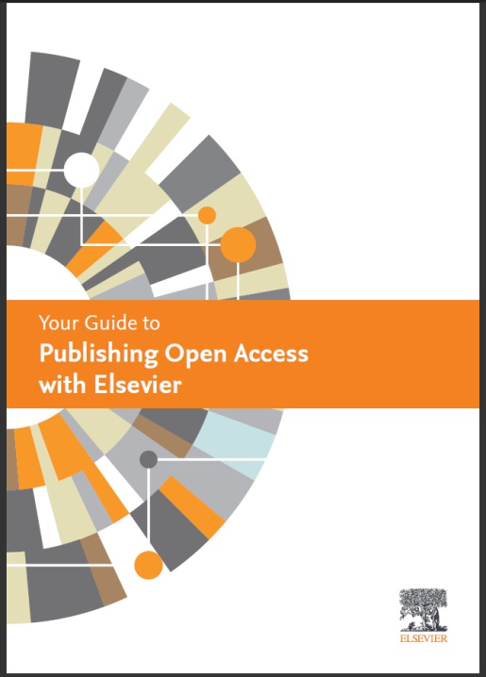
Want more information
See our author resources for more on open access publishing
Open access publishing booklet
Copyright
Authors Home
Journal Finder
Publishing Connect Training Webcasts

Slide 64
Thank you
For further information please visit: www.elsevier.com/openaccess www.elsevier.com/authors
Visit Elsevier Publishing Campus
www.publishingcampus.com

