Slide 1
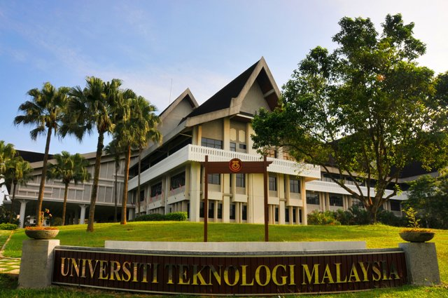
PREPARATION TOWARDS PROPOSAL DEFENSE
AND FINAL VIVA
FOR POSTGRADUATE STUDENTS

Slide 2
RESEARCH PROGRAMMES
MASTER BY RESEARCH
Master of Management Specialization : Management (MHAM)
Master of HRD (MHAF)
DOCTOR OF PHILOSOPHY (PHAM)

Slide 3
CREATING POSITIVE MINDSET
Check your registered email and faculty website daily.
Plan your work from week 1-15 (every semester)
Be focus
Meet your supervisor frequently
Work with your friends
Communicate professionally to all parties (don’t be rude)
Be patience
Create a good image

Slide 4
Things to REMEMBER!!
Academic Calendar
Course Registration
Pay your Fees
Progress Report for Research
Complete and Attend Examination for Coursework

Slide 5
RESEARCH STUDENT ROLES & RESPONSIBILITIES
Register Research Courses Every Semester
Make sure that there is no outstanding fee every semester
Submit progress report to supervisor every semester
Comply all the Post Graduate Rules & Regulation for Graduation
Make a plan for the research progress
Have a professional relationship with Supervisor
Produce Publication
Practice a good research ethics
Schedule a meeting with a Supervisor

Slide 6
SEMESTER REGISTRATION
Register Every Semester – Week 1-2
You should know :
Which semester you are
Code of Subject (University Subject & Research Methodology) and Research (refer to faculty website)

Slide 7
REGISTRATION
COURSE REGISTRATION IS YOUR RESPONSIBILITY !!
Registration for the programmers
Full Time
Part Time
Course Registration
for every semester
Open one week before commencement of classes every semester
Please refer to ACADEMIC CALENDAR at SPS website for AMENDMENT and WITHDRAWAL of the courses
LATE REGISTRATION will be penalized RM 25.00/course
Failure to register course will be
COMPULSORY
TERMINATED

Slide 8
COURSE REGISTRATION
International students are required to take either:
a) Malay Language, or
b) Malaysian Culture
Exemption may be given to those who have already fulfilled such requirement prior to registration of their respective programmers of study.
“Audit” (HS) refers to registration status given to any course taken which does not meant for gaining credits and has not computed grade. It assessed based on attendance only. The course registration is recorded (HS) in the transcript if the student’s attendance is at least 80% of the total contact hours.
As part of graduation requirement

Slide 9
COURSE REGISTRATION
“Compulsory Attendance” (HW) is a registration status of a course which is stipulated by the faculty and is subjected to normal assessment. The assessment result is given a grade of HL (Pass) or HG (Fail). The credit obtained for a “HW” course is included in the Credit Obtained but not in the Credit Count. A student who fails must repeat with status HWUM.
A student may withdraw (TD) any course registered in the current semester within the prescribed duration subject to the minimum credits.
A student who withdraws (TD) all of the courses will be given a deferment of the study.

Slide 10
COURSE REGISTRATION
Credit Exemption (CE) student may apply for Credit Exemption in the first semester of his/her study by submitting relevant documents. Only courses equivalent to those at UTM with minimum equivalent grade of B will be considered for Credit Exemption.
The maximum total Credit Exemption is 50% of the total maximum credits for the taught course components of the study program.
Approvals for Credit Exemptions will be notice to students in “Credit Transferred Slip” that can be obtainable from course registration STUDENT RECORD AND SUBEJCT REGISTRATION

Slide 11
How to register the course?
Get your ACID (http://acid.utm.my)
Go to STUDENT RECORD AND SUBJECT REGISTRATION (http://pendaftaran.utm.my/sps)
Print Registration Slip
Register the Course
*please refer to your faculty for the course

Slide 12
TERMINATED STATUS STUDENT (Not Register Any Courses )
Students may appeal using Application For Reinstatement Of Terminated Status Form obtainable from the Faculty/School /Centre or SPS website.
Students is required to get the support of the Main Supervisor (for research mode student) or the support of the Deputy Dean (Academic) of the Faculty/School/Centre (for Coursework and Mix mode student) before submitting the form to SPS.
Approval to reinstatement of Terminated Status can only be given if the period of terminated status is not more than two (2) semesters at any one time, subject to the remaining period of study were still there.
Appeal from students whose have been given Terminated Status by more than two (2) semesters will not be considered. Students have to re-apply for admission as new students
Students have to pay a fine of RM250.00 before re-registration.

Slide 13
DEFERMENT OF STUDIES
Student must FILL the Deferment form and submit the COMPLETE form to SPS. You can get the form at faculty counter or download from SPS website.
Deferment because of military/medical reasons WILL NOT BE COUNTED in the duration of study
Other reasons WILL BE COUNTED in the duration of study
Deferment of more than two (2) consecutive semesters is not allowed. A student who fails to register after deferment of two (2) consecutive semesters may be terminated.

Slide 14
CONVERSION OF REGISTRATION STATUS
Students are ALLOWED to convert their registration status ONCE during the duration of study
Convert from FULL TIME to PART TIME
Conversion is NOT ALLOWED in FINAL SEMESTER

Slide 15
STUDY LEAVE
By COURSEWORK
Mid semester break
Semester Break
Absent not more than 20%
By RESEARCH
Study leave 30 days per year with permission of supervisor and approval of faculty
Obtaining formal permission to SPS

Slide 16
PROGRESS REPORT
Week 10-12
Include in your semester plan or calendar
Submit online via GSMS
Fail to do – TM (Unsatisfactory)
2 TMs consecutively – Pack your bags and get ready to the airport.

Slide 17
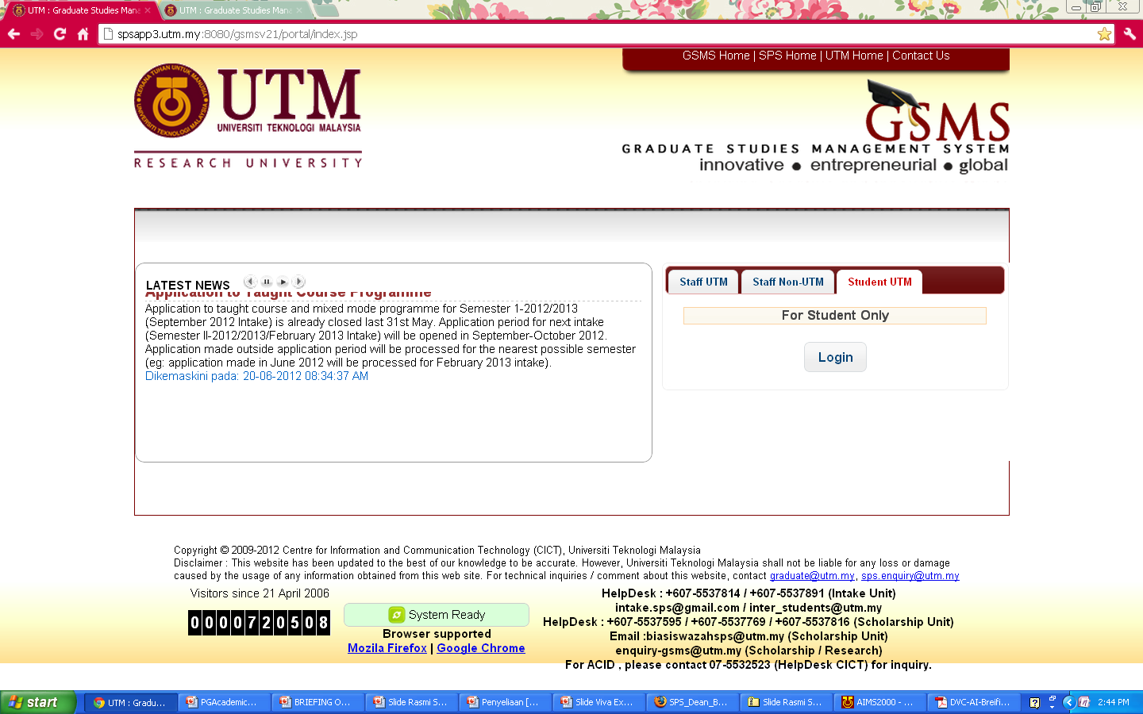
PROGRESS REPORT
Progress report MUST BE SUBMITTED EVERY SEMESTER by ONLINE.
Go to http://spsapp3.utm.my:8080/gsmsv21/portal/index.jsp

Slide 18
1. Select Student UTM tab 2. Click Login
Click on Student UTM and click LOGIN

Slide 19
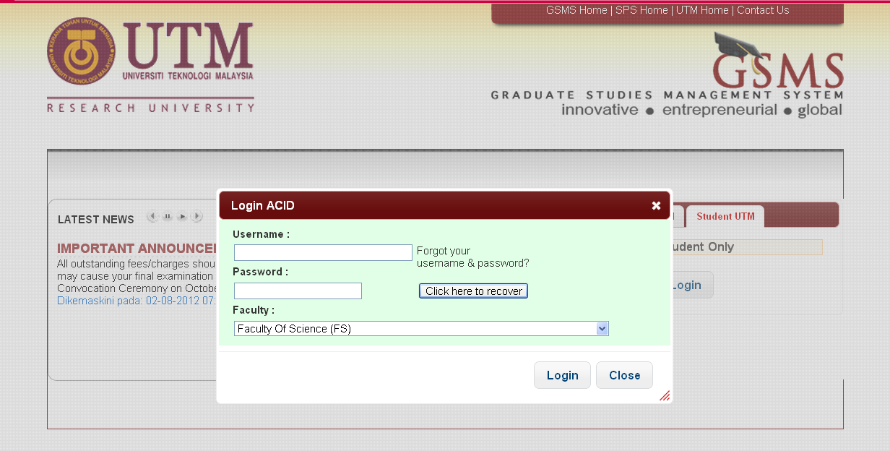
3. Insert your ACID username 4. Click Login
Click on Student UTM and click LOGIN

Slide 20
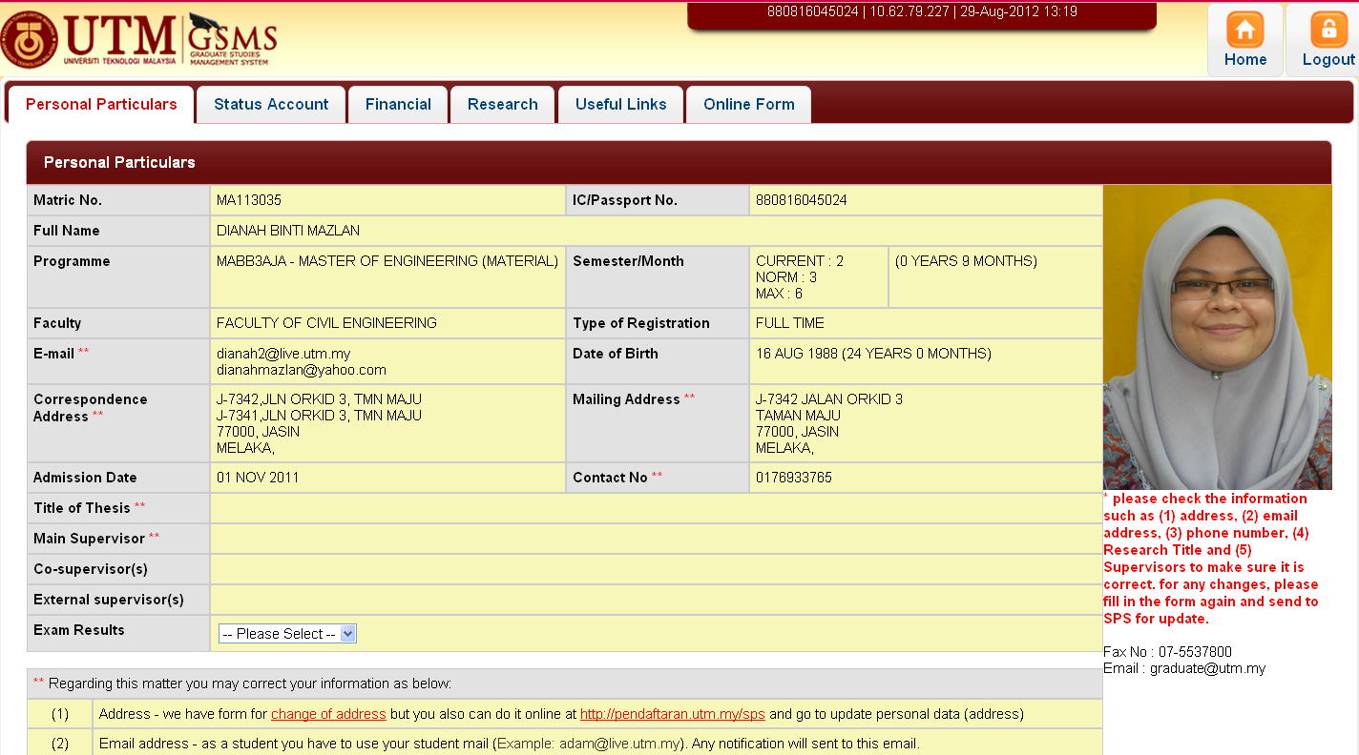
5. Click on Research Tab

Slide 21
6. Find Log Book or Progress Report and proceed with the process
LOG BOOK
1ST ASSESSMENT PROPOSAL DEFENSE
PROGRESS REPORT

Slide 22
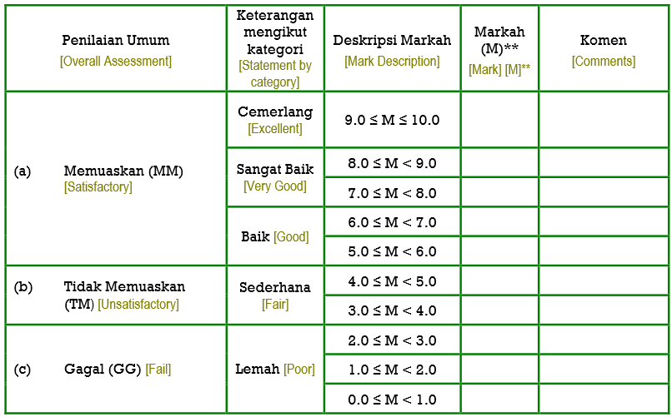
EVALUATION OF PROGRESS REPORT

Slide 23
RESEARCH STUDENT EXAMINATION
Register
Research Under Supervision
Progress Report Every Semester
Proposal Presentation & Evaluation
Notification of Thesis Submission (3 Month)
Appointment of Examiner (JAPSU)
VIVA - VOCE
Correction
Resubmission
Senate Committee Approval (JKTS)
Graduation
Thesis Submission for Examination

Slide 24
PROPOSAL DEFENSE
Master by Research (by Sem 4) and
PhD (by Sem 5)
Refer to the Flowchart 1
Abstract
- 1 paragraph ONLY
- Should TYPE
- Must have intro, objective and method
- Language - English or Malay

Slide 25
PROPOSAL DEFENSE
Manual (download the Notification of Evaluation Form from the faculty website)
Publication – minimum conference paper
Should have completed the University Subject and Research Methodology
Notice valid for 6 months
The date of proposal will be decided within 3-4 weeks from the submission date of the proposal copies / approval of JKPS

Slide 26
FINAL VIVA-VOCE
Requirement – Prepare abstract with intro, objective, method, findings and conclusion.
Before submission of the notice of thesis, student should do the following:-
i. Provide list of publications
ii. Do the turnitin (by chapter and full thesis)
– Plagiarism Agreement
iii. Fill in the Submission of Thesis Form

Slide 27
RE-EXAMINATION FEES FOR DOCTORAL DEGREE & MASTER (RESEARCH)
Universiti Teknologi Malaysia has agreed to implement fees for thesis re-examination for Master by Research and Doctoral Degree.
The fee is imposed to Master by Research and Doctoral candidates who are required to have their thesis to be re-examined after the viva-voce.
The fees for thesis re-examination are as follows;
1. Doctoral Degree RM2000.00
2. Master (Research) RM1000.00
The fee must be paid to Bursar Office, Universiti Teknologi Malaysia.
The regulation is enforceable to those whom submitted their thesis for the purpose of examination commencing from Semester 1 Session 2015/2016.

Slide 28
THESIS SUBMISSION REQUIREMENT FOR EXAMINATION
Fulfill the Post Graduate Academic Rules & Regulation
Format of the thesis must follow UTM Thesis Manual (2015 Edition)
Plagiarism check Verification (email to susilawati@utm.my)
Complete all the required forms
Guidelines & Forms can be downloaded at www.sps.utm.my
Supervisor Approval Thesis is ready to be evaluated

Slide 29
PUBLICATION REQUIRED FOR THESIS SUBMISSION
Publication | Semester
 | Semester 5 | Semester 6 and above
Number of Publication Required for Thesis Submission | 2 publications in indexed journal (ISI or Scopus) * | 1 publication in indexed journal (ISI or Scopus) *
* Published or accepted
Please be informed that number of publication required for thesis submission is one international refereed journal.
The first author of the paper must be the student him/herself.
The paper must be a product from the thesis itself. (if the title of the paper is not related to students thesis, the application will be rejected.)

Slide 30
PLAGIARISM CHECK REQUIREMENT
Senate University only allow ≤ 20% Similarity Index

Slide 31
SUBMISSION OF BOUND THESIS AND AWARD OF DEGREE
Abstract - (Approved by faculty, SPS, Senate)
Before submitting the copies of bound thesis, candidate should :
i. Get approval of abstract translation (Malay and
English) from Language Academy
ii. Download the Abstract Approval Form and submit to
faculty together with Chairman’s Report, Thesis Title
Page and Award Form.

Slide 32
OTHER ISSUES
Research Clinic – Dr Abbas Mardani (Consultation Hours : Wednesday 2-5pm at Viva Room 5)
Change of Main Supervisor / Co-Supervisor / External Supervisor – should be approved by Main Supervisor and JKPS
Deferment of studies – Normal deferment and Medical deferment
Letters, Turnitin, etc. – 3 working days
Post Graduate Progress Colloquium – every semester (compulsory)

Slide 33
ACADEMIC RULES AND REGULATIONS
MUST
READ
Download from SPS Website
http://sps.utm.my/sps/images/academicresources/peraturan-akademik-2011.pdf

Slide 34
DON’T FORGET !!!
Pay your FEES
REGISTER your COURSES
Fill your PROGRESS REPORT (Research students)
Complete and Attend EXAMINATION for Coursework and Mixed Mode
Refer your ACADEMIC CALENDAR

Slide 35
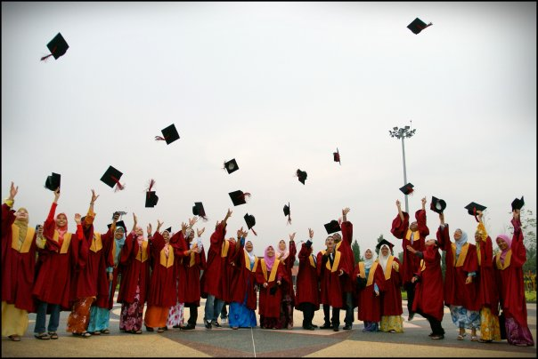
ENJOY YOUR LIFE AT UTM

