Slide 1
DETC2010-28427
Rupture and reformation
of
ultra-thin lubricant surface films
BY
WILLIAM CHONG
DR MIRCEA TEODORESCU
PROF HOMER RAHNEJAT

Slide 2
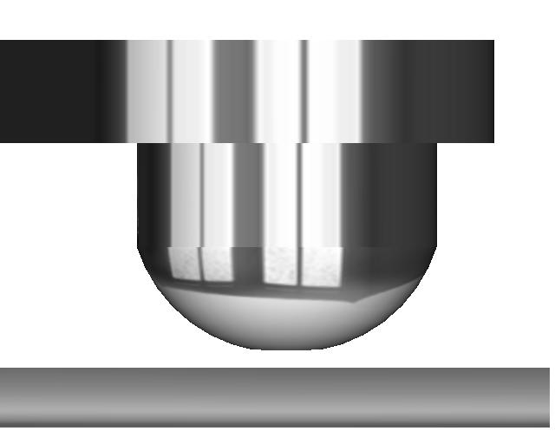
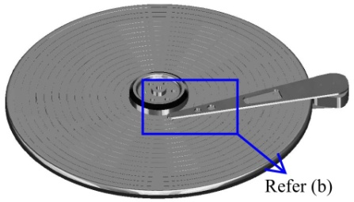
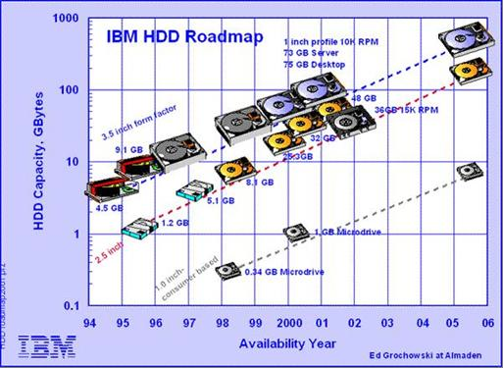
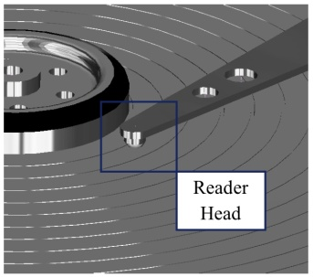
motivation
Increasing demand for higher data storage capacity for modern hard-disk drives
FLY HEIGHT
Higher recording/areal density for the hard-disk drive platter (1 Tbit/inch²)
(a)
Smaller flying height between the reader head and disk platter (2nm gap) [1]
GOAL
Predict the tribological behaviour of the head-disk conjunction of a hard-disk drive
(b)
[1] Wood, R., 2009. “Future hard disk drive systems”. Journal of Magnetism and Magnetic Materials, 321(6), 3, pp. 555–561.

Slide 3
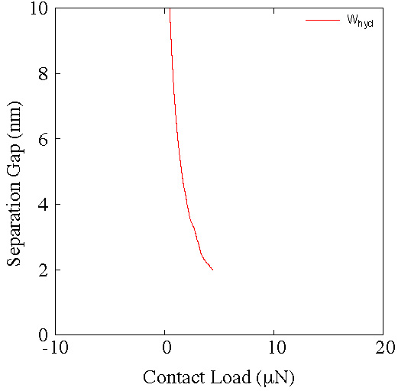
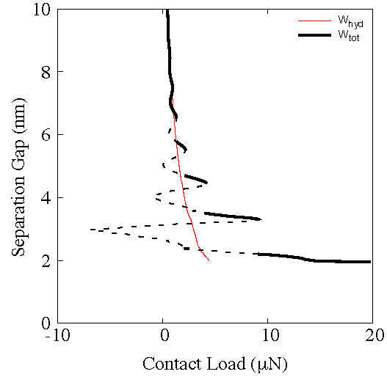
Smaller flying height between the reader head and disk platter (2nm gap) [1]
FLY HEIGHT
Increases the effect of molecular structural forces (Solvation forces)
Tribological behaviour of nano-scale separation gaps cannot be properly described using continuum theory [2-4]
[2] Al-Samieh, M. F., and Rahnejat, H., 2002. “Physics of lubricated impact of a sphere on a plate in a narrow continuum to gaps of molecular dimensions”. J. Phys. D: Appl. Phys., 35, pp. 2311–2326.
[3] Matsuoka, H., and Kato, T., 1997. “An ultra-thin liquid film lubrication theory calculation method of solvation pressure and its applications to EHL problem”. Trans. ASME, J. Tribology, 119, pp. 217–26.
[4] Israelachvili, J. N., 1992. Intermolecular and surface forces. Academic press London.

Slide 4
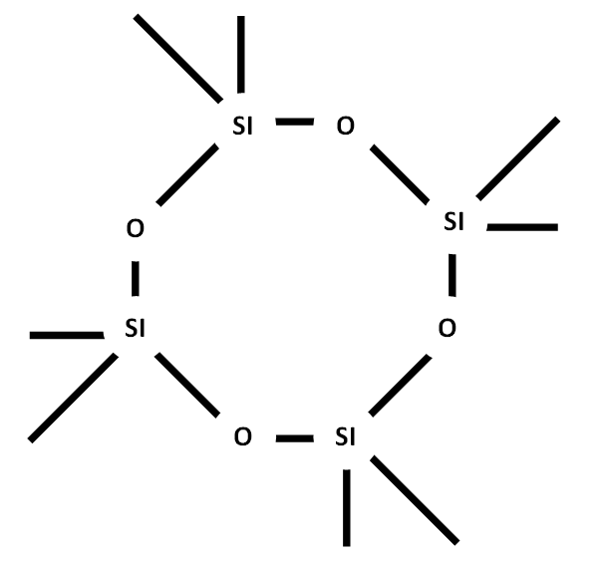
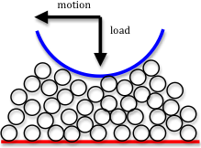
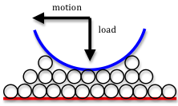
Octamethylcyclotetrasiloxane (OMCTS) ((CH₃)₂SiO-)₄
The lubricant molecules are:
Non-polar
Spherical
Homogeneous (No additives)
Molecule-Layering

Slide 5
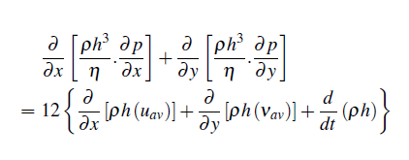
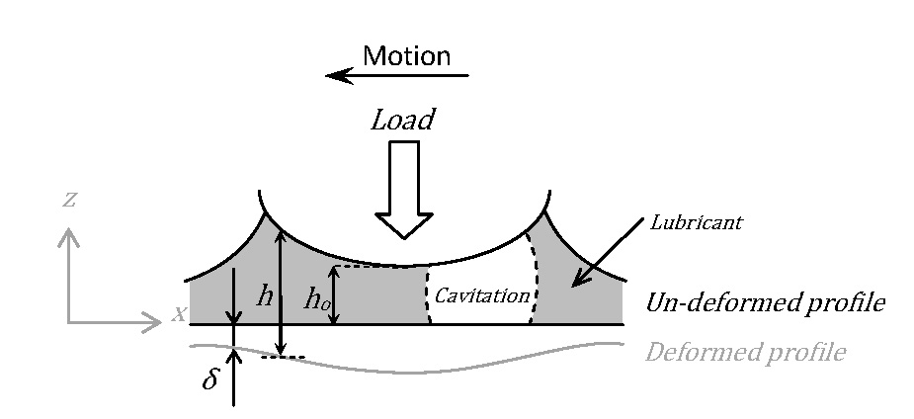
tribology
The flow of the lubricant is assumed to be supplied/carried through the contact hydrodynamically
Hydrodynamic Pressure
(Reynolds Equation)
Hydrodynamic Pressure
(Elrod’s Cavitation Algorithm )

Slide 6
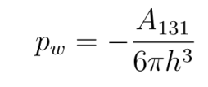
Intermolecular & surface forces
Solvation Pressure
Short range forces due to the oscilatory behaviour of molecules near solid barriers
Causes restructuring of molecules into discrete layers
Van der Waals Pressure
long range forces which can be effective from distances of 10nm
Affected by the presence of other molecules nearby
Molecule-Layering

Slide 7
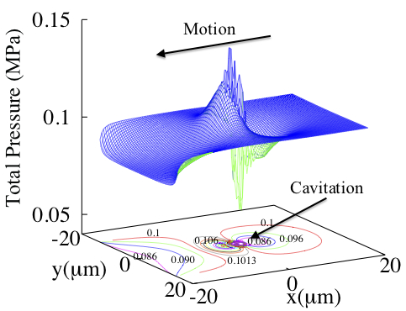
Results and discussions
Load
Motion
FLY HEIGHT

Slide 8
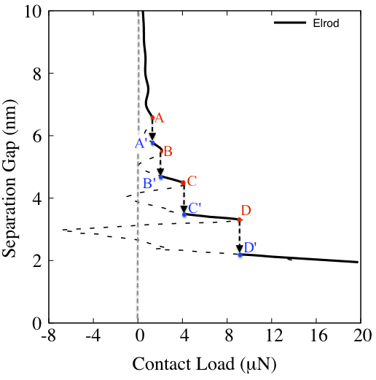
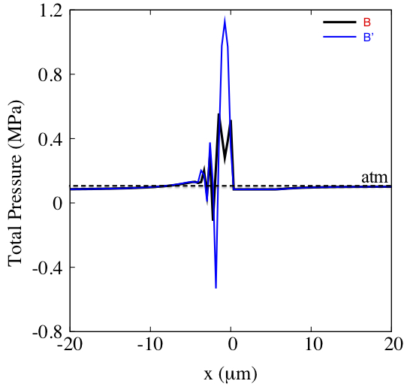
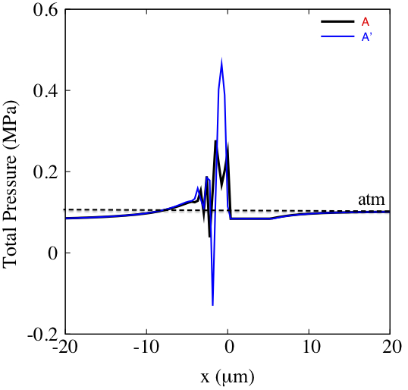
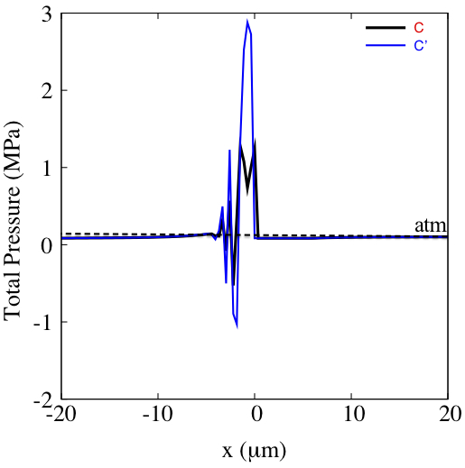
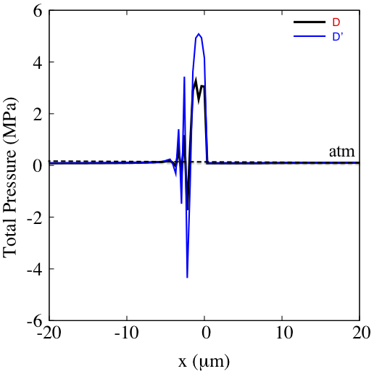
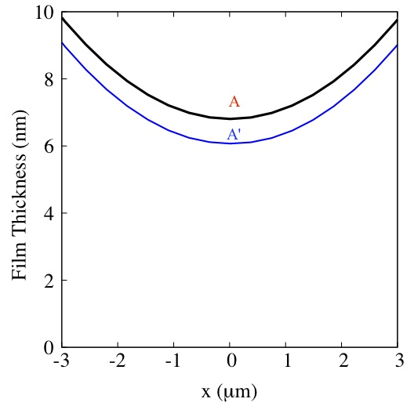
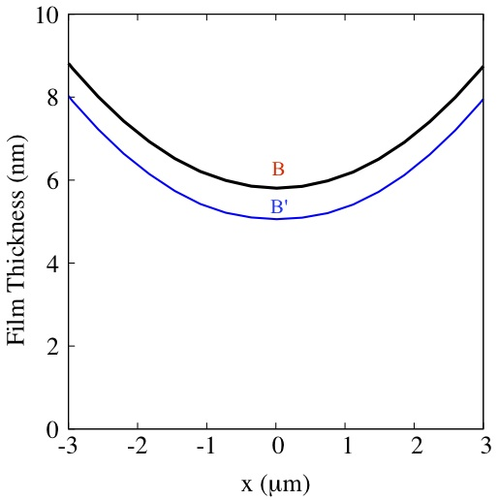
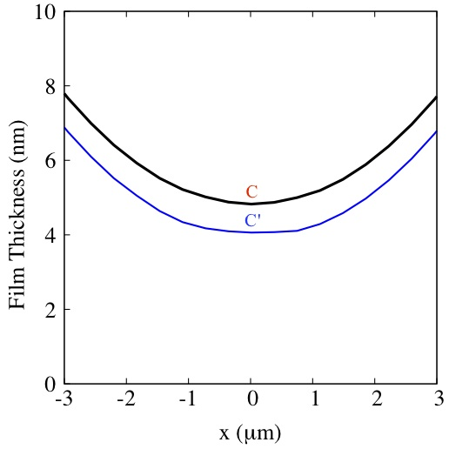
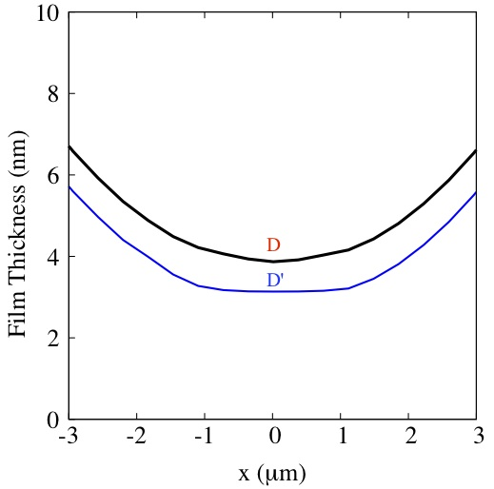

Slide 9
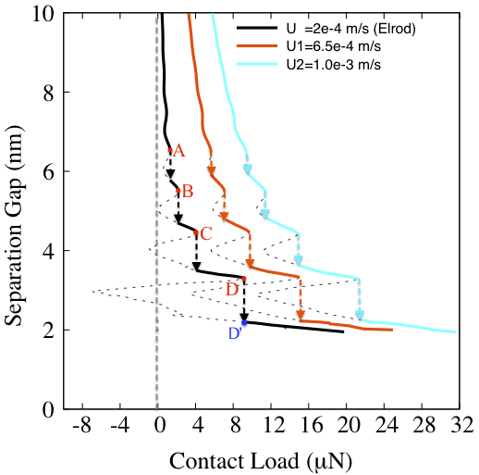
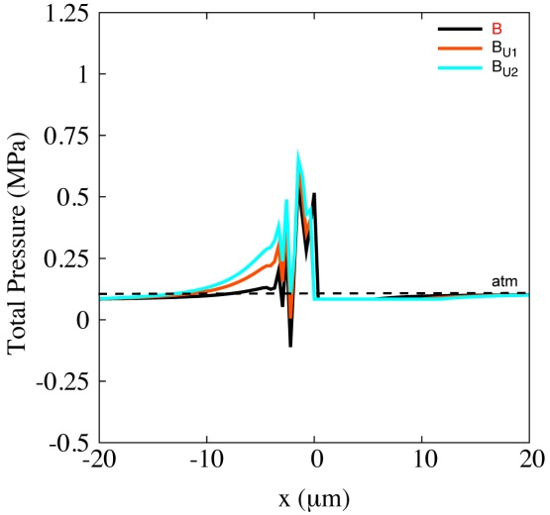
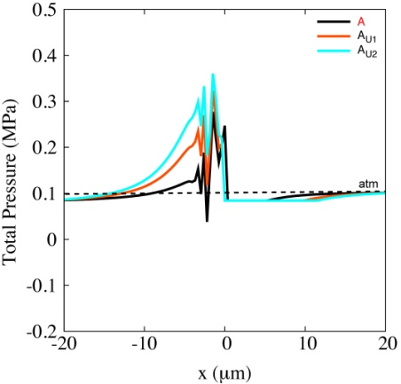
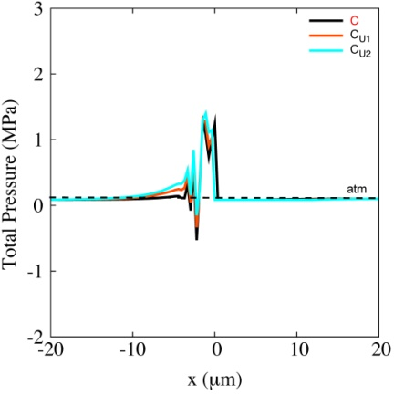
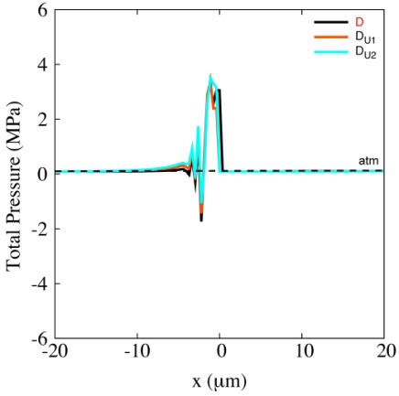
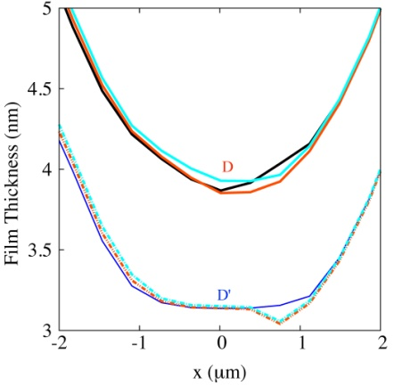
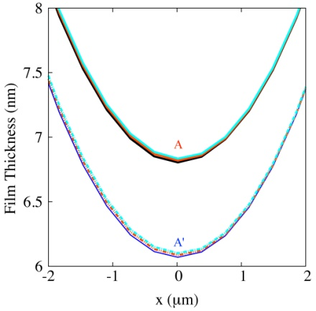
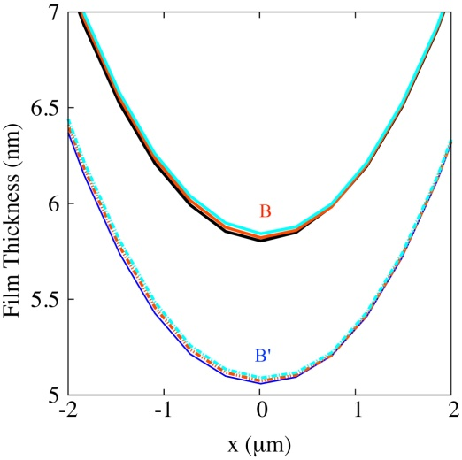
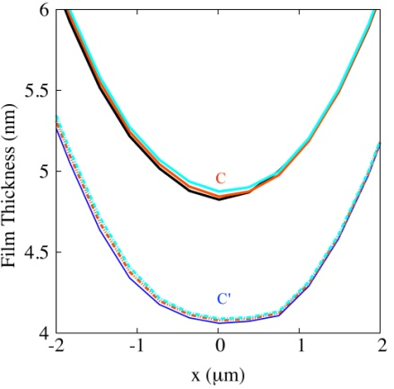
Influence of
sliding velocity

Slide 10
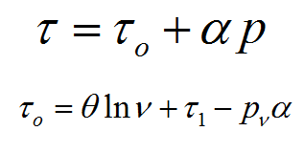
Friction/shear stress prediction
Eyring Model
Molecule-Layering

Slide 11
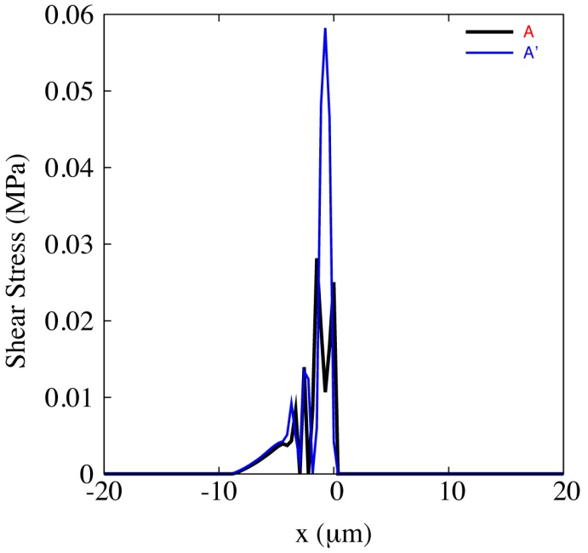
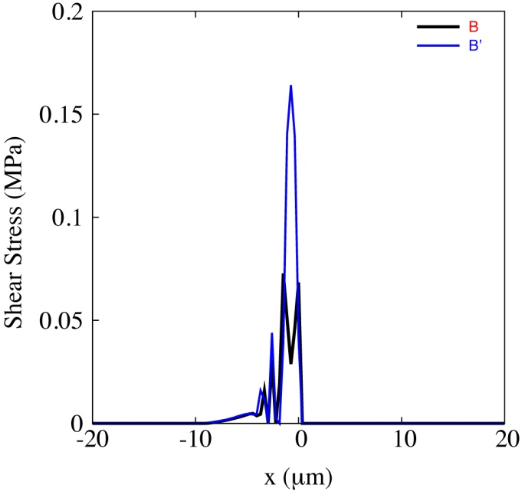
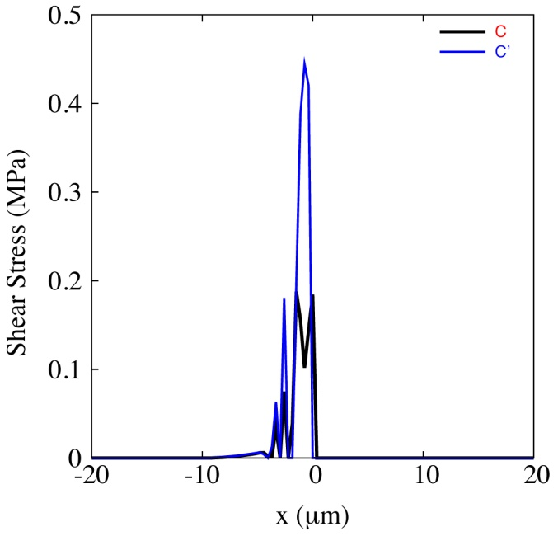
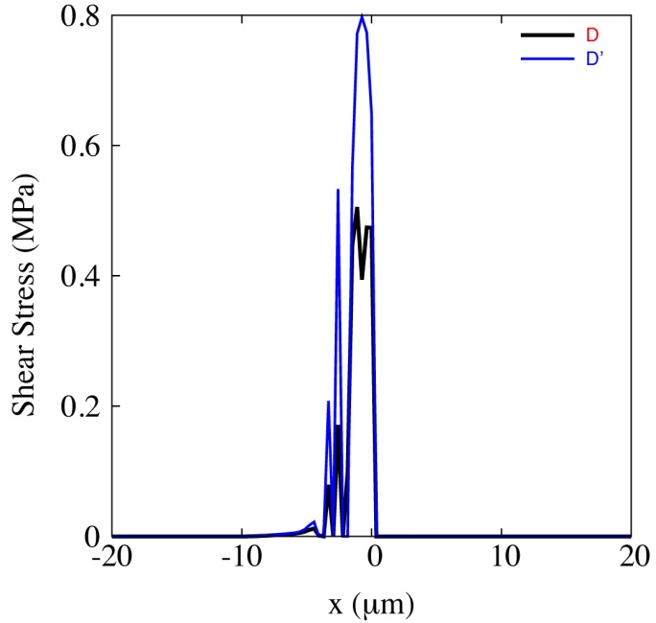
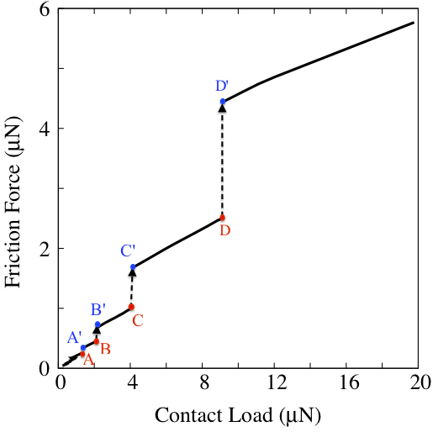
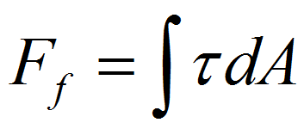

Slide 12
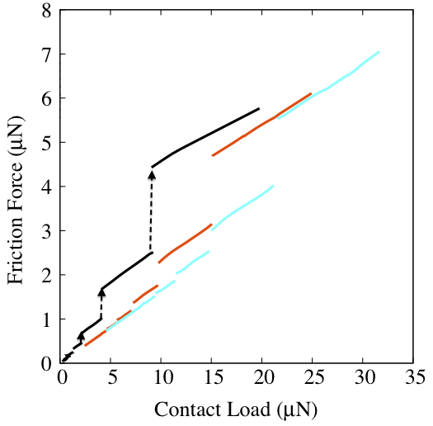
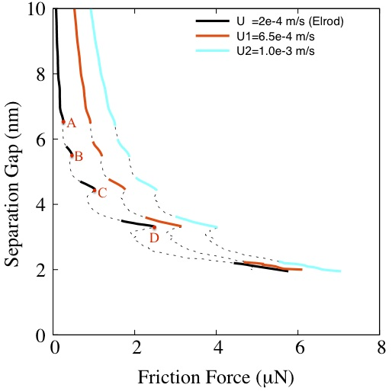
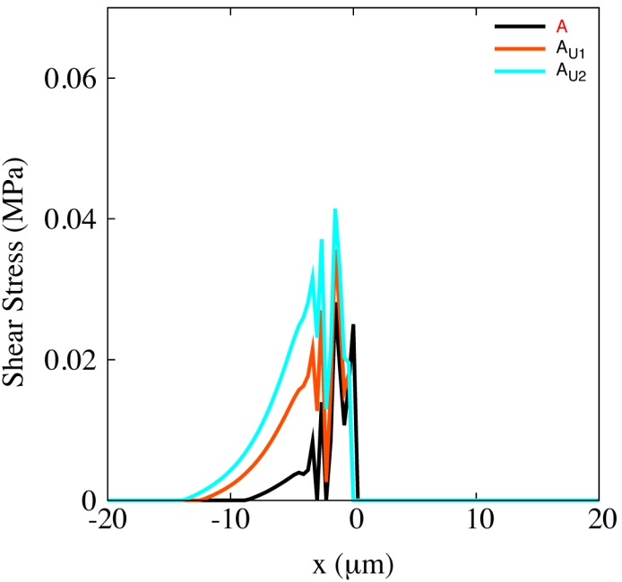
Influence of
sliding velocity

Slide 13
conclusion
The nanotribological behaviour along the head-disk conjunction depends on the lubricant rheology and film reformation
The friction force at the head-disk conjunction (nano-scale separation gaps) depends on the effect of the molecule layering known as solvation

Slide 14
Thank you

