Slide 1
IJTC2010-41099
PISTON RING CAVITATION AND STARVATION
DURING ENTRAINMENT MOTION
REVERSAL
By
William Chong
Dr Mircea Teodorescu
Prof Nick Vaughan

Slide 2
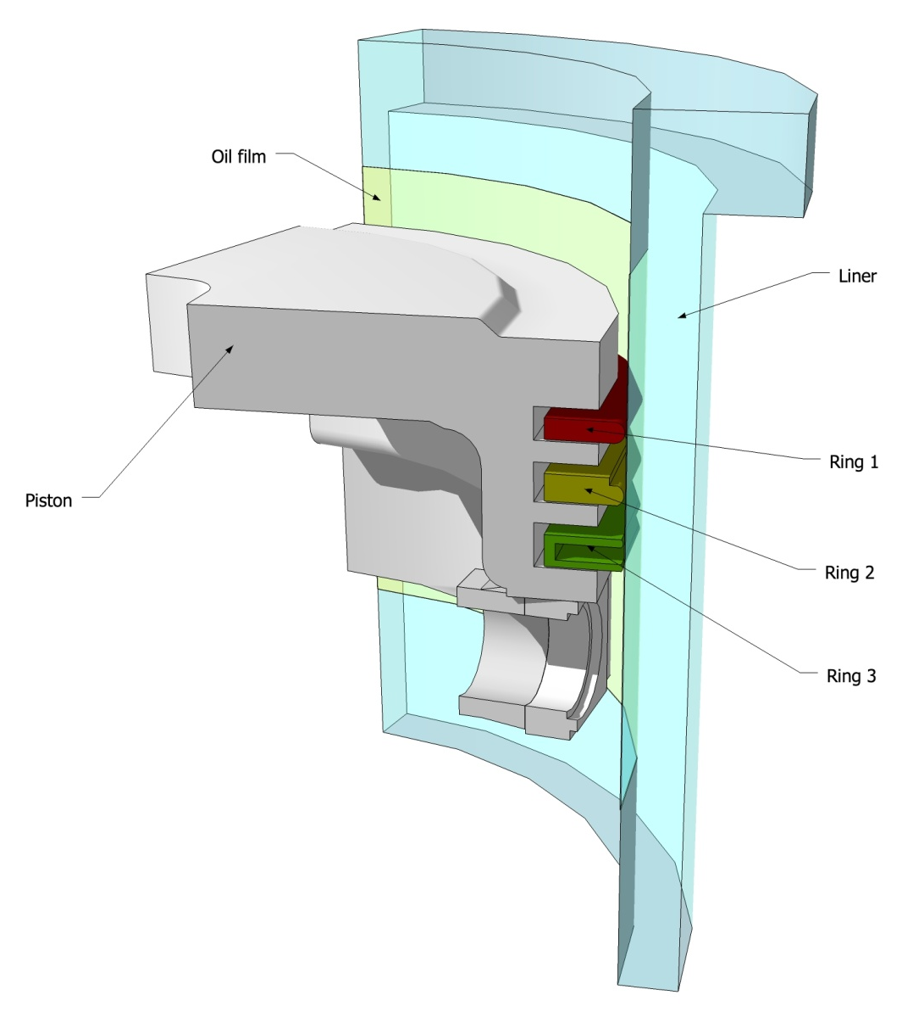
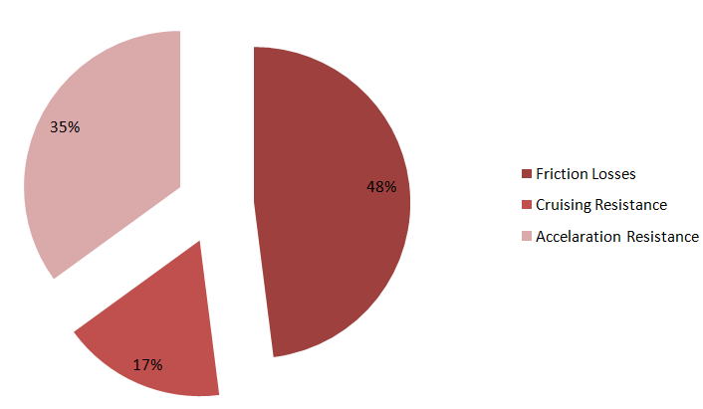
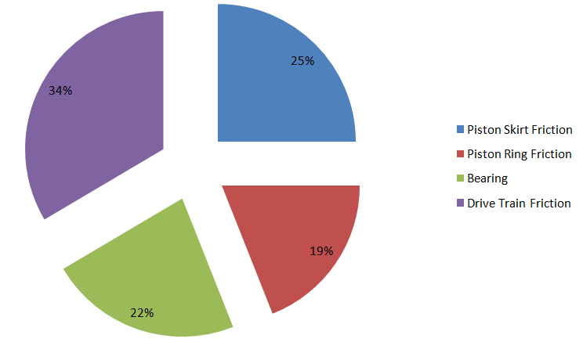
motivation
48% of the total energy consumption of an Internal Combustion Engine
(ICE) is used to overcome FRICTION [1]
19 % of the total FRICTION loss of an ICE is caused by the friction
between the piston ring and liner [1]
[1] S. C. Tung and M. L. McMillan. Automotive tribology overview of current advances and challenges for
the future. Tribology International, 37(7):517{536, 2004.

Slide 3
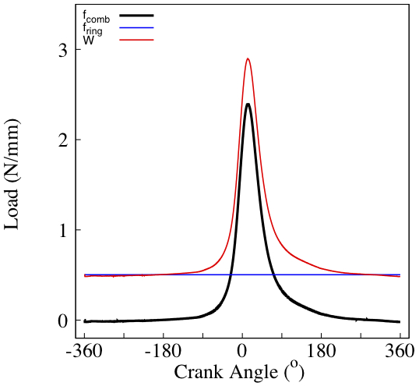
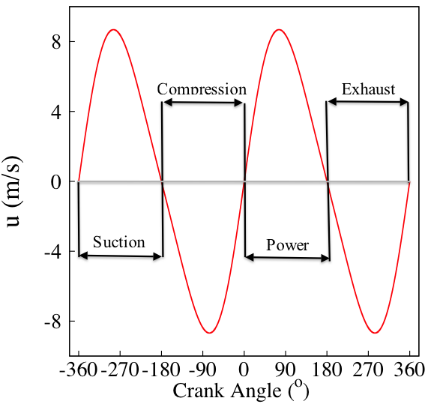
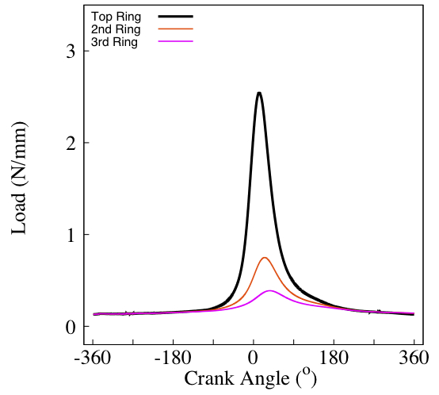
Load for Top Ring

Slide 4
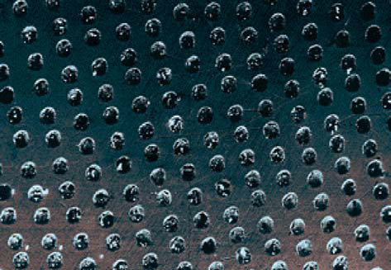
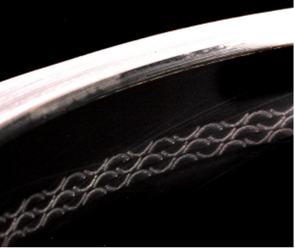
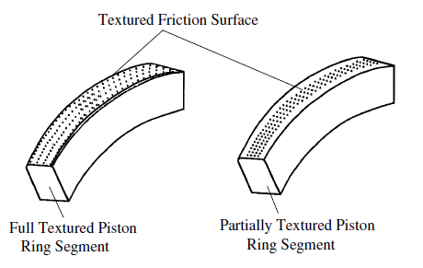
To reduce friction
by
piston ring assembly
Transient
nature of tribology
Effect of Cavitation
Surface interactions
along the ring-liner conjunction
Texturing on the cylinder liner[2]
Texturing on the ring[3]
[2] Rahnejat, H., Balakrishnan, S., King, P. D., and Howell-Smith, S. In-cylinder friction reduction using a surface finish optimization technique. Proc. IMechE, Part D: J.Automobile Engineering, 2006, 220(D9), 1309–1318.
[3] I, Etsion, Improving tribological performance of mechanical components by
laser surface texturing, Tribology Letters,17(4)733-737,2004

Slide 5
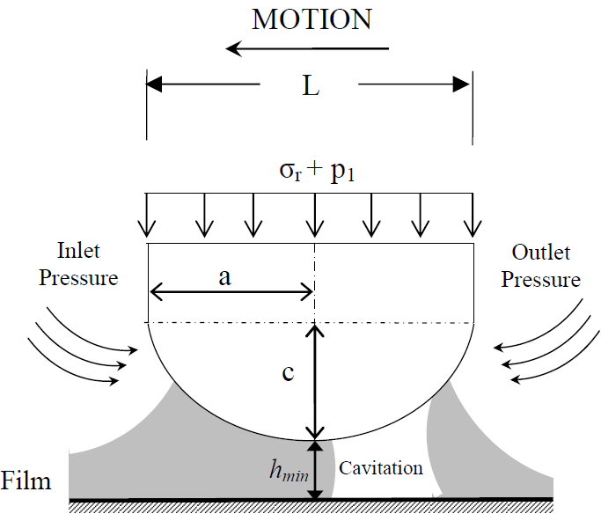
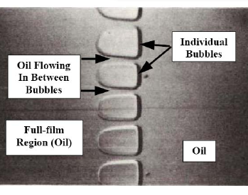
TRIBOLOGY
Important Issues of Understanding Cavitation
When and Where lubricating film rupture or separation occurs
Measures to avoid component damage due to high friction
Improves the lubricating process
By Prof Dowson[4]
[4] D. Dowson. Laboratory experiments and demonstration in tribology. the principles of hydrodynamic
lubrication and cavitation in lubricating lms. 1968.

Slide 6
Reynold’s equation
Shortcomings of Reynold’s Equation [5] & Reynolds Boundary Condition
Analysis of lubricating film characteristics without taking into consideration:
i. Cavitation Effect
ii. Starvation Effect
ONLY works under Full Film conditions where flow is laminar
[5] O. Reynolds. On the theory of lubrication and its application to mr. beauchamp tower's experiments, in-
cluding an experimental determination of the viscosity of olive oil. Royal Society of London Philosophical
Transactions Series I, 177:157-234, 1886.

Slide 7
Elrod [6,7] proposed a cavitation model based on Jacobsson-Floberg-Olsson’s (JFO) [8,9] theory which
considers mass-conservation principle at the cavitation region
considers the non-laminar flow at the interface between lubricant and
cavities at the cavitation region
[6] H. G. Elrod and M. L. Adams. Computer program for cavitation and starvation problems. In Proceedings of 1st Leeds-Lyon Symposium on Tribology: Cavitation and Related Phenomena in Lubrication, pages 37-41, New York, 1974 1976. Mechanical Engineering Publications.
[7] H. G. Elrod. A cavitation algorithm. American Society of Mechanical Engineers, New York, 1981. H.
G. Elrod.; In: Transactions of ASME. Journal of lubrication technology, Vol. 103, No. 3, (July 1981).
[8] B. Jakobsson and L. Floberg. Journal bearing considering vaporization. Transactions of Chalmers University of Technology, 1957.
[9] K. O. Olsson. Cavitation in dynamically loaded bearings. 1965.

Slide 8
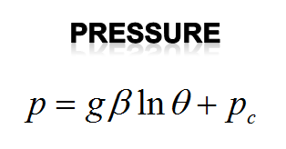
Reynold’s equation
Elrod’s cavitation algorithm

Slide 9
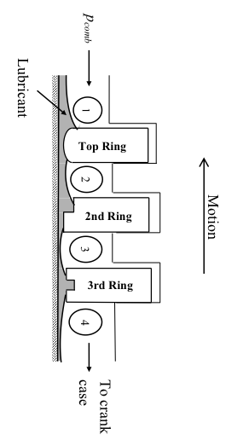
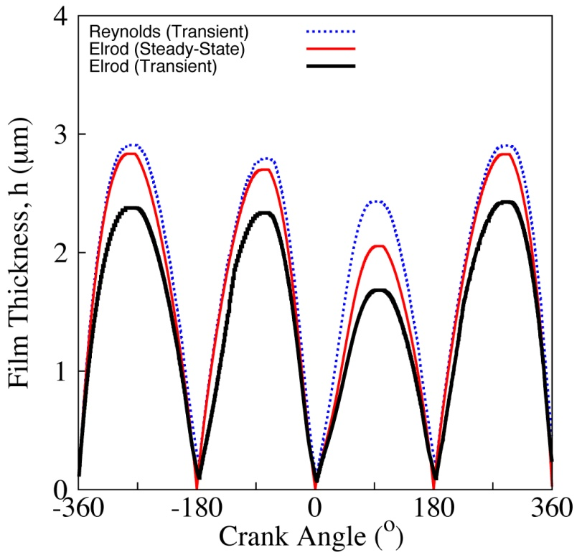
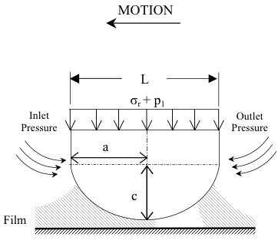
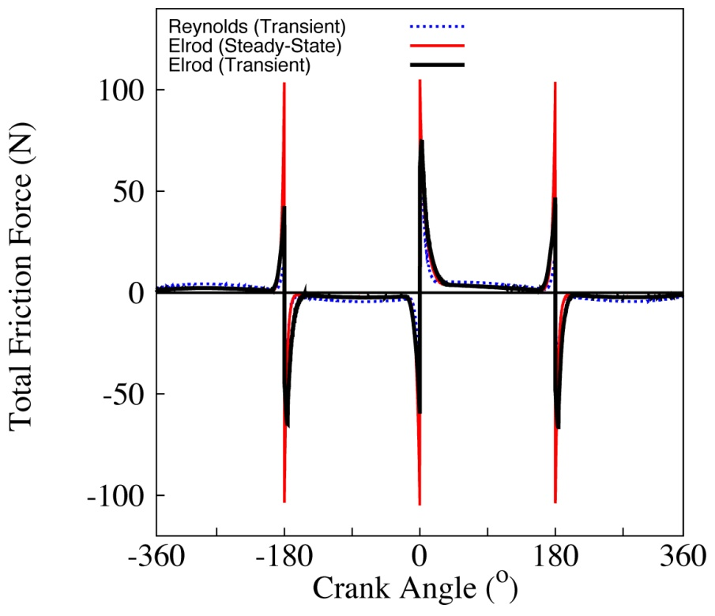
Piston ring geometry
Piston kinematics
Piston ring load
Lubricant viscosity
Lubricant density

Slide 10
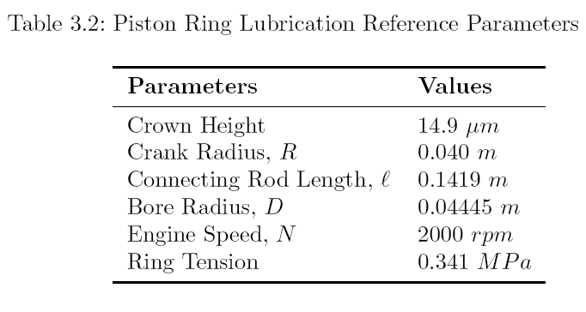
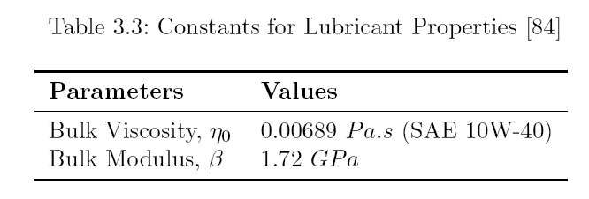
[10] Y. R. Jeng. Theoretical analysis of piston-ring lubrication part ifully
flooded lubrication. Tribology Transactions, 35(4):696-706, 1992.

Slide 11
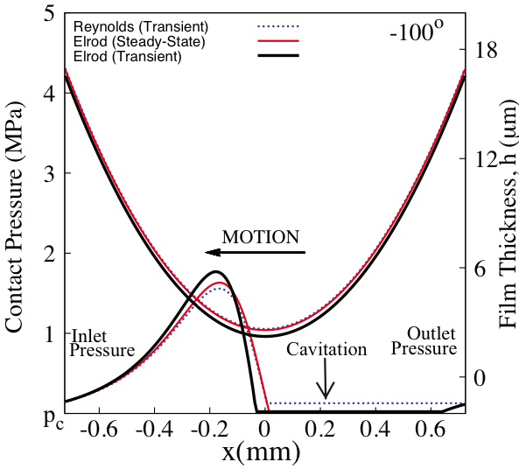
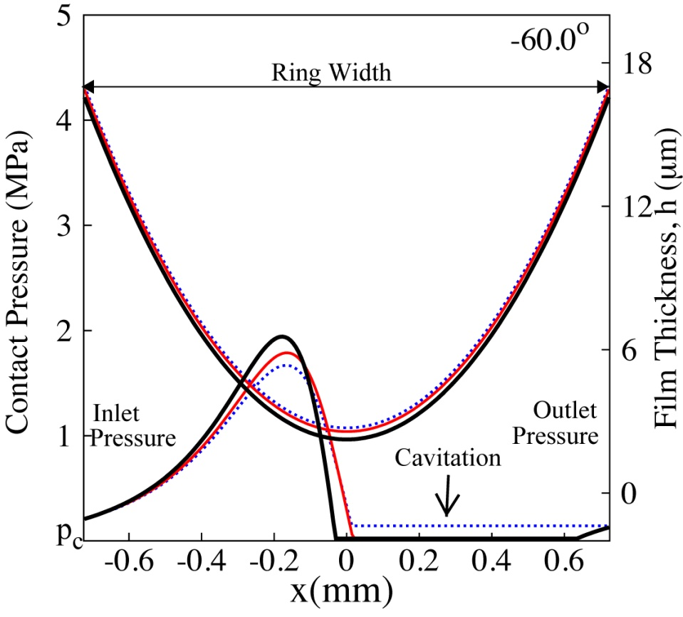
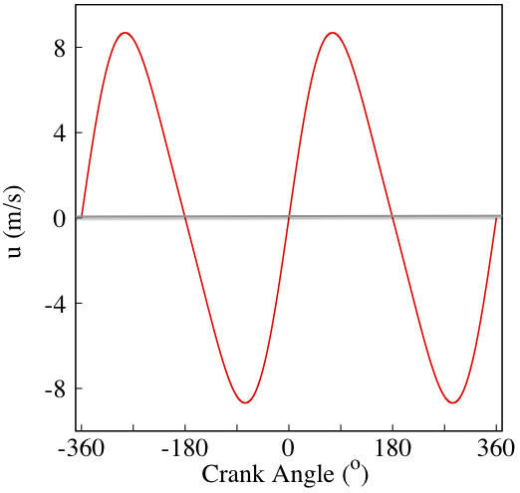
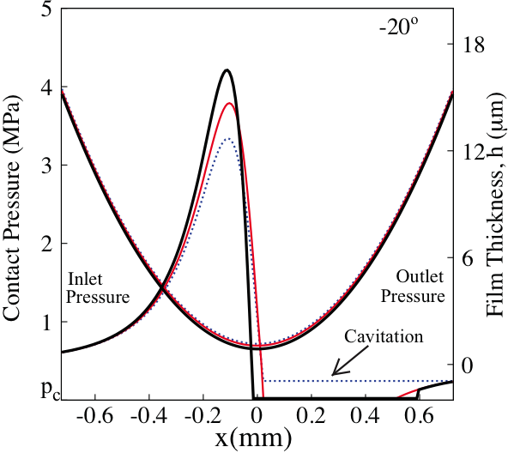
High Entrainment
Velocity

Slide 12
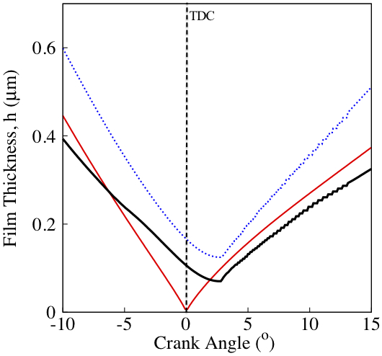
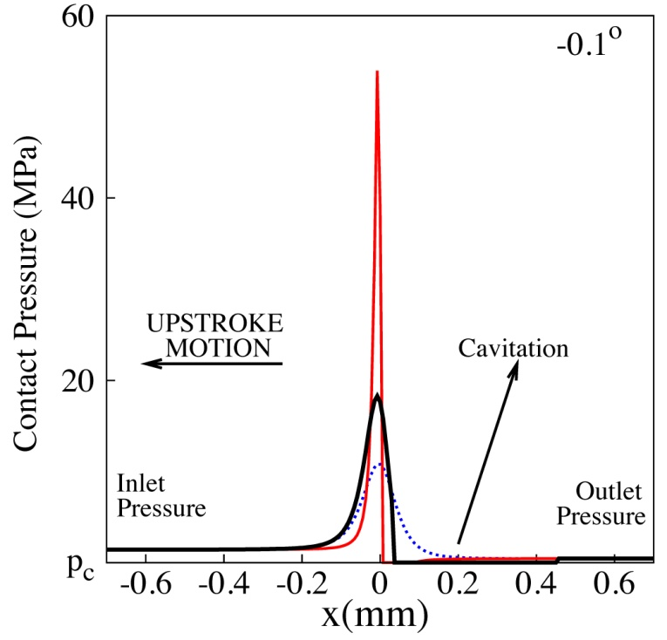
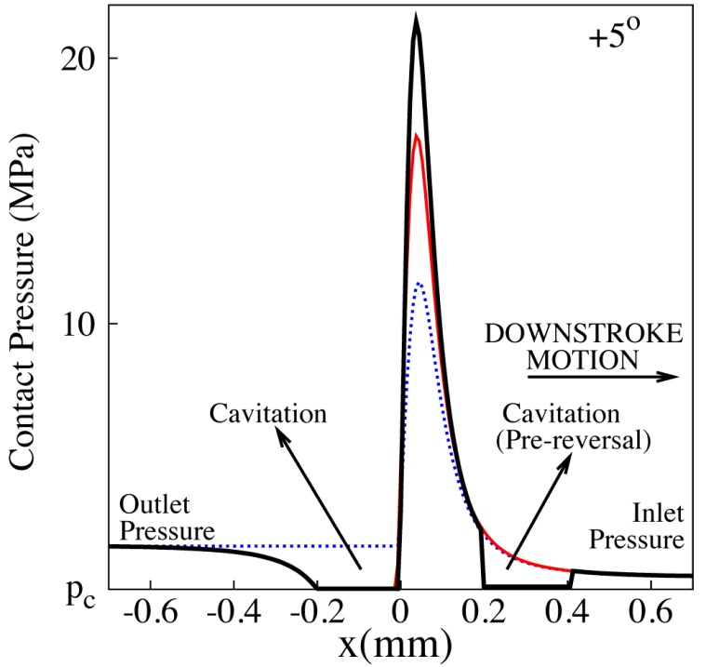
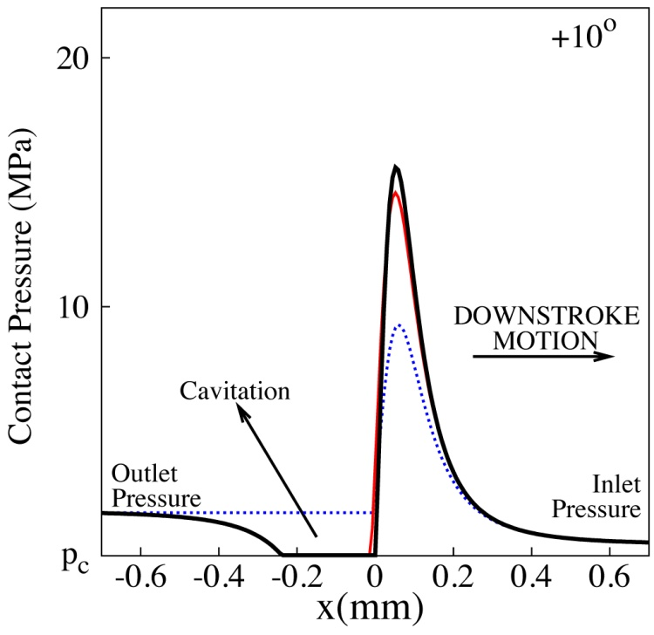
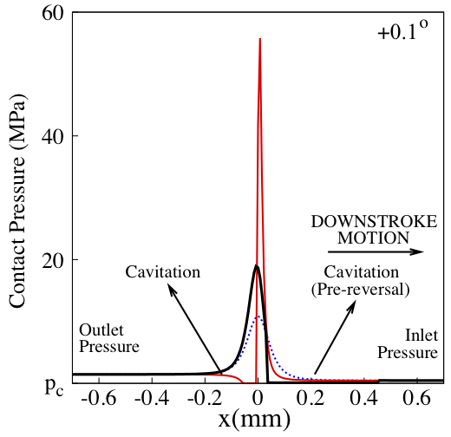
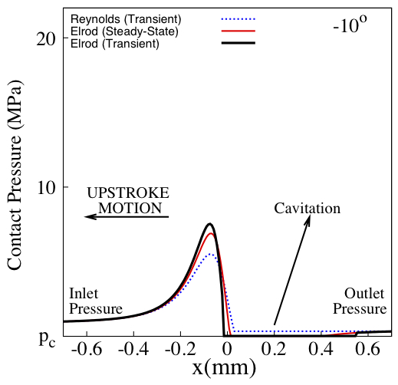
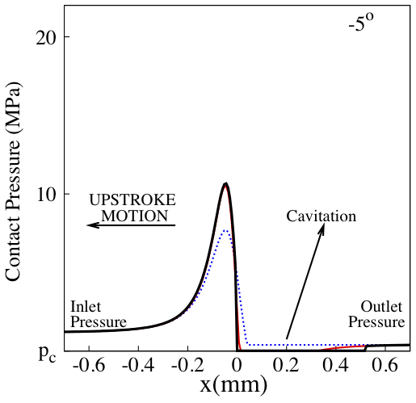
Firing TDC
(Pressure)

Slide 13
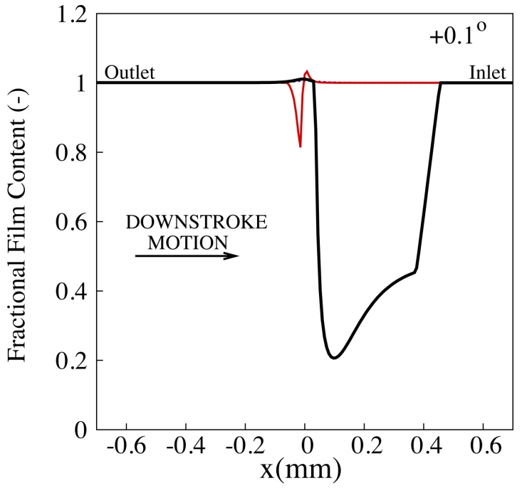
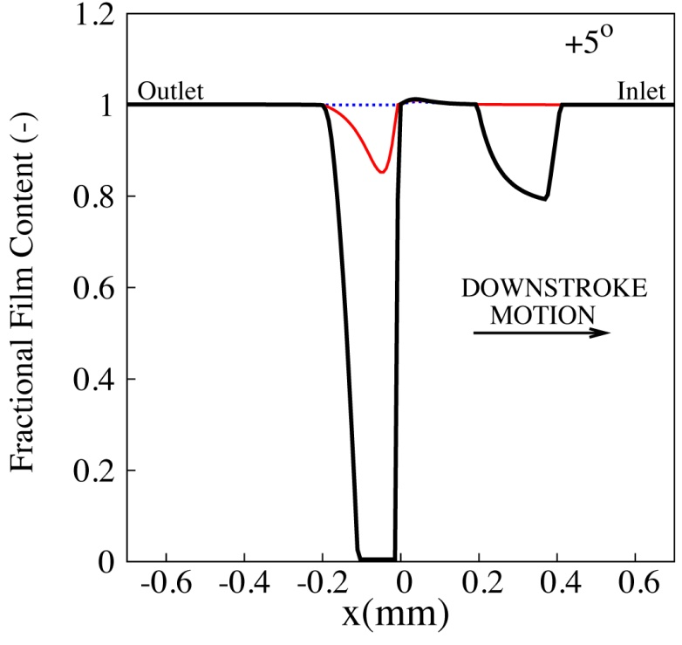
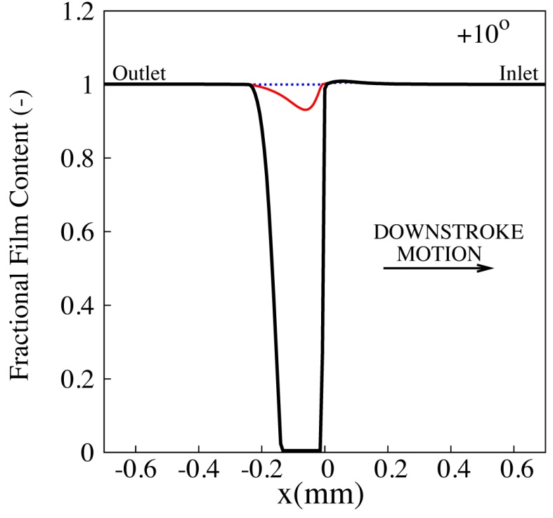
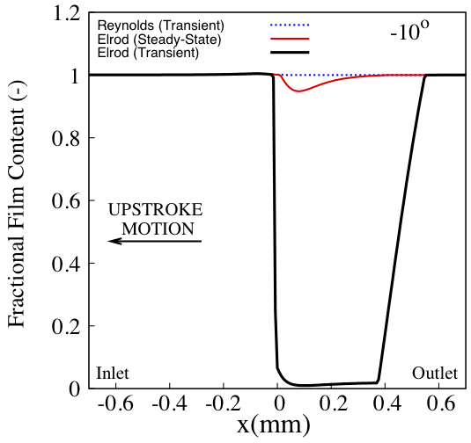
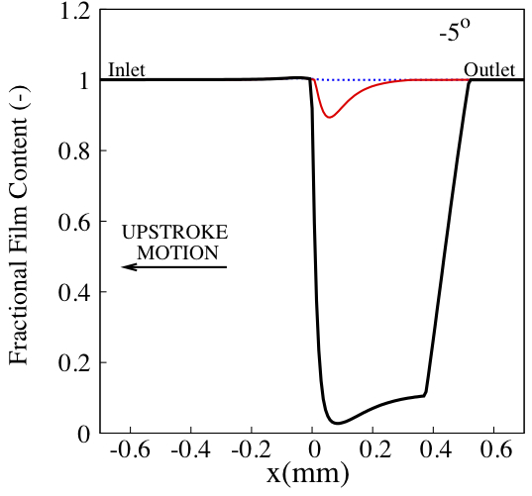
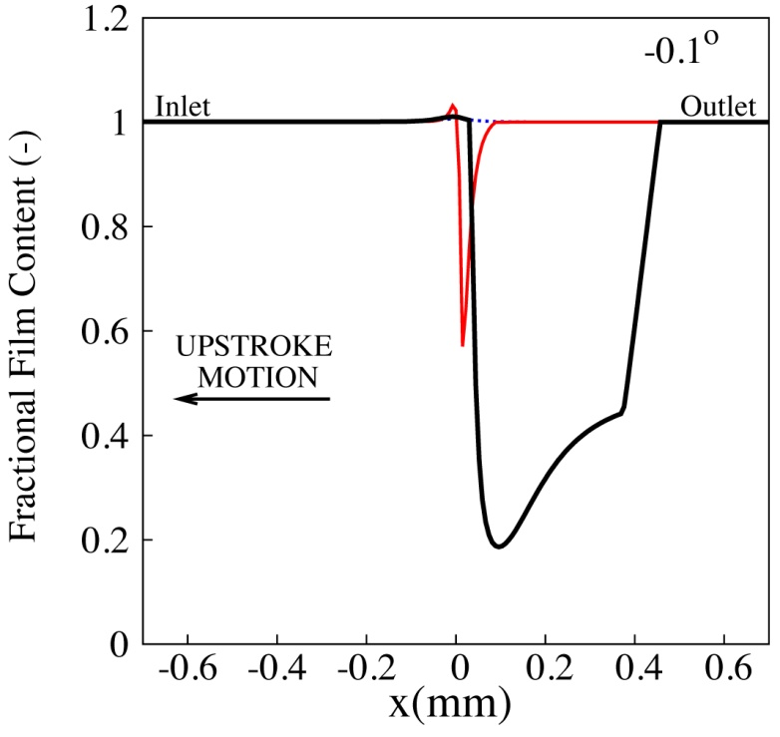
Firing TDC
(Fractional Film Content)

Slide 14
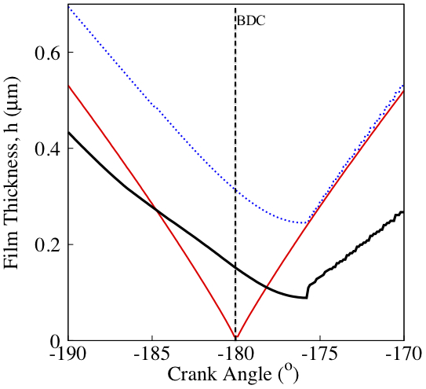
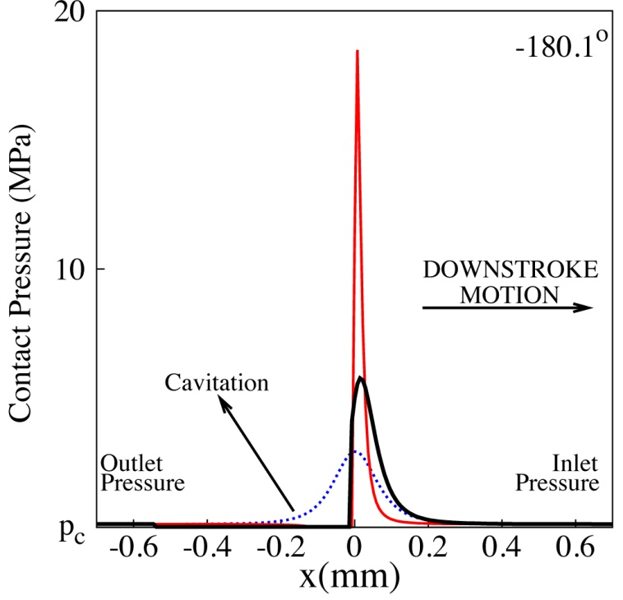
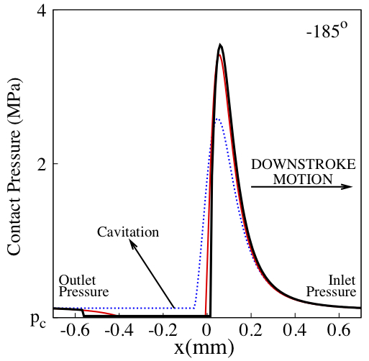
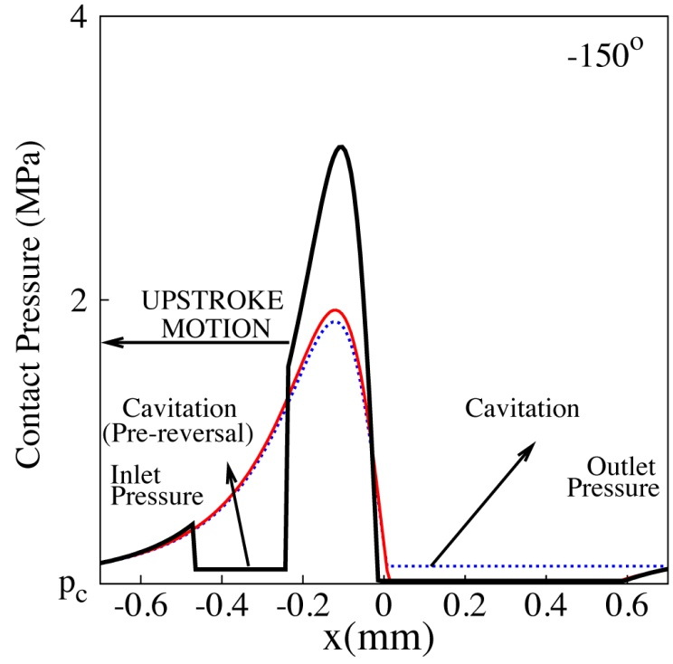
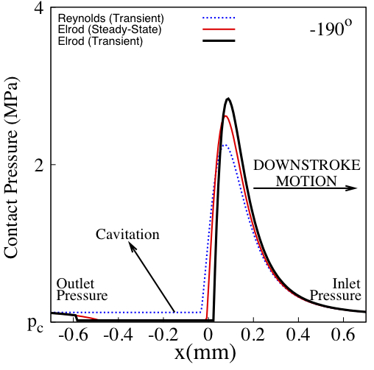
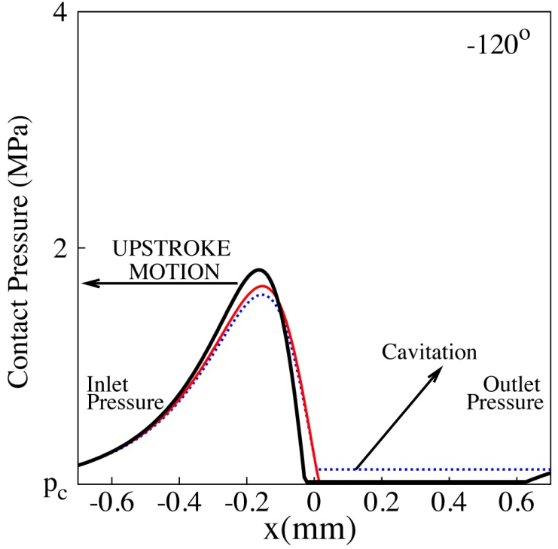
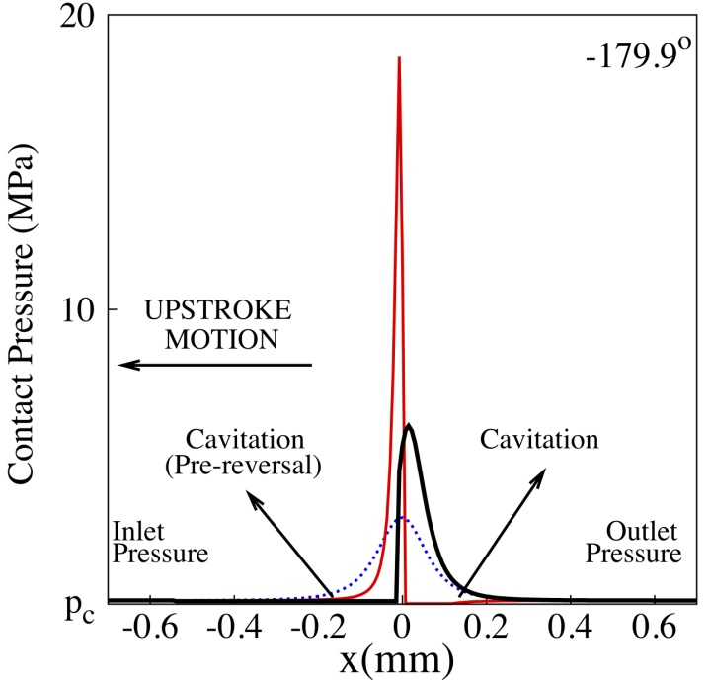
Suction BDC
(Pressure)

Slide 15
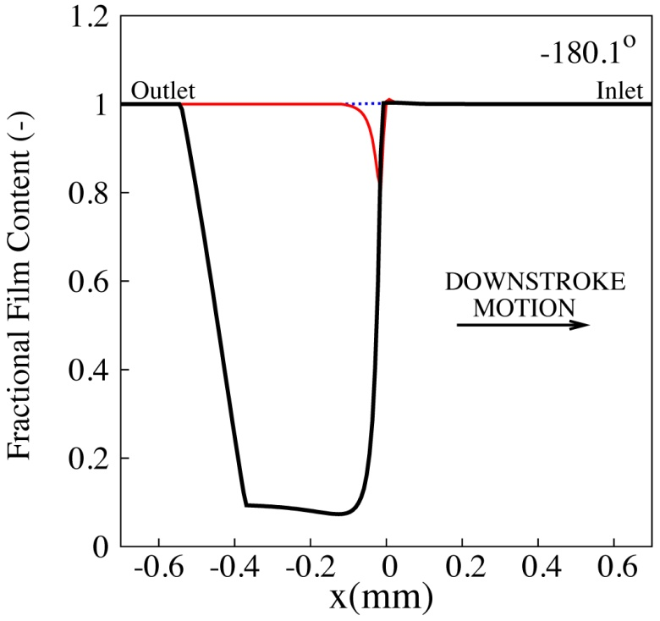
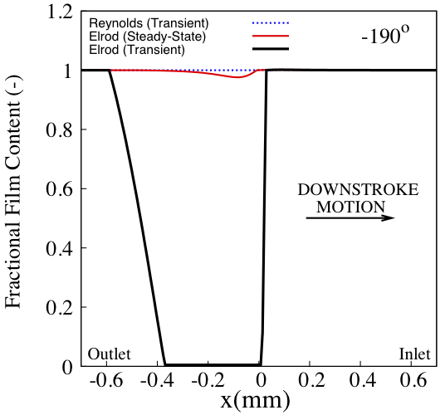
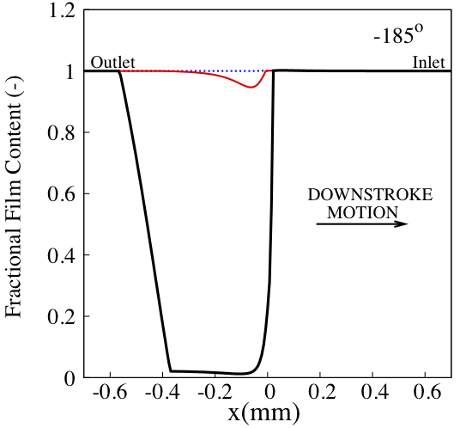
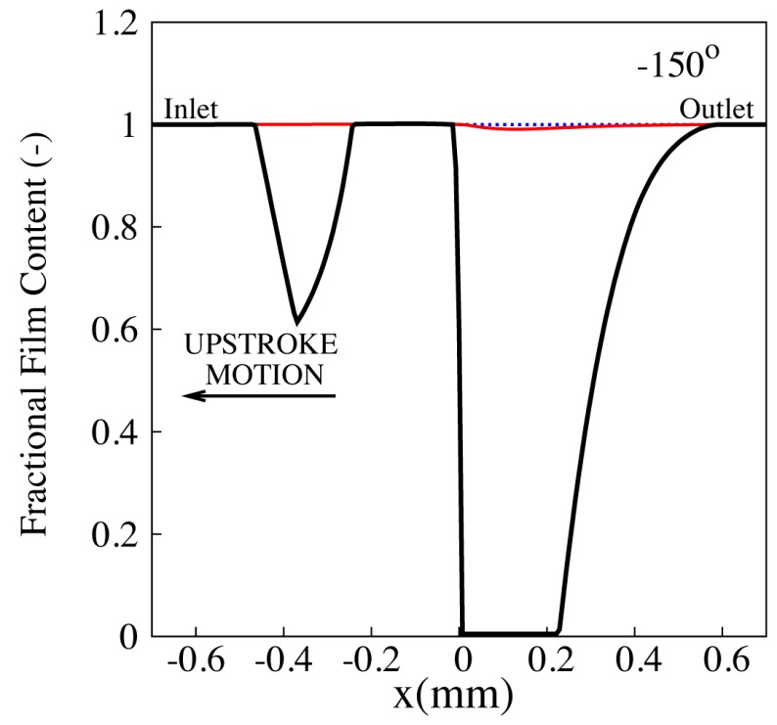
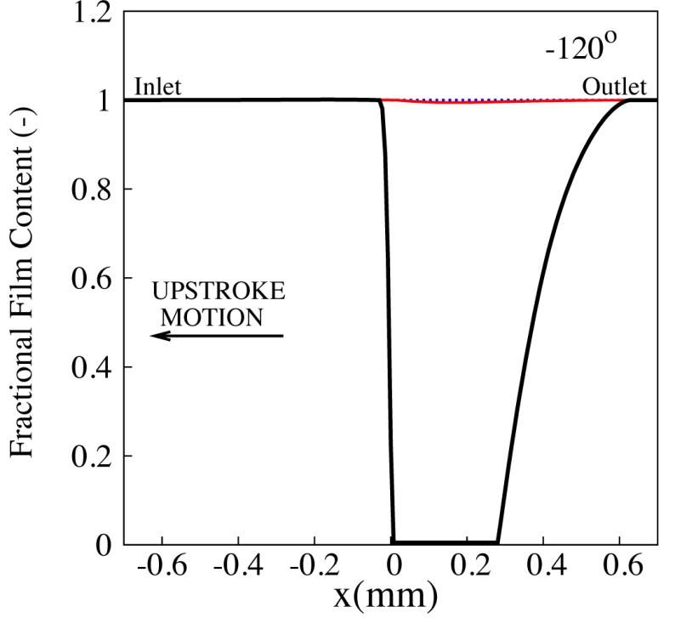
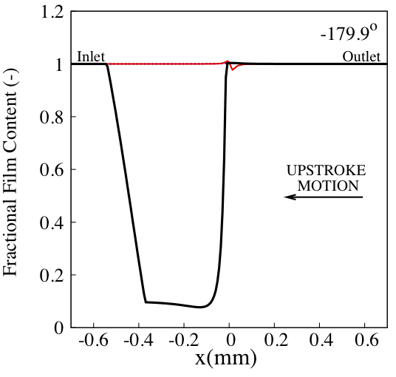
Suction BDC
(Fractional Film Content)

Slide 16
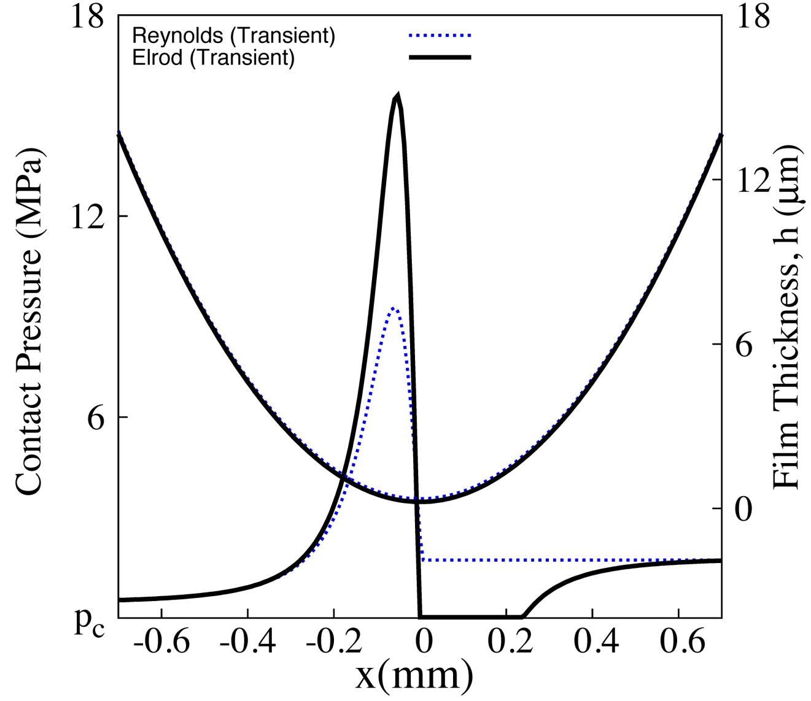
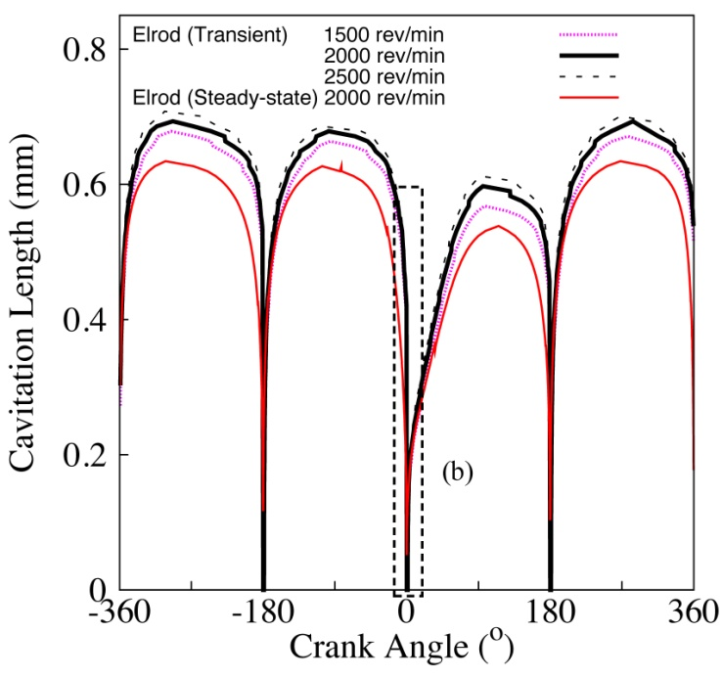
Piston Motion
Start of Cavitation
Reformation point
p_{out}
Cavitation

Slide 17
Piston Motion
Pre-reversal
Cavitation

Slide 18
Friction/shear stress prediction
Boundary
Friction
Asperity contact
Viscous
Friction

Slide 19
Greenwood and Tripp Friction Model

Slide 20
Single Asperity contact –
Solvation (IJTC2010 – 41128)
Molecule-Layering

Slide 21
conclusion
The tribological characteristics of the piston ring lubrication can be predicted using Elrod's cavitation algorithm.
The cavitation region formed at the trailing edge before inlet reversal briefly survives after the reversal leading to lubricant starvation and reduced film thickness.

Slide 22
Thank you

