Slide 1
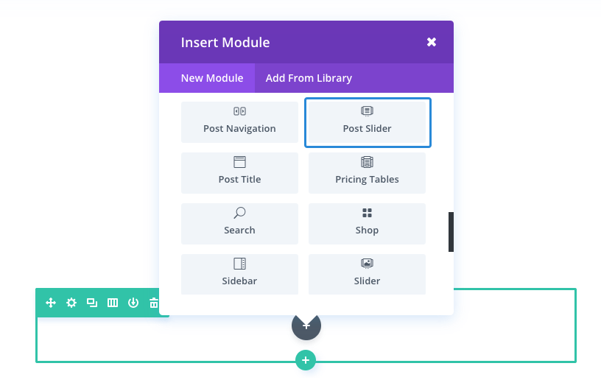
How To Add A Post Slider Module To Your Page
Once you have logged in to your account, you will notice a Use Divi Builder button above the post editor
every time you are building a new page. Clicking this button will enable the Divi Builder, giving you access to all of the Divi Builder’s modules.
Next, click the Use Visual Builder button to launch the builder in Visual Mode.
Once you have entered the Visual Builder, you can click the gray plus button to add a new module to your page.
If you want this module.

Slide 2
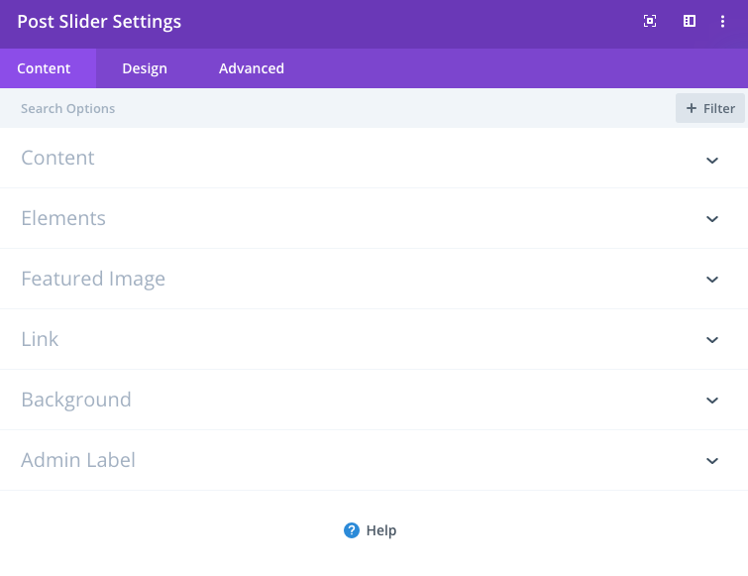
POST SLIDER SETTINGS
1
3
1. Slider Content Options
2
Within the content tab you will find all of the module’s content, elements, such as text, images and icons. Anything that controls what appears in your module will always be found within this tab.
2. Slider Design Options
Within the design tab you will find all of the module’s styling options, such as fonts, colors, sizing and spacing. This is the tab you will use to change how your module looks. Every Divi module has a long list of design settings that you can use to change just about anything.
3. Slider Advanced Options
Within the advanced tab, you will find options that more experienced web designers might find useful, such as custom CSS and HTML attributes. Here you can apply custom CSS to any of the module’s many elements. You can also apply custom CSS classes and IDs to the module, which can be used to customize the module within your child theme’s style.css file.

Slide 3
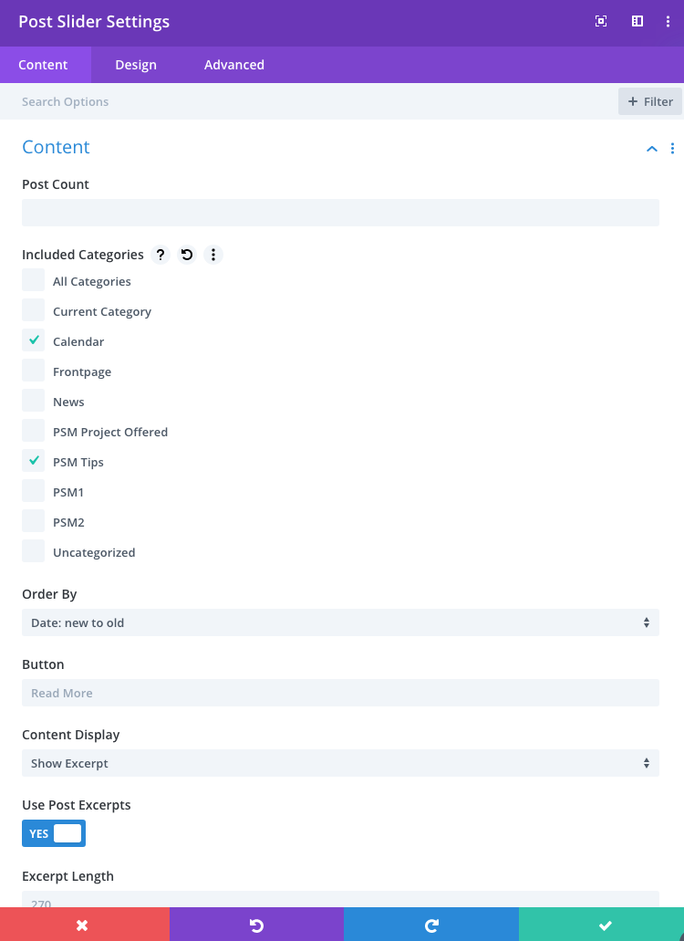
How to Edit Post Slider Settings
• Log in to your account • Then select Enable Visual Builder • Click the gear icon to change the Module Settings
1
Our modification begin with Content setting
2
Choose how many posts you would like to display in the slider.
Choose which categories you would like to include in the slider. You can select more than one category.
Define the text which will be displayed on Read More button. Leave blank for default (Read More)
Save settings.
3
4

