Slide 1
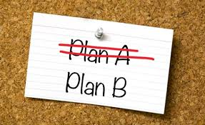
ADAPTABILITY
KESESUAIAN
NOR AKMAR BINTI NORDIN
HUMAN RESOURCE DEVELOPMENT (PSYCHOLOGY)
FACULTY OF MANAGEMENT

Slide 2
UTM GRADUATES ATRIBUTES 2017
(ADAPTABILITY SKILL)
At theend of the lecture students will be able to:
AD1 adapt to the culture of new communities and work environment.
AD2 recognize potential for improvement.

Slide 3
What is Adaptability?
Definition
“The quality of being able to adjust to new conditions ”- oxford
“ Individual’s capacity to modify behavior according to the
requirements, new environments, situation or events”
(Johnsons, 2012).

Slide 4
  Why do we need to develop adaptability
The world is changing - today’s life and work environments require far more than thinking skills and content knowledge.
Multiple generation,multiracial , multi-ethnic – need to mix
around
A symbol of intelligence and wisdom
One of the 21st century student outcomes
Advance in technologies – keep learning and evolving

Slide 5
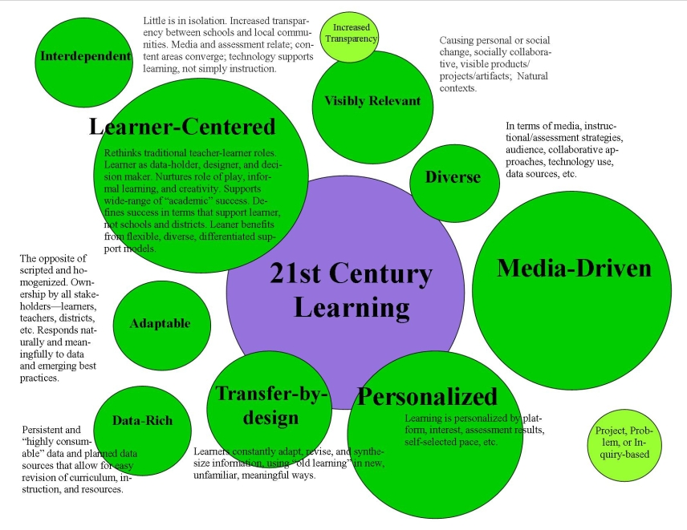

Slide 6
adaptability is behavior therefore we can:
MODIFY
ADJUST
CHANGE
CHANGE
NEW
ENVIRONMENT

Slide 7
DIMENSIONS OF ADAPTABILITY
INTRAPERSONAL
DEALING WITH UNCERTAIN AND UNPREDTABLE
LEARNING EFFORT
INTERPERSONAL
DEVELOP GOOD RELATIONSHIP WITH OTHERS
CULTURE ADAPTABILITY
ENVIRONMENTAL ADAPTABILITY
SOLVING PROBLEM CREATIVELY
MANAGING STRESS
HANDLING EMERGENCIES AND CRISIS
TECHNOLOGY
ACCEPTANCE OF NEW TECHNOLOGY AND IINOVATION

Slide 8
INTRAPERSONAL
PHYSICAL
EMOTIONAL
SOCIAL

Slide 9
INTERPERSONAL
Race - A large group of people distinguished by certain similar and genetically transmitted physical characteristics.
Ethnicity - A cultural heritage shared by a category of people who also share a common ancestral origin, language, and religion.
Nation - A large group of people who constitute a legitimate, independent state, and share a common geographical origin, history, and frequently language.
Shiraev/Levy Cross-Cultural Psychology 5/e

Slide 10
GAME
Lecturer select students to form two groups.
Each group is comprised of different faculties, multiracial and gender.

Slide 11
Pictionary
The classic game of Pictionary is great for an students because it’s simple and can involve every team member. It helps build stronger teamwork. You will need a large enough surface to draw on to ensure the whole group can see, i.e. dry erase board or flip chart.
Split your group into two teams.
Decide which team will go first, and then have the first person on the team select a word card.
Allow the team one minute to try and guess the object being drawn.
If the team isn’t able to guess it within the allotted time frame, allow the second team 30 seconds to guess.
Switch teams, and follow steps three and four. Allow each player the opportunity to draw for their team.
After everyone has had a turn, either start over and continue, or stop when a certain team achieves a certain amount of points.

Slide 12
BASIC MODULES
1. SELF ASSESSMENT TOOL TO IDENTIFY INDIVIDUAL ADAPTABILY PERFORMANCE ( e-learning)
Adaptive Performance
Scale

Slide 13
Key Definitions
The Integrative Approach
CHANGE
Psychological & Environment Phenomena
Activity: the individual’s goal-directed interaction with the environment
Resources and access to them
Modify & Change
Adapt
Shiraev/Levy Cross-Cultural Psychology 5/e

