Slide 1


UHAK1012
Lecture 11: GLOBAL CITIZENSHIP SKILL

Slide 2
Enable one to :
be aware of the wider world and has a sense of their own role as a world citizen
respects and values diversity
have an understanding of how the world works
participates in and contributes to the community locally and globally so as to make the world a more equitable and sustainable place
Takes responsibility for their actions

Slide 3
What are Global Citizen Skills?
Asking questions and developing critical thinking skills
Equipping young people with the knowledge, skills and values to participate
Acknowledging the complexity of global issues
Revealing the global as part of everyday life
Understanding how we relate to the environment and each other as human beings

Slide 4
Global Citizenship: 21st Century Context
We are linked to others on every continent:
socially through telecommunications
culturally through movements of people
economically through trade
environmentally through sharing one planet
politically through international systems of regulations

Slide 5
demonstrate the capacity for critical reflection based on interdisciplinary perspective, dimension or approach to a global issue

Slide 6
Students will be able to:
demonstrate the capacity for critical reflection based on interdisciplinary perspective, dimension or approach to a global issue

Slide 7
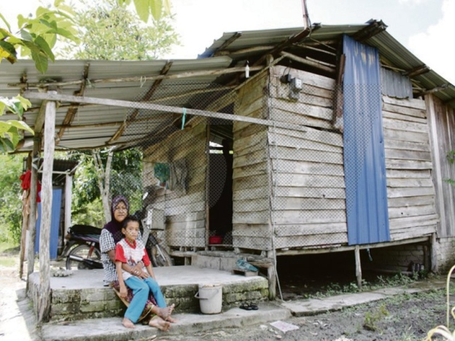
DISCUSSION
Look at the picture, what can you deduce about the woman and her child?
Notes:
NOTA KEPADA PENSYARAH : Slide no 8 dan 9 menunjukkan gambar yang sama. Namun, jawapan untuk kedua-dua slides bergantung kepada pelajar yang berkemungkinan bergantung kepada budaya, nilai, dan latar belakang / persekitaran kehidupan masing-masing.

Slide 8
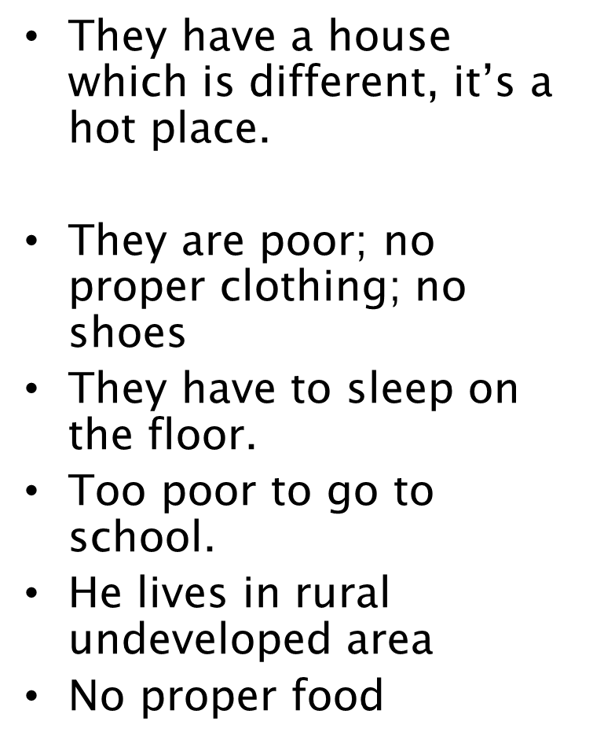
Suggestion answers

Slide 9
DISCUSSION
Look at this picture again; focus on similarities rather than differences

Slide 10
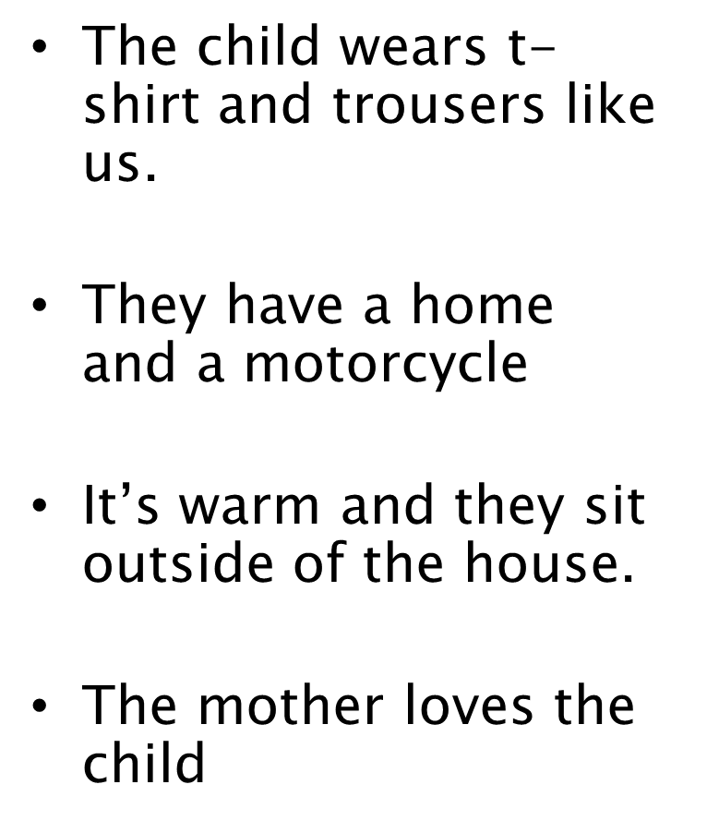
Suggested Answers

Slide 11
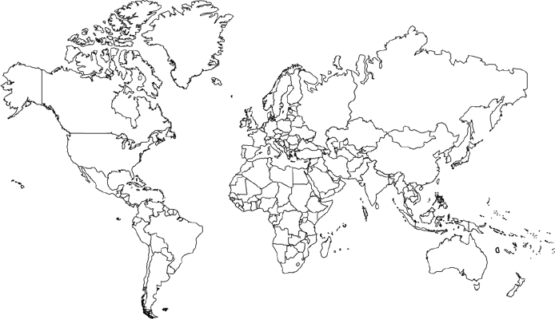
Exercise: World Map
Shade and mark on the map these countries based on the numbers given:
Mongolia
Somalia
Yemen
Kazakhstan
Argentina
United States of America
Notes:
Exercise ini untuk menguji pengetahuan am pelajar. Pengetahuan ini boleh menerangkan sejauhmana pelajar peka tentang apa yang berlaku di sekeliling mereka dan dapat menghuraikan apa yang mereka tahu tentang negara-negara tersebut terutama yang berkaitan dengan aspek sosial, ekonomi dan politik.

Slide 12

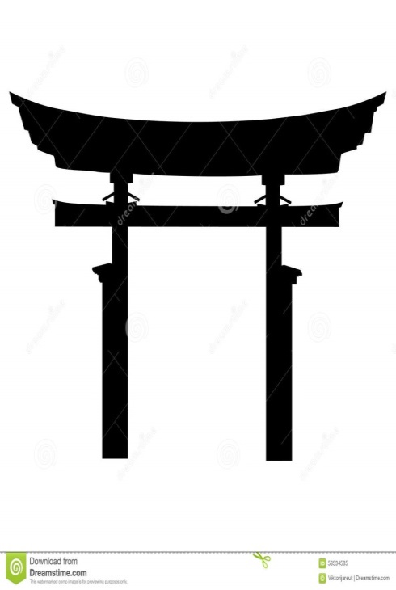
Exercise: World Symbols
Identify these symbols:
2.
1.
Notes:
JAWAPAN : (1) Islam, (2) Shintoism

Slide 13
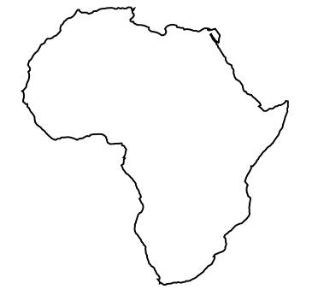
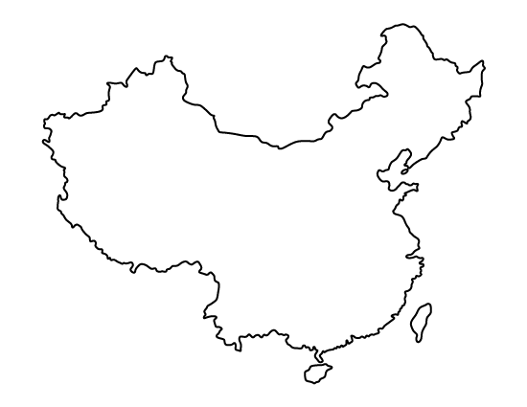
Exercise: What do you say about….?
Africa
China
**It is good practice to use contemporary images and art as a stimulus, not just traditional artefacts
Notes:
Objektif : untuk mengenalpasti pengetahuan pelajar tentang bagaimana mereka melihat dunia di sekeliling mereka dari aspek ekonomi, sosial, budaya, politik dan persekitaran.

Slide 14
Interculture
In order to actively engage in identifying civic issues, one must :
have the ability to question culture and how this understanding is represented in communities
reflect of one own culture is important, so he can reflect on aspects of other cultures

Slide 15
Culture
Characteristics of culture include:
    Learned
    Shared
    Trans-generational
    Symbolic
    Patterned
    Adaptive

Slide 16
Sathe’s Levels of Culture
Manifest
culture
Manifest
culture
Expressed values
Expressed values
Water
line
Basic
assumptions
Basic assumptions
Iceberg
Onion

Slide 17
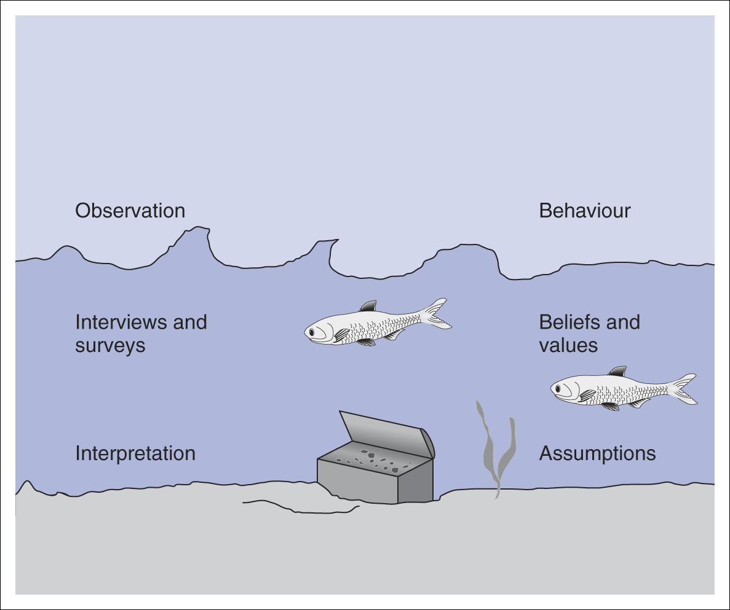
How can we explore culture?

Slide 18
Key points to take away today:
Focus on similarities, not differences.
Challenge narrow and stereotypical views of people and places.
Present a balanced view
Understanding cultures & diversity
Ethics of community engagement to be at the forefront in any of our social work

Slide 19
Globalization
“Globalization is not the only thing
influencing events in the world today,
but to the extent that there is a North Star and
a worldwide shaping force, it is this system.”
Thomas Friedman, The Lexus and the Olive Tree, 1999

Slide 20
Globalization
Friedman's comment above serves to illustrate the profound importance assigned to the cultural (and technological) forces now reshaping the world.
ascribed tremendous importance to the forces of globalization and informatization that have already redefined industries, politics, and cultures, and perhaps the underlying rules of social order.

Slide 21
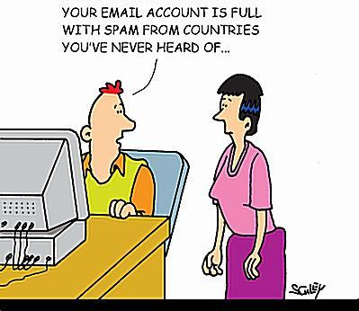
What is Globalization?
'Globalization means when your e-mail account is full with spam from countries you've never heard of...'

Slide 22
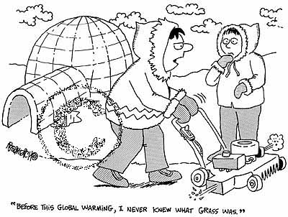
"Before this Global Warming,I never knew what grass was."

Slide 23
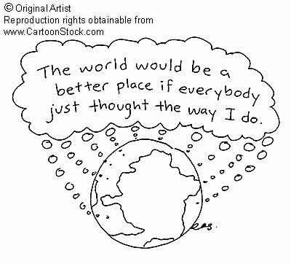

Slide 24
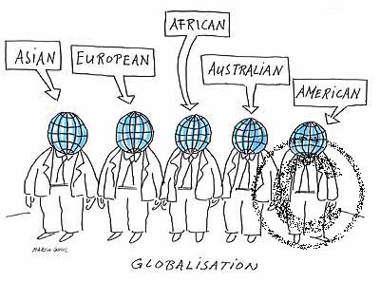

Slide 26

Global Issues
SAVING THE NATURAL WORLD: Protecting flora and fauna.
THE STATE OF JAPAN: Facing shock waves of change.
WEAPONS OF WAR: The challenge of disarmament.
THE WORLD OF ISLAM: Tradition, change, and conflict.
WORLD POPULATION: The biggest problem of all?
WORLD URBANISATION: The dominance of the city.
MIDDLE-EAST AND THE WEST: A failure to communicate.

Slide 27
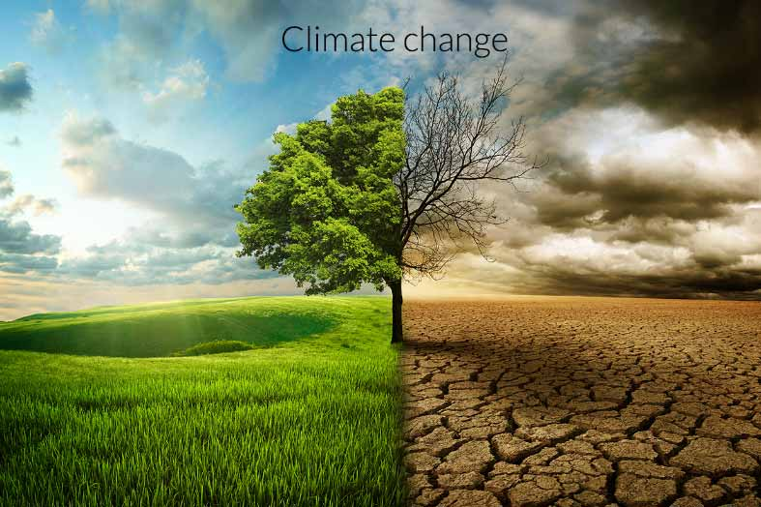

Global Issues
ANTARTICA: Protecting the last wilderness.
CHINA IN TRANSITION: The making of a new superpower.
THE BATTLE FOR WATER: Earth’s most precious resource.
CLIMATE CHANGE: What’s happening to the weather?
THE CONQUEST OF DISEASE: An impossible dream?

Slide 28
Global Issues
LOSING THE EARTH: Land abuse and soil erosion.
MARINE POLLUTION: The poisoning of the seas.
MIGRANTS AND REFUGEES: Millions of people on the move.
MULTINATIONAL BUSINESS: Beyond government control.
NORTH AND SOUTH KOREA: The last ideological frontier.
NUCLEAR ENERGY: Who’s afraid of atomic power?
THE PACIFIC RIM: Powerhouse of the 21st century.
RENEWABLE ENERGY: Wind and water power.

Slide 29
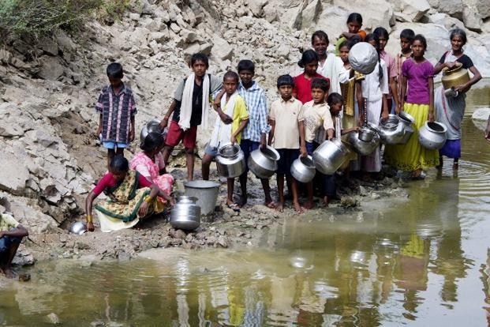
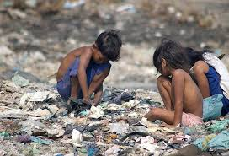
What would you do to help this community????
Notes:
Note what are the issues being presented and discuss ways to help.

Slide 30

Conclusion
We feel now that the issue of developing global citizen skill deserves much more attention due to rapidly progressing internationalization of business, science, finance, commerce and many other areas.

Slide 31

