Slide 1

LEADERSHIP
&
TEAMWORKING
DR. HALIMAH MOHD YUSOF
Notes:
Notes to Instructor: Video & some images have to be removed due to the excessively large file sizes of the PPT. (unable to email the ppt to instructors due to the large size).

Slide 2
Course Learning Outcome
At the end of the course, students should be able to demonstrate professional sense of shared purpose on attitude and behavior of leadership and work group.

Slide 3

LEADERSHIP

Slide 4
The best of all leaders is the one who helps people. So that, eventually they don't need him. Then comes the one they love and admire. Then comes the one they fear. The worst is the one who lets people push him around. Where there is no trust, people will act in bad faith. The best leader doesn't say much, but what he says carries weight. When he is finished with his work, the people say; It happened naturally. - Lao Tzu (550 BC)

Slide 5
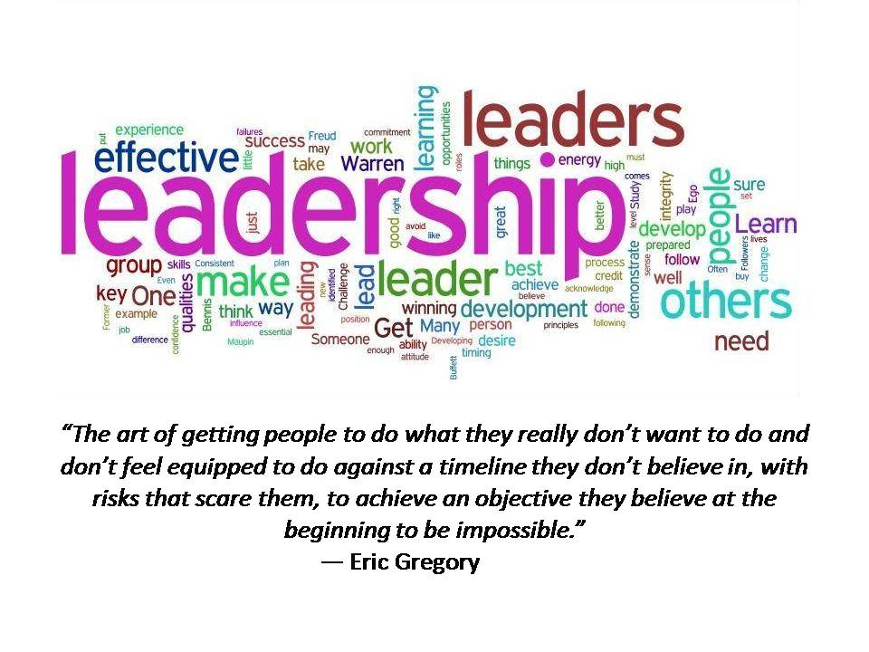
What is Leadership?

Slide 6
Leadership
is a process whereby an individual influences a group of individuals to achieve a common goal.
-Northouse (2013)

Slide 7
Managers vs Leaders
Managers
Focus on things
Do things right
Plan
Organize
Direct
Control
Leaders
Focus on people
Do the right things
Inspire
Influence
Motivate
Build

Slide 8
Leadership Attributes
Who leaders ARE
What leaders KNOW
What leaders DO

Slide 9
Inner Habits and Qualities of a True Leader
Knowledgeable
Professional
Delegate
Decisiveness
High Emotional intelligence
Positive mental attitude
Self-confidence and self-reliance
Challenge people to think
Notes:
Decisiveness All leaders must make tough decisions. It goes with the job. They understand that in certain situations, difficult and timely decisions must be made in the best interests of the entire organization, decisions that require a firmness, authority, and finality that will not please everyone. Extraordinary leaders don't hesitate in such situations. They also know when not to act unilaterally but instead foster collaborative decision making.
3. Empathy Extraordinary leaders praise in public and address problems in private, with a genuine concern. The best leaders guide employees through challenges, always on the lookout for solutions to foster the long-term success of the organization. Rather than making things personal when they encounter problems, or assigning blame to individuals, leaders look for constructive solutions and focus on moving forward.
4. Accountability Extraordinary leaders take responsibility for everyone's performance, including their own. They follow up on all outstanding issues, check in on employees, and monitor the effectiveness of company policies and procedures. When things are going well, they praise. When problems arise, they identify them quickly, seek solutions, and get things back on track.

Slide 10
Inner Habits and Qualities of a True Leader
Honesty & Integrity
Communicate effectively
Make others feel safe to speak up
Measure & reward performance
Provide continuous feedback
Properly allocate and deploy talent

Slide 11
Inner Habits and Qualities of a True Leader
Inspire others : Lead by example
Willingness to change & consider new opportunities
Creativity in searching for new solutions
Faithfulness, mercifulness, empathy & fairness
Persistence & determination in challenging situations

Slide 12
LEADERSHIP STYLES

Slide 13
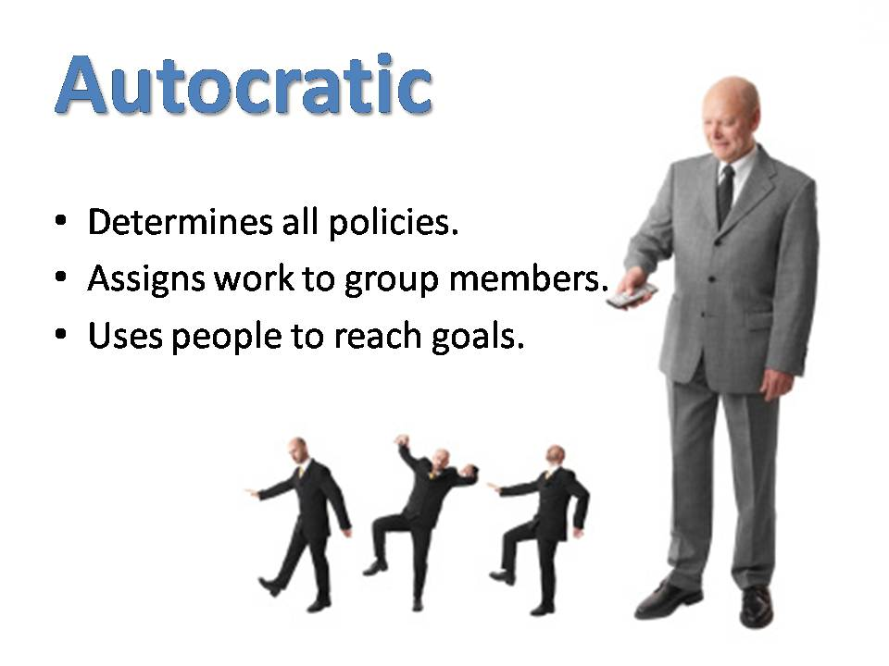
Autocratic
Control over all decisions.
Takes very little inputs from team members.
Use people to reach goal.

Slide 14

Democratic
Encourage group to discuss.
Ideas are exchanged freely.
Fair in giving praise and criticism

Slide 15
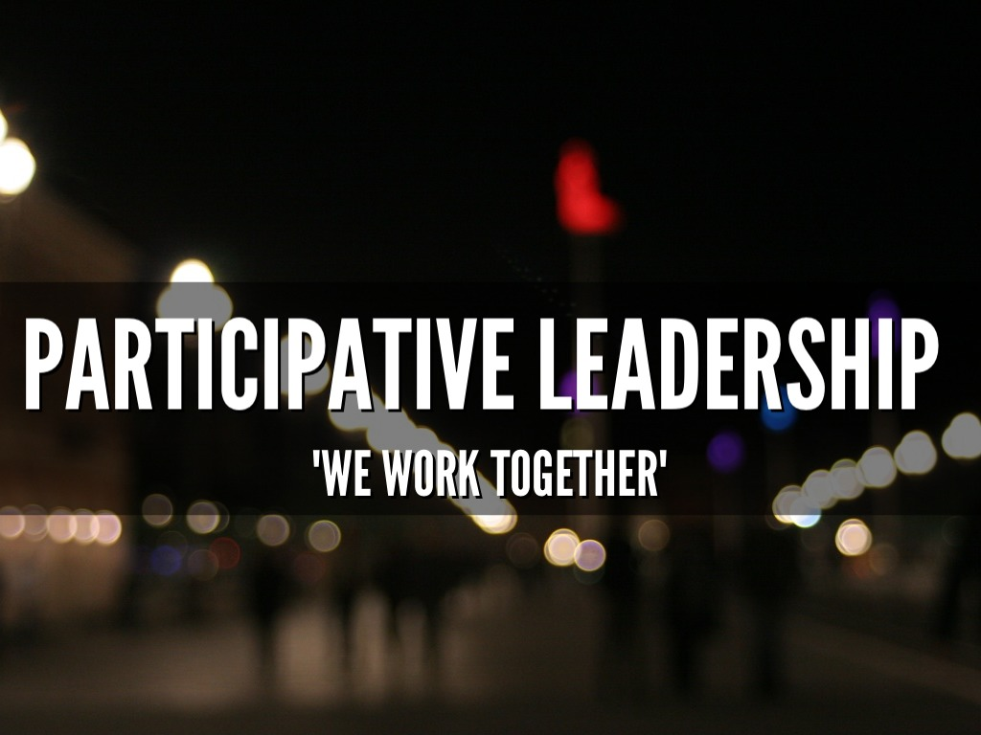

Slide 16
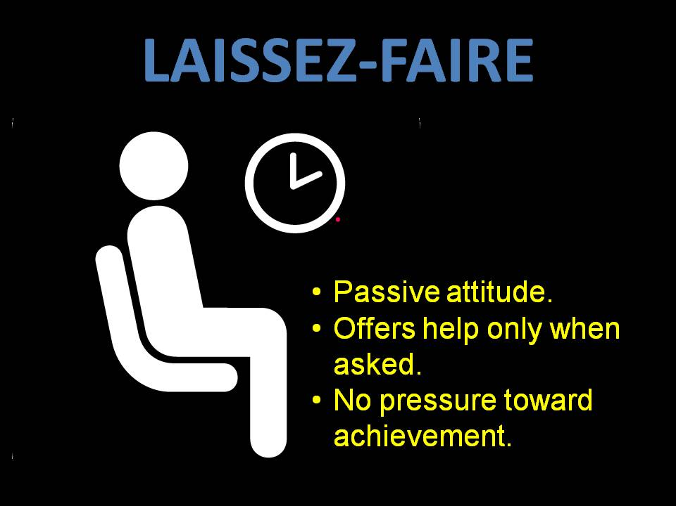
Laissez-Faire
Passive attitude
Offers help only when asked.
No pressure toward achievement.

Slide 17
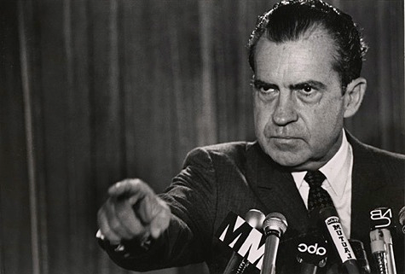
Transactional
Use Reward and Punishment.
Monitor people to see that they do the expected.
Maintain status quo

Slide 18
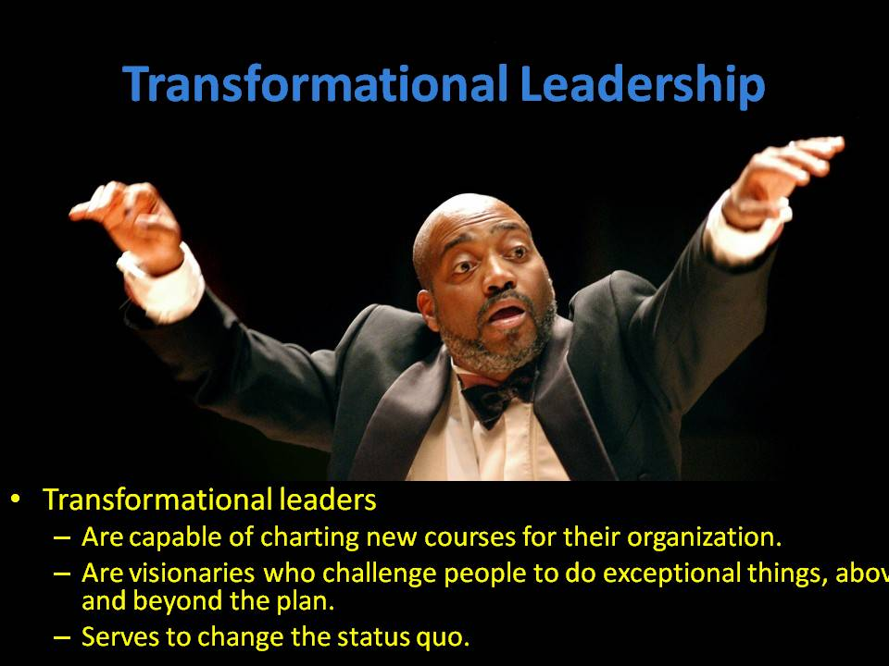
Transformational
Visionary.
Challenge team to do exceptional things .
Capable of charting new courses for their organization

Slide 19
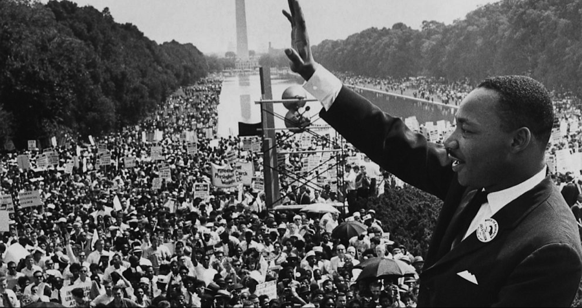
Charismatic
Powerful self-image/self-confidence.
Good communicator.
Inspire others.

Slide 20

Situational

Slide 21
ETHICAL LEADERSHIP

Slide 22
LEADERSHIP & ETHICS
Has to do with what leaders do and who leaders are
It is concerned with the nature of the leaders’ behavior and their virtuousness
What choices leaders make and how they respond in a particular circumstance are informed and directed by their ethics.

Slide 23
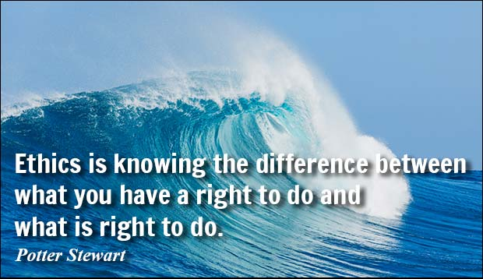

Slide 24

LEADERSHIP ETIQUETTE
Work for the success of the entire group, not for self.
Know that power is given by the members and can be taken away.
Everybody is important and no one should be demeaned.

Slide 25
Dishonest and Unethical Influence Tactics

Slide 26

TEAMWORK

Slide 27
Teamwork
The combined action of a group of people, especially when effective and efficient.

Slide 28
So, what is a Good Teamwork?
when a group of people work together cohesively, towards a common goal, creating a positive working atmosphere, and supporting each other to combine individual strengths to enhance team performance.

Slide 29
Tips for a Good Teamwork
Think about your team first
Supportive & Care for each other
Never underestimate your team member
Cooperate & Contribute
Not criticizing/bad-mouthing team member
Respectful of other team member

Slide 30
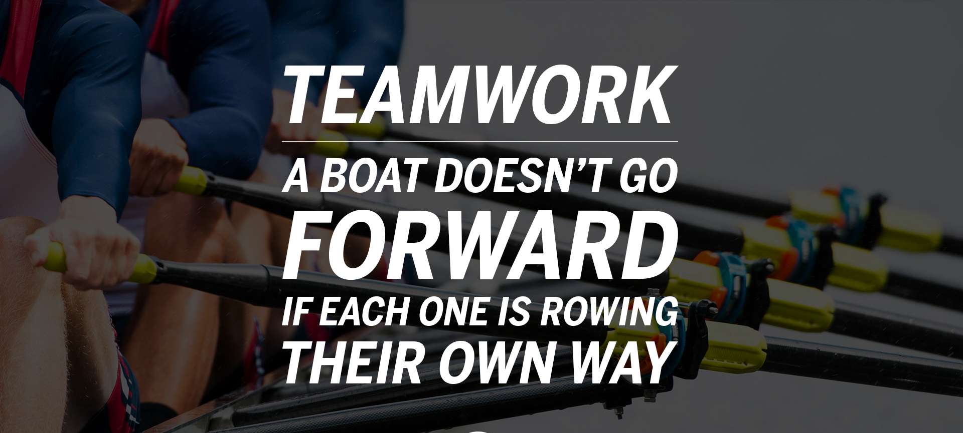

Slide 31
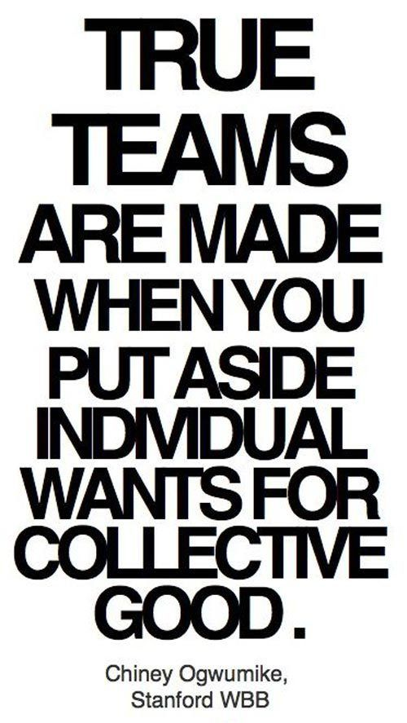
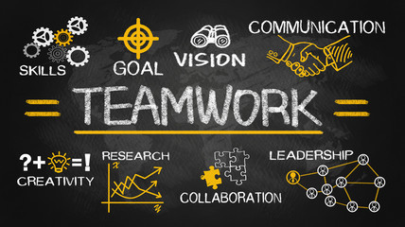

Slide 32
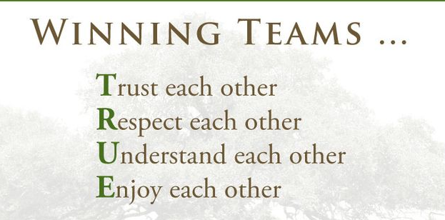

Slide 33
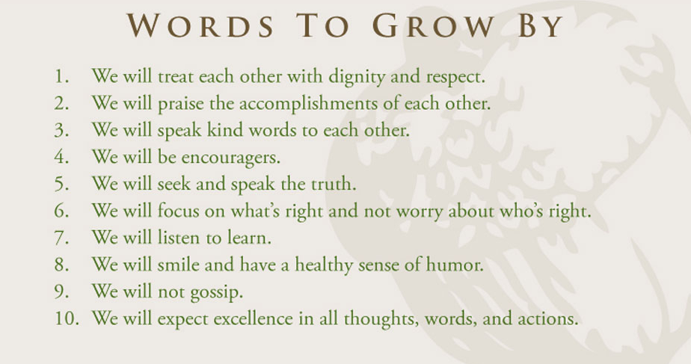

Slide 34
When ‘i” is
replace by ‘we’
Even
‘illness’
Becomes
‘Wellness’

Slide 35
Characteristic of Disruptive Team Member
Aggressive
Gossiping
Negativity
Dominating
Irresponsible
Self-Centred
Withdrawn
Jealousy

Slide 36
Successful people build each other up. They motivate, inspire, and push each other.
Unsuccessful people just hate, blame and complain.

Slide 37
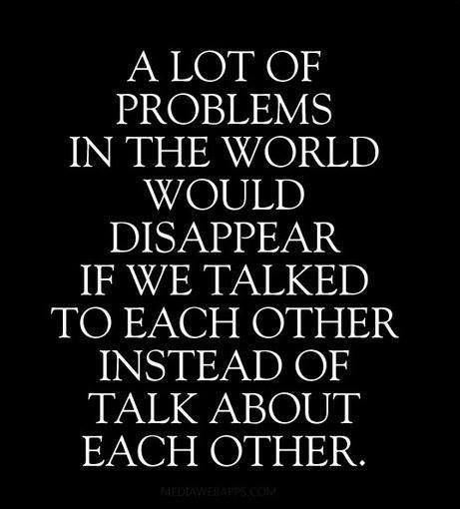

Slide 38
If you cannot be positive, then at least be quite.

Slide 39
SUMMARY

Slide 40

CONFLICT MANAGEMENT

Slide 41
WHAT IS CONFLICT?

Slide 42
HOW CONFLICT HAPPEN?

Slide 43
Causes of Conflict
Differences in Goals/Aims
Differences in Values
Differences in Personality/Attitudes
Poor Communication
Ego
Competition/Scarce Resources

Slide 44
We are very good lawyer for our own mistakes, but very good judge for the mistakes of others.

Slide 45
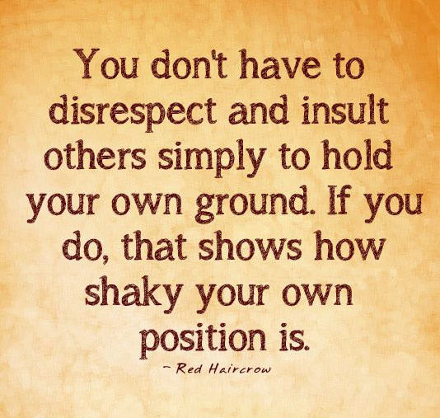

Slide 46
HOW TO HANDLE CONFLICT?

Slide 47
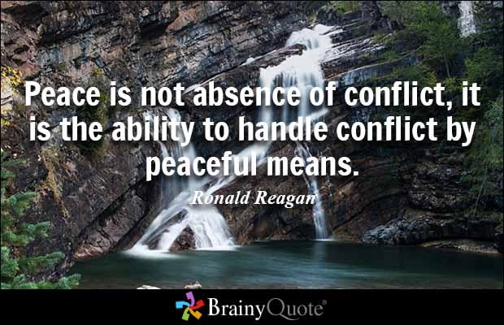

Slide 48
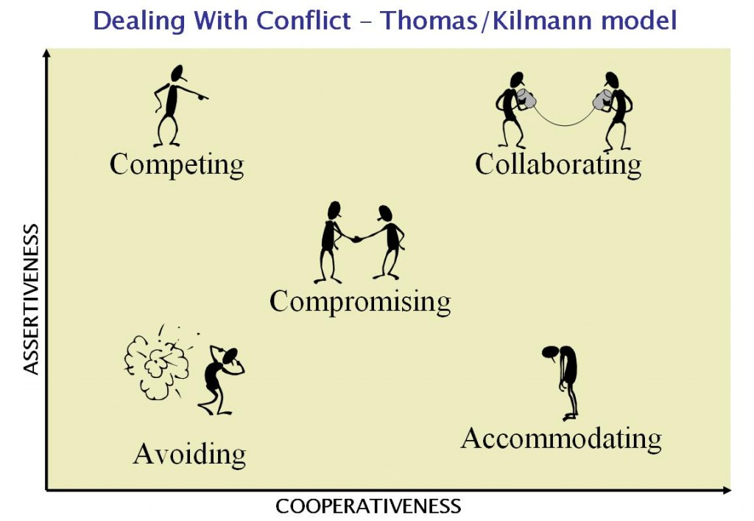
Conflict Management Styles

Slide 49
Accommodating
People who accommodate are unassertive and very cooperative.
Give in during a conflict.
Acknowledge they made a mistake/decide it was no big deal.
Put relationships first, ignore issues, and try to keep peace at any price.
Effective when the other person or party has a better plan or solution.

Slide 50
Avoiding
People who avoid conflict are generally unassertive and uncooperative.
Avoid the conflict entirely or delay their response instead of voicing concerns.
Can create some space in an emotional environment.
Not a good long-term strategy.

Slide 51
Collaborating
Collaborators are both assertive and cooperative.
Assert own views while also listening to other views and welcoming differences.
Seek a “win-win” outcome.
Identify underlying concerns of a conflict.
Create room for multiple ideas/ Requires time and effort from both parties.

Slide 52
Competing
People who do not cooperate while pursuing their own concerns at another’s expense.
Takes on a “win-lose” approach where one person wins and one person loses
Does not rely on cooperation with the other party to reach outcome
May be appropriate for emergencies when time is important

Slide 53
Compromising
Compromisers are moderately assertive and moderately cooperative.
Try to find fast, mutually acceptable solutions to conflicts that partially satisfy both parties.
Results in a “lose-lose” approach.
Appropriate temporary solution.
Considered an easy way out when you need more time to collaborate to find a better solution.

Slide 54
WHICH ONE IS THE BEST?

Slide 55
There is no BEST way to handle conflict. Each conflict is different and requires a different response.

Slide 56



Slide 57
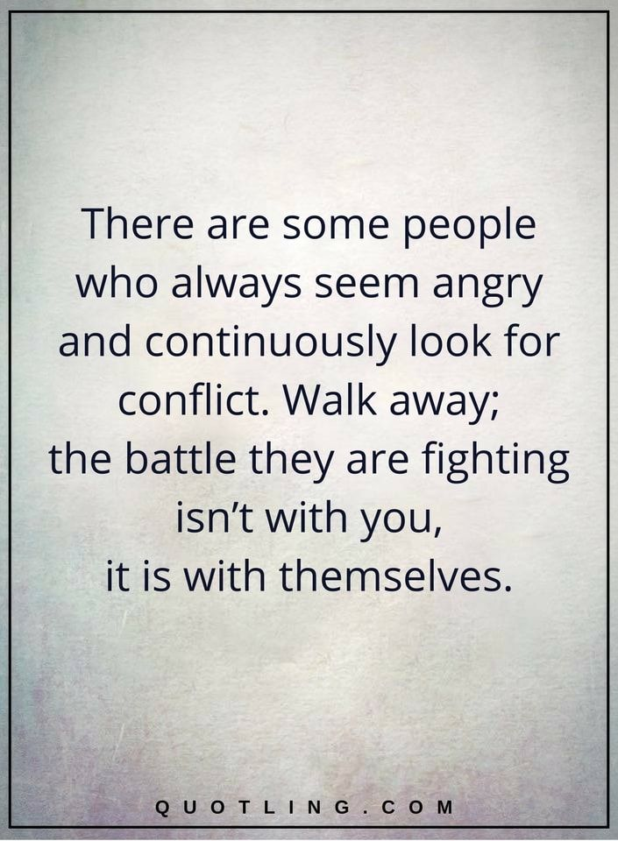

Slide 58
SUMMARY

