Slide 1

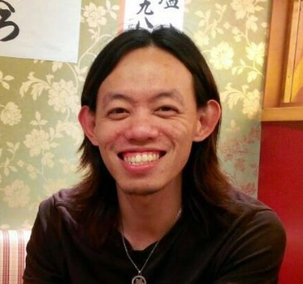
Faculty of Science
Department of Physics
Please modify this as much as possible!!
Yap Yung Szen, Ph.D.
23 Jun 2016
10⁰⁰ – 11⁰⁰ pagi

