Slide 1
ELECTRICAL SAFETY
Safety and Health Officer Certificate Programme

Slide 2
Session/LessonPlans
Timing (minutes) | Learning Objective | Main tasks / Process | Resources / tools
5 | Title | Standard Operating Procedures for Power Press Machine | Slide 1
5 | Index | Contents of the presentation | Slide 2
15 | Introduction | The main purpose of guideline Limitation How to use the guideline | Slide 3, 4and 5
10 |  |  | Slide 6-15
10 |  |  | Slide 16 - 25
BREAK (30 MIN)
45 |  |  | Slide 26 - 35
10 |  |  | Slide 36 - 49
10 |  |  | Slide 50 - 48
BREAK (LUNCH)
20 |  |  | Slide 49 + Video duration (15 min)
10 |  |  | Slide 50
15 |  |  | Slide 51
30 |  |  | Slide 52
BREAK (30 MIN)
120
 | Total Time

Slide 3
OBJECTIVES
State the definition of current, volt and ohm
Explain 4 hazards related to electricity
Explain 2 basic preventive measures in electrical safety

Slide 4
OBJECTIVES
State at least 4 considerations in the safe use of electricity
Identify statutory requirements related to electrical safety

Slide 5
SCOPE
Definition
Electrical installation
Hazard and effects of electric currents
Principles of electrical safety
Safe use of electricity
Electrical safety controls
Conclusion

Slide 6
ELECTRICITY
A form of energy that is efficient and simple
Usages:
Lighting
Heating
Energy use (oven etc)

Slide 7
TERMINOLOGY
Electric is a form of energy
that is
produced from the flow of electrons.
It is a general term that includes energy related to electricity charges, whether static or dynamic.

Slide 8
FACTORS THAT INFLUENCE ELECTRICITY
Volt
The force of electric energy
Ampere
Actual flow of electricity
Ohm
Characteristic for the circuit or route of which electricity flows and offers resistance to the current

Slide 9
ADVANTAGES OF ELECTRICITY
Cost effective
Clean
Easy to use
Does not require storage

Slide 10
CHARACTERISTICS OF ELECTRICITY
Cannot be seen
Cannot be heard
Cannot be smelt

Slide 11
ELECTRICAL INSTALLATIONS
Includes:
Circuit
Conductor
Main switch, local and distributing board
Circuit breakers
Fuse
Socket and plug

Slide 12
ELECTRICAL INSTALLATIONS - CIRCUIT
Where electric current flows
Provides the source of energy
Is complemented by use of a conductor to allow control of current

Slide 13
ELECTRICAL INSTALLATIONS - CONDUCTOR
Comprises of:
Internally: Metal which allows the flow of electricity
Externally: Rubber – for insulation

Slide 14
ELECTRICAL INSTALLATIONS - MAIN SWITCH, LOCAL & DISTIBUTION BOARD
Main switch functions as a source of electric current and distributes it to other parts according to requirements
Functions to stop the flow of electricity current in the circuit
Distribution board comprises of main switch, circuit breaker and other switches. It receives electric current externally before distribution.

Slide 15
ELECTRICAL INSTALLATIONS - CIRCUIT BREAKERS
Functions when there is overload of electricity
Prevents overload of excess heat that may cause combustion
Closed switch
It has an automatic switch which retracts from the ‘on’ position to ‘off’ position when there is an overload of electricity flow in the circuit

Slide 16
ELECTRICAL INSTALLATIONS - FUSE
A piece of thin metal that will melt at a level below overload level to break the circuit
Stops the flow of electricity

Slide 17
ELECTRICAL INSTALLATIONS - EXTERNAL SOCKET
Entry to the circuit and allows tapping to let electricity flow to the equipment requiring it.

Slide 18
ELECTRICAL INSTALLATIONS - PLUG
Is connected to a flexible cable that supplies
electricity to the equipment, and is inserted into the external socket to complete another circuit.

Slide 19
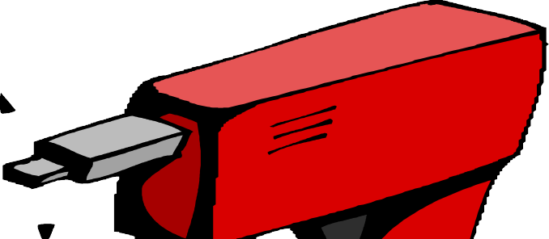
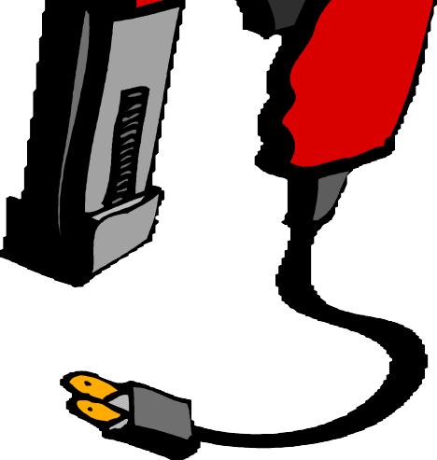
ELECTRICAL HAZARDS
Electric shock
Lighting
Fire
Electrostatic

Slide 20
ELECTRICAL HAZARDS - ELECTRIC SHOCK
Usually from a live wire to earth
Makes the muscles shorten and spasm
May affect heart reactions
May result in respiratory failure

Slide 21
ELECTRICAL HAZARDS - LIGHTING
Arc Eyes
From ultraviolet lights when looking at electric arc or welding flash
Symptoms similar to conjunctivitis
Situation may continue for 3 to 4 days
20
Does not affect contact lens

Slide 22
ELECTRICAL HAZARDS - FIRE
From | contact | with electric arc caused | by
short | circuit | conductor or overload | of
equipment charges.
or release
of electrostatic

Slide 23
ELECTRICAL HAZARDS ELECTROSTATIC
Results that is produced by electricity charges trapped in isolators. The charges may be distributed inside or outside objects that have been isolated or it may concentrate on conductors that have been earthed
High voltage, low current
Effect of electric shock and ignition sources in a highly flammable environment, if charges are high

Slide 24
ELECTRICAL SAFETY
The effects of electric current differ according to:
Age
Gender
Body resistance
Health level

Slide 25
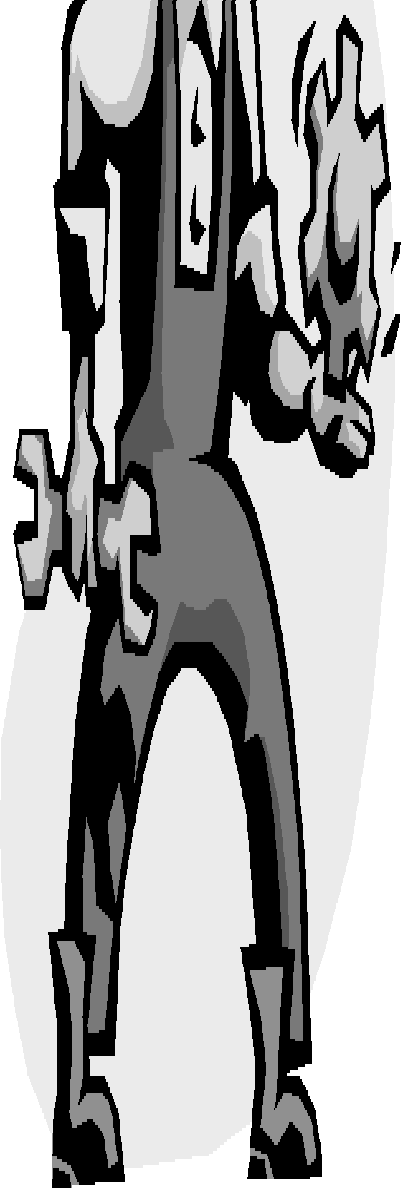
HOW ELECTRICITY FLOWS IN THE BODY
High pain Moderate pain
To earth
To earth
24
HAND TO FEET
HAND TO HAND
Copyright@NIOSH 2005

Slide 26
EFFECTS OF ELECTRICITY
Depends on:
The amount of current and voltage
Body resistance
Severity of electric shock
Duration of current flow

Slide 27
OHM LAW
Current (I) : Volt (V)
Resistance (R )
Or use the actual measurement:
Amperes :
Volt
Ohm

Slide 28
OHM LAW EXAMPLE
For electric shock effects
Volt : | 240 volt
Average body resistance : | 100 ohm
Ampere : | 240/100 | = 2.4 amps
value of danger
27

Slide 29
EFFECTS OF ELECTRICITY
National Safety Council -Indus. Safety & Health mgmt book
Current (mAmps)
Effects to human
3 milliamps
Mild shock
7 milliamps
Painful electric shock
20 milliamps
Difficulty breathing
70 milliamps
Risk of death
700 milliamps
Burning of body tissues
3000milliamps
Heart stops

Slide 30
HUMAN BODY RESISTANCE TO ELECTRICITY FLOW
TYPES OF RESISTANCE
Dry human skin Wet human skin Internal body
-Hand to feet
Internal body
- Ear to ear
VALUE
100,000 - 600,000 ohms
Approx. 1,000 Ohm
400 - 800 ohms
Approx. 100 ohms

Slide 31
VOLTAGE SHOCK THRESHOLD AT 50 Hz
Minimum Threshold for Feel | 10 -12 Volt
Minimum Threshold for Pain | 15 Volt
Minimum Threshold for Excessive Pain | 20 volt
Minimum Threshold for Voltage Grip | 20 - 25 Volt
Vibration | 50/60 - 2000 Volt

Slide 32
PRINCIPLES OF ELECTRICAL SAFETY
Main objective:
Protect people from electric shock, fire and effects of burns due to contact with electricity

Slide 33
PRINCIPLES OF ELECTRICAL SAFETY
Two basic prevention steps:
Protection from direct contact
Protection from indirect contact

Slide 34
PRINCIPLES OF ELECTRICAL SAFETY
Protection from direct contact
Provides isolation to parts of equipments that has potential to release charges
Protection from indirect contact
Provides effective earthing to isolate metals that can charge electricity in case of failure of the main isolator

Slide 35
SAFE USE OF ELECTRICITY
Considerations:
Circuit protector
Isolating switch
Equipment maintenance and repair
Earthing
Protection

Slide 36
SAFE USE OF ELECTRICITY CIRCUIT PROTECTOR
All electric equipments used must have a fuse and circuit breaker that is suitable to prevent it from overloading.

Slide 37
SAFE USE OF ELECTRICITY
- ISOLATING SWITCH
Labeled
Easy reachable from the floor
Is attached to each individual machinery
Possess safety lock when in ‘off’ position

Slide 38
SAFE USE OF ELECTRICITY EQUIPMENT MAINTENANCE & REPAIR
Prepare safe work procedures for maintenance works
Prepare rules and conduct inspection / monitoring
Prepare a maintenance programme / schedule

Slide 39
SAFE USE OF ELECTRICITY EQUIPMENT MAINTENANCE & REPAIR
Prepare access around the equipment to allow easy maintenance and repair
Works done by a competent technician
Ensure suitable replacement of components such as fuse, capacitors

Slide 40
SAFE USE OF ELECTRICITY
- EARTHING
For all electrical items
Circuit is connected direct, not through a switch

Slide 41
SAFE USE OF ELECTRICITY
- PROTECTION
Provide for earth leakage protection such as Residual Current Devices
Have an emergency stop switch, interlock switch
Isolate the conductor
Display appropriate warning signages

Slide 42
ELECTRICAL SAFETY CONTROLS
Government controls:
Provision of Regulations and enforcement
Electricity Supply Act 1990
Electricity Supply Regulations 1994
SIRIM Standards
Occupational Safety and Health Act 1994 (OSHA 1994)

Slide 43
ELECTRICAL SAFETY CONTROLS
OCCUPATIONAL SAFETY AND HEALTH ACT 1994
Employers:
Have safe system of work (SOP)
Provide training, information and instruction
Provide prevention measures and protection to workers and contractors

Slide 44
ELECTRICAL SAFETY CONTROLS
OCCUPATIONAL SAFETY AND HEALTH ACT 1994
Manufacturers, suppliers, designers:
Conduct testing and inspection to ensure user safety
Workers:
Comply to all rules and regulations issued by the employer

Slide 45
CONCLUSION
Electricity may result in multiple hazards that may affect worker safety and health
There are two basic prevention measures that may be taken to protect against electrical hazards
These are followed electrical safety measures as discussed
The government also regulates the safe use of electricity through the formulation and enforcement of various regulations
44

