Slide 1
WELDING SAFETY
Safety and Health Officer Certificate Programme

Slide 2
Session/LessonPlans
Timing (minutes) | Learning Objective | Main tasks / Process | Resources / tools
5 | Title | Standard Operating Procedures for Power Press Machine | Slide 1
5 | Index | Contents of the presentation | Slide 2
15 | Introduction | The main purpose of guideline Limitation How to use the guideline | Slide 3, 4and 5
10 |  |  | Slide 6-15
10 |  |  | Slide 16 - 25
BREAK (30 MIN)
45 |  |  | Slide 26 - 35
10 |  |  | Slide 36 - 49
10 |  |  | Slide 50 - 48
BREAK (LUNCH)
20 |  |  | Slide 49 + Video duration (15 min)
10 |  |  | Slide 50
15 |  |  | Slide 51
30 |  |  | Slide 52
BREAK (30 MIN)
120
 | Total Time

Slide 3
OBJECTIVES
State the definition of welding
Explain three categories of welding
State at least five hazards related to welding works
List the considerations in safety of welding equipments
Discuss the safety measure, before and during welding works

Slide 4
SCOPE
Introduction / definition of welding
Types of welding and equipments
Welding hazards
Considerations for welding equipments
Safety measures for welding equipments
Safety measures for welding activities
Conclusion

Slide 5
WELDING
Definition
Fusion of
through the
two pieces of metals melting of the metals
using heat, pressure or both.

Slide 6
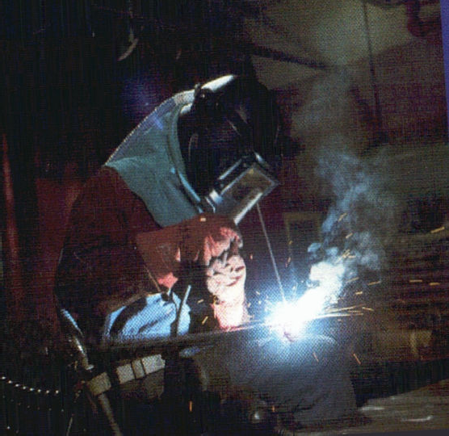

Slide 7
TYPES OF WELDING
Gas welding
Electric arc welding
Current welding

Slide 8
GAS WELDING
Melting of metals using fire that is produced by gas mixtures using torch or blowpipes at high temperatures.
Gases: Oxygen and flammable gasses such as acetylene or LPG

Slide 9
ELECTRIC ARC WELDING
Electrodes and high voltage produces an arch where the electrode is in a position close to the steel work material
The electrode is moved along the part to be welded
The temperature reached for welding is 4000°C
The metal pieces will melt and fuse at that temperature

Slide 10
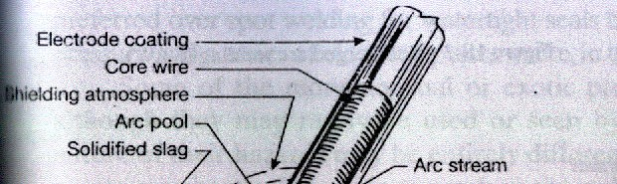
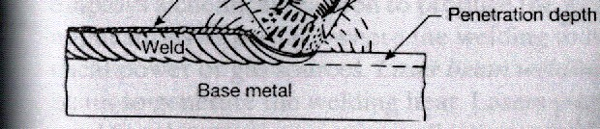
ELECTRIC ARCH WELDING

Slide 11
RESISTANCE WELDING
Electricity currents are flowed through the part to be welded
Heat is generated to melt the metal
Use of physical force to weld the metals
Limited to thin materials
Least hazardous

Slide 12
WELDING EQUIPMENTS
Oxygen cylinder and acetylene
Hose
Regulator
Blowpipe or torch

Slide 13
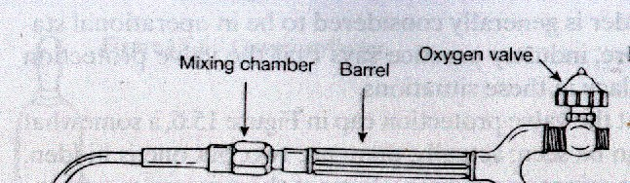
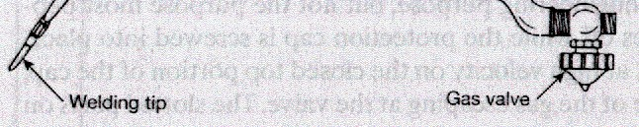
BLOWPIPE FOR GAS WELDING

Slide 14
EQUIPMENTS GAS WELDING
Identify Cylinder
Cylinder | Colour | Thread valve outlet
Oxygen | Black | Right
Flammable LPG Acetylene | Red Maroon | Left

Slide 15
EQUIPMENTS GAS WELDING
Identify Hose
Gas | Colour
Acetylene LPG Oxygen | Red Orange Blue

Slide 16
EQUIPMENTS GAS WELDING
Regulator
Attached to cylinder
Controls gas pressure inside the cylinder and blowpipe

Slide 17
EQUIPMENTS GAS WELDING
Torch or Blowpipe
Part where the mixture of gases occur
Has a nozzle to release gas that is ignited/produced

Slide 18
EQUIPMENTS
ELECTRIC ARC WELDING
The equipments:
Electric generator
Electric cables and coupling
Electrode holder

Slide 19
EQUIPMENTS RESISTANCE WELDING
The equipments:
Electric generator
Electric cables and coupling
Holder for metal / material to be welded
Electricity conductor

Slide 20
WELDING HAZARDS
Fire and explosion
Skin burns
Flying objects
Heat stress
Exposure to chemicals
Electric shock
Radiation

Slide 21
WELDING HAZARDS
Fire and Explosion
Source:
Gas cylinder
Arch and fire from welding equipment

Slide 22
WELDING HAZARDS
Skin Burns
Source:
Contact with hot work materials
Metal sparks
Continuous exposure to welding heat can result redness of skin

Slide 23
WELDING HAZARDS
Flying Objects
Source:
Sparks
Metals
Other materials

Slide 24
WELDING HAZARDS
Heat Stress
Source:
Exposure to excessive heat from the welding process

Slide 25
WELDING HAZARDS
Exposure to chemicals
Source:
Inhalation of generated gas and fumes Example: Gas-CO, fume-ferum oxide, nitrous
Respiratory disease
Systematic poisoning
□Inhalation of fumes from galvanised metal (lead or toxic metals)

Slide 26
WELDING HAZARDS
Electric shock
Source:
Contact with arch welding equipment
Electric arch welding what uses voltages up to 100v
Electricity direct currents (DC) or alternating current (AC)

Slide 27
WELDING HAZARDS
Radiation
Source:
Ultra violet and ozone
  Conjunctivitis
  Damage to retina
Infra-red and bright lights
  Dryness and irritant to eyes

Slide 28
SAFETY MEASURES EQUIPMENTS
Considerations
Storage of gas cylinder
Handling of gas cylinder
Gas leakage from regulator
Damage to hose
Mixture of oxygen and flammable gas in the hose
Obstruction at mouth of nozzle and blowpipe

Slide 29
SAFETY MEASURES EQUIPMENTS
Gas welding
Isolate oxygen cylinder and acetylene or LPG cylinder (at least 3m distance)
Inspect hose, regulator and nozzle
Install non return valve and flashback arrestor at blowpipe

Slide 30
SAFETY MEASURES EQUIPMENTS
Gas welding
Clean nozzle
Proper storage procedures for cylinders
Proper handling procedures for cylinders

Slide 31
SAFETY MEASURES EQUIPMENTS
Electric arc and resistance welding considerations:
Generator
Damage to transformer
Damage to the electrode holder and electric cables

Slide 32
SAFETY MEASURES EQUIPMENTS
Electric arc and resistance welding
1. Inspect generator, transformer cable and electrode holder
2. Maintenance of welding equipment
3.
4.
Earthing of equipment/electric cables
Selection of suitable equipment to job task

Slide 33
SAFETY MEASURES DURING WELDING WORKS
Fencing welding work area
Provision of fire prevention and control equipments in welding area
Isolate flammables from work area
Provision and proper use of suitable personal protective equipment and clothing for welders

Slide 34
SAFETY MEASURES DURING WELDING WORKS
Local exhaust ventilation system for welding
process
Prepare safe operating procedures for welding activities
Provide safety and health training for welders
Proper selection of workers
Supervision of welding works

Slide 35
CONCLUSION
All the welding processes – gas, electric arc and resistance – have multiple hazards
To prevent hazards, welding safety measures for equipments have to be taken, followed by safety measures for actual welding activities
There are various statutory provisions in OSHA 1994 and FMA 1967 related to welding safety.

Slide 36
Welding Safety Quiz
Tick the right answer.
To prepare yourself for welding operations you should
A) get someone to watch you.
B) wear eye, face, hand, and breathing protection.
C) keep rags nearby for wiping down the tool.
D) Learn first aid.
2) Adequate ventilation is very important because
A) you need an adequate supply of air.
B) welding materials have an mild odor.
C) welding materials may give off toxic fumes.
D) the air gets stale and doesn't move.

Slide 37
3. If the material has a flammable coating, you should
A) strip the coating.
B) get a new material.
C) use screws or bolts instead of a weld.
D) call the manufacturer.
4. To equip the work area against safety hazards, you should have
A) a larger bench.
B) an extra set of attachments.
C) different materials.
D) a fire extinguisher.
5. You notice a defect in one of the hoses. You should
A) set it in the storage area.
B) report it to your supervisor.
C) ask your buddy about it.
D) clear the workbench.

Slide 38
6. You should never open an acetylene cylinder valve more than
A) enough to release the gas.
B) three-fourths of a turn.
C) one turn.
D) one and one-half turns.
7. When stopping gas welding tasks for lunch, you should
A) put your tools away.
B) open the doors for ventilation.
C) shut off valves and gas supplies.
D) put the welding tool out of sight.
8. To protect yourself from UV radiation when arc welding, you should wear
A) a welding apron and gloves.
B) a welding helmet and hand shields.
C) nonflammable clothing.
D) UV cream on your skin.

Slide 39
9. When arc welding, use holders that are
A) properly rated for the electrodes.
B) comfortable and fit in your hands.
C) designed for easy welds.
D) made to hold other attachments.
10. You are using an arc welder and have to leave the work area. What should you do?
A) Put up a danger sign.
B) Clean up for the day.
C) Get someone to watch the equipment.
D) Shut off power to the equipment.

