Slide 1

SAFETY AND HEALTH IN PROCESS INDUSTRIES(MKKK1653)
2015/2016
ASSIGNMENT:
Amuay Oil Refinery Explosion
By
Yahya Gambo (MKK152006)
SUBMITTED TO:
Ir. Dr. ZAKI YAMANI

Slide 2

PRESENTATION HIGHLIGHTS
INTRODUCTION
THE INCIDENT
THRESHOLD OF THE DISASTER
EVENTS SEQUENCE
SCALE OF THE DISASTER
CHALLENGES TO AVERT FUTURE REOCCURRENCE
CONCLUSION

Slide 3
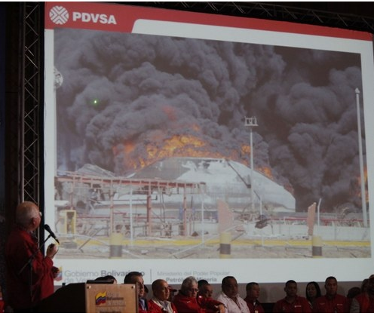
INTRODUCTION
On the 25th of August 2012 about 1.11 AM (GMT) an explosion took place at Punto Fijo refinery (also known as Amuay refinery) situated in the northwest of Venezuela and run by an state-owned company Petróleos de Venezuela, S.A. (PDVSA)
It is the world's 2ND largest refinery after Jamnagar in India. Its major products include crude oil, Liquefied Petroleum Gas (LPG) and Liquefied Natural Gas (LNG).
The severity of shock waves generated by the explosion shook the nearby residential areas and the residents.

Slide 4
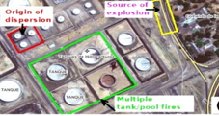
THE INCIDENT
Even though the cause of the Amuay oil refinery disaster was not clear, possible scenarios that could result in the disasters include:
Equipment failure
Dispersion of fuel
Vapor Cloud Explosion
Multiple tank fires

Slide 5
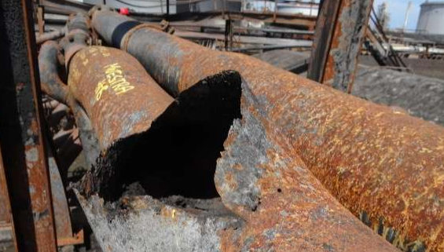
THRESHOLD OF THE DISASTER
EQUIPMENT FAILURE:
Valves
Piping
Pumps
It could be lack of maintenance, corrosion, and poor safety know-hows and can be even intentional
An official report by president of PDVSA revealed that studs (screws without heads) in pump 2601 was the root-cause. Seven of the eight studs were insufficiently screwed down, with one absent entirely, meaning that motor vibrations could cause the screws to gradually fail.

Slide 6
EVENTS SEQUENCE
Sequence of events that led to the disaster scenario:
7/8 loose screw in pump2601
Leak of flammable gases; alkene, LPG or Propane
Fuel dispersion
Dense cloud move towards detachment 44 of National guards
Ignition from guard’s evacuation vehicle

Slide 7
SCLAE OF THE DISASTER
The incident cost significant damage, which comprise of;
More than 50 lives (some also reported up to 100),
Over 100 seriously injured and several suffered with light injuries.
More than 1600 houses that were completely damaged,
More than 200 houses were evacuated and people were transferred to safer places.
The total capital loss assessed was more than $1 billion

Slide 8
CHALLENGES TO AVERT FUTURE RE-OCCURRENCE
The safety experts of the plant should motivate and aware the subordinates to follow safety practices at the maximum possible limits.
The following points summarize the challenges ahead.
Appropriate estimation of the overpressures and learning from Buncefield, Sitapura and Perto Rico incidents.
Appropriate estimation of thermal radiation hazards from multiple fire tanks.
Reducing the poor management policies towards maintenance and motivating employee awareness towards safety.
Strict procedures/rules for negligence and ignorance on minor leakages.
Minimizing the congestion in the safety region (blast radius).

Slide 9
CONCLUSION
Amuay incident has added one more question mark in process safety know-hows and serious implementations thereof. The residents and daily lives should be in no way affected by the incidents. Similar incidents in the past have occurred more or less due to similar reasons. Leak of a high vapour pressure gas was the root-cause of the disaster and about 100 live were lost as well as estimated more than $1 billion capital loss.

Slide 10

THANK YOU ALL

