Slide 1
CONSTRUCTION SAFETY
Safety and Health Officer Certificate Programme

Slide 2
Session/LessonPlans
Timing (minutes) | Learning Objective | Main tasks / Process | Resources / tools
5 | Title | Standard Operating Procedures for Power Press Machine | Slide 1
5 | Index | Contents of the presentation | Slide 2
15 | Introduction | The main purpose of guideline Limitation How to use the guideline | Slide 3, 4and 5
10 |  |  | Slide 6-15
10 |  |  | Slide 16 - 25
BREAK (30 MIN)
45 |  |  | Slide 26 - 35
10 |  |  | Slide 36 - 49
10 |  |  | Slide 50 - 48
BREAK (LUNCH)
20 |  |  | Slide 49 + Video duration (15 min)
10 |  |  | Slide 50
15 |  |  | Slide 51
30 |  |  | Slide 52
BREAK (30 MIN)
120
 | Total Time

Slide 3
OBJECTIVES
State the definition of building operations according to the FMA 1967
List at least 6 hazards existent on construction sites
Explain the types of accidents at construction sites

Slide 4
OBJECTIVES
Elaborate the employer strategy in site safety management
Explain the statutory requirements as stated in FMA 1967 and OSH Act 1994

Slide 5
SCOPE
Definition and statutory requirements
On site activities
Machinery commonly used on site
Equipments commonly used on site
Hazards at construction sites
Types of accidents at construction sites
Safety and health management
Conclusion

Slide 6
DEFINITION AS PER REGULATIONS
Factories and Machinery Act 1967
Building Operations:
Construction, structural alteration, repair or maintenance of a building (including re-pointing, re- decoration and external cleaning of the structure), the demolition of a building, and the preparation for and the laying of foundation of an intended building

Slide 7
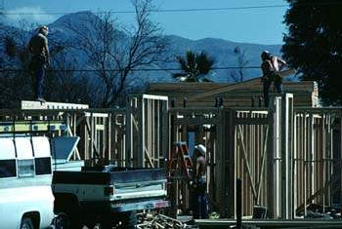

Slide 8
STATUTORY REQUIREMENTS
1) Occupational Safety and Health Act 1994
Responsibility of the Employer
Employ a Safety and Health Officer
Formulate a Policy and Safe Operating Procedures (SOP)
Establish a Safety and Health Committee

Slide 9
STATUTORY REQUIREMENTS
Occupational Safety and Health (Safety and Health Officer) Order 1996
Requirement to employ a Safety and Health Officer at the workplace for projects of over RM20 million whether for works of:
Building operations
Engineering construction

Slide 10
STATUTORY REQUIREMENTS
2) Factories and Machinery Act 1967 General provisions related to the certification of fitness for machinery, installations and workers
Factories and Machinery (Building Operations and Works of Engineering Construction) (Safety) Regulations 1986
Provisions related to the safety and health involving work activities and equipments and workers

Slide 11
ON SITE ACTIVITIES
List the activities at the
construction site

Slide 12
ON SITE ACTIVITIES
Excavation
Piling
Concrete works
Demolition
Brick laying
Welding works
Installation of wires/electric cables and pipes
Handling/ transportation of construction materials

Slide 13
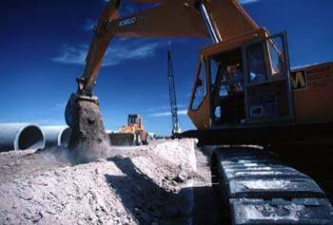

Slide 14
ON SITE ACTIVITIES
Installation and collapse of scaffolding
Form works
Painting works
Installation and operationalisation of machinery
Transportation of raw materials
Clearing and cleaning
works

Slide 15
MACHINERY/EQUIPMENTS ON SITE
MACHINERY/EQUIPMENT | APPLICATIONS/USE
Crane (Tower/Crawler) Hoist (Skip hoist) | Lifting material
Passenger hoist Gondola | Lifting workers
Bending machine Cutting machine | Cutting and shaping piles Cutting metals, wood and plywood
Excavator | Earth excavation
Piling and structure | Laying columns/building structure
Lorry | Transport construction materials
Batching plant | Mixing and delivering cement

Slide 16
MACHINERY/EQUIPMENTS ON SITE
Hand tools and mobile power tools - hammer, sledge, drill
Stairs
Scaffold – fixed and mobile
Air Compressor
Hammer Drill
Generator Set
Welding equipments

Slide 17
MACHINERY/EQUIPMENTS
CERTIFICATE OF FITNESS - DOSH
Crane (Tower/Crawler)
Passenger hoist Gondola
Air compressor
Lift
Piling and Structure machine
Skip Hoist
Material Hoist
Aerial Platform

Slide 18
HAZARDS ON SITE
Heat stress
Noise
Mineral dust exposure
Mechanical hazards
Electrical hazards
Radiation
Chemicals
Ergonomic hazards
Biological hazards
Working at height
Confined space
Lighting
Drowning

Slide 19
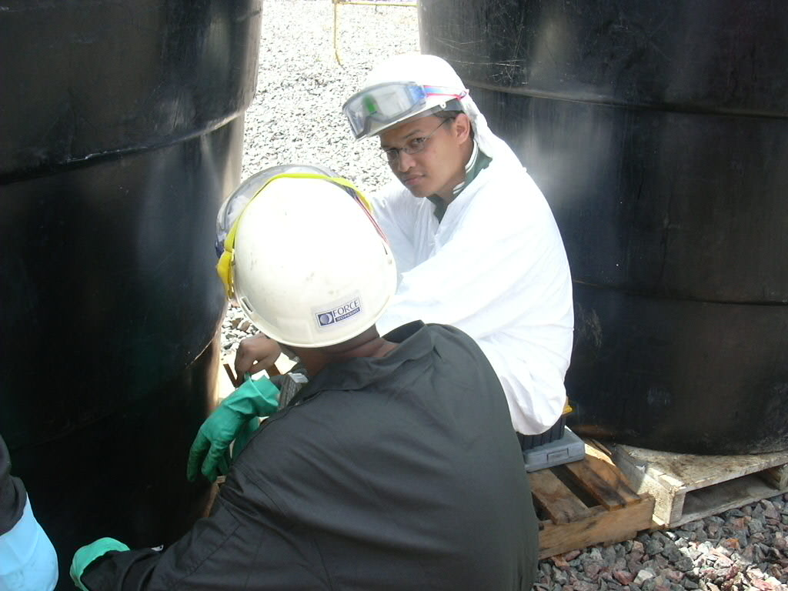

Slide 20
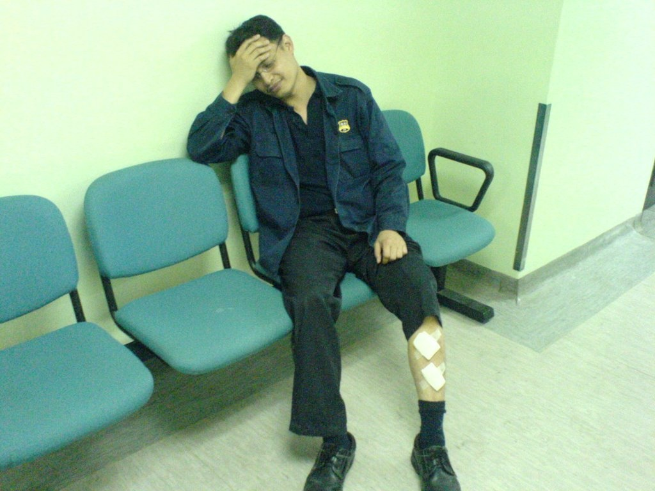
CONSTRUCTION SAFETY
TYPES OF ACCIDENTS
Falling from height
Falling at same level
Hit by falling object
Buried under falling earth /structure
Electric shock
Drowning
Hit by vehicle
Inhalation of toxic chemicals
Contact with moving machinery
Crushed/stuck between objects

Slide 21
FALLING FROM HEIGHT
This includes falling from:
Stairs
Work platforms
Roofs or peaks
Through floor openings
Open sides
Scaffolding

Slide 22
FALLING FROM HEIGHT
CAUSES OF FALL
No fencing of hazardous work area
Lack of workplace/equipment maintenance
No prior inspection of workplace/equipment
Installation of equipment by incompetent persons

Slide 23
FALLING FROM HEIGHT
CAUSES OF FALL
No provision of safety harness
Faulty design of structure / stairs
Use of damaged stairs / scaffold
Use of unsuitable stairs / scaffold
Improper position of stairs / scaffold

Slide 24
FALLING FROM SAME LEVEL
Tripping over wires and objects on floor
Slips due to slippery floor
CAUSES OF FALL:
Poor housekeeping
Lack of proper housekeeping programme
No designated area for storage of equipments

Slide 25
HIT BY FALLING OBJECT
CAUSES OF ACCIDENT:
Poor housekeeping
No toe-board on work platform
No overhead protection
No installation of safety net
Improper lifting techniques

Slide 26
BURIED UNDER FALLING EARTH/STRUCTURE
May occur during excavation works, erection of scaffolding and formwork
CAUSES OF ACCIDENT:
No installation of earth support
No guidelines and safe work procedures
Overloading
Faulty design of structure

Slide 27
BURIED UNDER FALLING EARTH/STRUCTURE
CAUSES OF ACCIDENT:
Use of unsuitable/damaged scaffolding
Position of scaffold is unsuitable
No proper maintenance of work area/scaffold
No prior inspection of work are/scaffold
Erection of scaffold by incompetent persons

Slide 28
ELECTRIC SHOCK
CAUSES OF ACCIDENT:
Contact with electricity current due to faulty conductor
Use of electrical equipments that are damaged or modified
No earthling
No provision of suitable PPE

Slide 29
DROWNING
In confined space – tanks, sewerage pipes
Lack of oxygen
In pools – retention pools
Swallowing of water
CAUSES OF ACCIDENT:
Lack of proper ventilation
No exhaust system
Lack of guidelines and SOPs
Presence of excessive water
Untrained, unknowledgeable and inexperienced
workers

Slide 30
HIT BY VEHICLE
CAUSES OF ACCIDENT:
No designated passage for pedestrians/workers
No guards/fencing to separate vehicle routes
No traffic related rules and enforcement in the premises
No inspection of vehicles
No proper vehicle maintenance
Inexperienced and untrained drivers

Slide 31
INHALATION OF TOXIC CHEMICALS
IN PAINTING AND WELDING ACTIVITIES
CAUSES OF ACCIDENT:
Failure to wear proper respiratory protection
Insufficient ventilation
No exhaust system
Untrained and inexperienced workers

Slide 32
CONTACT WITH MOVING OBJECTS CRUSHED IN BETWEEN OBJECTS
CAUSES OF ACCIDENT:
No guards
Use of damaged/faulty guards
Lack of training for workers
Unsuitable design of guards
Guards placed in ineffective positions

Slide 33
SAFETY AND HEALTH MANAGEMENT
STRATEGIES:
Establish a Safety and Health Committee
Identify hazards at the workplace
Conduct risk assessment
Plan and implement safety and health measures

Slide 34
SAFETY AND HEALTH MANAGEMENT
EMPLOYER CONTROL MEASURES:
Formulate a Safety and Health Policy
Employ a Safety and Health Officer
(requirement based on total project value) or site safety supervisor
Formulate and enforce safety and health rules at the workplace

Slide 35
SAFETY AND HEALTH MANAGEMENT
EMPLOYER CONTROL MEASURES:
Establish system for issuance of work permits for high risk activities
Increase supervision on high risk activities
Provide safety and health induction training for all workers

Slide 36
SAFETY AND HEALTH MANAGEMENT
EMPLOYER CONTROL MEASURES:
Provide personal protective equipment for all workers and ensure proper use
Prepare safe work procedures for all activities
Provide suitable and safe equipments for all
work activities

Slide 37
SAFETY AND HEALTH MANAGEMENT
EMPLOYER CONTROL MEASURES:
Select and appoint competent and trained persons for high risk activities such as handling cranes and working at height
Investigate all accidents and dangerous occurrences
□ Conduct workplace inspections

Slide 38
SAFETY AND HEALTH MANAGEMENT
EMPLOYER CONTROL MEASURES:
Provide effective communication system to enable and encourage worker feedback
Formulate scheduled preventive maintenance programme for all machinery and equipments
□ Display safety warning signages at appropriate locations

Slide 39
CONCLUSION
The various activities at construction sites may
produce hazards that may cause accidents
There are specific statutory requirements regarding construction safety in the FMA 1967 and OSHA 1994
□
The employer is responsible for proper safety management to ensure that the protection of
worker safety and health as well as to fulfill
regulatory requirements

